Slide 1
Isioma Ward PROJECT TWO – ANALYSING NYSE DATA
Task 1: CATEGORICAL VARIABLE AND QUANTITATIVE VARIABLE
QUESTION: What is the impact of SG&A expenses on the return on assets for companies in the Healthcare and Consumer Discretionary subsectors over the past quarter?

Slide 2
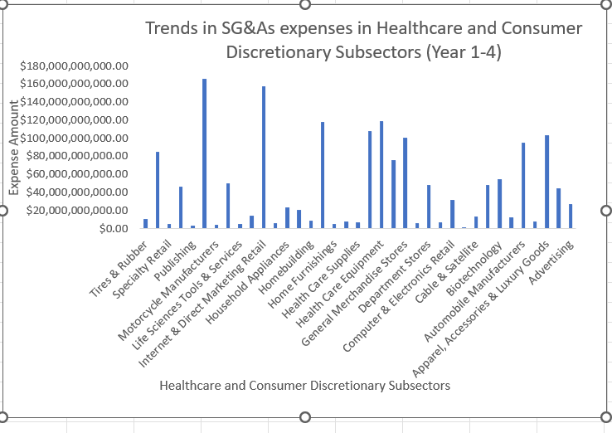
Visualization or summary statistics used for finding
Summary of the Statistics The large range for SG&A expenses in the healthcare and Consumer Discretionary industries ($119,825,326,930.29) including mean and Standard deviation, suggests that it is heavily influenced by outlier. The outlier is an extreme outlier considering that the values are spread out over a large range. It is an indication that there is at least one data point that falls significantly outside the typical range, and it is Skewed to the right of values for SGAs expenses in these industries.

Slide 3
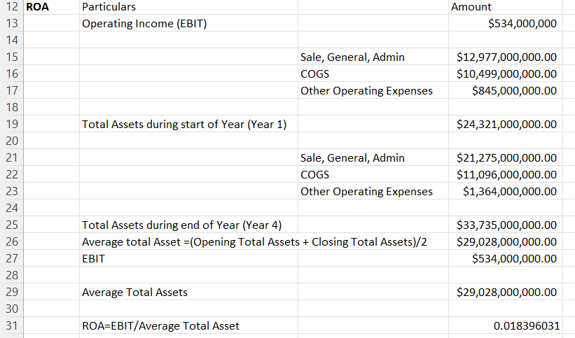
The presence of an extreme outlier in SG&A can have implications:
1. Unusual or unexpected expenses: The extreme outlier could represent unusual or unexpected expenses, such as one-time legal fees or a large investment in marketing. To fully understand the implications, it has for the company’s financial performance, it is important to investigate the cause of the outlier.
2. The presence of the extreme outlier could also highlight the differences in the way the companies operate within the healthcare and consumer discretionary industries. An example is while one may have lower overhead costs due to its centralized structure, the other may have more robust sales and marketing.
THE RETURN ON ASSET

Slide 4
INSIGHTS TO RETURN ON ASSET
The ROA (0.018396031) which shows that for every $1 of assets, the company is earning $0.018396 in profit. Here, the financial performance is established using the (Sales, General, and Administrative) expenses, cost of goods sold, and other operating expenses to show that high operating expenses relative to the net income could indicate that the company is not operating as efficiently as it could be.

Slide 5
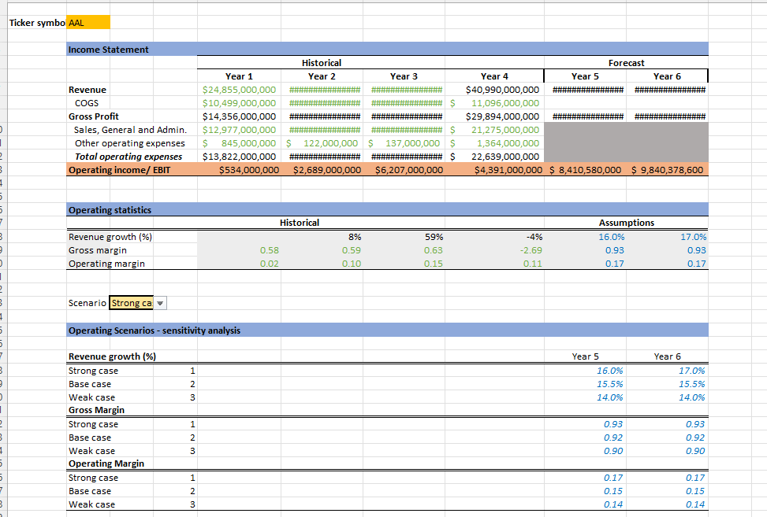
Task 3 – AAL (Airlines)
FORECAST The decrease in operating statistics from 59% in year 3 to -4% in year 4 while revenue remained constant could indicate a decline in the efficiency or performance of the company’s operations. However, the decline could also be a result of external factors such as market conditions, competition, or other macroeconomic influences.

Slide 6
Forecast Continued…
The subsequent increase in operating statistics to 16% in year 5 and 17% in year 6, according to a strong case scenario, suggests that the company may have made improvements to its operations, possibly through cost savings, increased efficiency, or other management strategies. Generally, the trend of a decline in operating statistics followed by a significant increase could be positive signal for the company’s future financial performance.

