Slide 1








































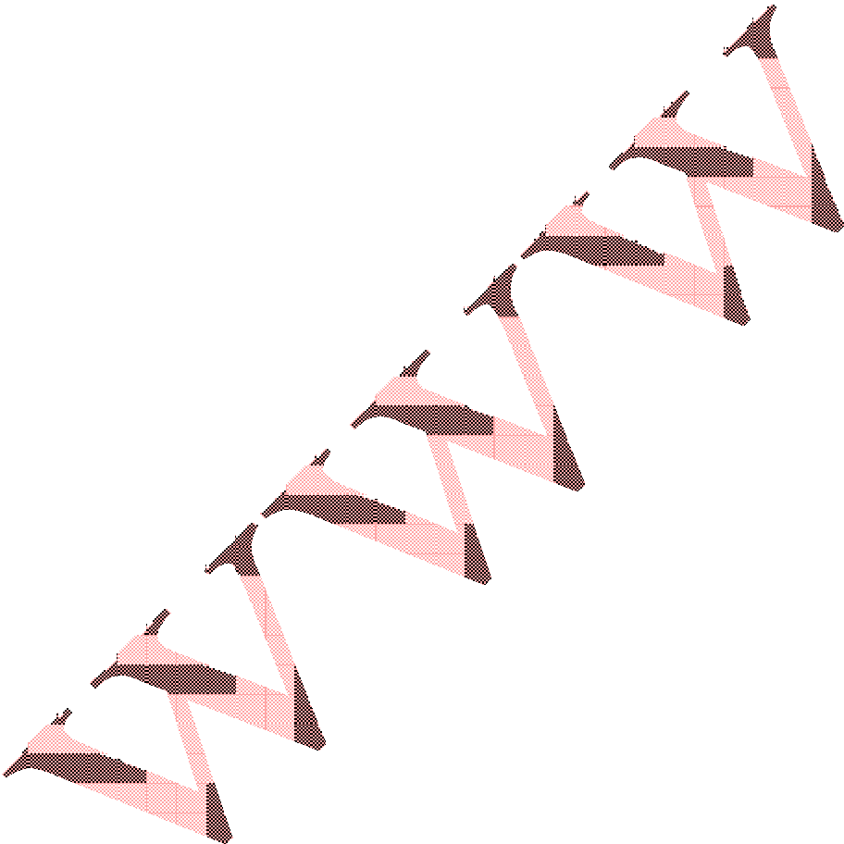
About Instaforex
InstaForex broker with its website instaforex.com is a part of InstaForex Companies Group. This is a group of financial and investment companies which render online trading services. InstaForex Company is ECN Forex broker. Currently, we have more than 500 000 individual and corporate clients. Every day more than 400 new traders open accounts with InstaForex to invest in financial markets. A comprehensive range of trading options, instant technical support and consulting service are available to all our customers, regardless a volume of their deposits. Our strategic priority is to render a full range of services and provide customer stewardship at every step, from new account registration to money withdrawal.
InstaForex trading conditions are rightfully considered as one of the best across the globe. Our customers have free access to a great variety of trading instruments as well as to state-of-the art information technologies and software products from leading companies such as MetaQuotes Software MetaTrader 4 developer), Reuters, e-Signal and others. To get access to trading options, open InstaForex trading account online.
Partnership with major market makers and brokers-contractors as well as a strong clientele hold great strategic potential of InstaForex and enable it to keep the top position in Forex and efficiently meet sensitive requirements of traders.
InstaTrade Investment Company is a Russian stock broker which provides access to MYCEX and RTS stock exchanges, and is a part of InstaForex Companies Group.
InstaForex Companies Group has a comprehensive range of financial instruments enabling individuals and institutions to invest in exchange and stock markets. For more information please visit www.instafxng.com
Introduction to Forex trading.
What Is Forex
"Forex" is the short term to Foreign Exchange market, also referred to as the or "FX" market, it is the largest financial market in the world, with a daily average turnover of well over US$2.8 trillion -- 30 times larger than the combined volume of all U.S. equity markets. Unlike other financial markets, the forex market has no physical location or central exchange. It is an over-the-counter market where buyers and sellers including banks, corporations, and private investors conduct business.

Slide 2

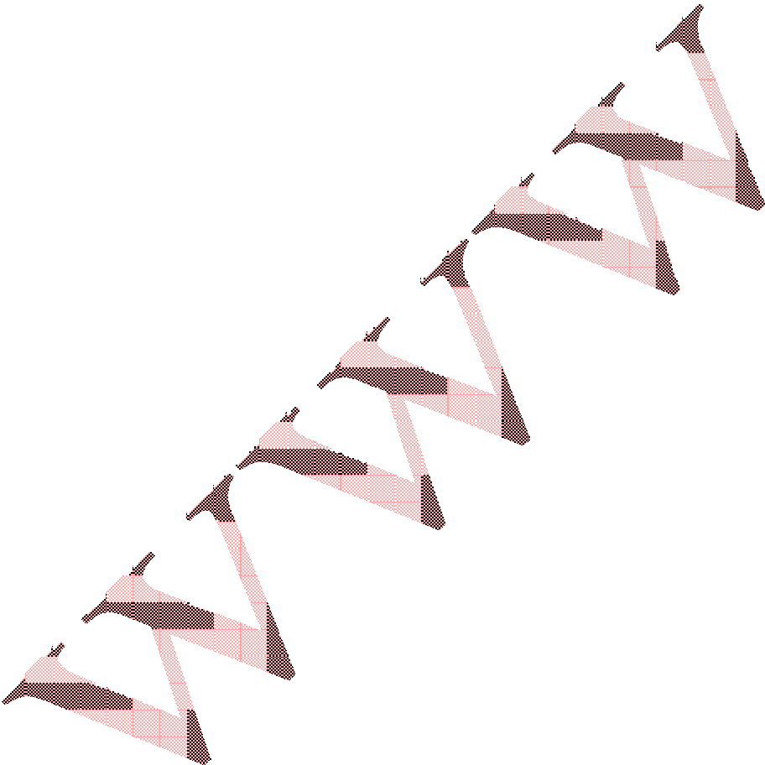
A true 24-hour market, Forex trading begins each day in Sydney, and moves around the globe as the business day begins in each financial center, first to Tokyo, London, and New York. Unlike any other financial market, investors can respond to currency fluctuations caused by economic, social and political events at the time they occur - day or night. The huge number and diversity of
players involved make it difficult for even governments to control the direction of the market. The unmatched liquidity and around-the-clock global activity make forex the ideal market for active traders.
Traditionally the forex market was only available to larger entities trading currencies for commercial and investment purposes through banks. Now trading platforms allow smaller financial institutions and retail investors’ access to a similar level of liquidity as the major foreign exchange banks, by offering a gateway to the primary (Interbank) market. In the forex market currencies are always priced in pairs; therefore all trades result in the simultaneous buying of one currency and the selling of another. The objective of currency trading is to exchange one currency for another in the expectation that the market rate or price will change so that the currency you bought has increased its value relative to the one you sold. If you have bought a currency and the price appreciates in value, the trader must sell the currency back in order to lock in the profit. An open trade or position is one in which a trader has either bought/sold one currency pair and has not sold/bought back the equivalent amount to effectively
close the position.
The first currency in the pair is referred to as the base currency, and the second currency is the counter or quote currency. This means that quotes are expressed as a unit of 1 of the first currency quoted per the other currency quoted in the pair.
As with all financial products, FX quotes include a "bid" and "ask". The bid is the price at which a market maker is willing to buy (and clients can sell) the base currency in exchange for the counter currency. The ask is the price at which a market maker will sell (and clients can buy) the base currency in exchange for
the counter currency. The difference between the bid and the ask price is referred to as the spread.
Currency Pair
Currency Pair is two countries currency which a trader trades at a time.
In forex market you can’t trade one currency alone as it’s been stated above.
Samples of currency pairs: EUR/USD = Euro/US Dollar
GBP/USD = British Pounds/ US Dollar USD/JPY = US Dollar/ Japanese Yen

Slide 3
EUR/USD
The currency by your left is called: Base Currency
The currency by your right is called: Counter Currency
Note: anytime you’re selling or buying currency pair, you’re simply selling or buying the base currency.
Spread
Spread is the difference between the buy and sell price. Like in stock market ask and bid. This is the difference between the market makers selling price and the price the market maker is ready to pay to buy the same currency. This means that if you buy a currency and then sell the currency before the price has changed you will lose money because of the spread. Bid price is always lower than the ask price, thus the situation. For example if EUR/USD bid/ask is 1.2010/1.2015 ( the spread is 5) then by selling the security before the price has changed, you will lose 5 pips.
Pip
Now you might be wondering what the heck the pip is. I know that when I first started reading about forex and such I wondered for quite a bit what is that pip they are talking about. Basically, as currency rates do not change a lot then the changes are brought out in pips. One pip is 0.0001 in case of all the currencies excluding Yen. For Japanese Yen one pip is 0.01. So if the exchange rate changes by 20 pips then now you’ll know it means 0.0020.
When in banks the exchange rates – buy/sell rates (spread) for different currencies may vary even more than 1000 pips, in forex market it’s a lot smaller and because of that.
In clearer form, the pip is the last digit number(s) at end of every currency pair
price: e.g. if the EUR/USD is 1.5467 the pip counting should start from 7 upward or downward.
Leverage
The leverage allows traders of forex market use credit. You might sort of compare it with short selling in stock market. Not the same, but starting traders might find the idea bit similar.
The leverage may allow a trader control 50-400 times bigger amount than he has actually deposited. For example if you deposit just $100 you may be able to actually play with $10 000. Of course, in this case this $100 is the margin you are willing to lose, everything’s at stake. Standard leverage is 100:1, which means if

Slide 4

you invest $100 the broker will lend you $9,900, you are leveraging 9,900$ of your total ($100) investment from your broker.
Trend
Trend is the overall direction (changing) prices are moving, UP, DOWN, OR FLAT.
Trend can happen within seconds and minutes, which may result to down or up trend.
Up-Trend:
An up-trend line is a straight line passing through the "rising" troughs of an up- move.
The importance of a trend line is increasing with every additional touching point, Confirming the trend lines value. A reversal of the trend is indicated with a violation of the up-trend line.
Up-Trend is when price of currency pair is moving up down.
Down –Trend:
A down-trend line is a straight line passing through the “falling” troughs of a
down move. The importance of a trend line is increasing with every additional touching point, confirming the trend lines value. A reversal of the trend is indicated with a violation of the down-trend line.
Down-Trend is when price of currency pair is moving down ward.
Note: to trade the forex market profitably you must make the trend your friend. If there is no trend no trader will make any profit in the market.
Trading Analyzer/Indicator

Slide 5

To speculate the forex market profitably is not always easy because the trend can go against our thought at any time even when we believe within our self that we got it right.
To help us help we speculate almost right before entering the market are two types of Market/Trend Analyzers.
Fundamental Analysis and Technical Analysis
The study of specific factors, such as wars, discoveries, and changes in Government policies, which influence supply and demand, and consequently prices in the market place.
Fundamental analysis comprises the examination of macroeconomic indicators, asset markets and political considerations when evaluating a nation’s currency in terms of another. Macroeconomic indicators include figures such as growth rates; as measured by Gross Domestic Product, interest rates, inflation, unemployment, money supply, foreign exchange reserves and productivity. Asset markets
comprise stocks, bonds and real estate. Political considerations impact the level of confidence in a nation’s government, the climate of stability and level of
certainty.
Sometimes governments stand in the way of market forces impacting their currencies, and hence, intervene to keep currencies from deviating markedly from undesired levels. Currency interventions are conducted by central banks and usually have a notable, albeit a temporary impact on FX markets. A central bank could undertake unilateral purchases/sales of its currency
against another currency; or engage in concerted intervention in which it collaborates with other central banks for a much more pronounced effect. Alternatively, some countries can manage to move their currencies, merely by hinting, or threatening to intervene.
If you are using fundamental analysis you must be ready to be current with Forex related news.
For forex news please always visit www.forexfactory.com,
www.easy-forex.com www.actionforex.com www.saxobank.com www.bloomberg.com

Slide 6

Technical Analysis
A Technical Analysis is what a trader uses to predict future price movements, based on Varieties of technical indicators which are designed to track the movement of the trend within short time frame.
Some Technical indicators can help you to dictate the movement of the price trend even before the trend begins.
There over 60 types of Technical indicators which you can use to analyze the market before entering or exiting.
In as much as it’s advisable that a forex trader should have basic understanding of almost the indicators, it’s most advisable you study and master the use of maximum of 3 of them to avoid confusion and time taking before entering/exiting the market.
In the context of this book I will be teaching you the most effective and simple forex trading Indicators which the successful traders uses, I use them.
One may ask which one is good for a successful trader, Fundamental or Technical Analysis?
I want you to know that most traders abide by technical analysis because it does not require hours of study. Technical analysts can follow many currencies at one time. Fundamental analysts, however, tend to specialize due to the overwhelming amount of data in the market. Technical analysis works well because the currency market tends to develop strong trends. Once technical analysis is mastered, it can be applied with equal ease to any time frame or currency traded.
Trading Charts
A chart is a graphical representation of price movement over a specific period of time and is composed of a (time) and a (price). The choice of the time frame employed depends on the user's need. It is obvious that an intra-day scenario will not be based on a weekly nor monthly chart.
Types of Charts
There 3 types trading charts namely:
Lines chart Bar Chart
Candlestick Chart
Line chart:

Slide 7

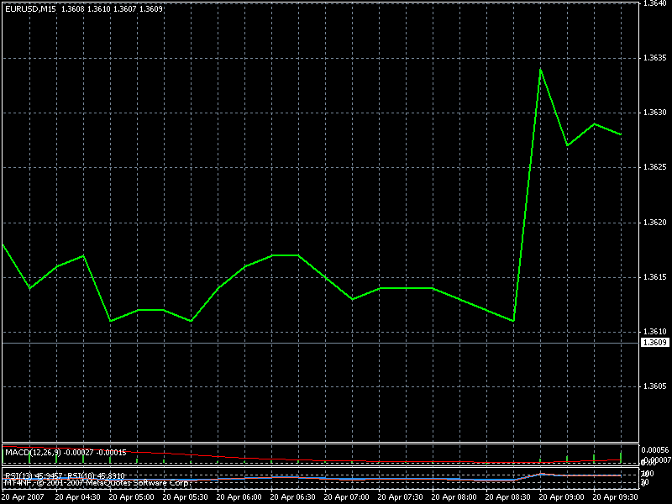


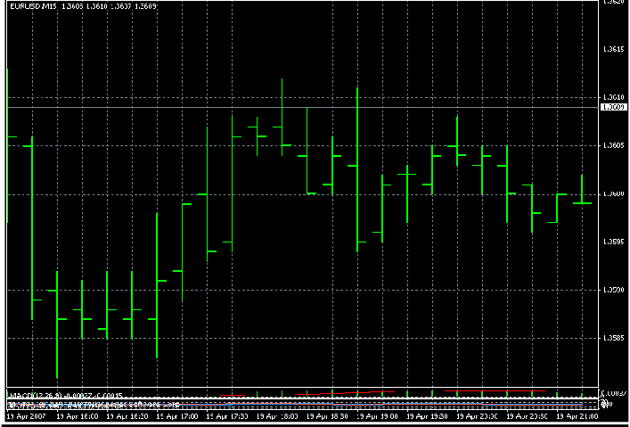
A line chart shows a line connecting the "closing prices". The closing is the last price recorded at
the end of a specific period of time (session).
Line Chart
Bar Chart
Bar chart: Basically all characteristics mentioned for the line chart also hold true for the bar chart. However, the construction is a different one. The bar chart is composed of a high (highest price during a session), a low (lowest price during a session) and the close. All that is required is to draw a vertical line (bar) from the high to the low. Then, set a horizontal dot from the vertical line to the right, representing the close. Sometimes users refer also to the opening price; a dot drawn on the left side of the bar. The bar chart is probably the most popular chart in use today.
Bar Chat | Bar Chart
Price open low | Price opened
and closed | high and
high | closed low
Candlestick Chart

Slide 8

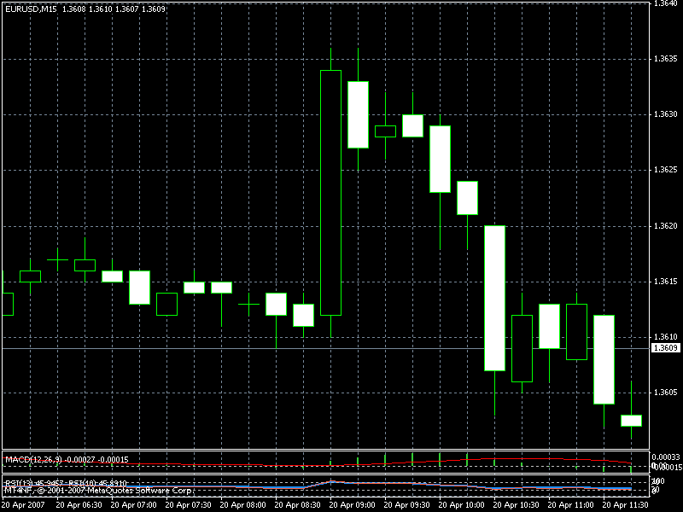
The building blocks for the candlestick chart are the high, the low, the opening and the closing.
The difference to the bar chart is that the open and the close form the
cornerstones for the, so called, real body. The body is white if the closing is higher than the opening. The contrary is true for the black body. The candlestick charting technique is an ancient Japanese invention dating from the late 18th century. The theory tries to unveil trend reversal or continuation signals.
Various tools of analysis (moving average, RSI, trend-lines etc.) can be applied in combination with the candlesticks.
Candlestick | Candlestick
Price open low | Price open
and closed | high and
high | closed low
More About Candlestick
You may be asking yourself, "If I can already use bar charts to view prices, then why do I need another type of chart?"
The answer to this question may not seem obvious, but after going through the following candlestick chart explanations and examples, you will surely see value in the different perspective candlesticks bring to the table. In my opinion, they are much more visually appealing, and convey the price information in a quicker and easier manner.
The Japanese began using technical analysis to trade rice in the 17th century. While this early version of technical analysis may have been different from the
US version initiated by Charles Dow around 1900, many of the guiding principles were very similar.
The "what" (price action) is more important than the "why" (news, earnings, and so on). All known information is reflected in the price.
Buyers and sellers move markets based on expectations and emotions (fear and greed). Markets fluctuate. The actual price may not reflect the underlying value.
According to Steve Nison, candlestick charting came later and probably began sometime after 1850. Much of the credit for candlestick development and charting goes to Homma, a legendary rice trader from Sakata. Even though it is

Slide 9

not exactly clear "who" created candlesticks, Nison notes that they likely resulted from a collective effort developed over many years of trading.
The body of the candlestick is called the real body, and represents the range
between the open and closing prices.
A black or filled-in body represents that the close during that time period was lower than the open, (normally considered bearish) and when the body is open or white, that means the close was higher than the open (normally bullish).
The Up-Trend (Bullish) Candlestick Graphic Description
The Highest Move of the Price
Up-Trend Shadow
The Price Closed Here
Up-Trend Real Body (Bullish Body)
The Price Opened Here
Down Trend Shadow
The Lowest Move of the Price
When the candle is moving in up-trend, the trader who bought (go long) position will be the one who will profit from the market.
Note: enter buying position when the trend is moving up!!
The Down-Trend (Bearish) Candlestick Graphic Description
The Highest Move of the Price
Up-Trend Shadow
The Price Opened Here

Slide 10

Down-Trend Real Body (Bearish Body)
The Price Closed Here
Down Trend Shadow
The Lowest Move of the Price
When the candle is moving in down-trend, the trader who sold (go short) position will be the one who will make profit from the market. Note: enter selling position when the trend is moving down!!
Three Important Indicators
As mention earlier in this book there are more than 60 types forex trading indicators but let’s give more detail on three most important indicators which many successful traders has been using to trade profitably..
These can be used:
Moving Average (MA)
Relative Strength Index (RSI)
Parabolic SAR.
Moving Average
A Moving Average is a moving mean of data. In other words, Moving Averages perform a mathematical function where data within a selected period is averaged and the average ‘moves’ as new data is included in the calculation while older data is removed or lessened. Moving Averages essentially smooth data by removing ‘noise’. This smoothing of data makes Moving Averages popular tools in identifying price trends and trend reversals.
Using MA has proved to be more reliable and profitable in trade the forex market. With MA you can make at least uninterruptible 10% of your total forex investment daily.
There are types Moving Average The differences between the three types of moving averages lie in the way that they are calculated and whether they look at all the data available or only the data within a selected period. This means that each type of moving average has its own characteristics, for example how quickly each will respond to changes in the underlying price.
Simple Moving Average

Slide 11

Simple Moving Averages are the most common and popular form of moving average. The primary reason for this is the relative ease with which Simple Moving Averages are calculated. A Simple Moving Average is calculated by adding values over a set number of periods and then dividing the sum by the total number of values. As with other types of moving averages, Simple Moving Averages smooth the data by removing ‘noise’ over the selected period. The ability to smooth data makes them a useful tool in identifying price trends and trend reversals.
Moving average - weighted
As with Simple Moving Averages, Weighted Moving Averages smooth the data by removing ‘noise’ over the selected period. However a Weighted Moving Average will be more sensitive to recent changes in data.
This is because a Simple Moving Average gives all observations equal emphasis in its calculation, but a Weighted Moving Average assigns a greater weight to the most recent observations.
Moving average - exponential
The Exponential Moving Average is similar to the Weighted Moving Average in that they both assign greater weight to the most recent data. Where they differ is that instead of dropping off the oldest data point in the selected period of the moving average, the Exponential Moving Average continues to maintain all the data. In other words, a 5 day Exponential Moving Average will contain more than
5 pieces of data information. Each observation becomes progressively less significant but still includes in its calculation all the price data in the life of the instrument. The Exponential Moving Average is another method of
weighting a moving average.
The most common uses of Moving Averages are to:
- Identify the trend ,buying and selling signal
The moving average can help a trader to dictate the movement of the trend earlier before the trend move far .
When the Moving Average line start moving above the chart (candlestick) that’s an indication of possible up-trend and selling signal . But if the Moving Average starts moving below the chart (candlestick) that’s an indication of possible down- trend and buying signal.

Slide 12
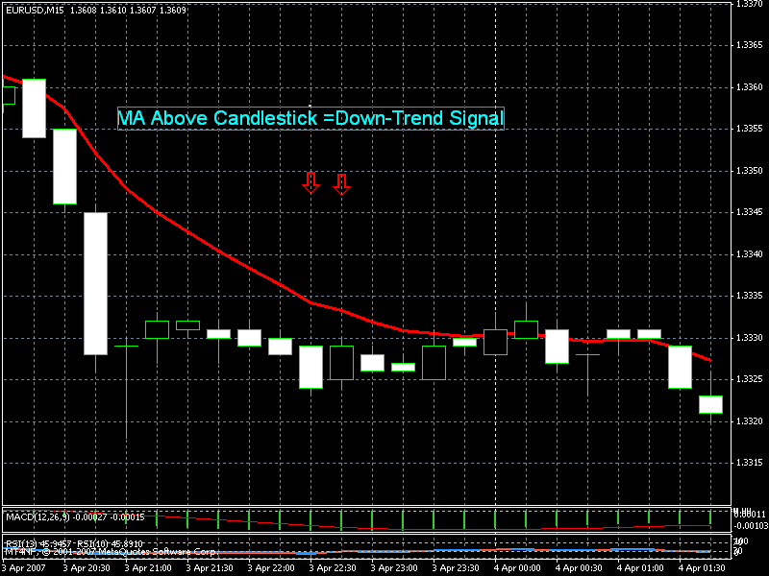

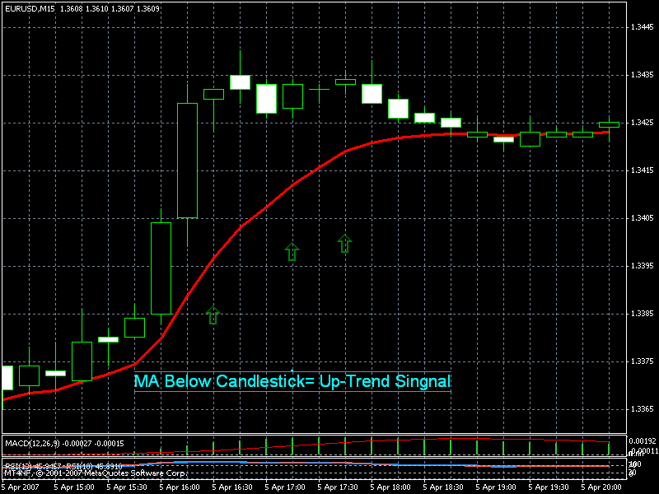
As you can see from the chart the MA is above the candle chart which is indicating down trend.
When the MA is above the chart it’s a strong indication for a trader to enter a selling (short) position.
Action= Sell or go short.
As you can see from the chart the MA is blow the candle chart which is indicating up trend.
When the MA is down the chart it’s a strong indication for a trader to enter a Buying (Long) position.
Action= Buy or go Long
Another method of Moving Average
The second way which you can apply MA to identify trend, buying and selling signal is to use two Moving Averages, one with a shorter observation period than the other. Buy and sell signals are generated when the short moving average crosses over the long moving average. For example if the short moving average crosses above the long moving average a buy signal is generated; a sell signal is generated when the short Moving Average crosses below the long Moving Average.

Slide 13
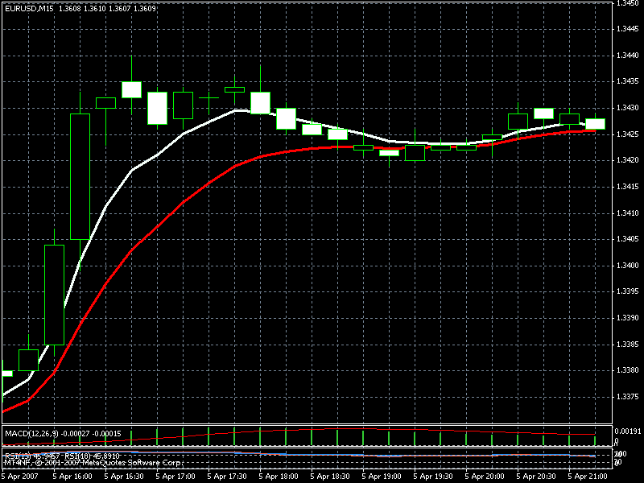

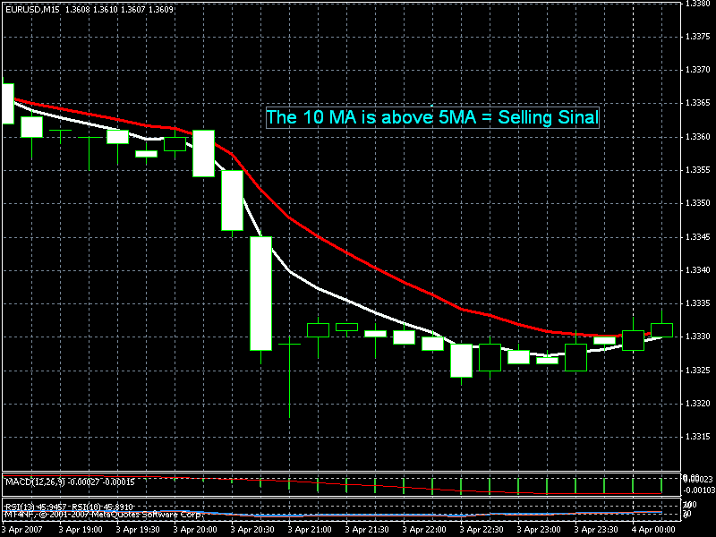
5 Periods MA
10 Periods MA
The MA in the shows that MA 5 is above MA 10. That indicates up trend, and buying signal.
Action= enter Buying (long)
Position
10 Periods MA
5 Periods MA
The MA in the shows that MA 10 is above MA 5. That indicates down trend, and selling signal.
Action= enter Buying (long)
Position
Note: Both of these buy and sell techniques are most effective when the market
is trending. If the market is non-trending then these techniques are likely to give false signals. This is simply because the market needs to continue in the direction of the buy or sell signal in order for the trade to be profitable.
Exponential Moving Averages are used in the same manner as the other types of moving average, usually to identify price trends and trend reversals.
Parameters
Averaging period: (default 14)
The exact averaging period to be used will depend upon the purpose of the moving average.
If you are using moving averages to identify the trend, then the length of the averaging period should reflect the length of the trend you are trying to identify.
The longer the trend - the longer the averaging period. For example, if you are looking at a daily chart to identify the long-term trend, you may decide to use an

Slide 14

averaging period of 200. For short and medium term trends periods of 20 and 50 could be used respectively.
If you are using moving averages to generate buy and sell signals then shorter, more responsive averaging periods are normally used. For example a two
moving average system may use averaging periods of 5 and 10.
I use 5 and 10 periods setting for my trading and it works very well when I trade at the right time.
Note: When selecting an averaging period there is a trade off between the averaging periods, the number of signals generated and the risk associated with the signal. A longer averaging period will generate less signals but will require a larger price move before responding, sacrificing potential profits in order to confirm the signal. A shorter averaging period will generate more signals and require less of a price move before responding, however the risk that the signal is false increases.
Parabolic SAR
Parabolic Time Price is a system that always has a position in the market, either long or short. You would close out the current position and enter a reverse position when the price crosses the current Stop And Reverse (SAR) point. SAR= Stop And Reverse
The SAR points resemble a parabolic curve as they begin to tighten and close in on prices once prices begin to trend. This explains the name - Parabolic Time Price.
Parabolic Time Price is usually charted with a candlestick analysis so that the stop and reverse points are easily identified. If you are long (buy), the SAR points will be below the prices or candlestick and the signal to go short will be when prices cross the current SAR point from above. If you are short, the SAR points will be above the prices or candlestick and the signal to go long will be when prices cross the current
SAR point from below.

Slide 15
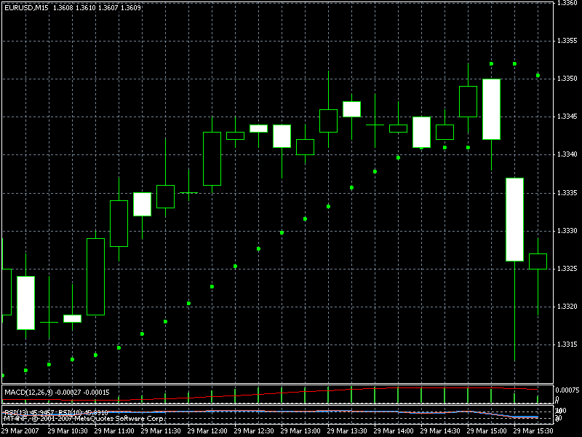

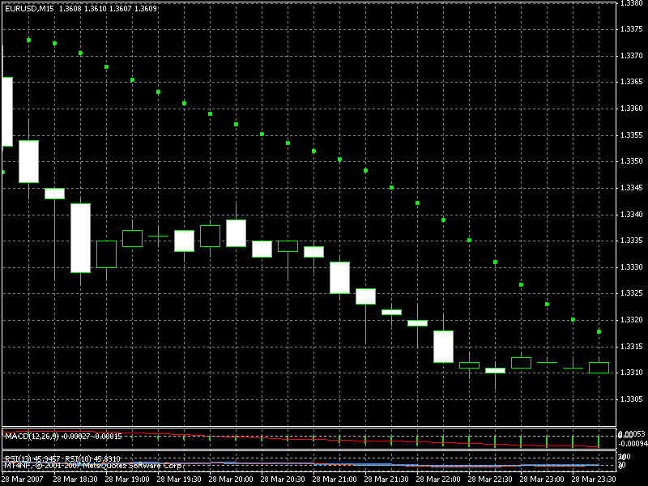
Looking at the chart you will notice that parabolic SAR is below the candlesticks, that’s an indication of up-trend and buying signal.
Action= enter buying (long) position
Parabolic SAR .
Parabolic SAR .
Looking at the chart you will notice that parabolic SAR is above the candlesticks, that’s an indication of down-trend and selling signal.
Action= enter selling (short) position
When a new position is entered the SAR points will be positioned far enough away from the prices to permit some contra-trend price movement. As the market begins to trend the SAR points will move with prices and progressively tighten as the trend continues. This is accomplished by the use of an acceleration
factor that increases up to a given limit each time a new extreme in the direction of the trend is reached.
The most common uses of Parabolic Time Price are:
- As a Stop And Reverse system

Slide 16

Signals to stop out of the current position and enter a reverse position are when prices cross the current SAR point. For example if the SAR points are below prices you would be long with an order to close out
the current long position and enter a short position at that period’s SAR point.
Once you are stopped into a short position the SAR points will be above prices and the current period’s SAR point will be the level at which you will be stopped out of your short position and enter a long position.
When applied in its original form Parabolic Time Price is a system that is always in the market. In order for this technique to be successful the underlying market needs to be trending strongly.
If Parabolic Time Price is applied in a non-trending market then it is likely that losses will result because the buy signals will occur at the top of the range and the sell signals at the bottom of the range.
As an entry and exit technique in a trending market
By using Parabolic Time Price in conjunction with an analysis that indicates market trend such as MACD,
you would take only long trades when the trend was up and only short trades
when the trend was down.
- To select a level at which to place a stop loss
After a trade has been entered using another method or technique, the SAR points of Parabolic Time Price
are used to trail a stop on the position.
Parameters
Acceleration factor: (default 0.02)
The Acceleration increment is the rate at which the SAR points will progressively tighten upon prices each t new extreme in the direction of the trend is reached.
A value greater (less) than 0.02 means that the SAR points will tighten more quickly (slowly) upon prices, earn less (more) room for counter trend price movements. Maximum constant: (default 0.2)
Relative Strength Index (RSI)
Relative Strength Index, or RSI, is one of the simplest charts which any Forex trader can use to identify overbought and oversold conditions in the market. It is also scaled from 0 to 100. Typically, readings below 25/20 indicate oversold, while readings over 75/80 indicate overbought.

Slide 17

Enter Short position
100
80
When the RSI line moves above 75/80 level that’s a very strong selling signal. The reason is because price will start drop.
Action= enter selling position
75
70
Buying Region
When the RSI line moves above 50 level that’s buying signal. The reason is because price is likely to move up.
Action= enter buying position
58
Enter Long position here
50
45
Enter Short position here
When the RSI line moves below 50 level that’s selling signal. The reason is because price is likely to drop.
Action= enter selling position
Selling region
30
When the RSI line moves below 25/20 level that’s very strong buying signal. The reason is because price will start moving up
Action= enter buying position
25
20
Enter Long position here
0
The above chart showed comprehensive detail with which
you can use RSI Magic to capture pips which in turn is big buck (money) in Forex Trading. All what u has to do is to follow the guides as it has been explained in the above chart.

Slide 18
After reading about so many Forex Trading Charts systems or strategies, I decided to study one of the simplest of all the charts that is the RSI. During my many months of studying the RSI I discovered a hiding Trading secrets which is in RSI (These secrets are been explained in the above chat)
Because RSI move with time it will be nice if you should know the right time to trade so you can make more pips with RSI. The next topic will give more detail about Market Time.
Trading Time
Yes, it is true that the Forex is open 24 hours a day, but that doesn’t mean it’s always active the whole day. You can make money in the Forex when the market moves up, and you can even make money when the market moves down. However, you will have a very difficult time trying to make money when the market doesn’t move at all. This lesson will help you to determine when the best times of the day are to trade.
Market Hours Market Hours Table
Time Zone | Eastern Time | GMT | Nigerian Time
Tokyo Opening | 7 PM | 0:00 | 11 PM
Time
 | 4 AM | 6:00 | 7 AM
Tokyo Closing
Time
London Opening | 3 AM | 8: 00 | 9 AM
Time
 | 12 PM | 17: 00 | 6 PM
London Closing
Time
US Opening Time | 8 AM | 13: 00 | 2 PM
US Closing Time | 5 PM | 22: 00 | 11 PM
You can see that in between each session there is a period of time where two sessions are open at the same time. From 3-4 a.m. EST (9-10 a.m. Nigerian Time), both the Tokyo and London markets are open, and from 8-12 a.m. EST (2-6 p.m. Nigerian Time), both the London and U.S. markets are open. Naturally, these are the busiest times during the market because there is more volume when two markets are open at the same time.

Slide 19
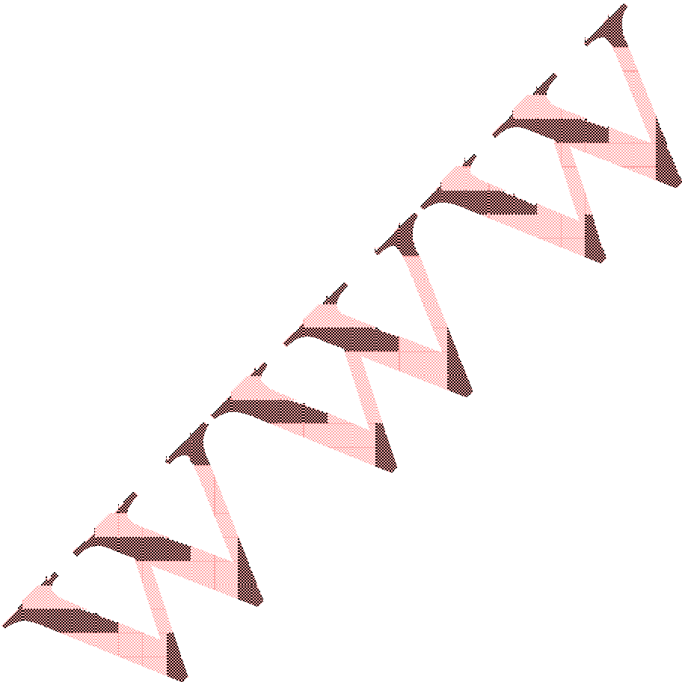
Trading Sessions
Morning session = 6-9 GMT change by 1 hour.
(7-10 am Nigerian Time) Time zone may
To really benefit from the RSI Trading Magic you must note that the RSI work with time, for example if you wake up by 7am Nigerian time and you meet the RSI line having moving below 50 level, you enter short position and remain in selling region till 9-10 am before you go off from the position, or when you have captured at least 20 pips you exit the market, that’s the of morning section.
Afternoon Session= 13:00-16:00 (2-5 pm Nigerian Time)
The next trading time should be the afternoon session which starts by 2 pm when USA has opened their session. If for example the RSI is at the buying region enter long (buy) position and expect to capture at least 25-50 pips because at this session the market volatility is always very high. The reason why volatility of online Forex is always high in the afternoon session is because that’s the time most of economical news which affects the market is released; secondly, more traders are in the market, because of long over lapping of London/US time.
The Most Currency Pair
There are over 40 currency pairs in forex market but not all are good for a trader, any currency pair which does not always make changes of price in a day is not worth trading on. The currency pairs which popularly traded are:
EUR/USD, GBP/USD, USD/CHF, USD/YEN.
Trading Recommendations;
The Trend is your friend 2. In up-trends, buy the dips; in downtrends, sell bounces .
Let profits run, cut losses short. Always use protective stops to limit losses and move them only to reduce potential losses or protect newly achieved profits.
Set up your plan before entering the market; don't trade impulsively
Employ at least a 3 to 1 reward-to-risk ratio 7 Learn to be comfortable being in the minority, if you are right on the market, most people will disagree with you.
Keep it simple; more complicated isn't always better.

Slide 20

Fundamental Indicators.
CPI (Consumer Price Index)
Definition The Consumer Price Index is a measure of the average price level of a fixed basket of goods and services purchased by consumers. Monthly changes in the CPI represent the rate of inflation.
Why do Investors Care?
The consumer price index is the most widely followed indicator of inflation in the United States.
Just knowing what inflation is and how it influences the markets can put an individual investor head and shoulders above the crowd.
Inflation is a general increase in the price of goods and services. The relationship
between INFLATION and INTEREST RATES is the key to understanding how data like the CPI influence the markets ( and your investments.)
If someone borrows $100 dollars from you today and promises to repay it in one year with interest, how much interest should you charge? The answer depends
largely on inflation, because you know that the $100 won't be able to buy the same amount of goods and services a year from now, as it does today. If you were in Brazil where prices can double every couple of months, you might want to charge 400% interest for a total payoff of $500 at the end of the year. In the United States, the CPI tells us that prices are rising about 2% a year, so you only have to charge 2% interest to recoup your purchasing power at the end of the year. You might want to add in a few more percentage points for default
risk and the opportunity cost, but the key variable in what interest rate you charge is the rate of inflation.
That basically explains how interest rates are set on everything from your mortgage and auto loans to Treasury bonds and T-bills. As the rate of inflation changes and as expectations on inflation change, the markets adjust interest rates accordingly. The effect ripples across stocks, bonds, commodities, and your portfolio, often in a dramatic fashion.
By tracking the trends in inflation, whether high or low, rising or falling, investors
can anticipate how different types of investments will perform
JOBLESS CLAIMS
Definition A weekly compilation of the number of individuals who filed for unemployment insurance for the first time. This indicator, and more importantly, its four-week moving average, portends trends in the labor market.
Why do Investors Care?

Slide 21

Jobless claims are an easy way to gauge the strength of the job market. The fewer people filing for unemployment benefits, the more have jobs, and that tells investors a great deal about the economy. Nearly every job comes with an
income which gives a household spending power. Spending greases the wheels of the economy and keeps it growing, so the stronger the job market, the healthier the economy.
There's a downside to it, though, which is relevant these days. Unemployment claims, and therefore the number of job seekers, can fall to such a low level that businesses have a tough time finding new workers. They might have to pay overtime to current staff, use higher wages to lure people from other jobs, and in general spend more on labor costs because of a shortage of workers. This leads to wage inflation which is bad news for the stock and bond markets. Federal Reserve chairman Alan Greenspan talks about it all the time and watches for it constantly.
By tracking the number of jobless claims, investors can gain a sense of how tight the job market is. If wage inflation threatens, it's a good bet that interest rates will
rise, bond and stock prices will fall, and the only investors in a good mood will be the ones who tracked jobless claims and adjusted their portfolios to anticipate
these events.
Just remember, the lower the number of unemployment claims, the stronger the job market, and vice versa.
LEADING INDICATORS
Definition A composite index of ten economic indicators that typically lead overall economic activity.
Why do Investors Care?
Investors need to keep their fingers on the pulse of the economy because it dictates how various types of investments will perform. By tracking economic data like the index of leading indicators, investors will know what the economic backdrop is for the various markets. The stock market likes to see healthy economic growth because that translates to higher corporate profits. The bond market prefers less rapid growth and is extremely sensitive to whether the economy is growing too quickly-and causing potential inflationary pressures.
The index of Leading Indicators is designed to predict turning points in the economy such as recessions and recoveries. Incidentally, stock prices are one of the leading indicators in this index.
MONEY SUPPLY
Definition The monetary aggregates are alternative measures of the money supply by degree of liquidity.

Slide 22

Changes in the monetary aggregates indicate the thrust of monetary policy as well as the outlook for economic activity and inflationary pressures.
Why do Investors Care?
To be honest, the various money supply measures don't matter to most investors these days. The monetary aggregates (known individually as M1, M2, and M3) used to be all the rage a few years back because the data revealed the Fed's (tight or loose) hold on credit conditions in the economy. The Fed issues target ranges for money supply growth.
In the past, if actual growth moved outside those ranges it often was a prelude to an interest rate move from the Fed. Today, monetary policy is understood more clearly by the level of the federal funds rate.
Money supply fell out of vogue in the nineties, due to a variety of changes in the financial system and the way the Federal Reserve conducts monetary policy. The Fed is working on some new measures of money supply, and given the way economic indicators ebb and flow in popularity, don't be surprised if the monetary aggregates make a comeback in the future.
NEW HOME SALES
DefinitionThe number of newly constructed homes with a committed sale during the month. The level of new home sales indicates housing market trends.
Why do Investors Care?
This provides a gauge of not only the demand for housing, but the economic momentum.
People have to be feeling pretty comfortable and confident in their own financial position to buy a house. Furthermore, this narrow piece of data has a powerful multiplier effect through the economy, and therefore across the markets and your investments. By tracking economic data such as new home sales, investors can gain specific investment ideas as well as broad guidance for managing a portfolio.
Each time the construction of a new home begins, it translates to more
construction jobs, and income which will be pumped back into the economy. Once the home is sold, it generates revenues for the home builder and the realtor. It brings a myriad of consumption opportunities for the buyer. Refrigerators, washers, dryers and furniture are just a few items new home buyers might purchase. The economic "ripple effect" can be substantial especially when you think a hundred thousand new households around the country are doing this every month.
Since the economic backdrop is the most pervasive influence on financial markets, new home sales have a direct bearing on stocks, bonds and commodities. In a more specific sense, trends in the new home sales data carry

Slide 23

valuable clues for the stocks of home builders, mortgage lenders and home furnishings companies.
NONFARM PAYROLL
Definition The employment situation is a set of labor market indicators. The unemployment rate measures the number of unemployed as a percentage of the labor force. Nonfarm payroll employment counts the number of paid employees working part-time or full-time in the nation's business and government establishments. The average workweek reflects the number of hours worked in the nonfarm sector. Average hourly earnings reveal the basic hourly rate for major industries as indicated in nonfarm payrolls.
Why do Investors Care?
If ever there was an economic report that can move the markets, this is it! The anticipation on Wall Street each month is palpable, the reactions are dramatic, and the information for investors is invaluable. By digging just a little deeper than the headline unemployment rate, investors can take more strategic control of their portfolio and even take advantage of unique investment opportunities that often arise in the days surrounding this report.
The employment data give the most comprehensive report on how many people are looking for jobs, how many have them, what they're getting paid and how many hours they are working. These numbers are the best way to gauge the current state and future direction of the economy. They also provide insight on wage trends, and wage inflation is high on the list of enemies for the Federal Reserve. Fed chairman Alan Greenspan talks about this data frequently and watches for inflation constantly.
By tracking the jobs data, investors can sense the degree of tightness in the job market. If wage inflation threatens, it's a good bet that interest rates will rise, bond and stock prices will fall. No doubt that the only investors in a good mood will be the ones who watched the employment report and adjusted their portfolios to anticipate these events.
. PERSONAL INCOME
DefinitionPersonal income is the dollar value of income received from all sources by individuals. Personal outlays include consumer purchases of durable and nondurable goods, and services.
Why do Investors Care?
The income and outlays data are another handy way to gauge the strength of the economy and where it is headed. Income gives households the power to spend and/or save.
Spending greases the wheels of the economy and keeps it growing. Savings are often invested in the financial markets and can drive up the prices of stocks and

Slide 24

bonds. Even if savings simply go into a bank account, part of those funds are typically used by the bank for lending and therefore contribute to economic activity. The only way savings fail to contribute is if they are deposited in the First
National Bank of Serta (under the mattress), and not too many people do that anymore.
The consumption (outlays) part of this report is even more directly tied to the economy, which we know usually dictates how the markets perform. Consumer spending accounts for two-thirds of the economy, so if you know what consumers are up to, you'll have a pretty good handle on where the economy is headed. Needless to say, that's a big advantage for investors.
Note:
There are other useful fundamental (News) indicators you need to know to be a successful forex trader.
This short manual maybe good and has give you the basic knowledge of online forex trading. But we assure you that you still need more in-depth but comprehensive knowledge if really want make constant profit from online forex.
You are invited to Instaforex Free forex training. For more information please visit www.instafxng.com.
Instaforex Nigeria.

