Slide 1
Deep learning prOJECT Image Caption Deep Neural Network Model (ICDNNM)

Slide 2
mOTIVATION
Lots of literature on caption to image models
Turn it around and make image to caption model
Exciting mix of R-CNN model with Autoencoder model
Possibly beneficial to blind people?
List go on..

Slide 3
Data description
1 GB of image data
8.091 images in total
Different sizes of the images
5 different captions for every image (= equals 40.460 captions in total)
(Data description i python)

Slide 4
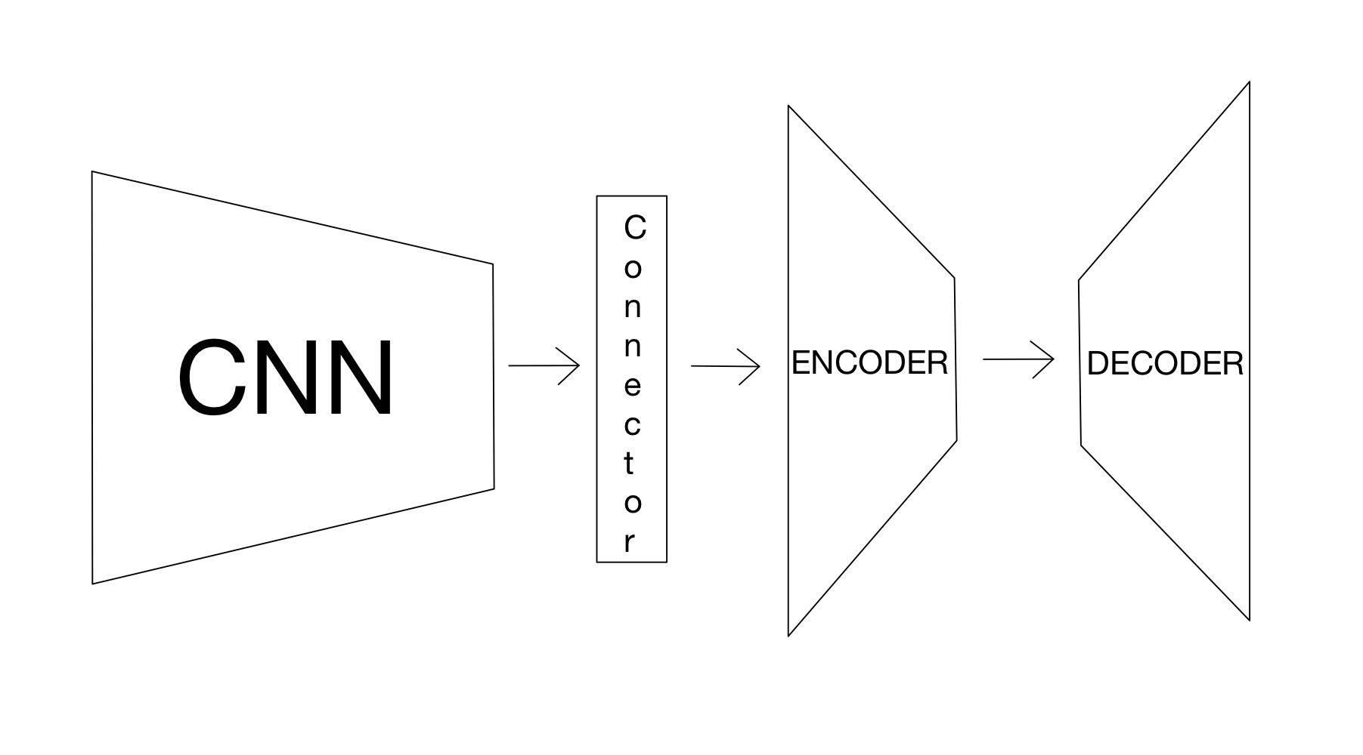
Model architecture
*indsæt flot billede tegnet af Simsefar*

Slide 5
Possible difficulties
Training the R-CNN by ourselves.
Enough data?

Slide 6
Ambition & expectations
Create the state of the art image-to-caption model

