Slide 1
Deep learning prOJECT Image Caption Deep Neural Network Model (ICDNNM)

Slide 2
mOTIVATION
Lots of literature on caption-to-image models
Turn it around and make image-to-caption model
Exciting mix of R-CNN model with Autoencoder model
Possibly beneficial to blind people.
All kinds of captions for website-images can be automized
List goes on..

Slide 3
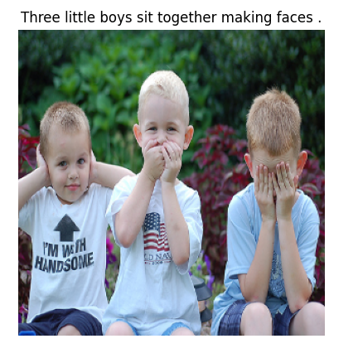
Data description
1 GB of image data
8.091 images in total
Different sizes of the images
5 different captions for every image (= equals 40.460 captions in total)
(Data description i python)

Slide 4
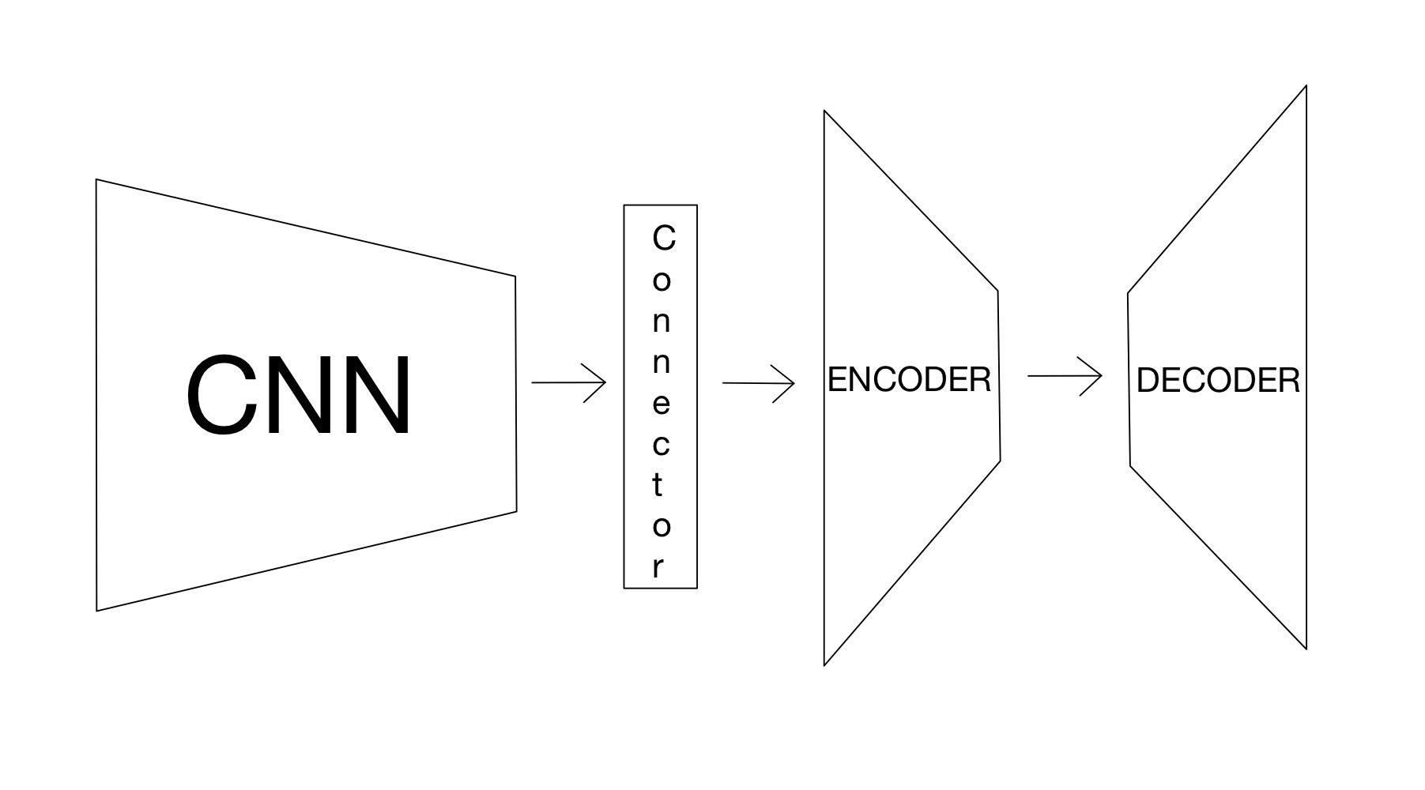
Model architecture

Slide 5
Possible difficulties
Training the R-CNN by ourselves -> finetuning existing CNN instead
How to evaluate performance? Weighting of certain words?
Possible biases of our model?
Enough data?
The time spent to train model? Cluster PC’s on AU-campus

Slide 6
Ambition & expectations
Create the state of the art image-to-caption model
Publish on Github for other people to see
Compare with similar models in the existing literature
Test it on our own super cool images ☺

