Slide 1


Project : Johnny Cloud
Johnny 5: Voice Activated AI-Powered Assistant for administrators
Notes:
Hi everyone, let me introduce project johnny cloud and johnny 5 our ai chatbot mascot. An ode to the 1986 film short circuit where a military robot has a malfunction and became self aware needing information or input as it would call it.
Project Criteria 1 low cost, 2 serverless, AI, real world problem for AWS services, and looking to the future, agentic AI
What is Johnny Cloud: a voice activated AI assistant that watches your AWS environment for security threats and cost anomolies, then alerts you when there is an issue. It’s a serverless, low-cost AI chatbot powered by a LLM(Claude for reasoning). Now we have the input!
In the next few minutes, how our solution works, a quick demo, a short press release, and then Q&A. but now, let me introduce you to the team

Slide 2

The Minds behind Project Johnny Cloud
Team:
🧑‍💼 Fredy Tapia (Project Manager)
📈 Roman Canger (Business Analyst)
🏛️ Hamad Iqbal (Architect)
💻 Chandramati Hiregoudra (Architect/Developer)
📱 Eskinder Kasshun (Developer)
Notes:
FREDY -Our team combined our diverse backgrounds and knowledge to help make this project possible. We are united by a common mission: to empower businesses with an intelligent assistant that makes cloud security and cost management effortless. We are making AI work along man and not replacing one.

Slide 3
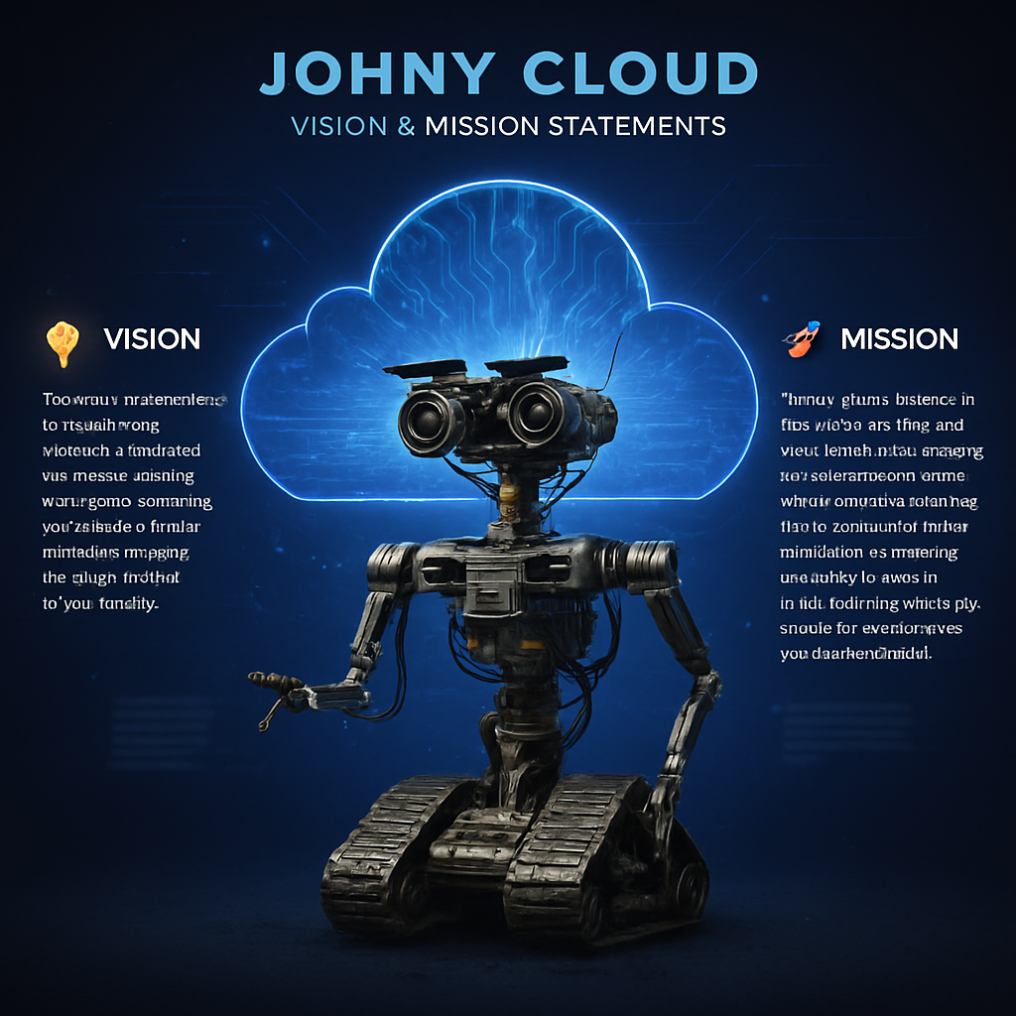
Notes:
Roman can speak o this
Empowering Cloud Teams: Provides real-time
insights and automation help teams work more efficiently.
Unified Operations: Bridges the gap between Man and Machine, helping with repetitive and proactive tasks.
Proactive & Native: Built for AWS-native environments, offering proactive guidance and user-friendly interaction, including voice integration.
Save time: Give time back to your team so they can be creative and innovative

Slide 4
Business Productivity Impact
📉 Reduce cloud cost with intelligent cost insights
🔒 Strengthen security posture with automated guardrails
📈 Build a clear business case for cloud adoption and optimization
🤖 Empower teams with AI-driven guidance and voice interaction
⌛Give back time to your employees to be creative
Notes:
ROMAN SPEAKS ON THIS thens goes “Why AWS page”, eskinder will be sharing screen on that.

Slide 5

What can Johnny 5 do?
Regain Your Time with AI
🗣️ Voice Activated Chat Bot with Artificial Intelligence
🤖 Automate repetitive tasks and reports
Notes:
Eskinder
Are you tired of constantly worrying about hidden security risks and unexpected costs in your AWS environment? Do you wish you had an extra set of eyes to watch your cloud services around the clock?
Introducing Johnny Cloud, the smart, serverless AI assistant for AWS.
Johnny Cloud goes beyond basic monitoring. It's a proactive partner that keeps an eye on your services, spotting issues before they become major problems. If something looks off—whether it’s a potential security threat or a sudden spike in spending—Johnny Cloud doesn't just send an alert. It delivers a clear, plain-English explanation of what happened, who owns it, and what you need to do next.
And because it's serverless and pay-as-you-go, there are no servers to manage and the cost is always low and predictable.
Stop reacting to problems and start preventing them. With Johnny Cloud, you get more than just an assistant—you get a new level of clarity, control, and confidence in the cloud.

Slide 6

What can Johnny Cloud do?
🔒 It can answer questions about cost, security, compliance.
🗣️ It supports voice input and spoken responses for seamless accessibility and hands-free cloud control.
🤝 It is designed to assist FinOps, SecOps, and administrators for repetitive and automatable tasks.
Notes:
Eskinder

Slide 7
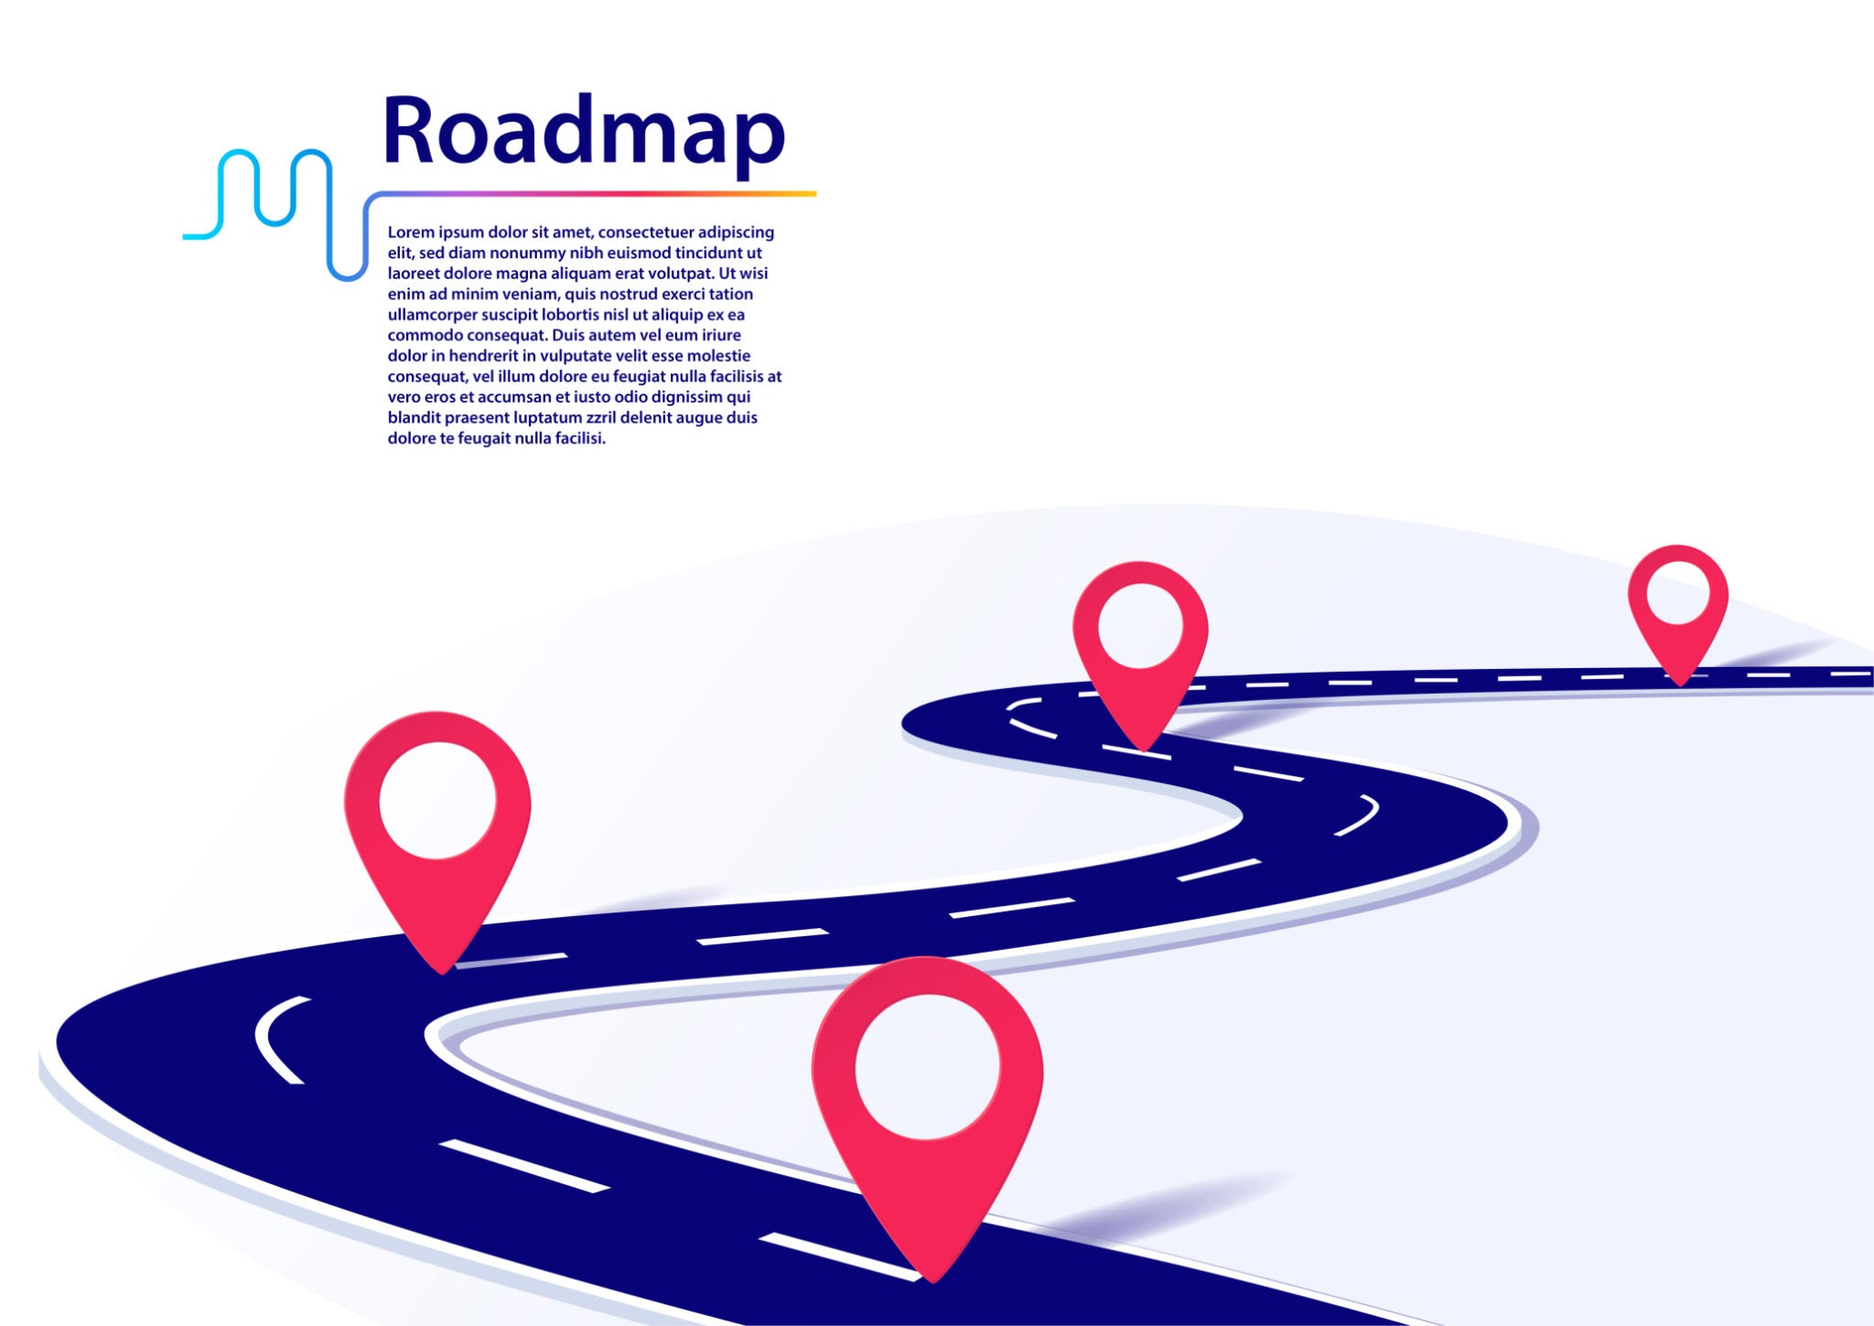
Johnny Cloud RoadMap
From foundation to full-spectrum AWS management.
🚀 V1 – Foundations (July 2025)
🏗️ Landing Zone
📊 Metrics Dashboard
✅ Guardrails (August 2025)
🔒 CIS/NIST controls
⚙️ Auto-remediation
🗣️ ✅ Voice Assistant (Sep 2025)
❓ Ask Johnny anything else
💬 Spoken insights via voice
🔄 Current Focus (Oct 2025)
⚡ Optimization Hub
🤝 Slack & Jira integrations

Slide 8
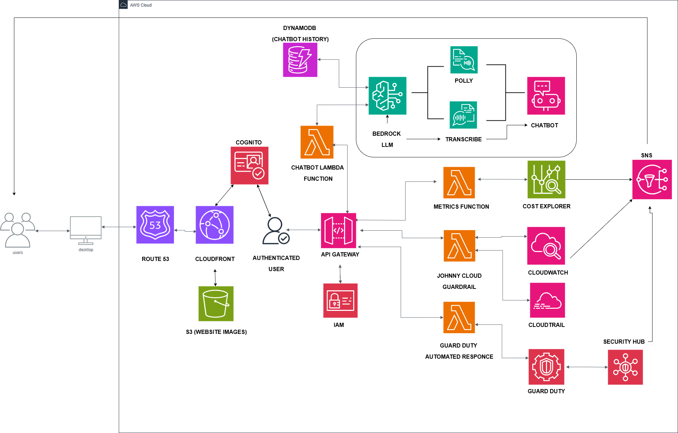
Johnny Cloud Architecture
Notes:
Chandramati can speak here

Slide 9
User Experience with simplicity in mind
🧑‍💻 Signed-in dashboard
🧱 Modular layout: Metrics, Guardrails, FAQ
🗣️💬 Accessibility via voice and chat
✨ AI Powered by Claude Sonnet LLM
Notes:
Chandramati speaks Designed for clarity, speed, and accessibility whether you’re a FinOps analyst or SecOps lead.

Slide 10
Challenges & Key Learnings
🧩Initial Hurdles with Service Integration
⚙️Controlling the AI
🔒Security & Permissions
🏛️Architectural Complexity
Notes:
Fredy first part Eskinder 2nd part
Initial Hurdles with Service Integration: Connecting different AWS services was a key challenge, requiring a deep understanding of each platform's unique API and configuration requirements.
Controlling the AI: We had to carefully craft the prompts to guide the chatbot, as we found it was a challenge to ensure it stayed on topic and used only the data provided to avoid "hallucinating" or inventing information.
Security & Permissions: Setting up the correct Identity and Access Management (IAM) roles was a major focus, as the Lambda function needed specific, least-privilege permissions to securely access services like GuardDuty and Cost Anomaly Detection without having overly broad access to the AWS account.
Architectural Complexity: Getting a firm grasp on how to best orchestrate the services from EventBridge routing, to alerts within the Lambda function required a solid understanding of how all the components would work together in a serverless pipeline

Slide 11
Q&A
🔄 Multi-Account Support
⚙️ Automated Fixes
🔐 Data Safety
💸 Cost to Run
🚨 What If Something Breaks?
Notes:
HAMAD SPEAKS ON THIS
🔄 Multi-Account Support Yes,we can use a central AWS Organization account to collect and route all events.
(Managing multiple AWS accounts can get complicated. With a central AWS Organization account, you can bring everything together in one place. This setup makes it easier to collect, manage, and route all events across accounts. Instead of checking each account separately, you can track security, billing, and resources from a single hub. This saves time, reduces errors, and makes monitoring much simpler for teams.)
⚙️ Automated Fixes Start with one-click runbooks. Enable safe auto actions, such as isolating risky instances or stopping costly resources.
(Security and cost issues often happen suddenly, and manual fixing can take too long. Automated runbooks provide one-click solutions to common problems. For example, if a server is acting suspicious, it can be isolated automatically. If resources are costing too much, they can be stopped quickly. These safe auto actions reduce risk, save time, and protect the organization without waiting for manual intervention.)
🔐 Data Safety We read from your account and return results to the UI. No sensitive data is stored outside your environment. Save remediation logs and chat threads in your own DynamoDB tables.
(Keeping data safe is a top priority. This system reads data from your AWS account and only shows results in the dashboard. Sensitive data is not stored outside of your environment. You also have the option to save remediation logs and chat history into your own DynamoDB tables for tracking. This means you remain in full control of your information, keeping privacy and compliance strong.)
💸 Cost to Run The serverless architecture keeps costs low just a few dollars per month for demos. We set a small budget and alerts before any unexpected cost surprises.
(The solution uses a serverless architecture, which means you only pay for what you use. This keeps costs very low just a few dollars per month for demo projects. It also helps you set budgets and alerts to make sure spending doesn’t get out of control. With cost monitoring, you can see exactly how much is being spent and take steps early to avoid unexpected bills.)
🚨 What If Something Breaks? System has retries, backup queues, and team alerts to ensure resilience and transparency.
(No system is perfect, but this setup is designed to recover quickly. If something fails, built-in retries automatically try again. Dead-letter queues make sure no messages or data are lost. Team alerts notify the right people instantly so they can take action. This ensures the system stays resilient, transparent, and reliable even when issues occur.)

Slide 12
Future Enhancements
⚡ From Alerts to Action
🔐 Security, Tightened
👁️‍🗨️ Visibility, Refined
💸 Cost View, Strengthened
🧠 Smarter Bot Experience
Notes:
Hamad speaks
⚡ From Alerts to Action
One-click auto-fix buttons with optional automatic remediation to quickly solve common issues.
(Instead of just showing problems, the system helps you fix them quickly. With one-click auto-fix buttons and optional automatic remediation, common issues can be solved immediately without wasting time. This means fewer delays, less manual work, and a more reliable system overall.)
🔐 Security, Tightened
Safer environment with private endpoints, stricter IAM roles, strong encryption, and compliance checks.
(The platform makes your environment safer by adding stronger protection. Private endpoints reduce exposure to the internet, stricter IAM roles ensure users only have the access they really need, and strong encryption keeps data safe. It also includes compliance checks so your system meets security standards without extra effort.)
👁️‍🗨️ Visibility, Refined
Cleaner logs, easy-to-use dashboard, and alerts for system failures to improve monitoring.
(Monitoring becomes much easier with clear and clean logs. The simple dashboard gives a quick overview of your system’s health, while alerts notify you right away if something goes wrong. This helps teams respond faster and avoid small issues becoming big problems.)
💸 Cost View, Strengthened
Breakdowns by service, region, or tag with budget vs. actual tracking and money-saving tips.
(Keeping costs under control is just as important as security. This tool gives detailed breakdowns by service, region, or even by project tags. You can compare your budget against actual spending and also get tips on where to save money. This makes cloud costs predictable and easier to manage.
)
🧠 Smarter Bot Experience
Multi-language support, daily email reports with MP3 briefings, and smarter Q&A for users.
(The built-in bot makes the whole process smoother and smarter. It supports multiple languages, sends daily email reports, and can even provide audio MP3 briefings for quick updates. The bot also answers questions more intelligently, giving teams the right information faster.)

Slide 13
THANK YOU

