Slide 1
BRSKI with Pledge in Responder Mode (BRSKI-PRM)
draft-ietf-anima-brski-prm-02
Steffen Fries, Thomas Werner, Elliot Lear, Michael Richardson
IETF 113 – ANIMA Working Group

Slide 2
BRSKI-PRM Status History of main changes 00→01
Issue #15: Included option for additional signature of the voucher by the registrar to support verification of POP of the registrars private key → supports provisional accept
Issue #11: New endpoint on registrar to enable delivery of the wrapped enrollment request (in contrast to plain PKCS#10 in simpleenroll).
Issue #8: No additional signature on enrollment-response object by the registrar. Enrollment response will only contain the generic LDevID EE certificate.
Issue #7: No support for multiple CSRs during the bootstrapping, as generic LDevID EE is expected to be used for further enrollment requests. Existing endpoints may be reused.
Issue #5: Verification of ietf-ztp-types usage in draft via PoC
Issue #4: Assertion-type aligned with voucher definition in RFC8366bis
3/4/2022
2

Slide 3
BRSKI-PRM Status History of main changes 00→01 (cont.)
Change of agent-sign-cert from simple object to an array to allow LDevID (RegAgt) certificate to be issued by a different CA than LDevID (Reg) certificate (changes in voucher enhancement and handling description)
Included description of authorization check of registrar-agent at registrar during TLS and during pledge-voucher-request processing (based on agent-signed-data)
Limitation section added if pledge is in power save mode
Housekeeping: Enhance draft with examples of trigger messages for pledge-voucher-request and enrollment-request. Editorial changes.
3/4/2022
3

Slide 4
BRSKI-PRM Status History of changes 01→02
Issue #15 finalized handling of additional signature verification on voucher from registrar
Included examples for General JWS JSON Serialization
Included error responses from pledge if it is not able to create a pledge-voucher request or an enrollment request in section was missing before
Issue 7+8+14: Resolved open issue regarding handling of multiple CSRs and enrollment responses during the bootstrapping:
Initial target is provisioning of generic LDevID certificate.
Defined endpoints on the pledge may also be used for management of further certificates.
3/4/2022
4

Slide 5
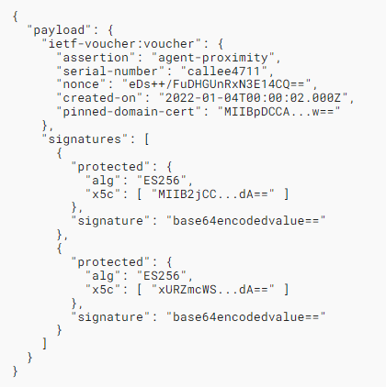
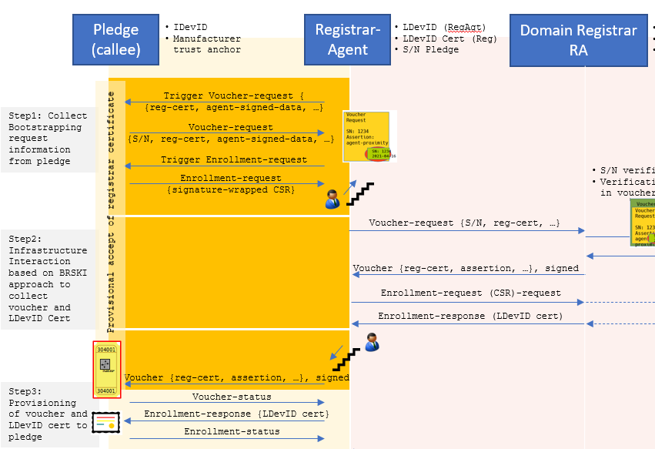
BRSKI-PRM Status Multiple signatures on voucher response
3/4/2022
5

Slide 6
BRSKI-PRM Status Next Steps
Currently no open issues
Security consideration section to be updated
PoC implementation ongoing
Peer review volunteers appreciated
WG review requested
3/4/2022
6

Slide 7
Backup
7

Slide 8
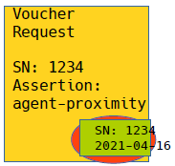


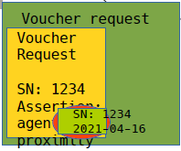


BRSKI-PRM – Abstract Protocol Overview
Pledge (callee)
IDevID
Manufacturer trust anchor
Registrar-Agent
LDevID (RegAgt)
LDevID Cert (Reg)
S/N Pledge
Domain Registrar
RA
LDevID (Reg)
IDevID Cert CA
S/N Pledge
Domain CA
Domain CA credentials
MASA
MASA credentials
Trigger Voucher-request { {reg-cert, agent-signed-data, …}
Step1: Collect Bootstrapping request information from pledge
Voucher-request {S/N, reg-cert, agent-signed-data, …}
Trigger Enrollment-request
S/N verification
Verification „reg-cert“ in prior-signed-voucher
Verification of “agent-signed-cert” and “agent-signed-data”
Issues voucher with assertion agent-proximity
Enrollment-request {signature-wrapped CSR}
S/N verification
Verification „reg-cert“ in voucher is own cert
Provisional accept of registrar certificate
Voucher-request {S/N, reg-cert, …}
Voucher-request {prior-signed-voucher, …}
Step2: Infrastructure Interaction based on BRSKI approach to collect voucher and LDevID Cert
Voucher {reg-cert, assertion, …}
Voucher {reg-cert, assertion, …}, signed
Enrollment-request (CSR)-request
Enrollment-response (LDevID cert)
Voucher {reg-cert, assertion, …}, signed
Step3: Provisioning of voucher and LDevID cert to pledge
Voucher-status
Enrollment-response {LDevID cert}
Enrollment-status
Voucher status
Device audit log
Enrollment status
Basement no connectivity to backend
First floor, connectivity to backend
3/4/2022
8

