Slide 1
Event Organizer Application
CS251 – Software Engineering – Fall ’14
Presented to : T.A. Sara Tarek
21/12/2014
Presenters :
Mostafa El-Sayad – Eslam Osama – Ahmed Saber – Ibrahim Abd El-Rheem

Slide 2
Project Overview
Objectives
Requirements
Design & Implementation
Challenges & difficulties
Lessons learned from this project
Live Demo ☺

Slide 3
Project Objectives :
Make Event organizing process more easier
Let people create and join different types of events via friendly user interface
Simulate EventUS the web based application that helps people to organize events

Slide 4
Project Requirements :
Functional Requirements :
Create Events
Join Events
View Recommended events
Search events
Follow users
View Created / joined Events

Slide 5
Cont’d : Project Requirements
Non functional Requirements :
User Interface
Legal
Free application
Open source

Slide 6
Design & Implementation
Class Diagram
ERD
GUI
Model Transformation
Initial Implementation
Final Implementation

Slide 7
Timeline
SRS
SDS
Initial Implementation
Final Implement.

Slide 8
Challenges & difficulties
Communication problem

Slide 9
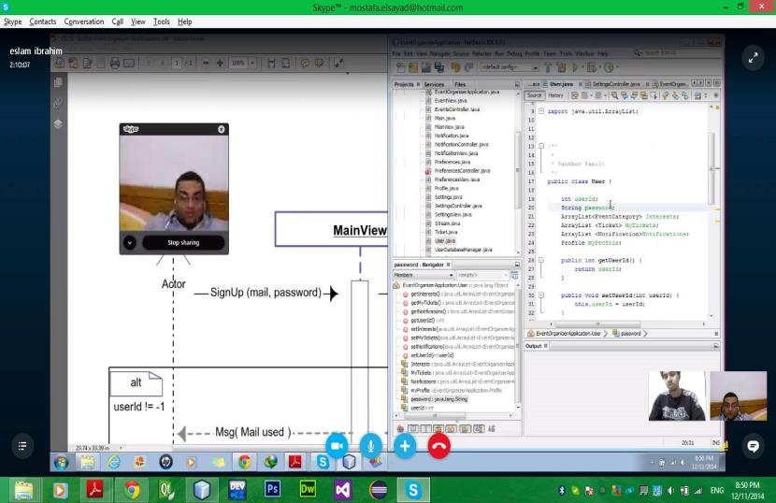
Skype Live Chat
Notes:
What are the dependencies that affect the timeline, cost, and output of this project?

Slide 10
Database Server
SQL OR Xampp

Slide 11
Class Diagram
Too many Classes
A lot of Relations

Slide 12
Time Constraint
One Week to deliver the final implementation

Slide 13
Lessons Learnt from this project
Time Management
Github
Xampp
MVC Structure

Slide 14
Let’s Run it together now we are talking ….

