Slide 1
Arabic Dialect Identification
Aim Technology

Slide 2
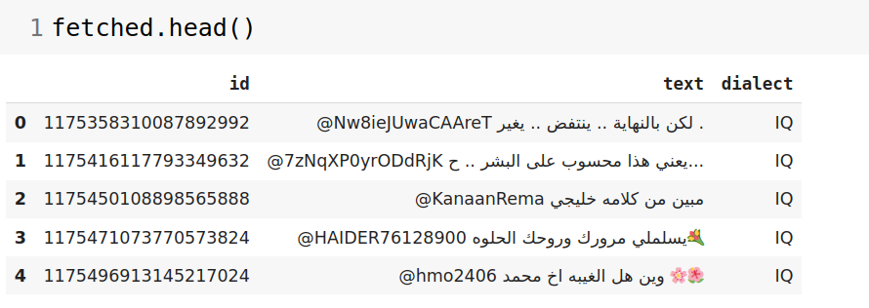
Fetching Dataset
In this phase i retrieved the tweets from the provided API and added it into a pandas dataframe.

Slide 3
EDA + pre-processing
Before cleaning and preparing the data I made a quick EDA to check the properties and the challenges that was mentioned in the paper.
The main challenges was the high imbalance between classes that was hard to deal with.
There was another issue mentioned in the paper that the samples are highly overlapped and the neighbourhood countries have a high error rate.

Slide 4
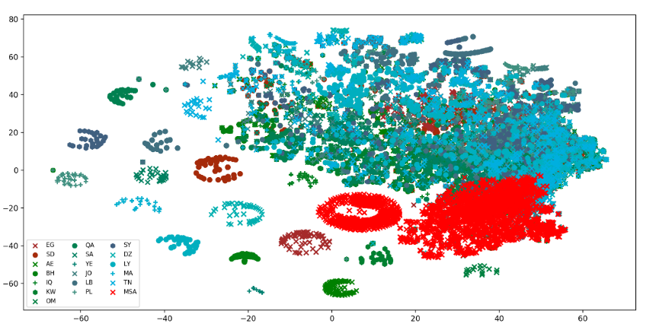
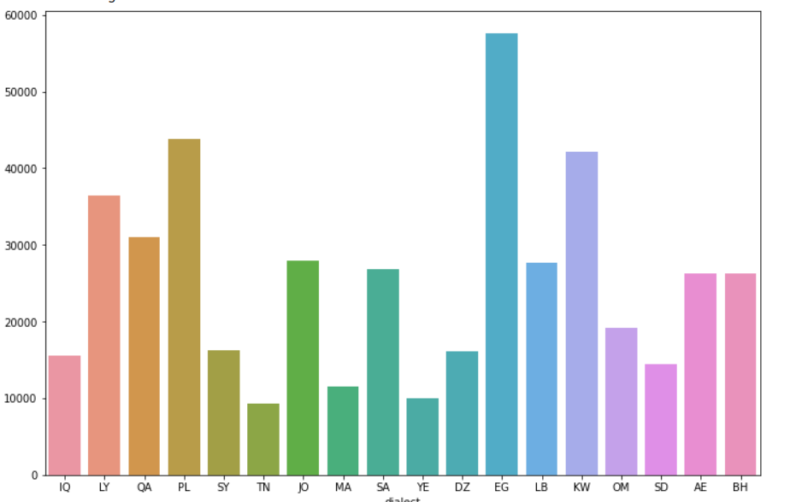
Addressing the imbalance problem and dialect overlapping problem

Slide 5
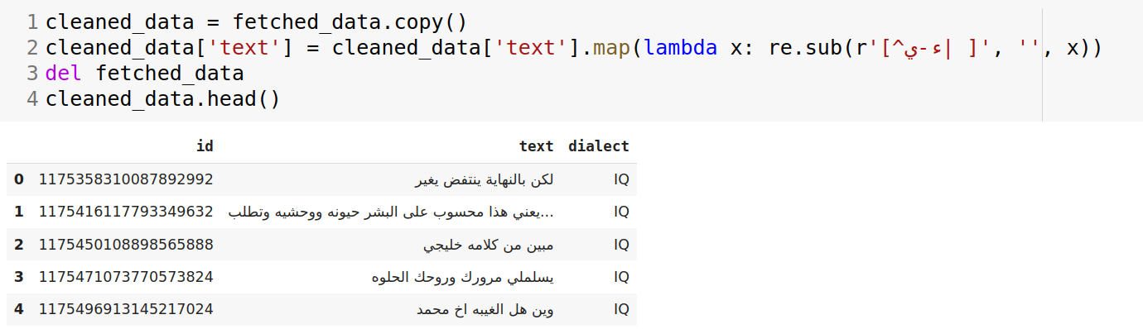
EDA + pre-processing
After that I cleaned and normailed the data to have a pure text for each tweet.
I removed all the emojis ,usernames,hashtags,mentions and all similar terms.

Slide 6
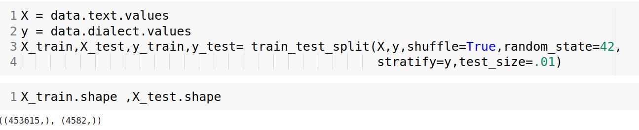
Building ML model
To do a multiclass classification task as the one we have here I decided to use the Naive bayes classifier.
Firstly, I splitted the data into train and test sets with ratio 99:1 as proposed in the paper to make sure I have most of the unique keywords from each dialect in the train data

Slide 7
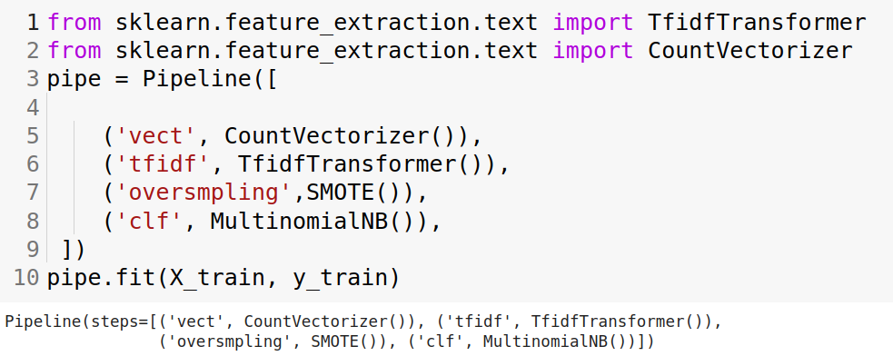
Building ML model
Secondly I used the TF-IDF to get the embeddings for the words in the tweets because this one suits out needs to identify the unique words that represents each dialect.
To deal with the imbalanced data i tried the smote oversampling technique although it is known that it doesn’t work well with the text data because the vectorizer return a huge dimensional representation.
And then I fit a pipeline including all previous steps

Slide 8
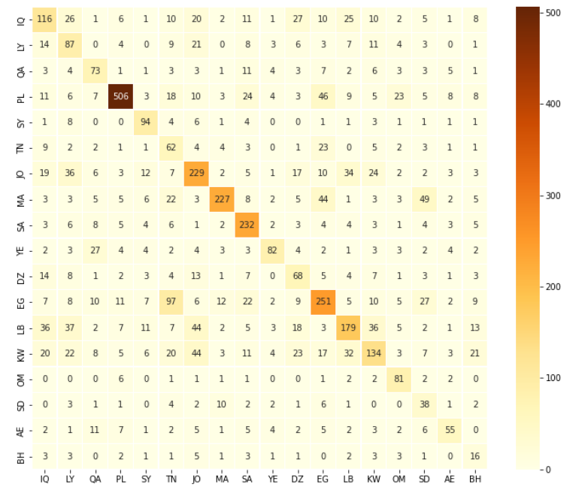
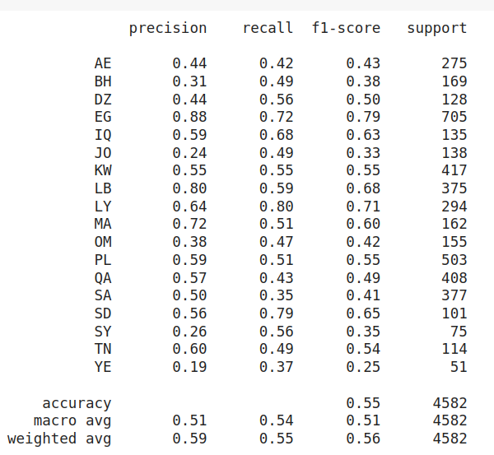
Error analysis

Slide 9
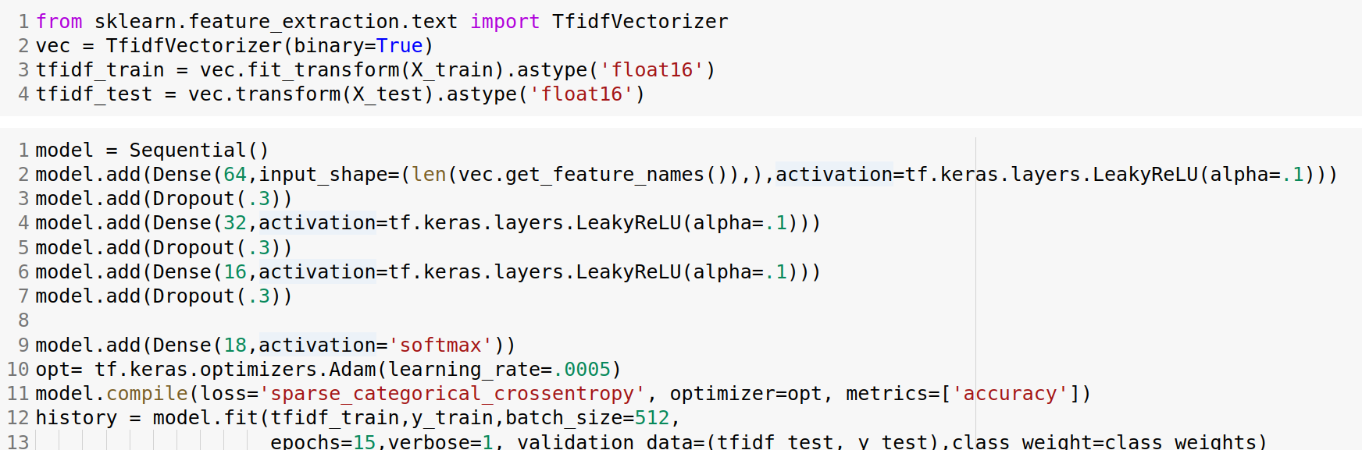
DL model
Using Deep neural networks and softmax output i trained my DL model using
3 layers with dropout= .3 , Leaky relu activation function and learning rate =.0005
Batch size= 512

Slide 10
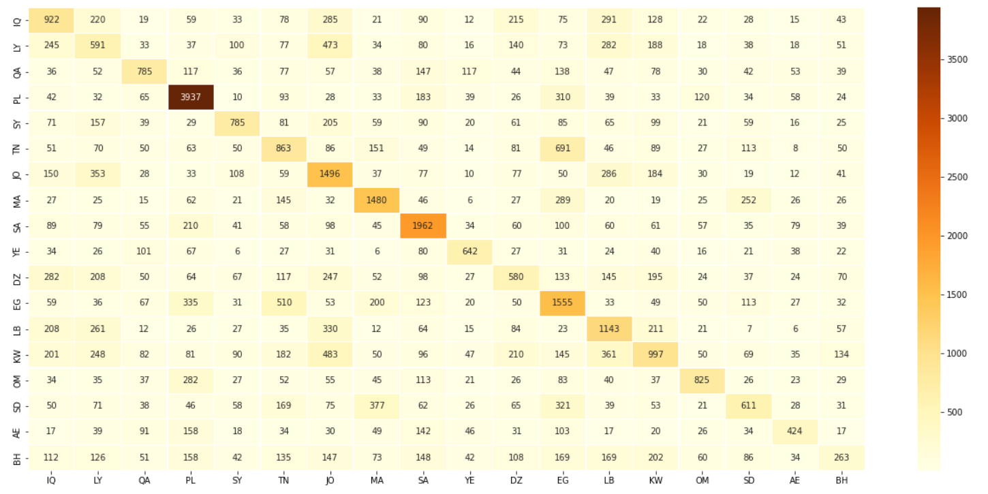
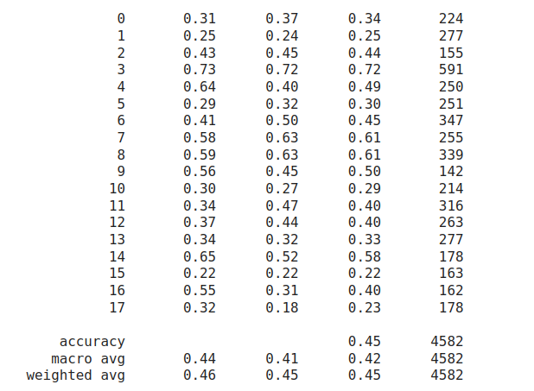
Error analysis

Slide 11
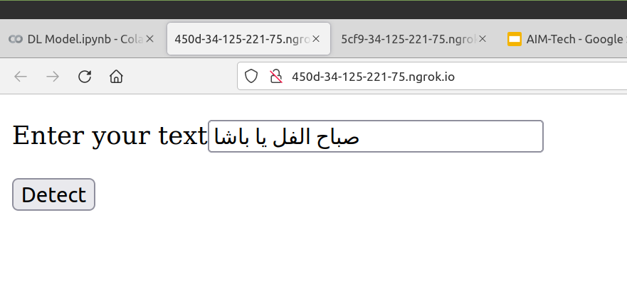
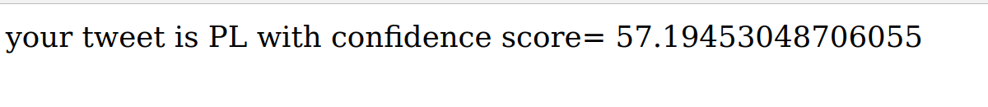
Flask API

