Slide 1
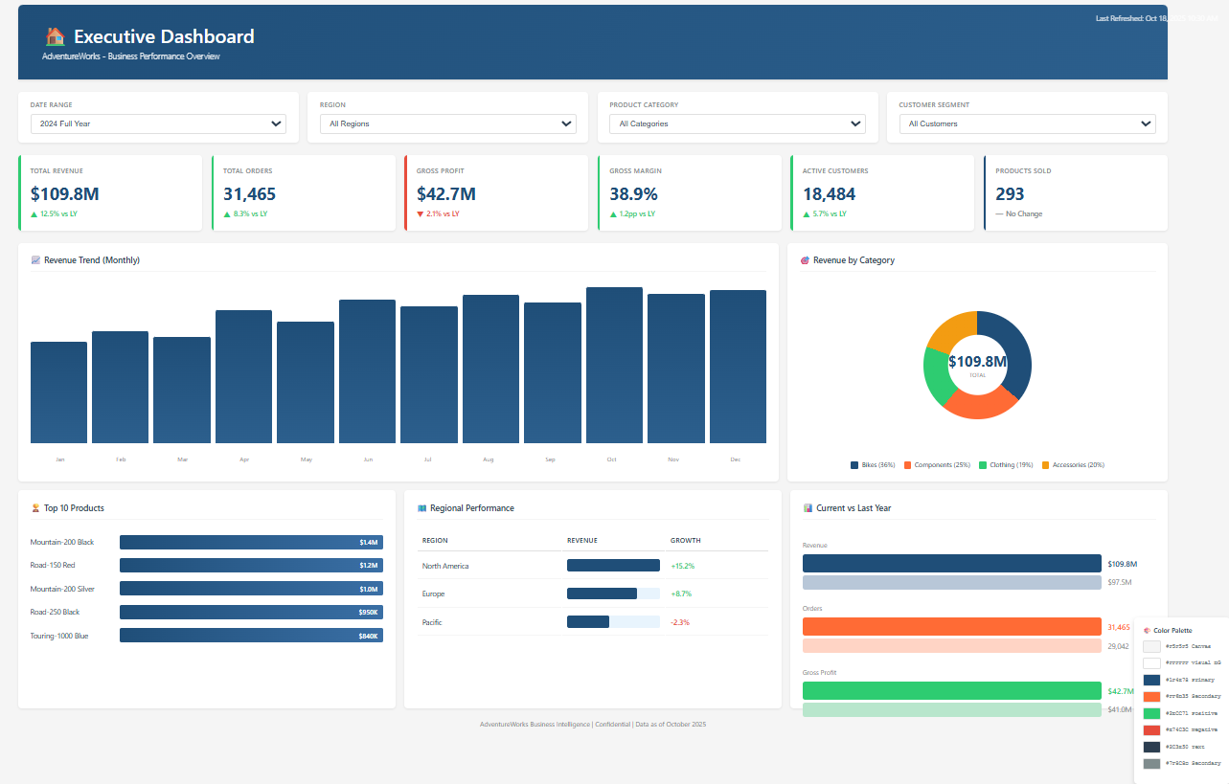

Slide 2
Old design colors
Canvas Background:
Background Colors:
Canvas Background: #F5F5F5 (Light Gray) - Easy on eyes, professional
Visual Background: #FFFFFF (White) - Clean contrast
Header Section: #1F4E78 (Dark Blue) - Professional, corporate
--------------------------------------------------------------------
Data Colors:
Primary Data: #1F4E78 (Dark Blue) - Main bars, lines
Secondary Data: #FF6B35 (Orange) - Comparison, accents
Positive/Growth: #2ECC71 (Green) - Up arrows, positive variance
Negative/Decline: #E74C3C (Red) - Down arrows, negative variance
Neutral: #95A5A6 (Gray) - Supporting elements
--------------------------------------------------------------------
Text Colors:
Primary Text: #2C3E50 (Dark Gray) - Main labels
Secondary Text: #7F8C8D (Medium Gray) - Subtitles, descriptions
KPI Values: #1F4E78 (Dark Blue) - Bold, important numbers
White Text: #FFFFFF - On dark backgrounds
Header Section:
Primary Data:
Secondary Data:
Positive/Growth:
Negative/Decline:
Neutral:
Primary Text:
Secondary Text:
KPI Values:

Slide 3
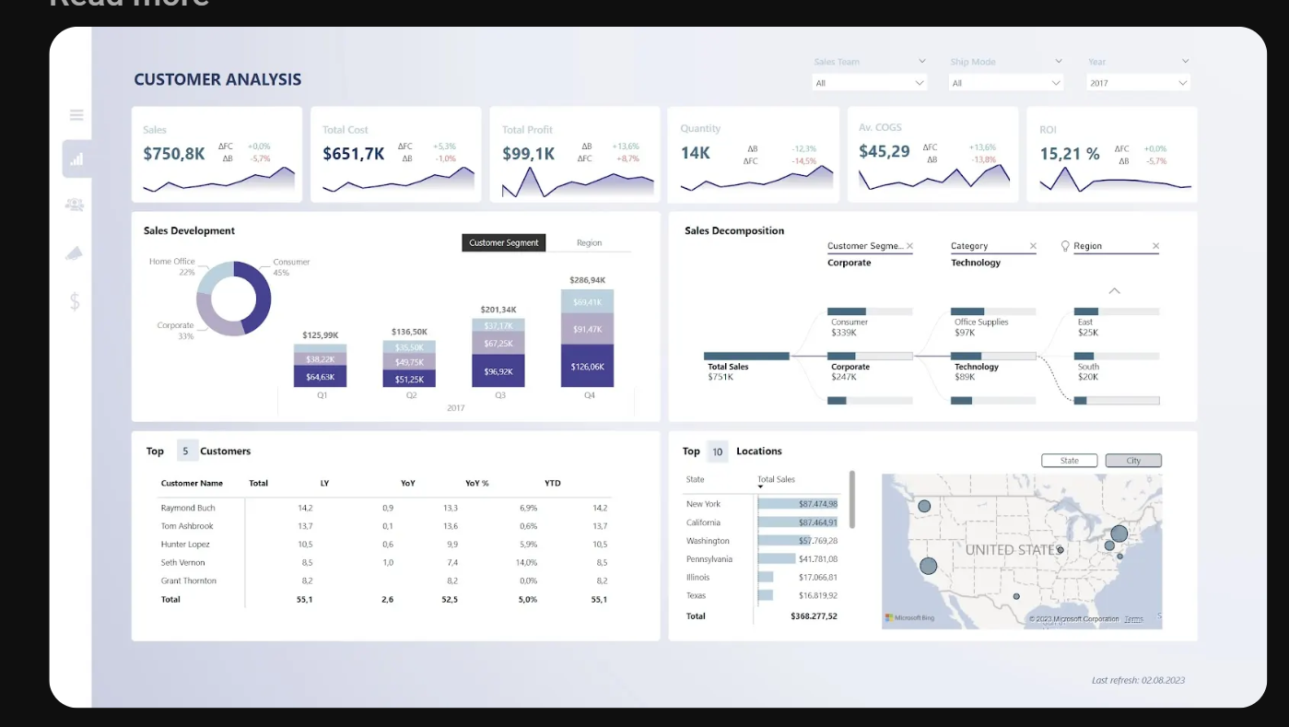

Slide 4
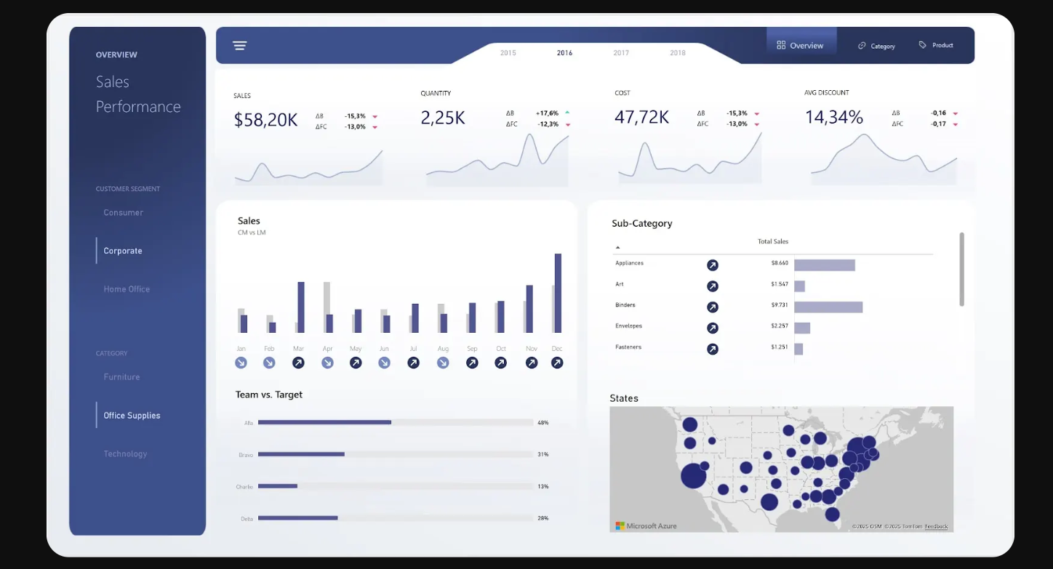

Slide 5








Current Design colors
#F1F2F6
Bg of sidebar, header:
#29355C
Bg of canvas:
#AAAAC9
KPI card title:
#7F8C8D
Visual (x-axis & y-axis) Title:
#605E5C
All Visuals Titles:
#1F4E78
#1F4E78
Primary Data (visuals):
⛟
$
#3D518C
Secondary Data
(visuals):
#CBCBCB
Third Data
(visuals):
#FF6B35

Slide 7
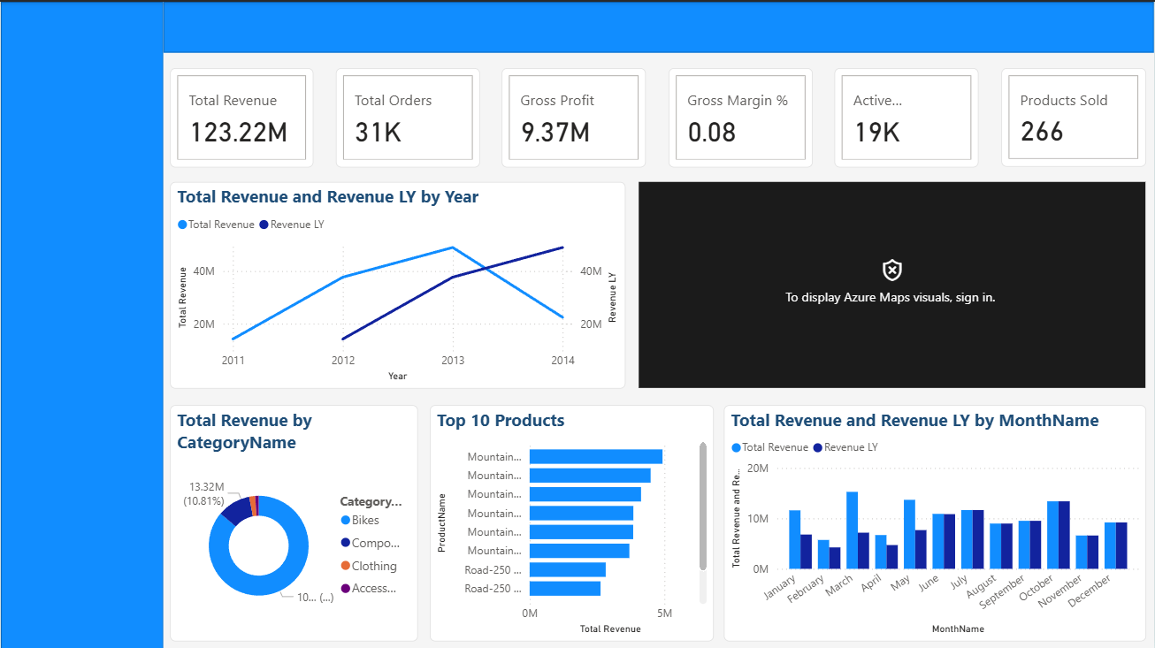

Slide 8
Notes:
page1

Slide 9
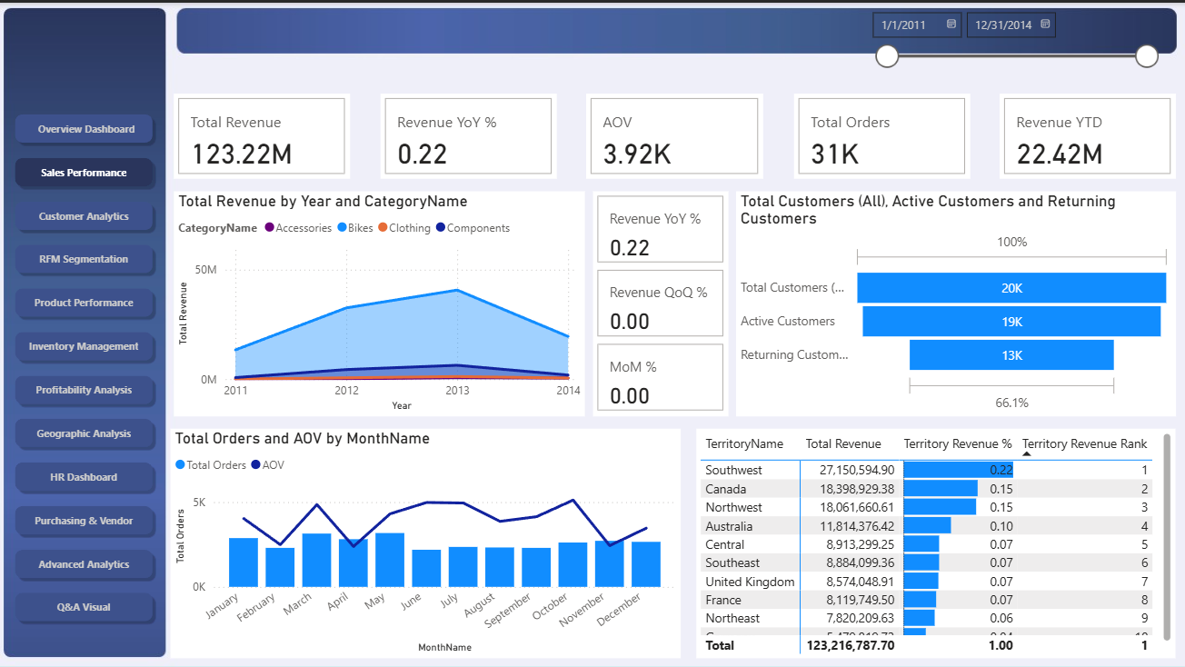

Slide 11
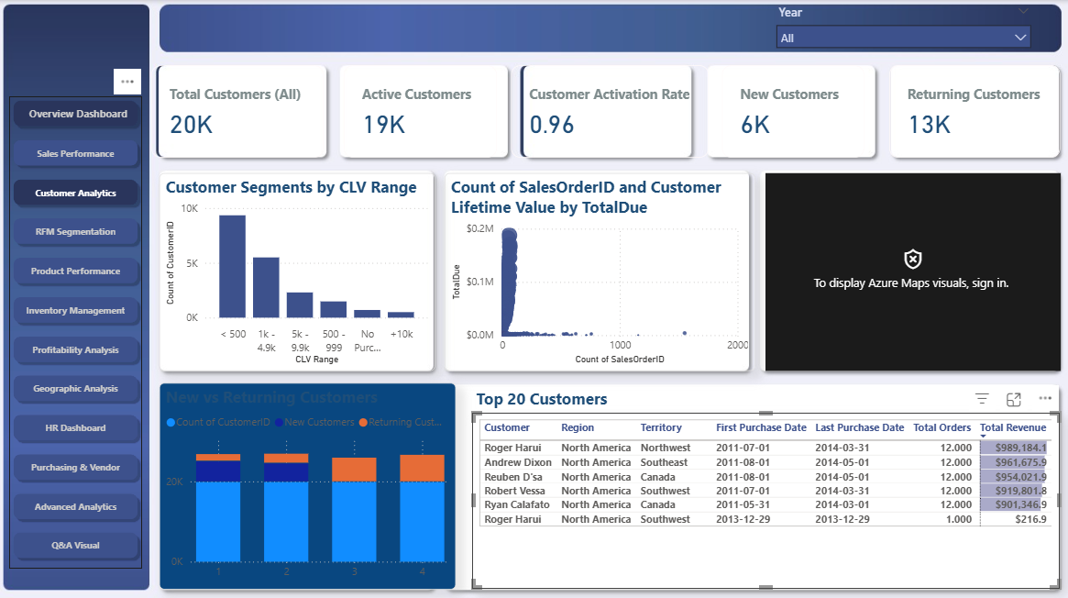

Slide 13
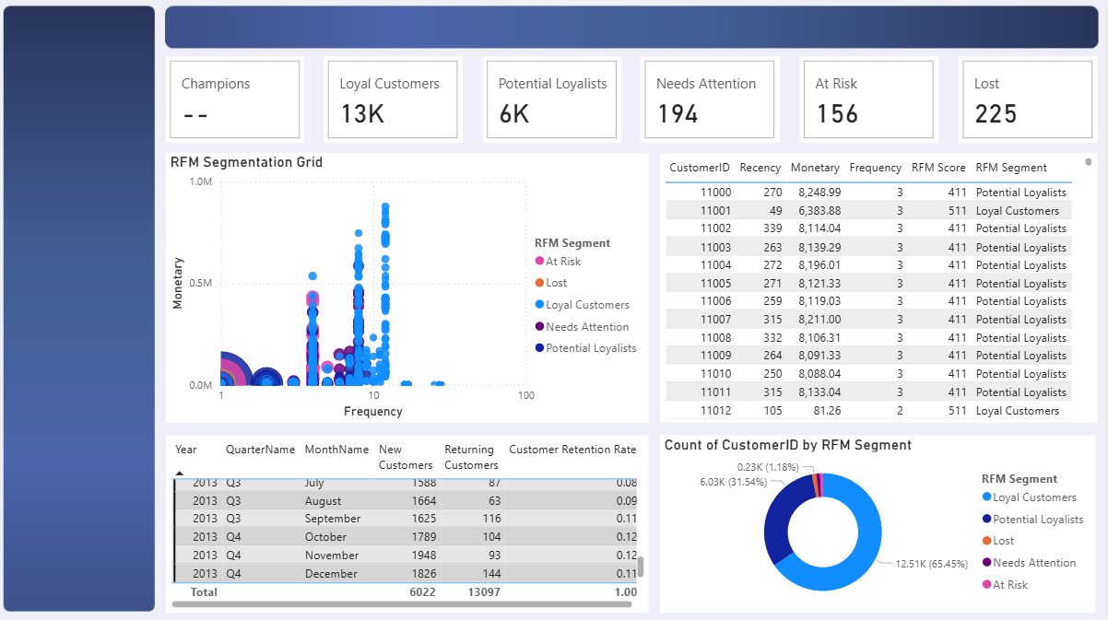

Slide 15
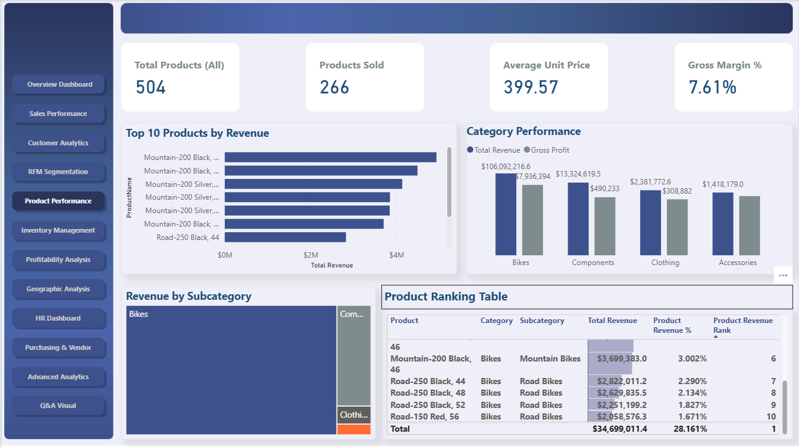

Slide 17
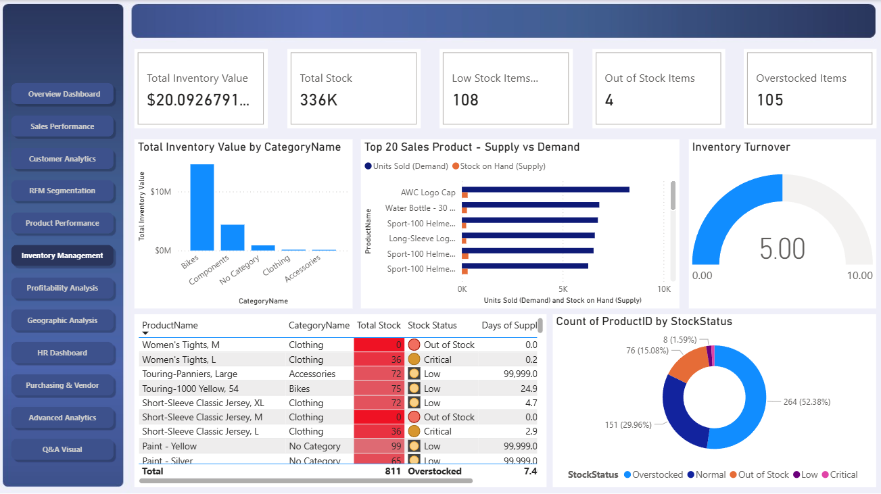

Slide 19
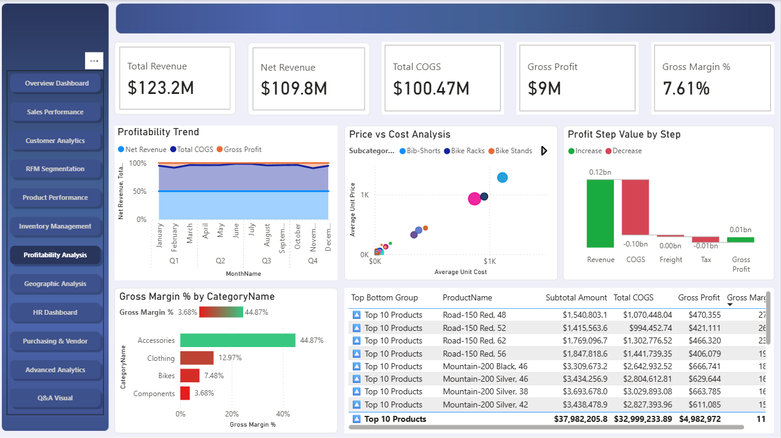

Slide 21
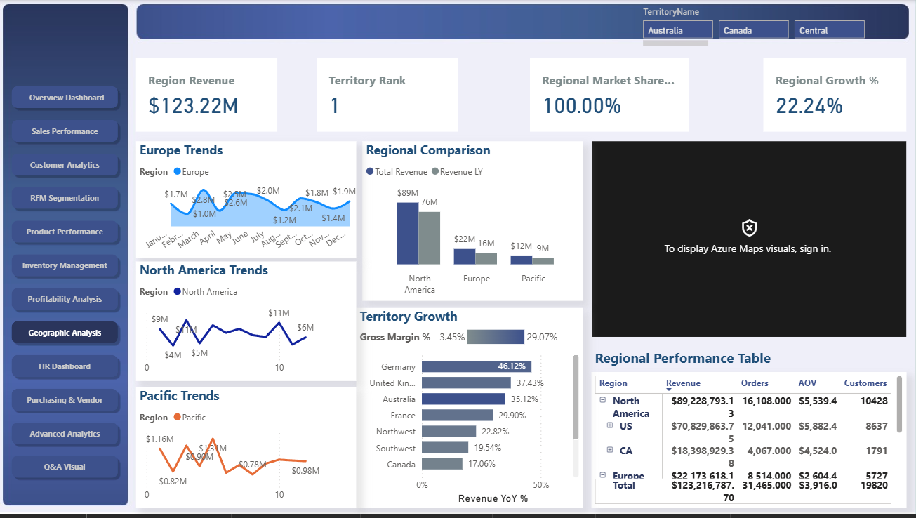

Slide 23
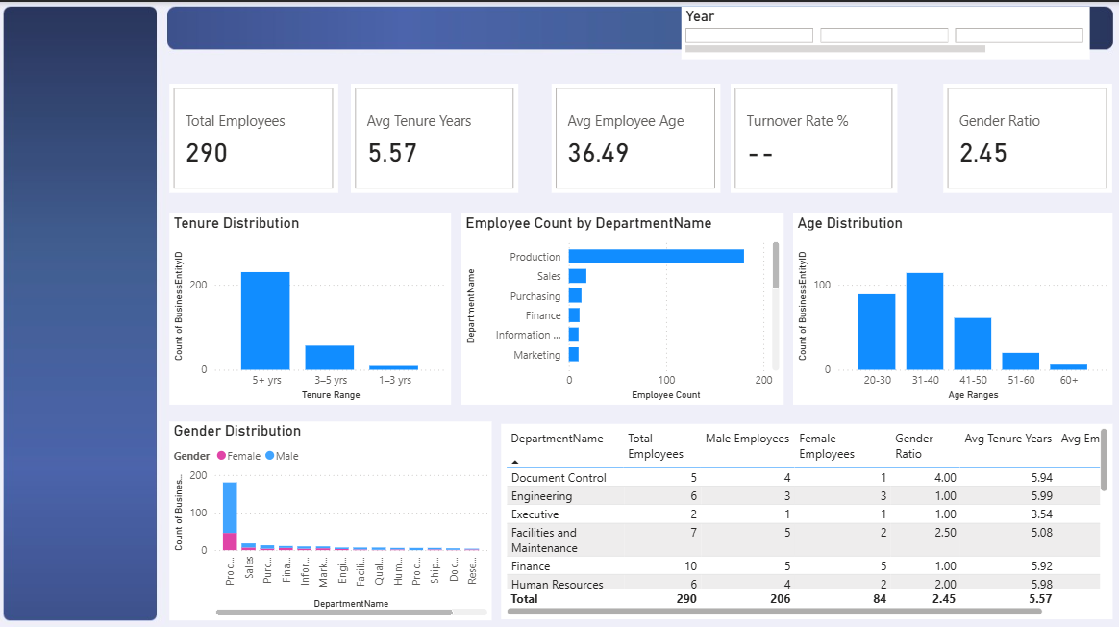

Slide 25
