Slide 1
Floorplanning
Eslam A. Soliman

Slide 2
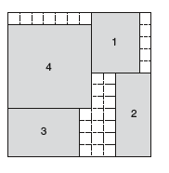
Objective
Minimize for Area

Slide 3

Assumptions
All dimensions are integers.
The core area is a perfect square.
Side = Max(width, height)

Slide 4
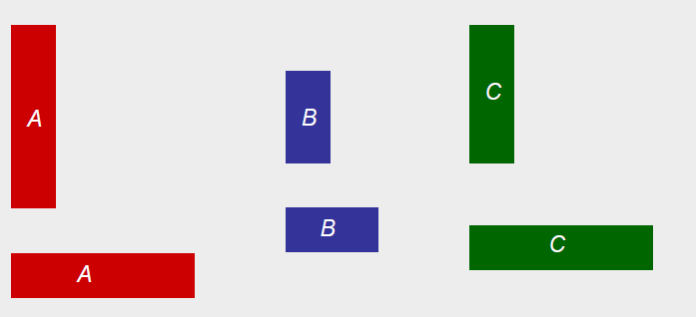
Block Types
Hard Blocks
Fixed height & width (may rotate).
Example
Given: Three blocks with the following widths and heights
Block A: w = 1, h = 4 or w = 4, h = 1
Block B: w = 1, h = 2 or w =2, h = 1
Block C: w= 1, h = 3 or w =3, h = 1

Slide 5
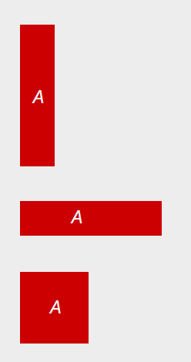
Block Types
Soft Blocks
Fixed Area (variable height and width).
Example
Block A: w = 1, h = 4 or w = 4, h = 1 or w =2, h = 2

Slide 6
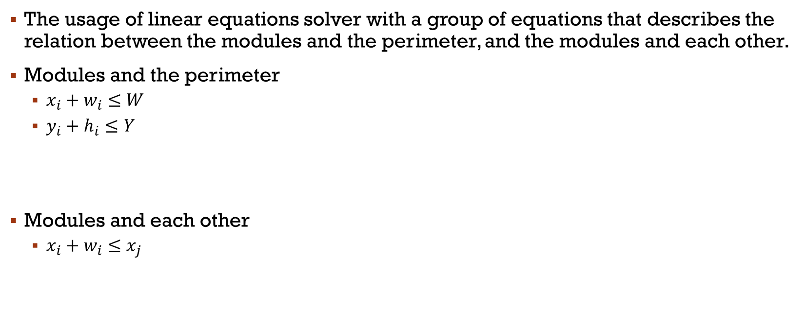
Methodology
The usage of linear equations solver with a group of equations that describes the relation between the modules and the perimeter, and the modules and each other.
Modules and the perimeter
$x_{i}+w_{i}≤W$
$y_{i}+h_{i}≤Y$
Modules and each other
$x_{i}+w_{i}≤x_{j}$

Slide 7
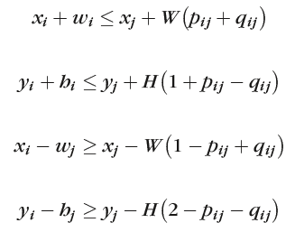
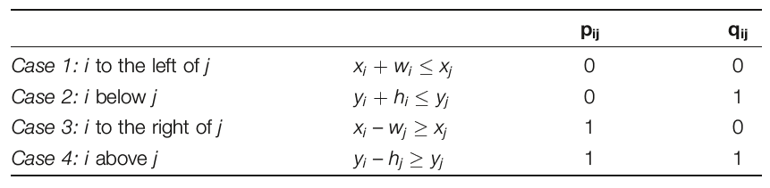
Non-overlapping
It is defined by the equations of the relation between the modules and each other.
The relation between each 2 modules can be defined by 4 equations, only one of them is enforced.
This is done using two binary variables that define the state of the 2 modules.

Slide 8

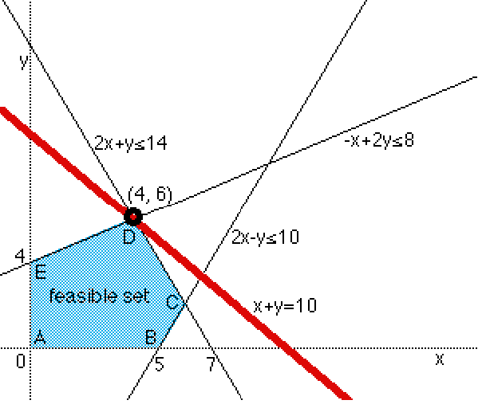

Linear Programming
Using the equations, and via the help of a linear programming solver. We can reach a common solution for the equation while trying to optimize for certain variable.
For example: Y

Slide 9
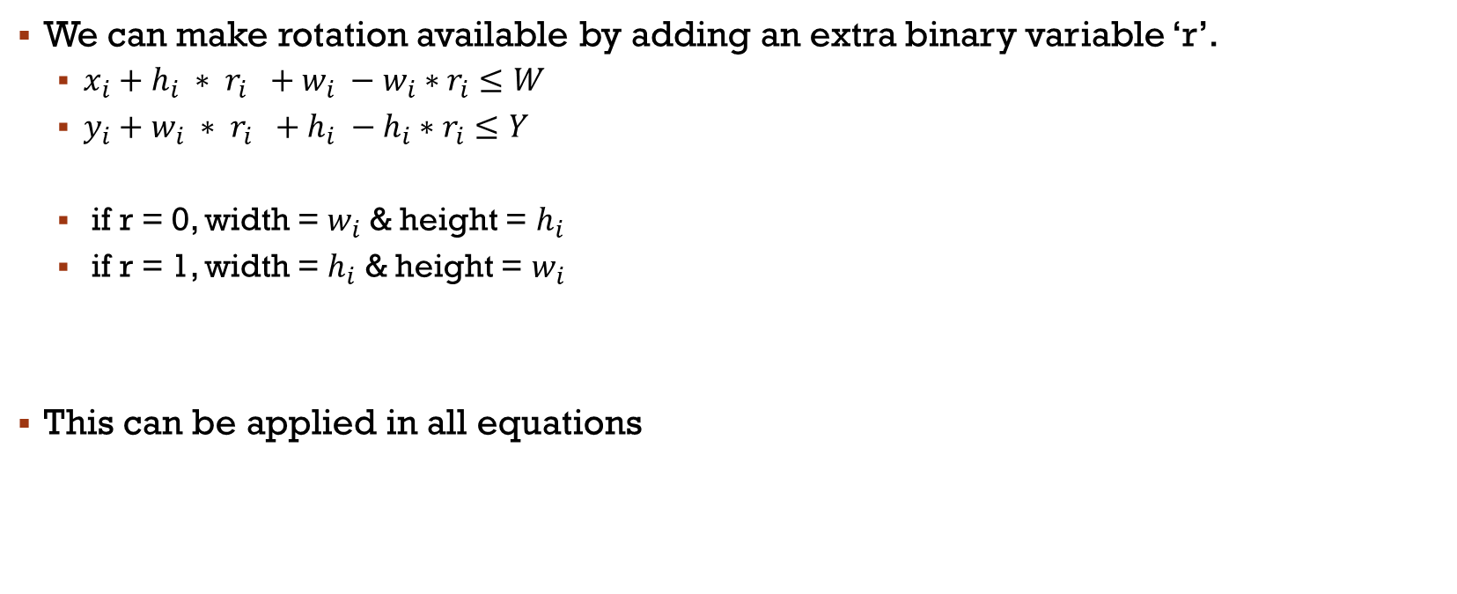
Rotation
We can make rotation available by adding an extra binary variable ‘r’.
$x_{i}+h_{i} ∗ r_{i} +w_{i} −w_{i}∗r_{i}≤W$
$y_{i}+w_{i} ∗ r_{i} +h_{i} −h_{i}∗r_{i}≤Y$
if r = 0, width = $w_{i}$ & height = $h_{i}$
if r = 1, width = $h_{i}$ & height = $w_{i}$
This can be applied in all equations

Slide 10
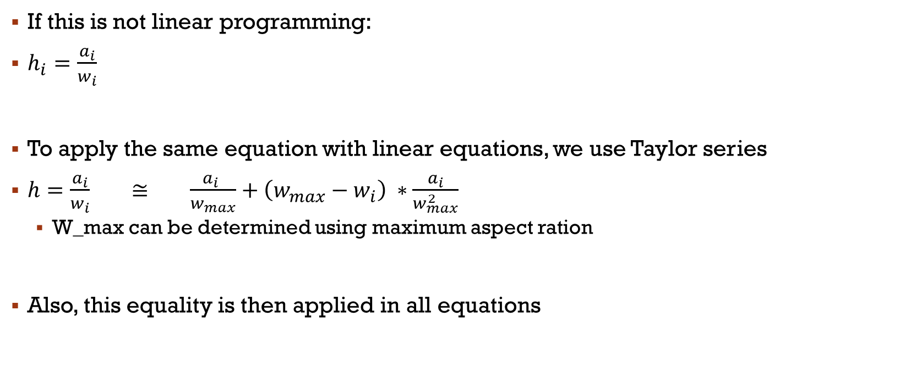
Soft Modules
If this is not linear programming:
$h_{i}=\frac{a_{i}}{w_{i}}$
To apply the same equation with linear equations, we use Taylor series
$h=\frac{a_{i}}{w_{i}} ≅ \frac{a_{i} }{w_{max}}+\left(w_{max}−w_{i}\right) ∗\frac{a_{i}}{w_{max}^{2}}$
W_max can be determined using maximum aspect ration
Also, this equality is then applied in all equations

Slide 11
Equation file exmaple
Hard module 1: width = 3, height = 5
Hard module 2: width = 4, height = 4
Soft module 3: area = 32, Max aspect ration = 4

Slide 12
