Slide 1

AI312: Reasoning and Knowledge Representation
Facial Recognition Mini-Project
June 2021

Slide 2
Eslam Nasser Abdelqader | 20180047
Ahmed Mohamed Abdel-Rashied | 20180028
Ahmed Rushdi El-Kilany | 20180008

Slide 3
Outputs: Facial expression containing:
Anger
Disgust
Sad
normal
Happy
Surprise
Fear

Slide 4
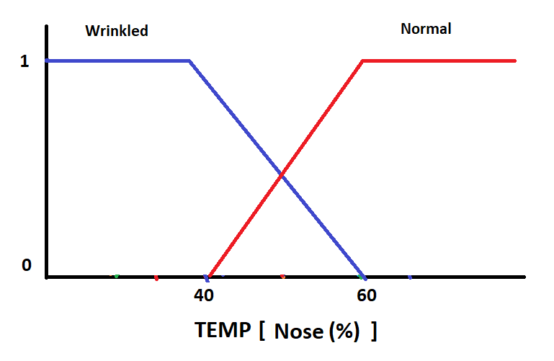

Slide 5
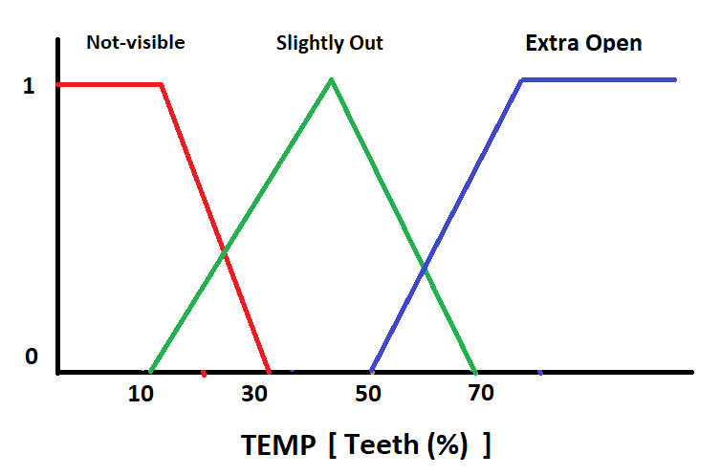

Slide 6
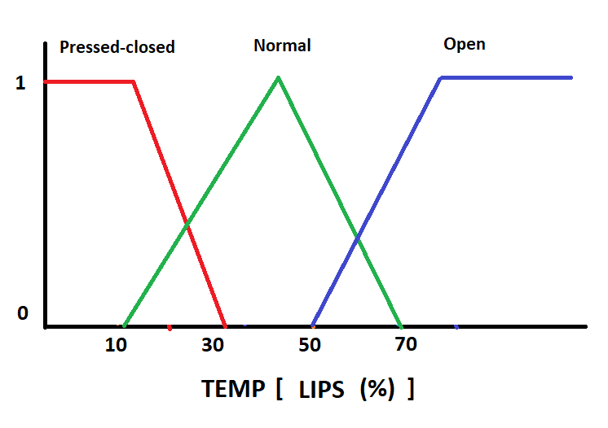

Slide 7
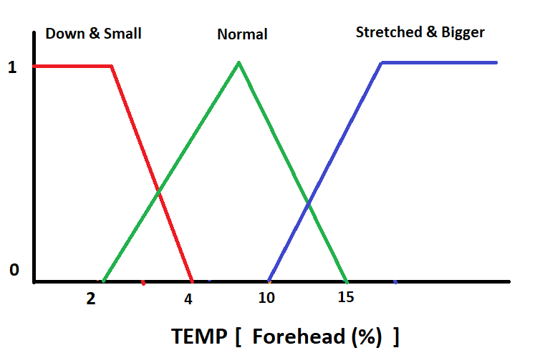

Slide 8
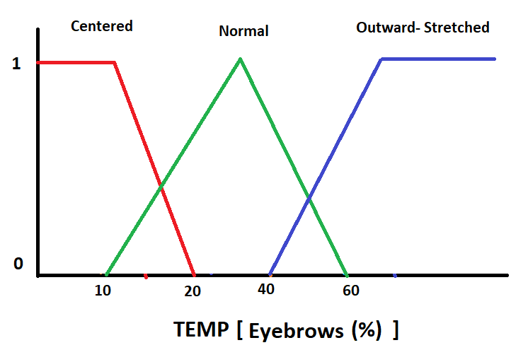

Slide 9
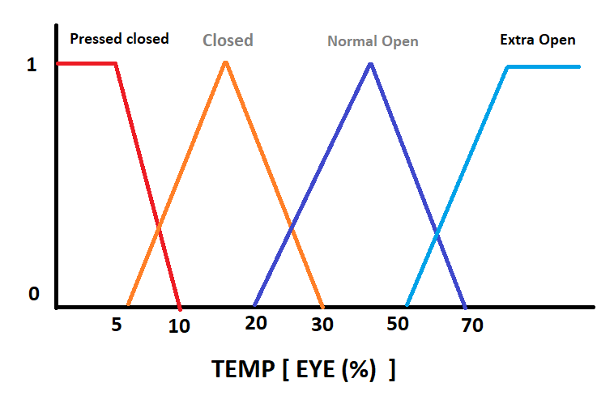

Slide 10
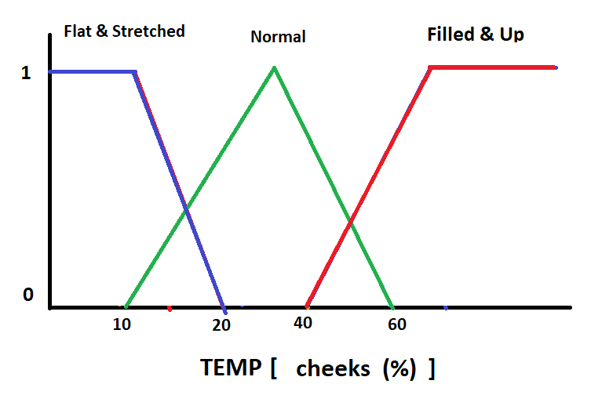

Slide 11
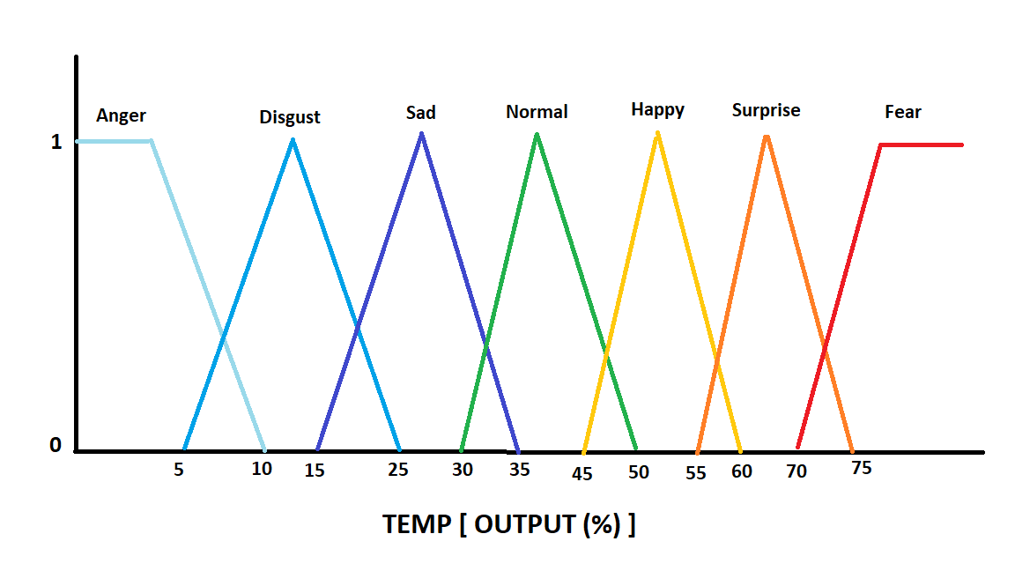

Slide 12
Knowledge base content/rules:
If cheeks Up ˄ Teeth Slightly Out ˄ Lips open Then Happy
If Eyebrows Centered ˄ Lips Normal ˄ cheeks Flat Then Sad
If Eyebrows Centered ˄ Lips Pressed-closed ˄ cheeks Flat ˄ Teeth Not-visible Then Angry
If Eye extra open ˄ Lips open ˄ Eyebrows Outward- Stretched Then Surprise
If Eyebrows Normal ˄ Lips Normal ˄ cheeks Flat ˄ Eye Normal open Then Normal
If Eyebrows Centered ˄ cheeks Up ˄ nose wrinkled Then Fear
If Eyebrows Centered ˄ cheeks Up ˄ nose wrinkled Then Disgust

Slide 13

defuzzification
$$x=\frac{\sum{variable value∗varible mean}}{\sum{variable value}}$$

