Slide 1
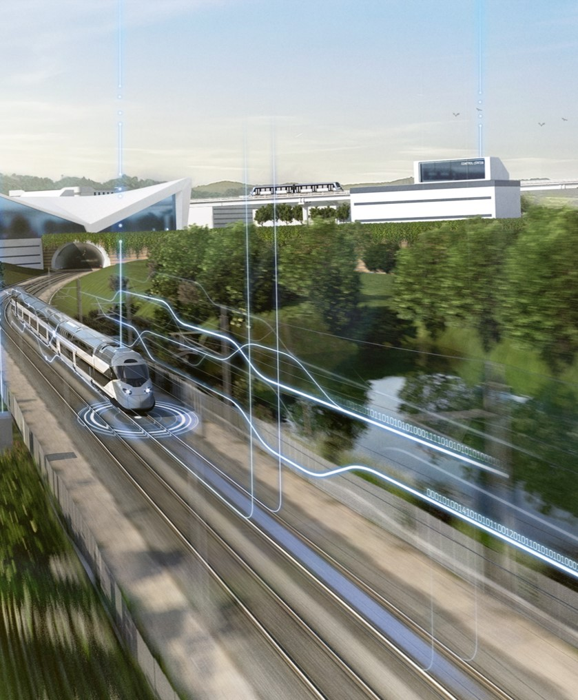
Pedal Cabinets for Railway Signalling Systems
Eslam Gamal
July 2026

Slide 2
Agenda
Introduction
System Architecture
Main Components
Cabinet Layout
Drawing Process
Key Advantages
Conclusion

Slide 3
01
Pedal Cabinet Overview in Railway Signaling Systems

Slide 4

Pedal Cabinet Overview in Railway Signaling Systems
The pedal cabinet is a field-side signaling enclosure associated with track-mounted train detection equipment. It provides the interface between the field detection devices and the downstream signaling or control system.
Within the system architecture, the pedal cabinet serves as the point where field wiring, power distribution, surge protection, and signal interfacing are brought together in an organized arrangement.
Its role is to receive the field-side connections, route them through the required internal components, and transfer the corresponding status information to the control equipment.

Slide 5
02
System Architecture

Slide 6
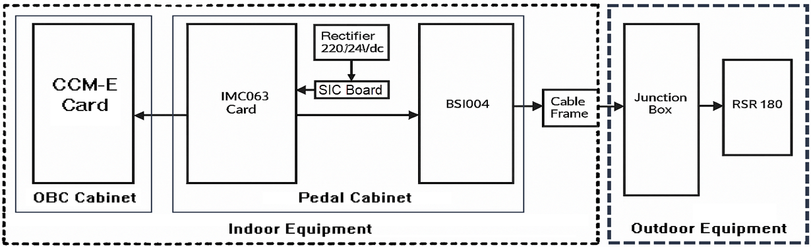
System Architecture
The diagram below shows a top view of the interface architecture between the outdoor detection equipment, the IMC063 evaluation card, and the vital input card CCM-E.
System Architecture for Pedal Cabinet

Slide 7
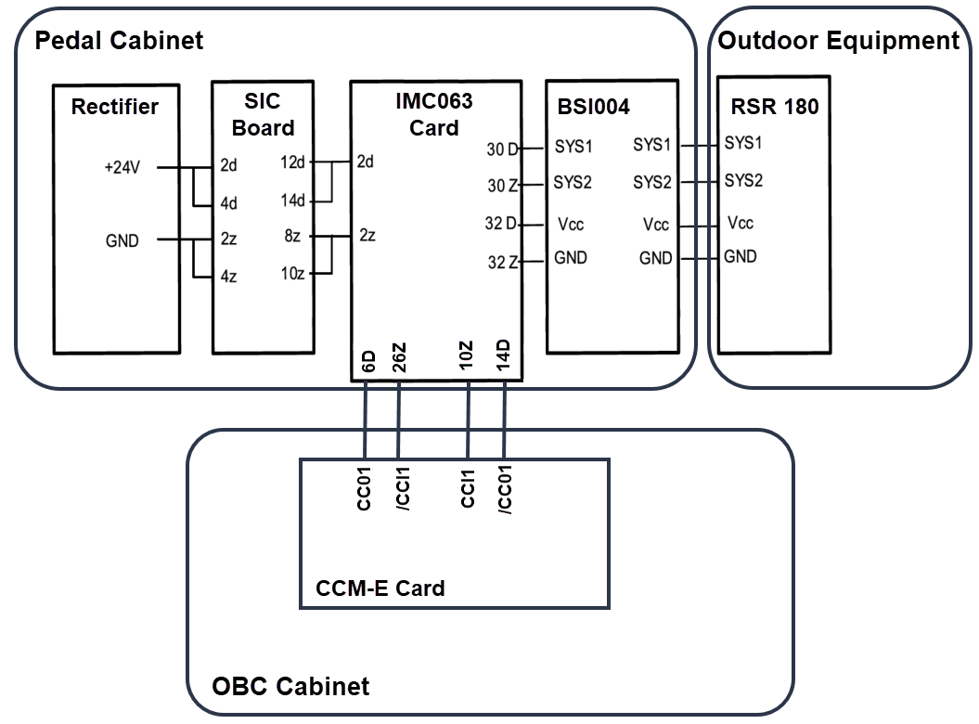
Pedal Cabinet Connection Wiring:

Slide 8
03
Main Components

Slide 9
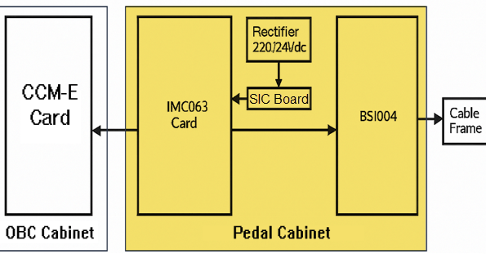
Main Components for Pedal Cabinet:
Functional Object:
IMC063 Evaluation Board:
The IMC063 evaluation board sends different states to the CCM-E controller board according to the axle counter status.
For the PDD Project, the IMC063 evaluation board can be configured for two different application modes depending on the required signaling function:
DA/EP Configuration
Supports Automatic Destruction (DA) and Enclenchement de Proximité (EP) functions.
Used to confirm train presence and determine the train direction, based on Positive Detection Philosophy
AxF/PA Configuration
Supports Auxiliary Closing (AxF) and Passage Announcement (PA) functions.
Used to confirm train absence and verify track clearance after train passage, based on Negative Detection Philosophy
Note: The same IMC063 hardware is used for both applications. The difference lies in the configuration settings and the operational logic required by each signaling function.

Slide 10
Main Components for Pedal Cabinet:
Non-functional Object:
Rectifier:
Transformer unit 220/24V DC.
SIC Board:
The SIC board provides fuse protection for the power supply distributed throughout the system.
BSI004:
BSI004 surge protection board, it prevents any surge in the detector cables from reaching the evaluation board.

Slide 11
Internal Wiring Types
Internal wiring refers to the cables and wires used inside electrical and electronic equipment to provide power and transmit signals between different components.
Within the Pedal Cabinet, three dedicated wiring types are used to establish the electrical connections between the main system components.
Purpose of Internal Wiring
Power distribution within the equipment.
Signal transmission between devices.
Reliable and safe operation.
Easy installation and maintenance.
Within the Pedal Cabinet, three dedicated internal wiring types are used. The following slides present each wiring type and its application.

Slide 12
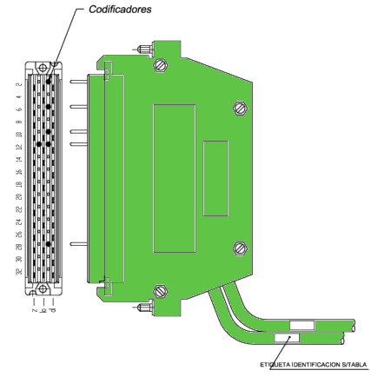
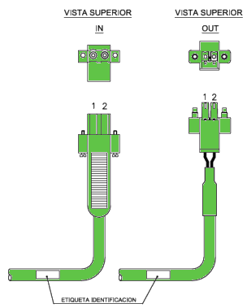
Internal Wiring Types Cont.
Cable Type 1 (MAN0125700) – SIC999 ↔ IMC063
This wiring connection is used to provide the 24 VDC power supply from the SIC999 Board to the IMC063 Evaluation Board.
It forms the power interface required for the operation of the evaluation board and ensures stable and protected power distribution within the Pedal Cabinet.
Application
Internal Power Distribution

Slide 13
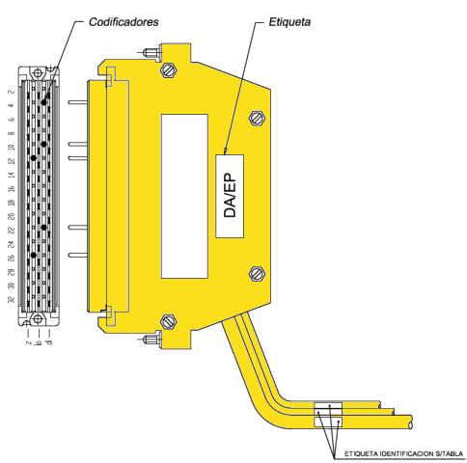
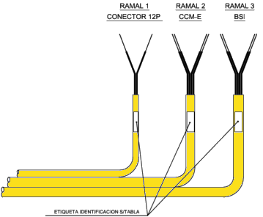
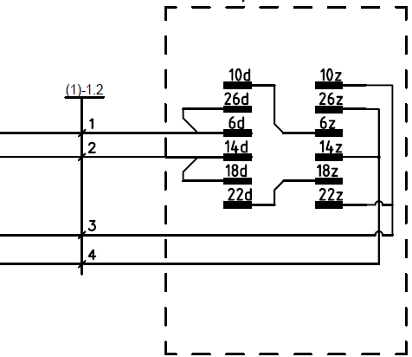
Internal Wiring Types Cont.
Cable Type 2 (MAN0125600) – IMC063 ↔ CCM-E ↔ BSI004 (DA/EP)
This wiring connection is used to transfer train detection status information between the IMC063 Evaluation Board and the CCM-E controller.
It also provides the electrical interface between the IMC063 Evaluation Board and the BSI004 Surge Protection Board.
This configuration is dedicated to DA/EP applications utilizing Positive Detection Philosophy.
Application
DA / EP Configuration
IMC of type DA/EP

Slide 14
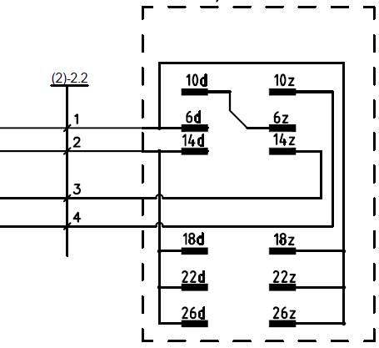
Internal Wiring Types Cont.
Cable Type 3 (MAN0125300) – IMC063 ↔ CCM-E ↔ BSI004 (AxF/PA)
This wiring connection is used to transfer train detection status information between the IMC063 Evaluation Board and the CCM-E controller.
It also provides the electrical interface between the IMC063 Evaluation Board and the BSI004 Surge Protection Board.
This configuration is dedicated to AxF/PA applications utilizing Negative Detection Philosophy.
Application
AxF / PA Configuration
IMC of type AxF/PA

Slide 15
04
Cabinet Layout

Slide 16
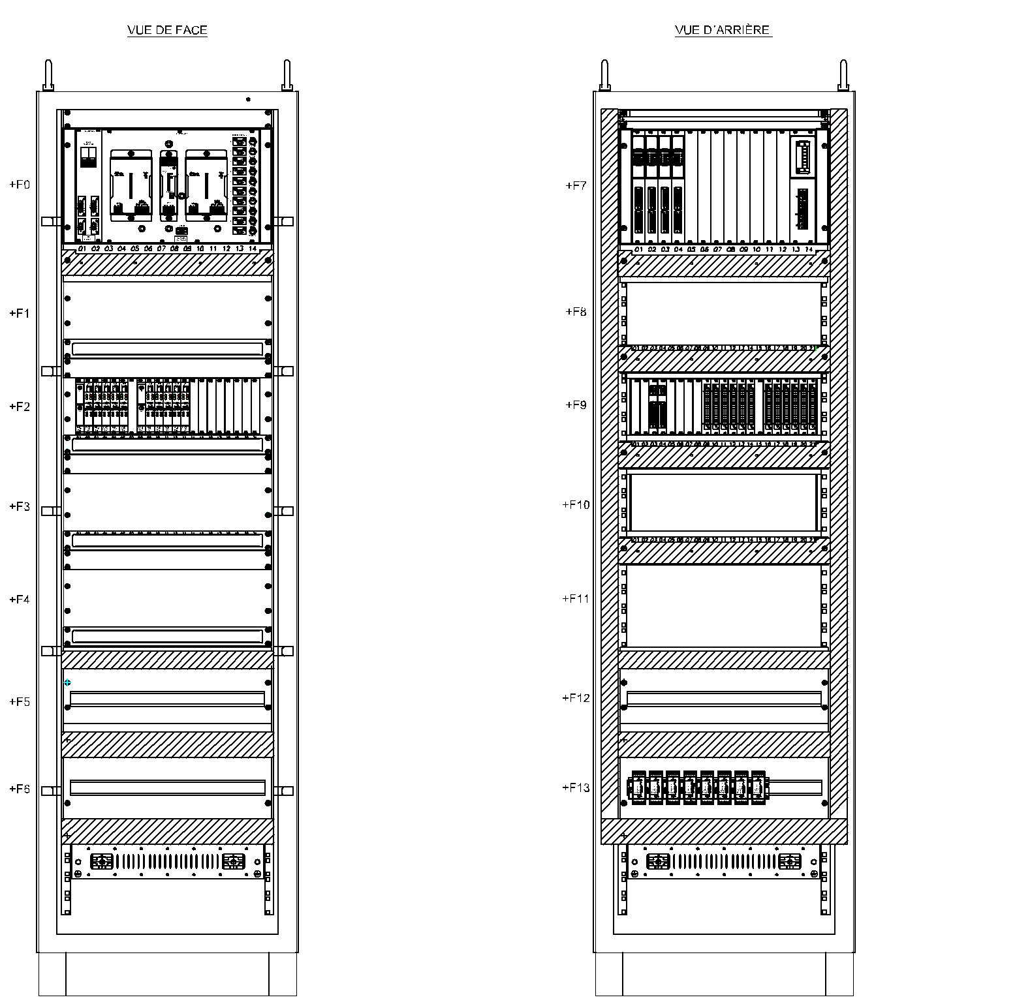
Cabinet Layout
2
8
+F0:
1- Protection Unit.
2- Rectifier Unit.
3- Redundancy Unit.
4- Fuses Block.
1
4
+F7:
7- Terminal Power Supply
8- Terminal Block
+F0
+F7
7
3
+F1
+F8
6
9
+ F2
+F9
+F9:
9- SIC Board.
10- IMC063 Cards.
5
10
+F3
+F10
+F2:
5- Power Supply Board
6- Evaluation Board AEB.
+F4
+F11
+F5
+F12
11
+F13:
11- BSI004 Cards
+F6
+F13
AEB: Advanced Evaluation Board

Slide 17
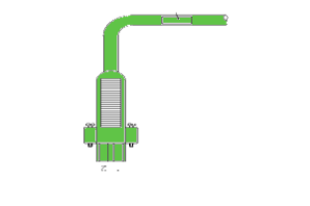
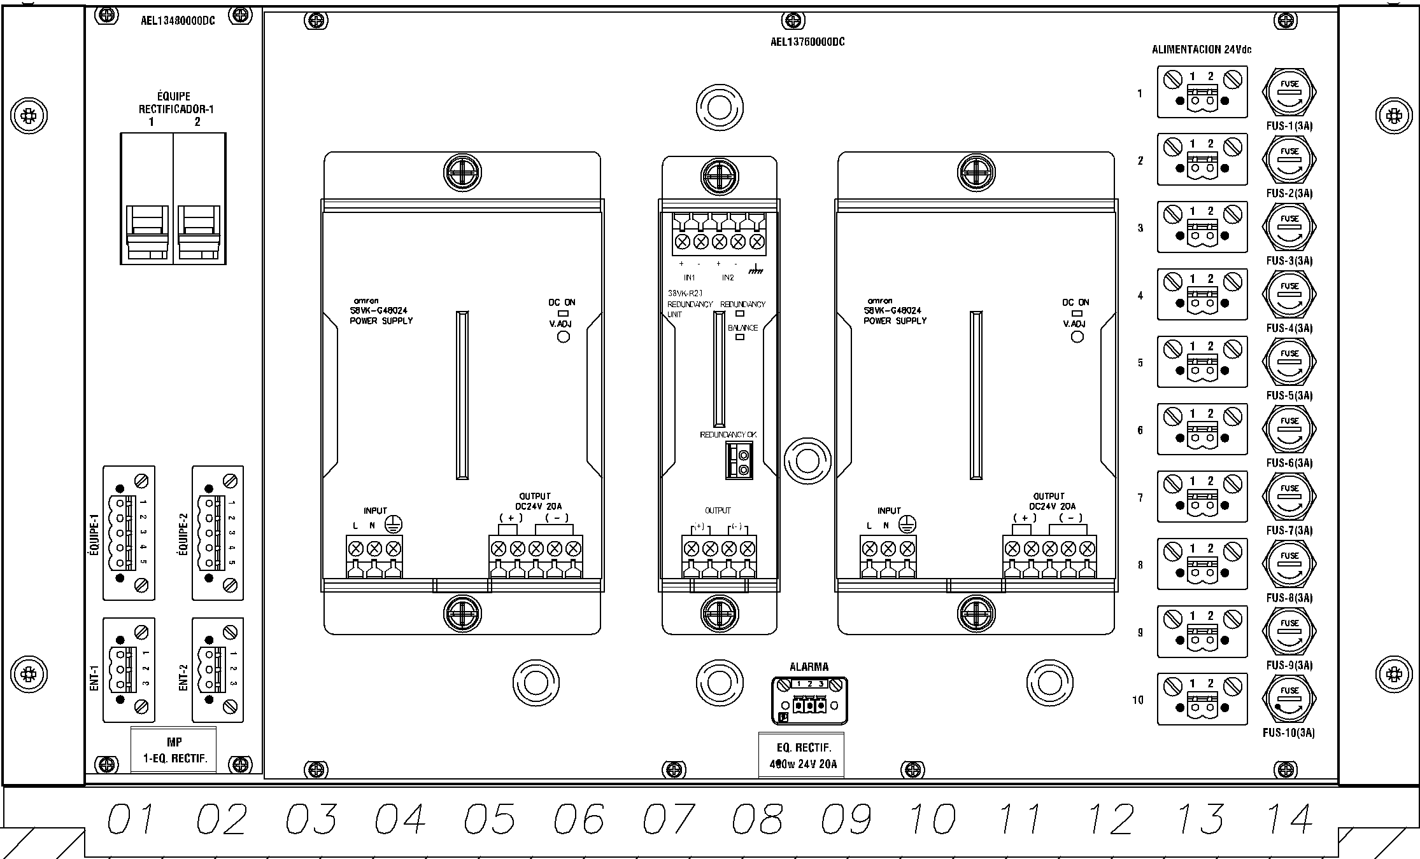
F0 Layout
2
Connector 2P ↔ SIC999
1
4
+F0:
1- Protection Unit.
2- Rectifier Unit.
3- Redundancy Unit.
4- Fuses Block
3
:MAN0125700 Cable

Slide 18
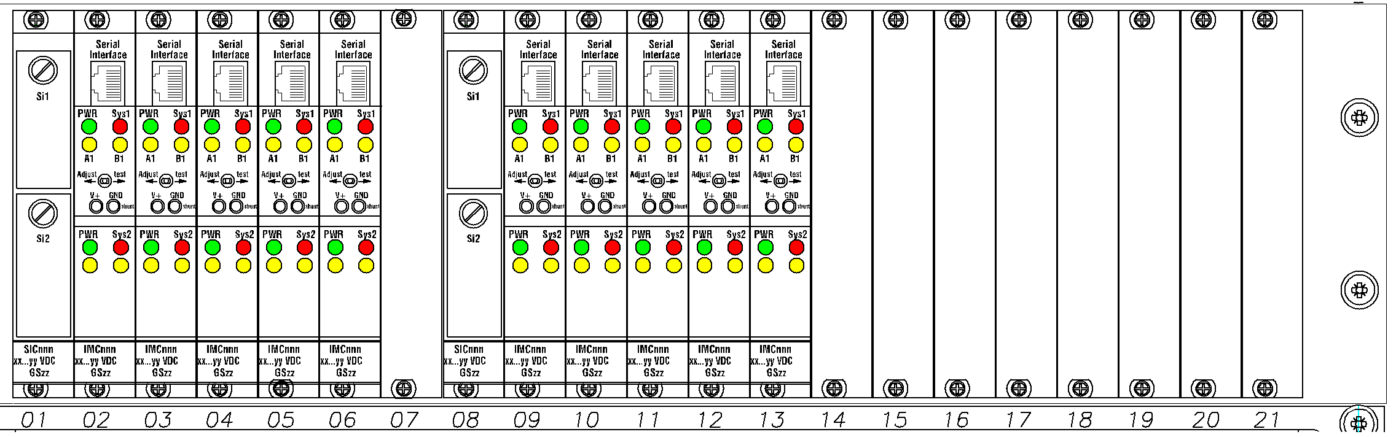
F2 Layout
6
+F2:
5- Power Supply Board
6- Evaluation Board AEB.
5
AEB: Advanced Evaluation Board

Slide 19
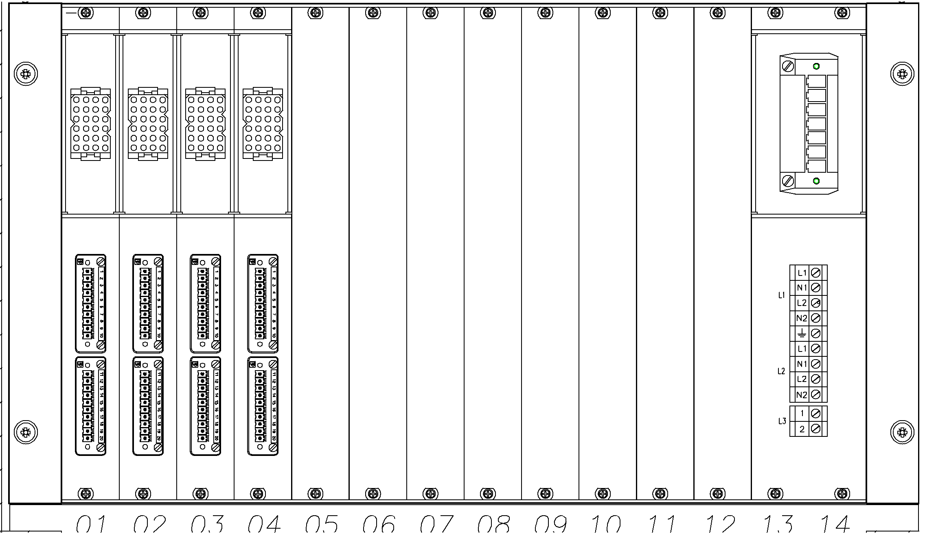
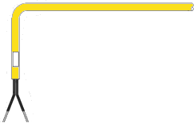
F7 Layout
7
8
:MAN0125600 Cable if DA/EP
OR MAN0125300 Cable if AxF/PA
+F7:
7- Terminal Block
8- Terminal Power Supply
CCM-E ↔ IMC063

Slide 20
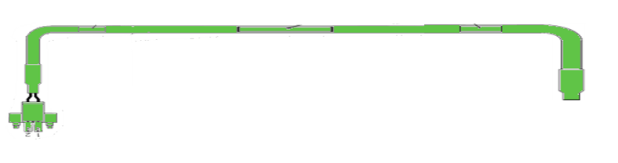
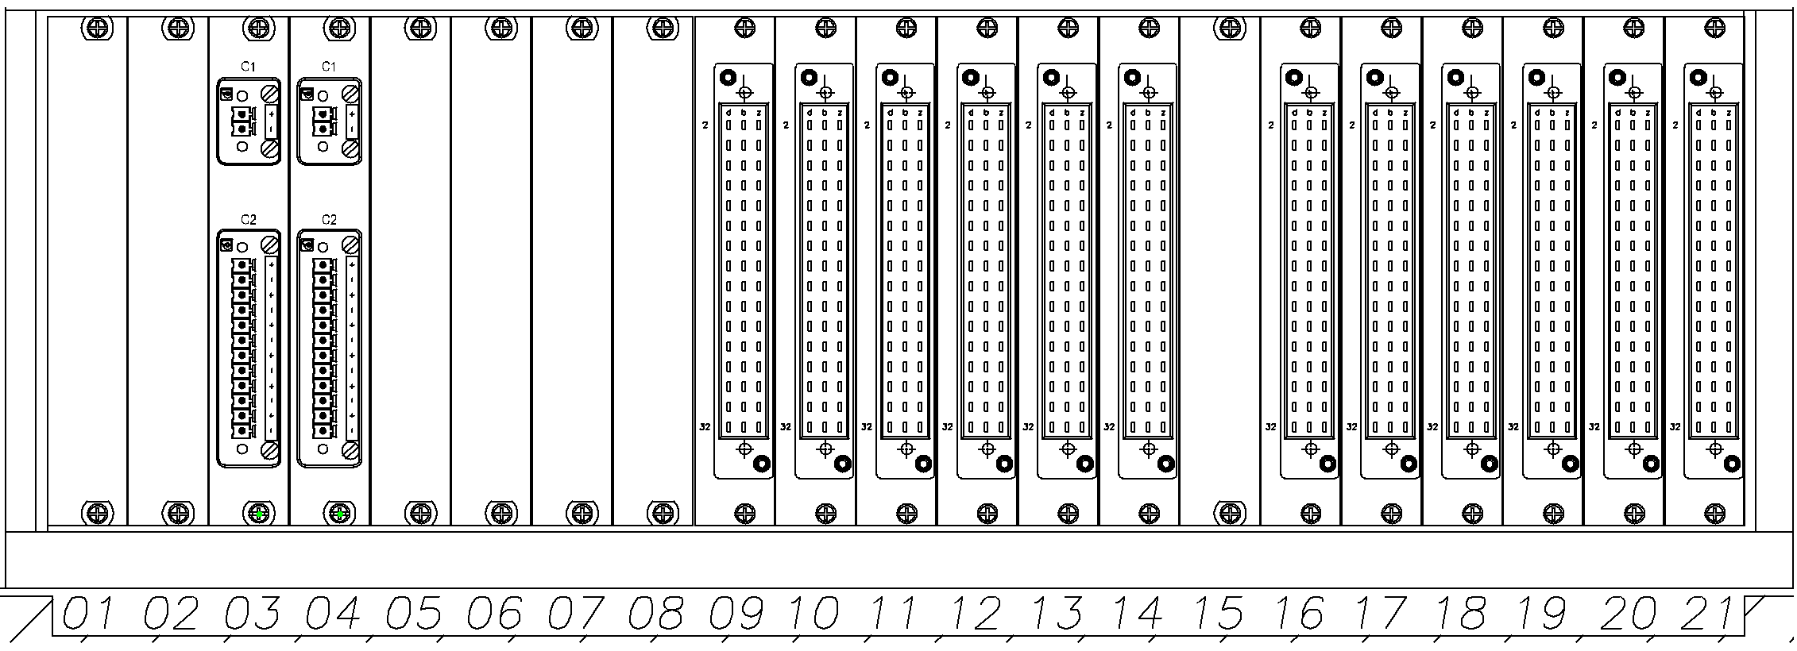
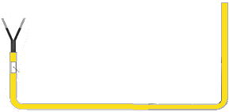
F9 Layout
Connector 2P ↔ SIC999
10
9
+F9:
9- SIC Board.
10- IMC063 Cards.
:MAN0125700 Cable
Connector 12P ↔ IMC063
:MAN0125600 Cable if DA/EP
OR MAN0125300 Cable if AxF/PA

Slide 21
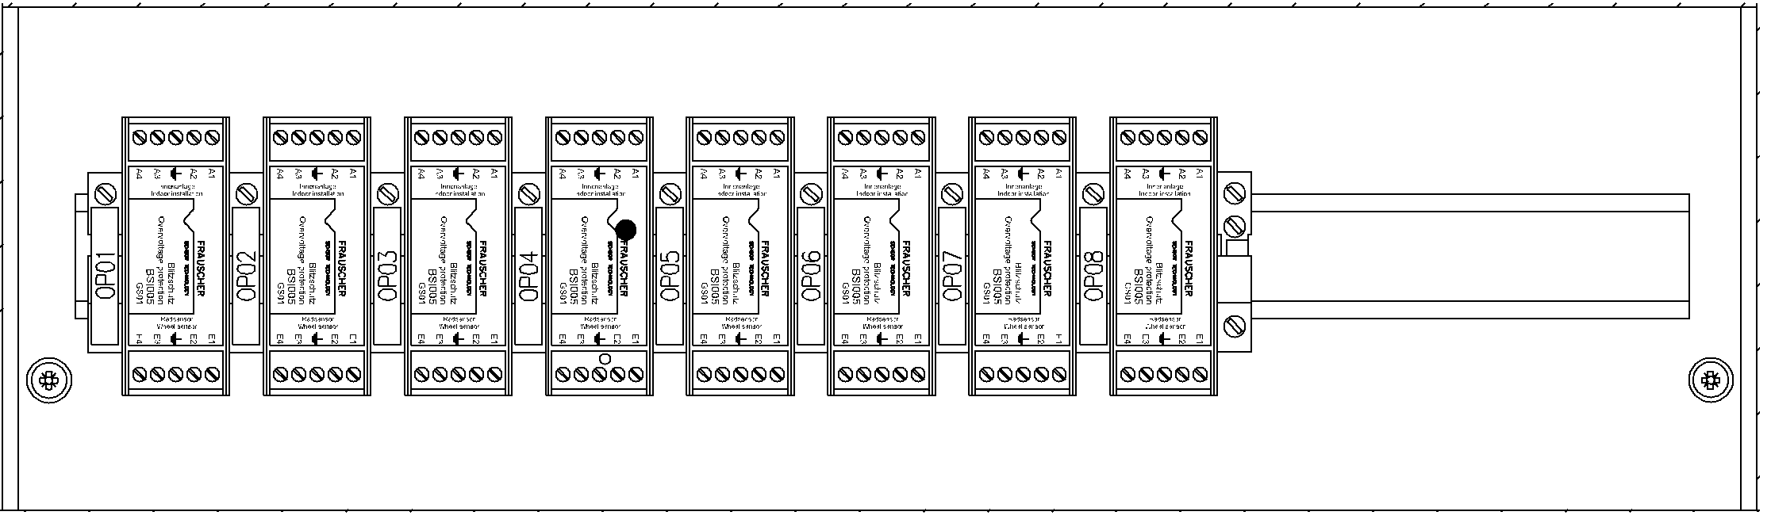
F13 Layout
BSI004 ↔ IMC063
:MAN0125600 Cable if DA/EP
OR MAN0125300 Cable if AxF/PA
11
+F13:
11- BSI004 Cards

Slide 22
05
Drawing Process

Slide 23
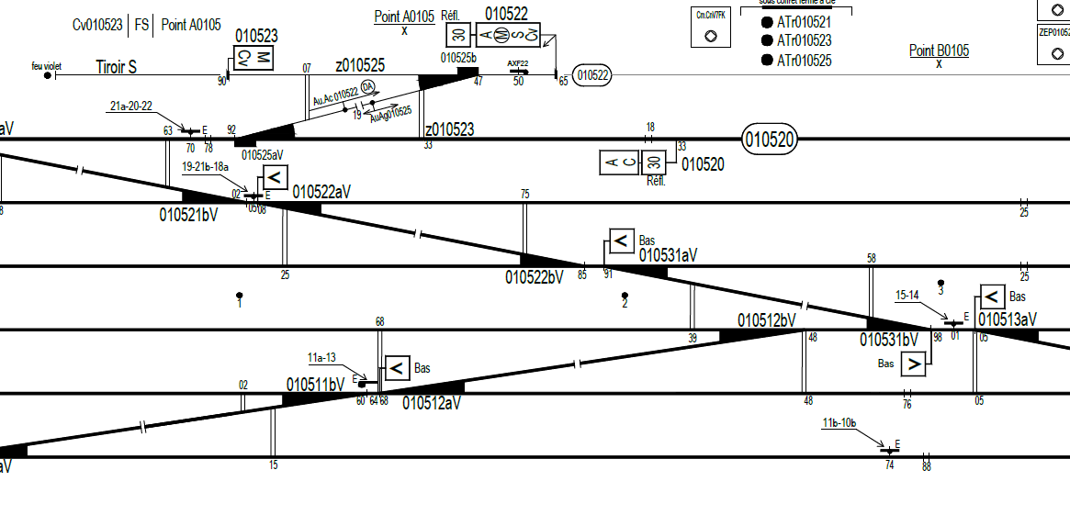
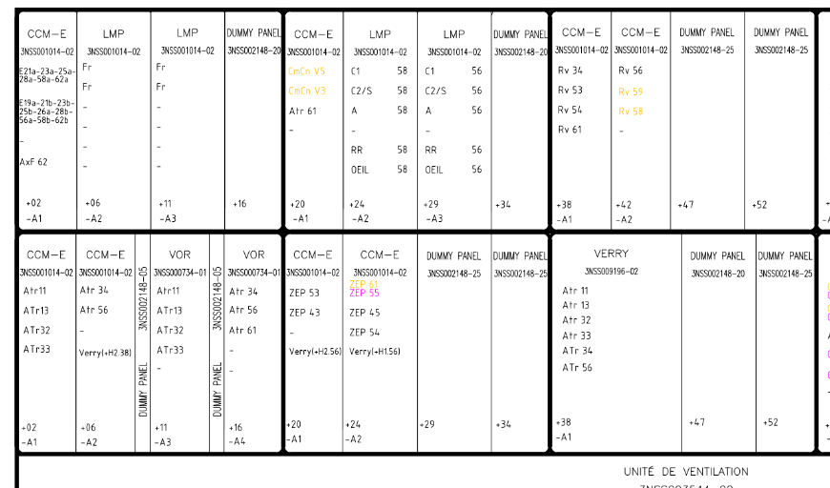
Required Input Documents for Pedal Cabinet Design
Cable Chassis_H53xx.
Used to supply power from the Cable Chassis to the Power Distribution unit.
OBC Drawing_H54xx.
Scheme Plan (PT)
Collected from both existing IMCs and will be utilized in the drawings.
IMC Identification from Scheme Plan
IMC Identification from OBC Drawing

Slide 24
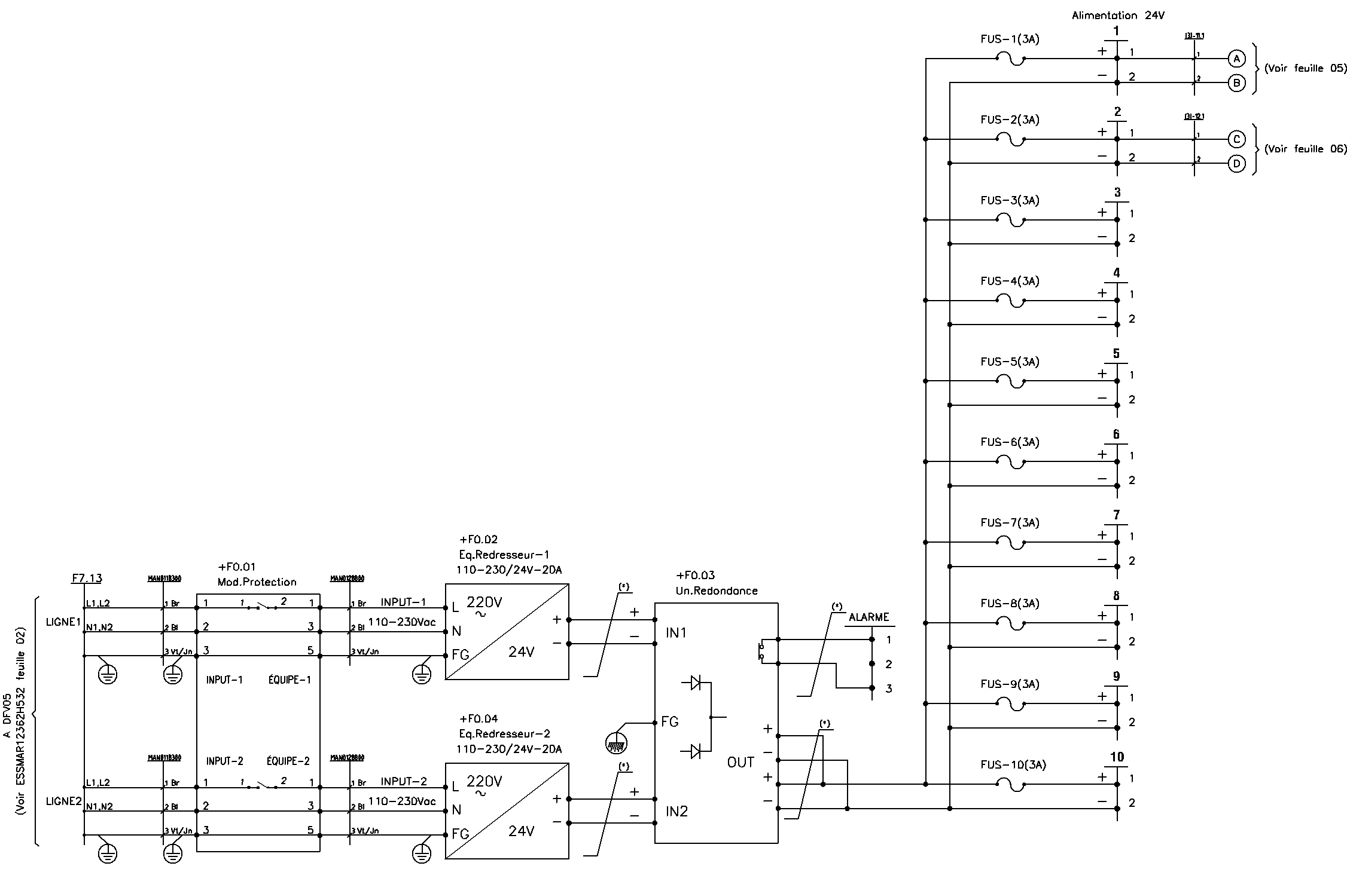
Pedal Cabinet Connections
Two Main Powers (LIGNE 1 and LIGNE 2) Provided from Distribution Almentation Armoier H53X sheet 2, enter to the Pedal Cabinet through Terminal Block at F7.17
Two main Powers pass to the Protection unit at F0.01
Two main Powers pass to the two Rectifiers Units to convert it from 220Vac to 24V DC at F0.02 & F0.04
Two main Powers (24VDC) Pass to Redundancy Unit at F0.03 to Keep the 24 VDC continuously Provided the Cabinet if any one power from 2 power failed
Main Power (24VDC) has ability to Provide Ten SIC cards if needed by 24 VDC through 10 Fuses at F9.13

Slide 25
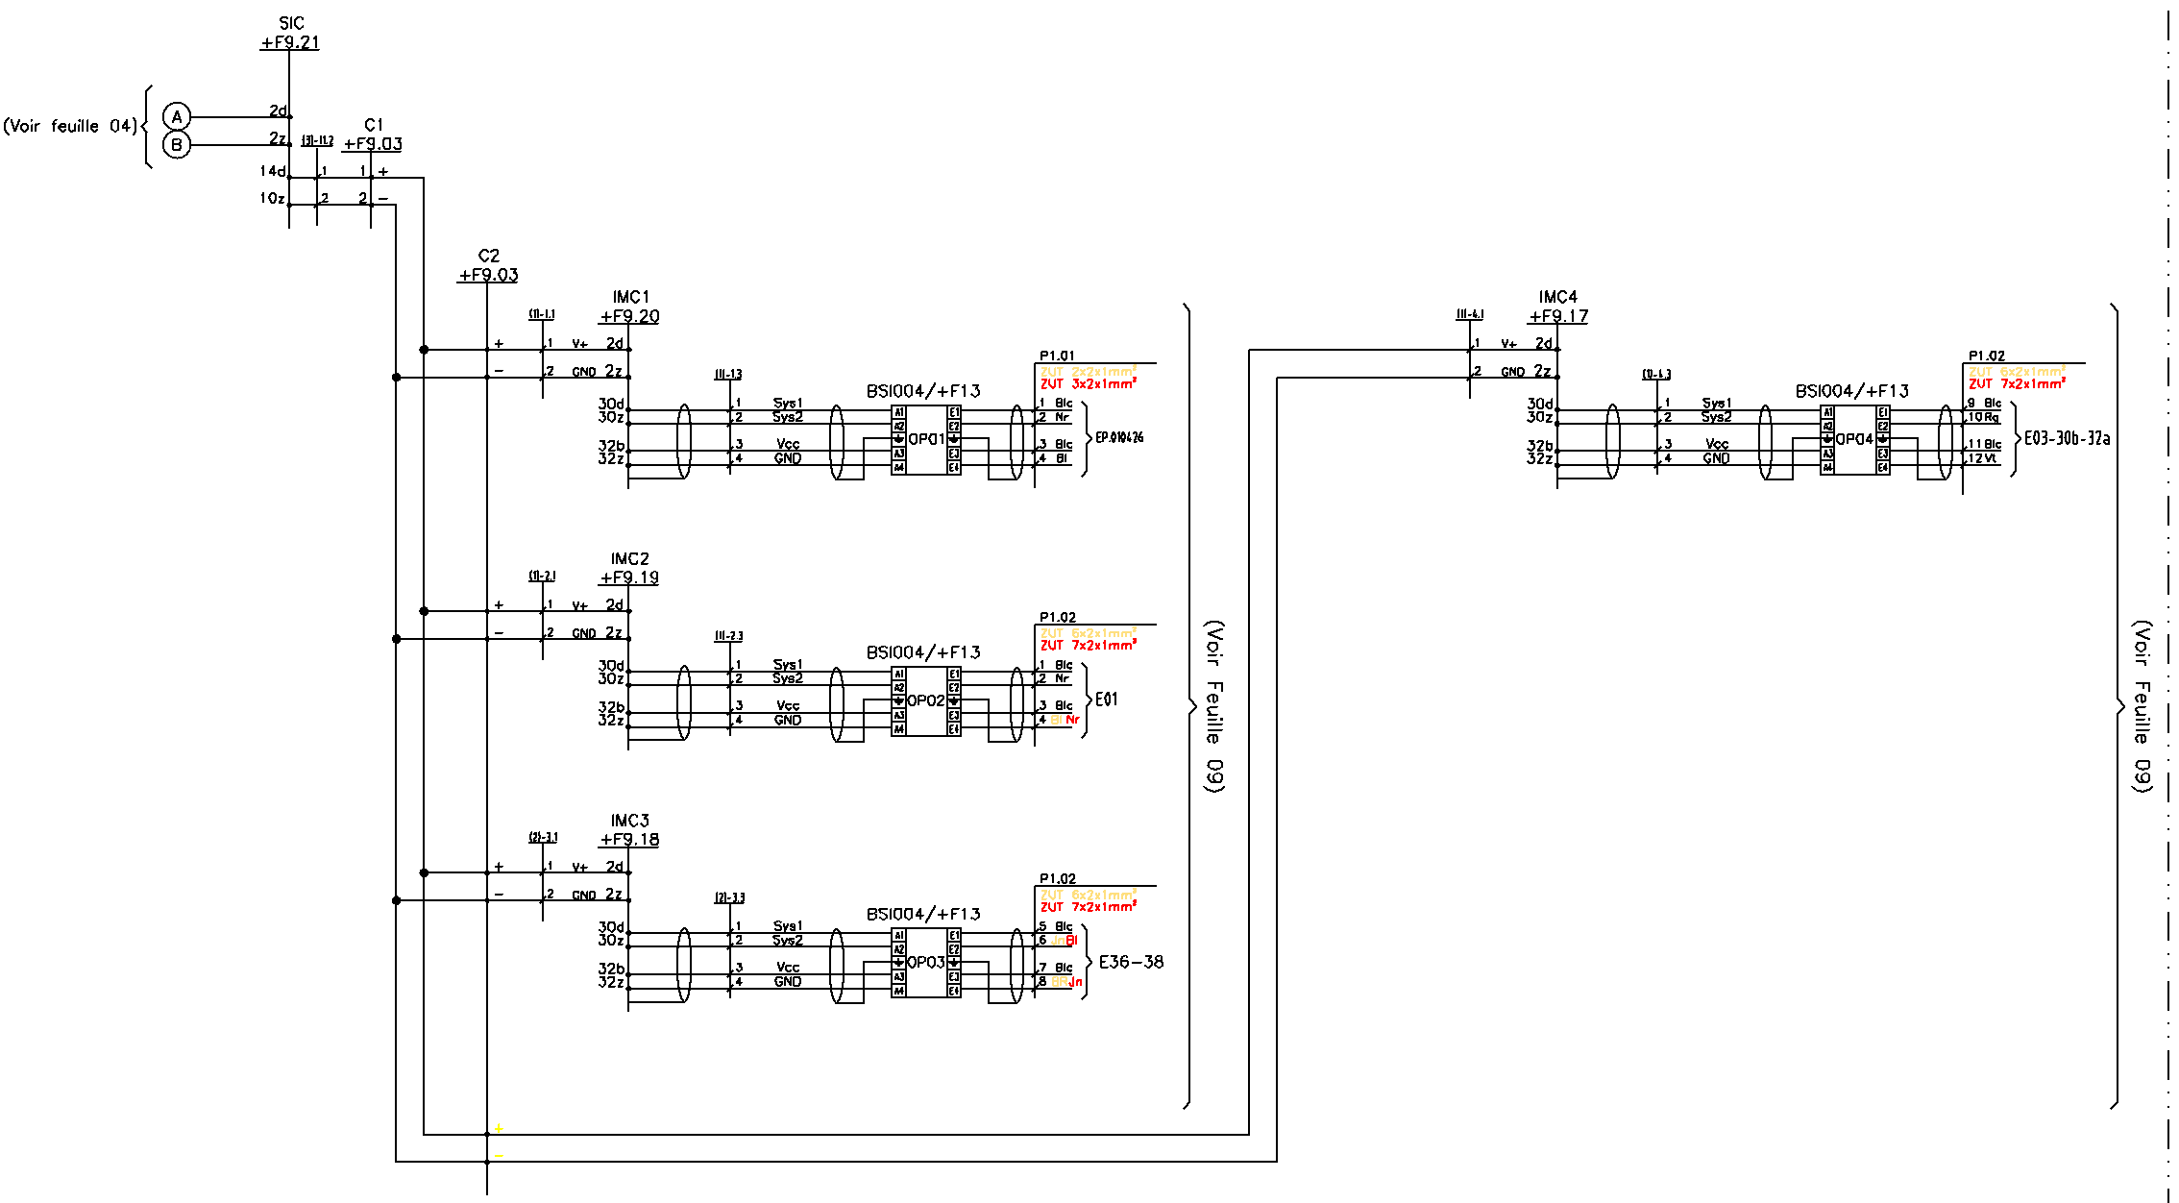
Pedal Cabinet Connections
Each IMC063 card connected to BSI004 surge protection board
The BSI004 connected to the Outdoor Equipment through Armoire and Chassis (out of Pedal Cabinet)
The Pedal Cabinet has ability to contain 10 SIC Board, and each SIC Board can protect 6 IMC063 Card through C1 and C2

Slide 26
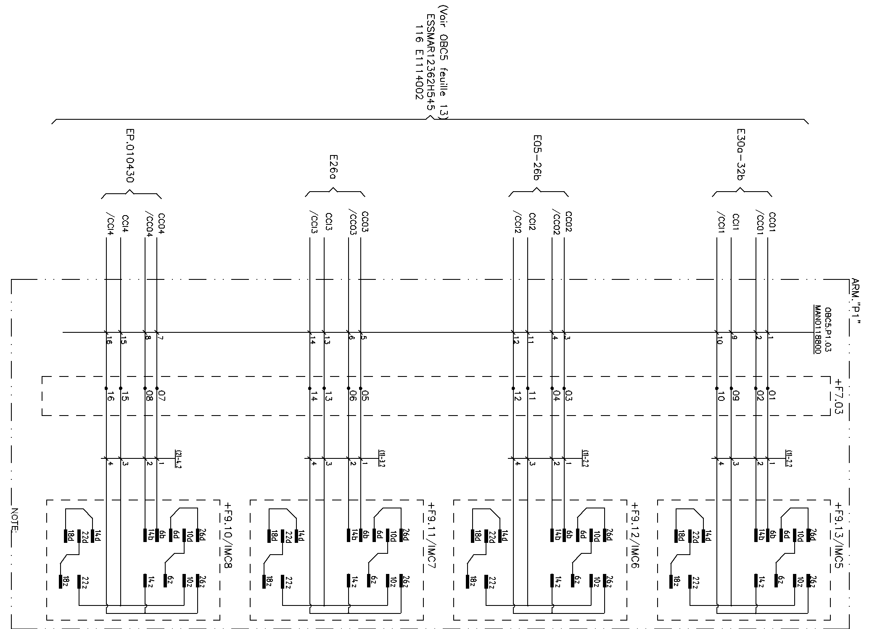
Interface Connection between OBC Cabinet and Pedal Cabinet
IMC063 Cards send different states to the OBC Cabinet (OBC Drawing_H54xx) through Terminal Block F7.03
Out of Cabinet
Inside Cabinet

Slide 27
06
Key Advantages

Slide 28
Key Advantages
The pedal cabinet design combines the required field interface functions in one structured arrangement. Its organization supports proper integration of power, protection, evaluation, and signal transfer functions while also improving clarity during engineering, installation, and maintenance activities.
Clear and structured internal arrangement
Integrated power, protection, and signal interface functions
Improved wiring organization and traceability
Easier inspection, testing, and troubleshooting
Supports multiple power supply arrangements according to project requirements.
Can be powered either from the Cable Chassis or directly from the OBC Cabinet for small-capacity configurations.
Supports a consistent engineering drawing process

Slide 29
07
Conclusion

Slide 30
Conclusion
The pedal cabinet is an important field interface element within the signaling architecture.
It provides the required arrangement for power conversion, protection, signal evaluation, and interfacing between the field detection equipment and the control system.
A structured design approach — starting from input data, followed by architecture definition, layout preparation, and detailed drawings — ensures correct integration of the cabinet within the project.
The presented design methodology ensures consistency, maintainability, and compliance with project requirements.
It supports safe, reliable and maintainable railway operations across the Morocco Project.

