Slide 1

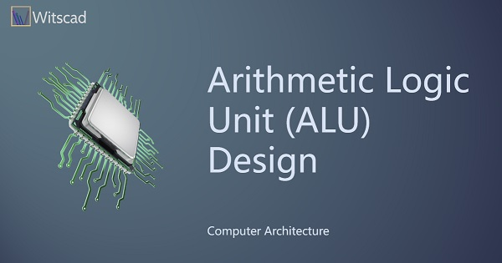
FACULTY OF ENGINEERING Helwan UNIVERSITY
Junior Mechatronics Eng. Program
Logic Design
Arithmetic Logic Unit (ALU ) Project
Name: Eslam Ahmed Ali
Department: Mechatronics
Supervisor: Dr Azza Anis

Slide 2
FACULTY OF ENGINEERING Helwan UNIVERSITY
Junior Mechatronics Eng. Program
Brief about ALU and its applications
An Arithmetic Logic Unit (ALU) is a fundamental component of a computer's central processing unit (CPU) responsible for performing arithmetic and logic operations on binary data. It is a combinational digital circuit that executes various mathematical and logical operations needed for processing data.
Here's a brief overview of ALU and its applications:
Arithmetic Operations:
1-Addition: ALUs can add two binary numbers, including handling carry bits.
Subtraction: By using techniques like two's complement, ALUs can perform binary subtraction.
Multiplication: ALUs can be designed to execute multiplication operations using algorithms like Booth's algorithm.
Division: ALUs can also handle binary division operations.
2-Logical Operations:
AND, OR, XOR: ALUs perform logical operations on corresponding bits of binary operands.
NOT: ALUs can invert individual bits of a binary number.
3-Shift Operations:
ALUs can perform left and right shift operations, shifting the bits of a binary number by a specified number of positions.
4-Comparison Operations:
ALUs can compare two binary numbers and generate outputs such as equal, greater than, or less than.

Slide 3
FACULTY OF ENGINEERING Helwan UNIVERSITY
Junior Mechatronics Eng. Program
5-Conditional Operations:
ALUs play a crucial role in conditional branching and decision-making within a computer program by determining which instruction to execute based on certain conditions.
6-Fixed-Point and Floating-Point Arithmetic:
ALUs can be designed to handle fixed-point or floating-point arithmetic, allowing for the processing of real numbers with fractional parts.
7-Graphics Processing Units (GPUs):
ALUs are a core component of GPUs, where they are utilized to perform parallel processing for graphics rendering, simulations, and other complex mathematical computations in parallel.
8-Digital Signal Processing (DSP):
In DSP applications, ALUs are used for real-time processing of signals, such as filtering, modulation, and demodulation.
9-Microcontrollers and Embedded Systems:
ALUs are found in microcontrollers and embedded systems to perform computations and control functions in various applications, from consumer electronics to industrial automation.
In our project we will focus on arithmetic and logic operations application

Slide 4
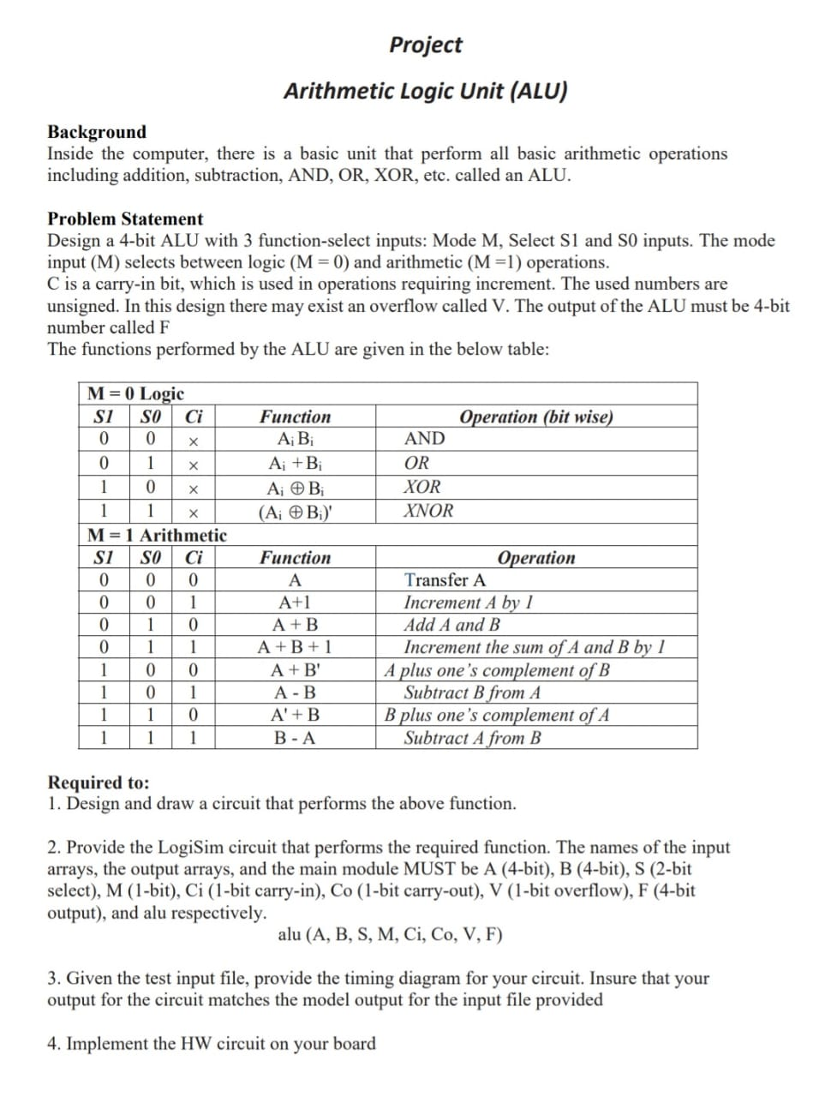
FACULTY OF ENGINEERING
Helwan UNIVERSITY
Junior Mechatronics Eng. Program

Slide 5

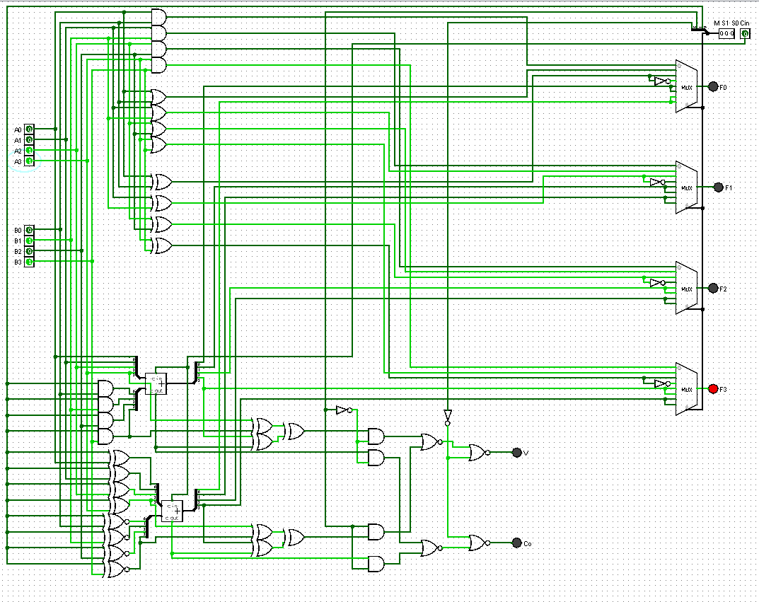
FACULTY OF ENGINEERING Helwan UNIVERSITY
Junior Mechatronics Eng. Program
Test cases
AND

Slide 6

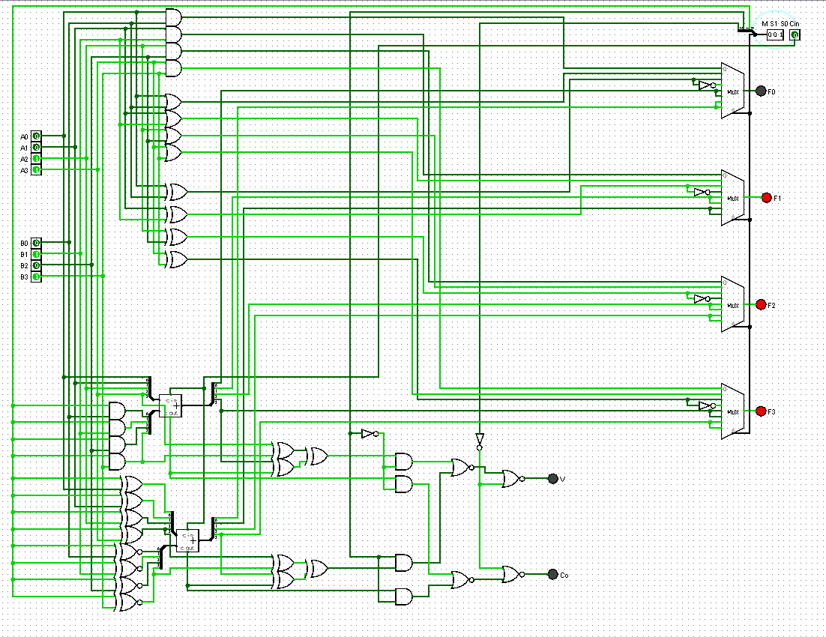
FACULTY OF ENGINEERING Helwan UNIVERSITY
Junior Mechatronics Eng. Program
OR

Slide 7

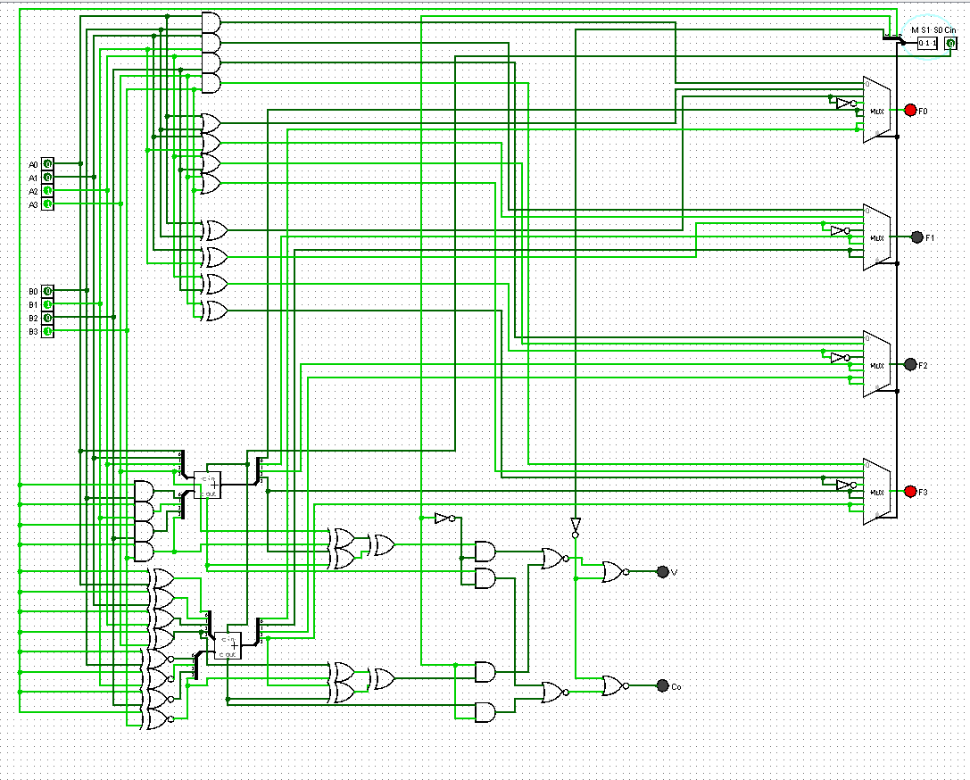
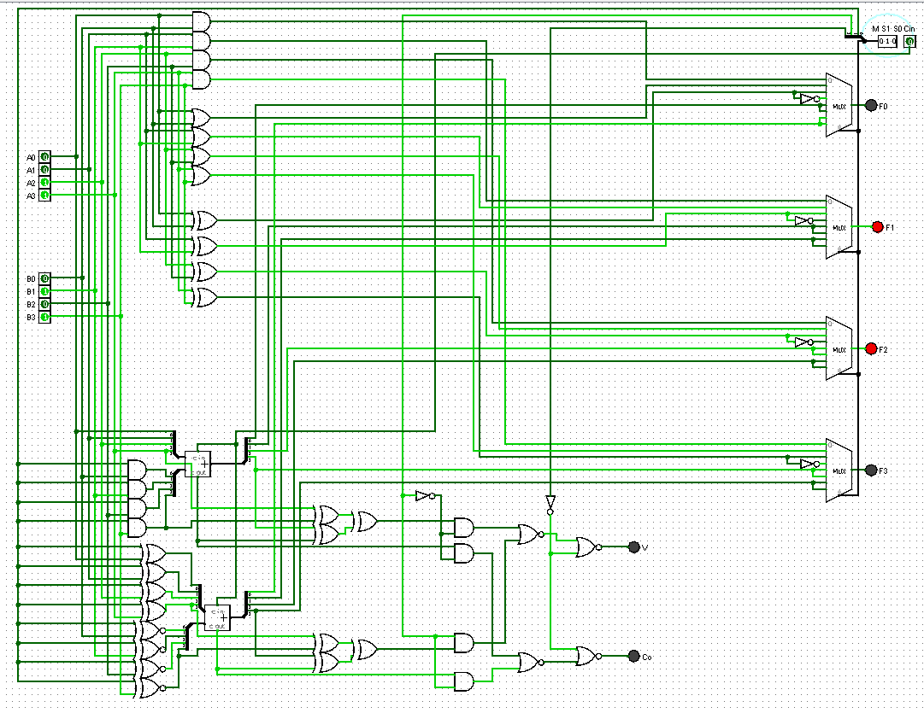
FACULTY OF ENGINEERING Helwan UNIVERSITY
Junior Mechatronics Eng. Program
XOR

Slide 8
FACULTY OF ENGINEERING Helwan UNIVERSITY
Junior Mechatronics Eng. Program
XNOR

Slide 9
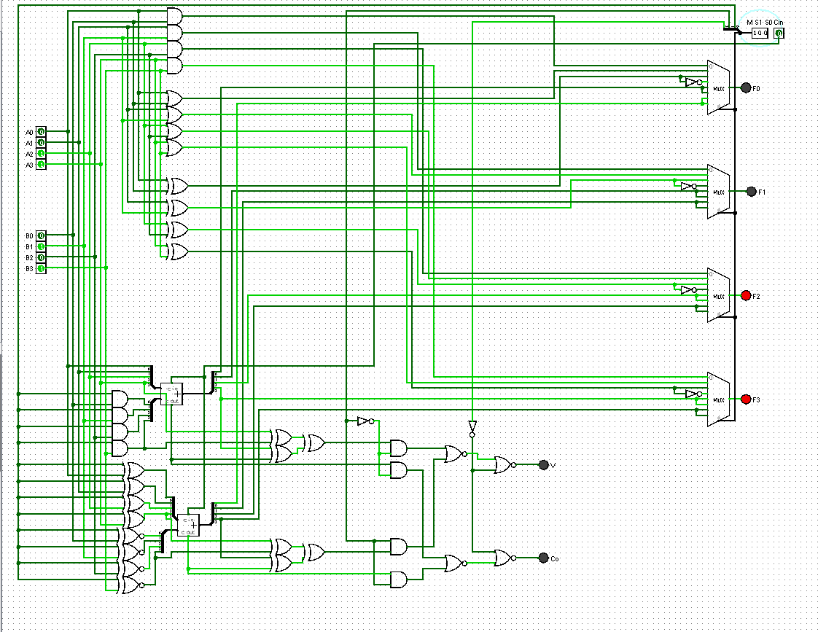
FACULTY OF ENGINEERING Helwan UNIVERSITY
Junior Mechatronics Eng. Program
Transfer A

Slide 10
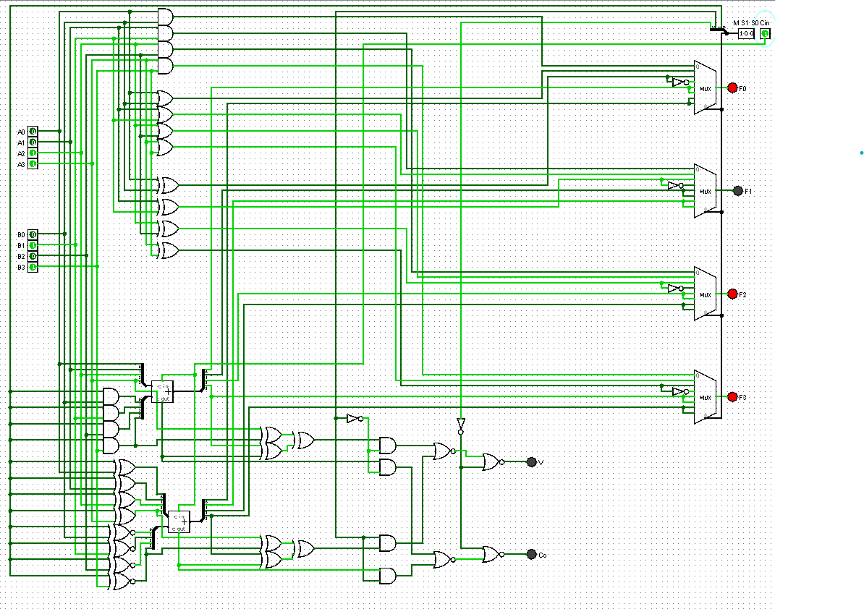
FACULTY OF ENGINEERING Helwan UNIVERSITY
Junior Mechatronics Eng. Program
A+1

Slide 11
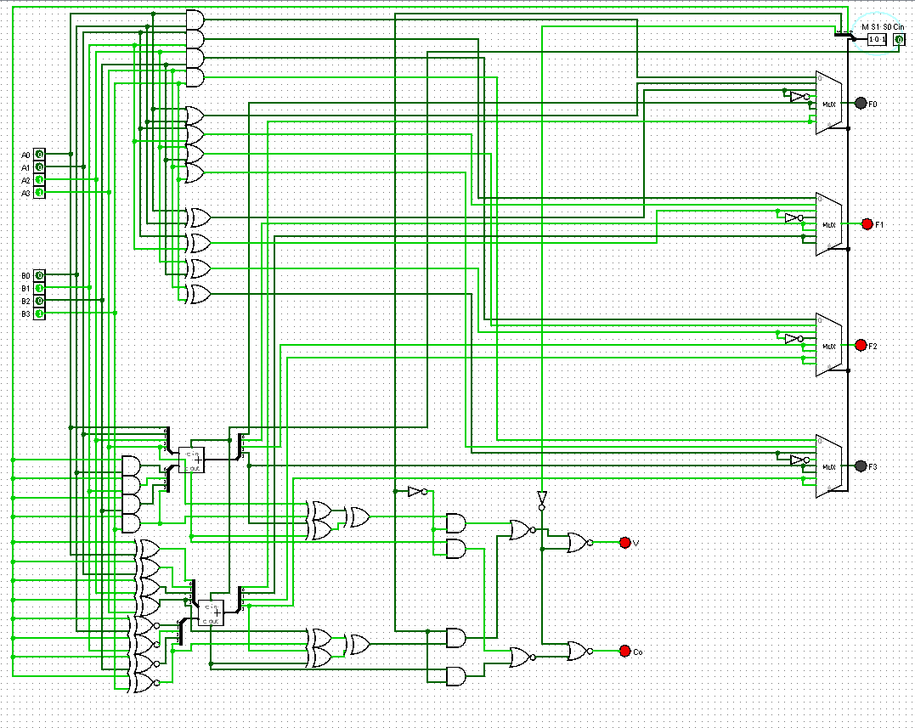
FACULTY OF ENGINEERING Helwan UNIVERSITY
Junior Mechatronics Eng. Program
A+B

Slide 12
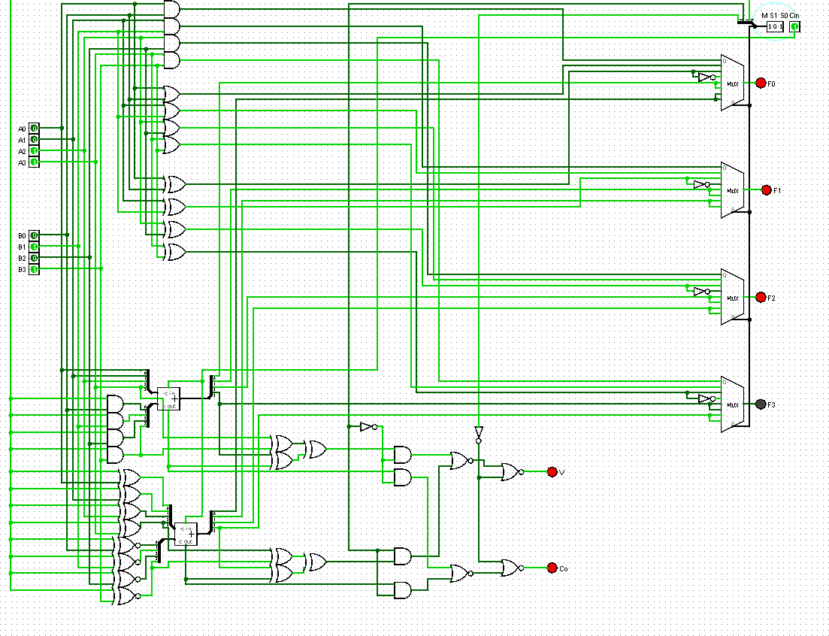
FACULTY OF ENGINEERING Helwan UNIVERSITY
Junior Mechatronics Eng. Program
A+B+1

Slide 13
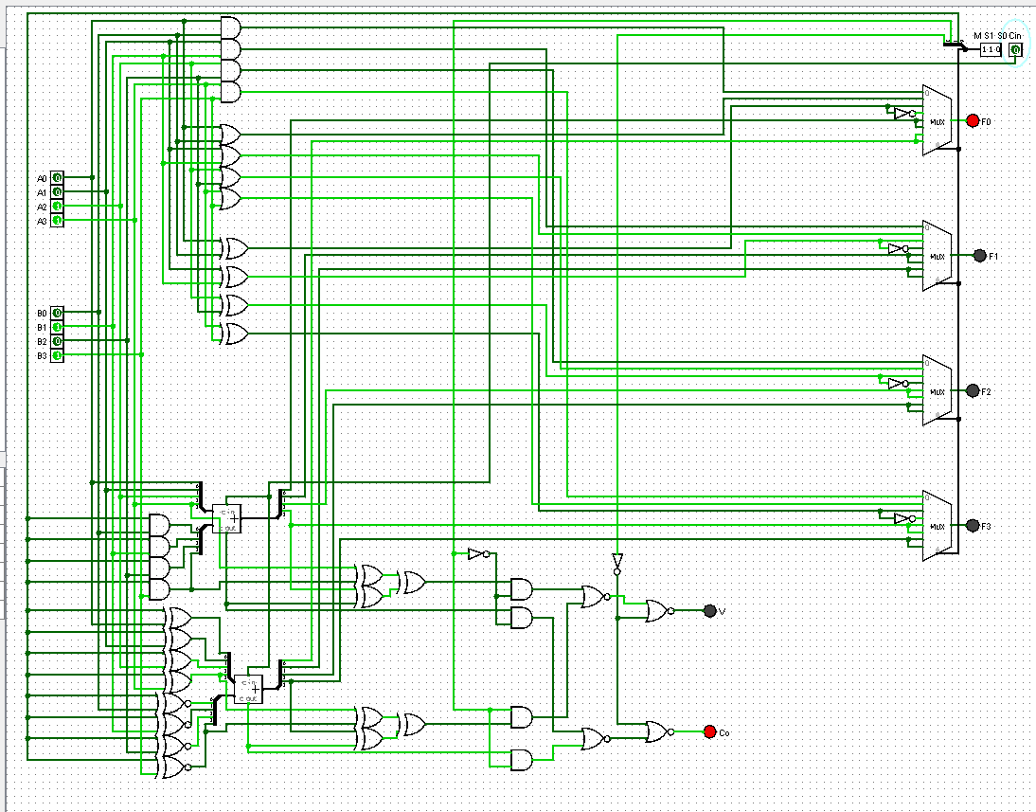
FACULTY OF ENGINEERING Helwan UNIVERSITY
Junior Mechatronics Eng. Program
A+B’

Slide 14
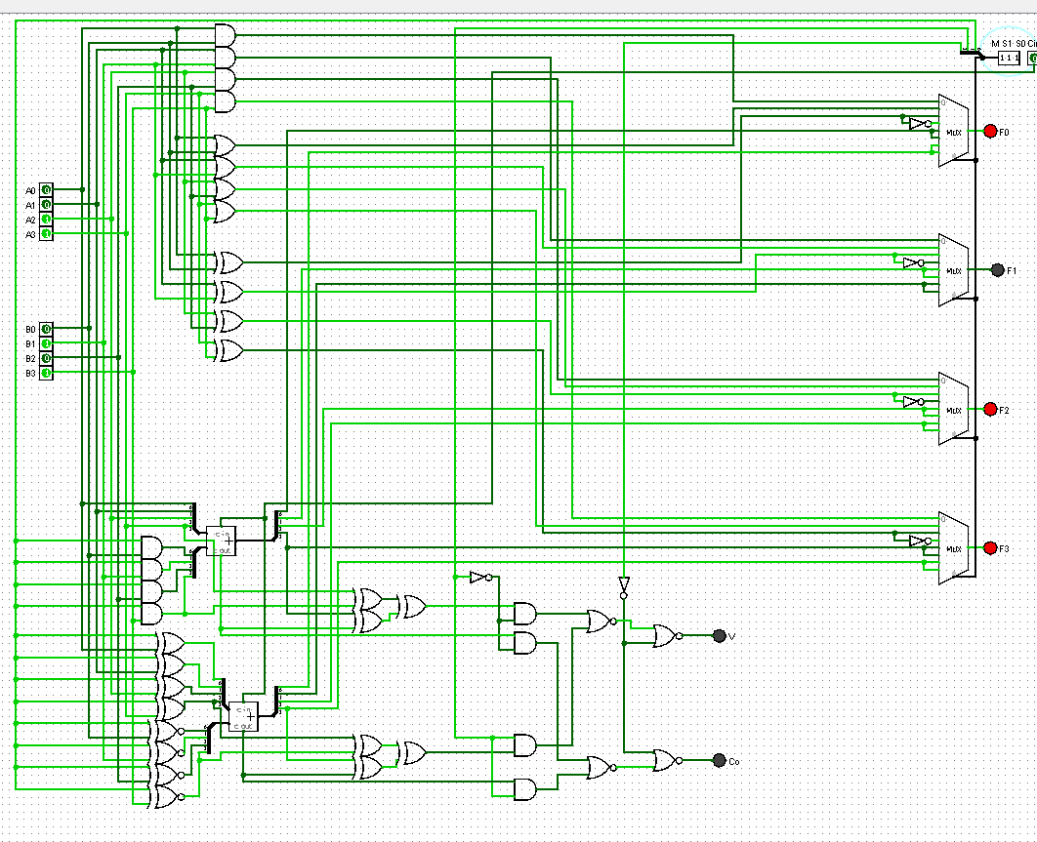
FACULTY OF ENGINEERING Helwan UNIVERSITY
Junior Mechatronics Eng. Program
A’+B

Slide 15
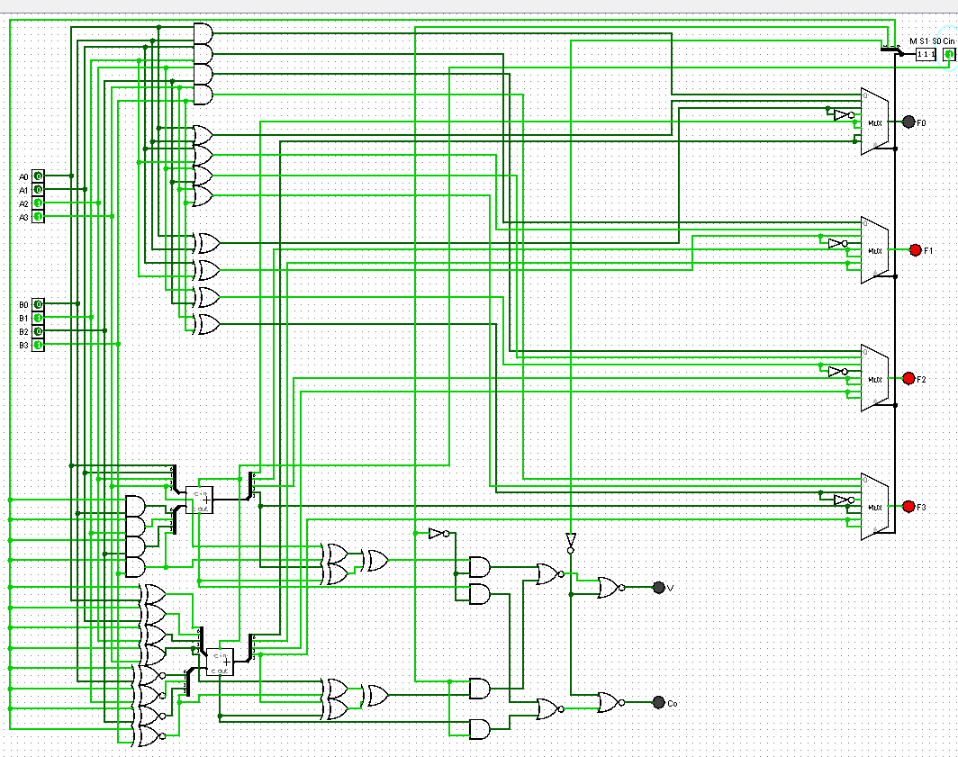
FACULTY OF ENGINEERING Helwan UNIVERSITY
Junior Mechatronics Eng. Program
B-A

Slide 16
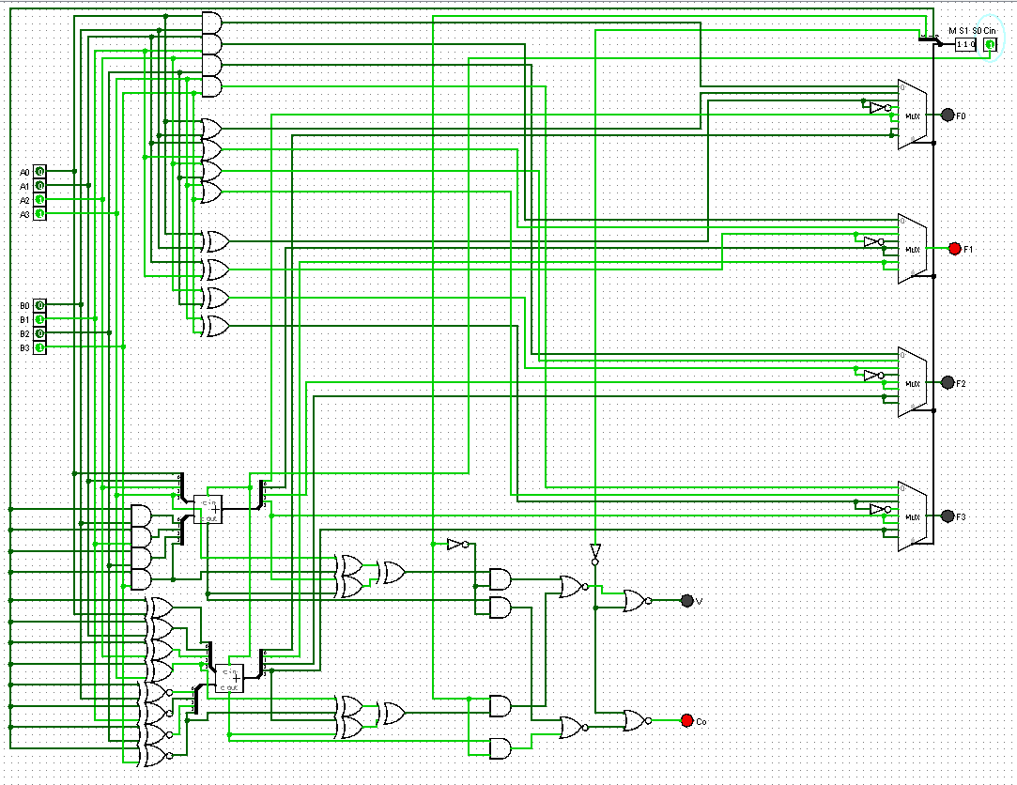
FACULTY OF ENGINEERING Helwan UNIVERSITY
Junior Mechatronics Eng. Program
A-B

Slide 17
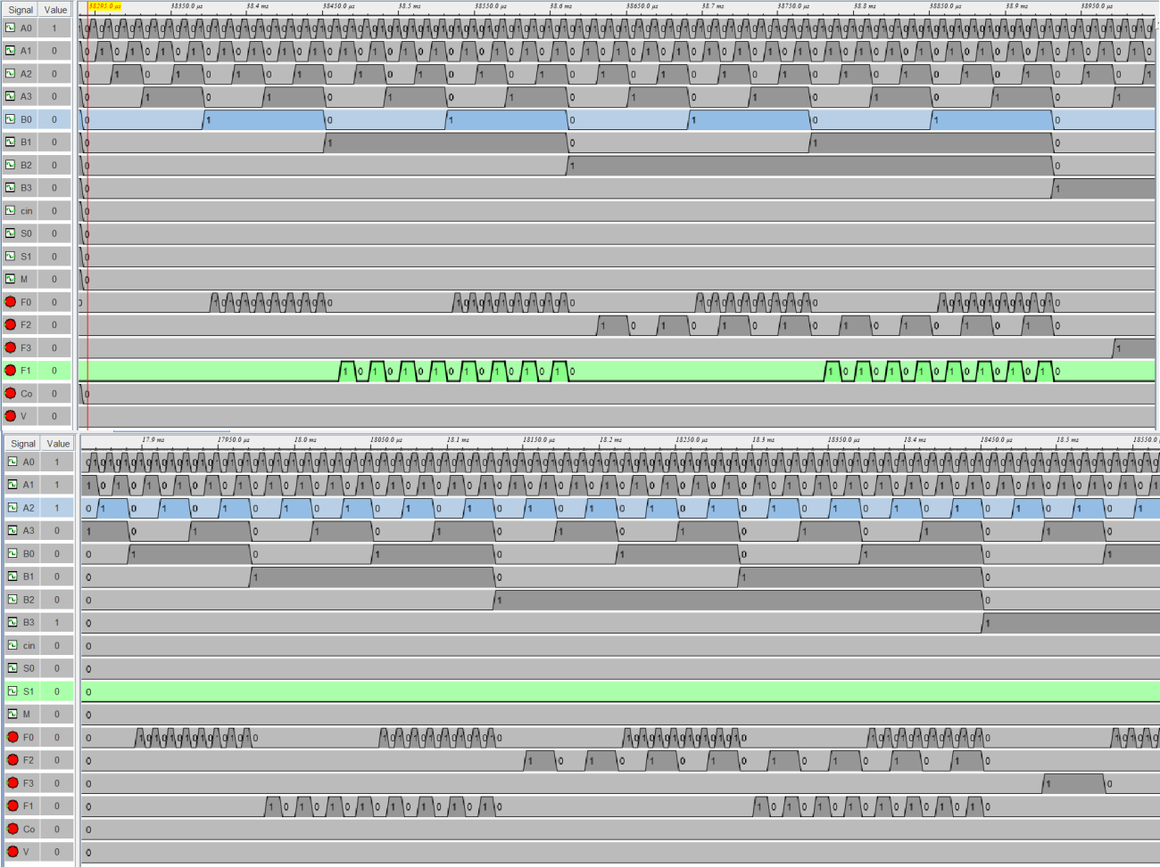
FACULTY OF ENGINEERING Helwan UNIVERSITY
Junior Mechatronics Eng. Program
Time diagram:

Slide 20
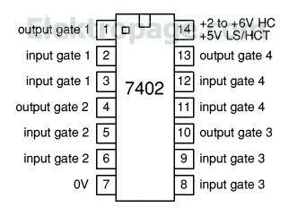
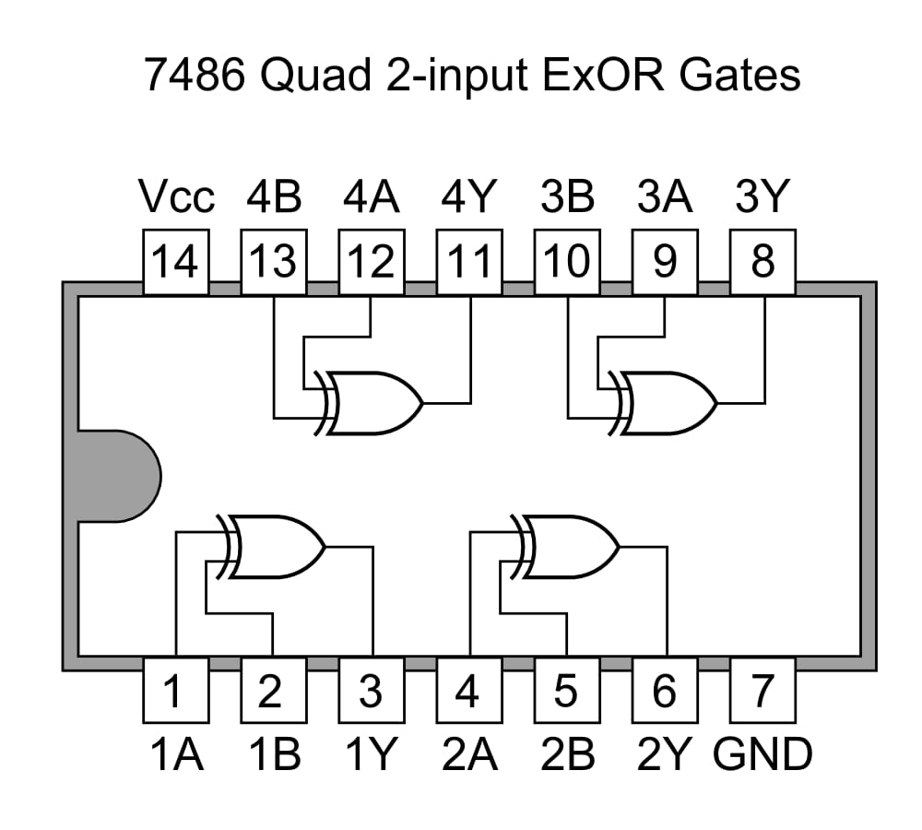
FACULTY OF ENGINEERING
Helwan UNIVERSITY
Junior Mechatronics Eng. Program
ICs Schematic and Data Sheets
Not Gate(DataSheet):https://www.alldatasheet.com/datasheet-pdf/pdf/50887/FAIRCHILD/7402.html
XOR Gate(Data Sheet): https://www.alldatasheet.com/datasheet-pdf/pdf/50914/FAIRCHILD/7486.html

Slide 21
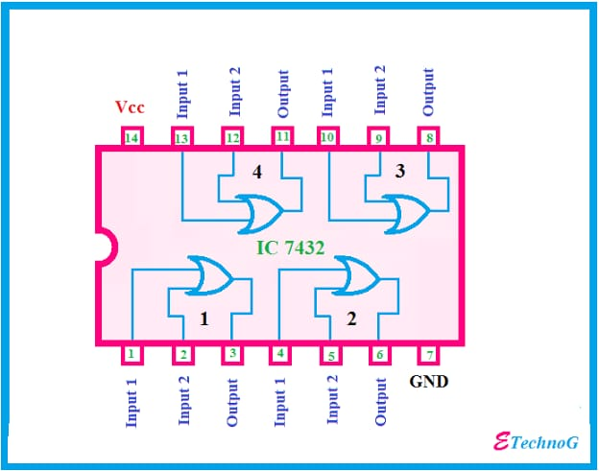
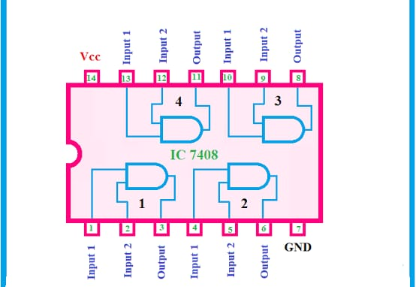
FACULTY OF ENGINEERING
Helwan UNIVERSITY
Junior Mechatronics Eng. Program
OR Gate(DataSheet): https://www.alldatasheet.com/datasheet-pdf/pdf/51073/FAIRCHILD/7432.html
AND Gate(DataSheet): https://www.alldatasheet.com/datasheet-pdf/pdf/253564/EDI/7408.html

Slide 22
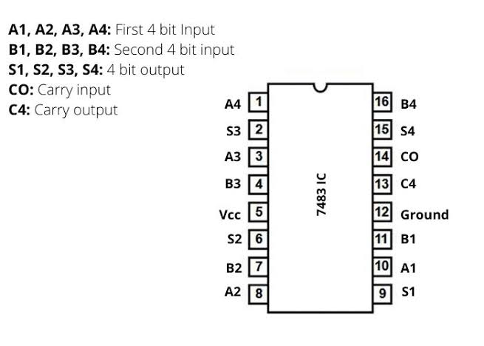
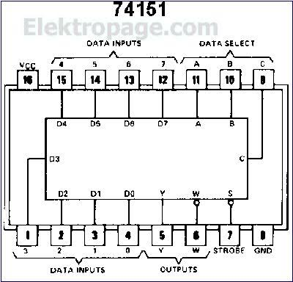
FACULTY OF ENGINEERING
Helwan UNIVERSITY
Junior Mechatronics Eng. Program
4-bit Full Adder(DataSheet): https://www.alldatasheet.com/datasheet-pdf/pdf/128897/FAIRCHILD/7483A.html
MultiPlexer 8*1(DataSheet): https://www.alldatasheet.com/datasheet-pdf/pdf/50940/FAIRCHILD/74151.html

Slide 23
FACULTY OF ENGINEERING
Helwan UNIVERSITY
Junior Mechatronics Eng. Program
References
main reference for me is the lectures (combinational circuit part)
https://en.wikipedia.org/wiki/Arithmetic_logic_unit
https://www.allaboutcircuits.com/projects/how-to-build-your-own-discrete-4-bit-alu/
https://web.cse.ohio-state.edu/~teodorescu.1/download/teaching/cse675.au08/Cse675.02.F.ALUDesign_part1.pdf
https://www.geeksforgeeks.org/overflow-in-arithmetic-addition-in-binary-number-system/
https://www.youtube.com/watch?app=desktop&v=p4yVpZGZ9tA
https://www.electronics-tutorials.ws/combination/comb_7.html

