Slide 1
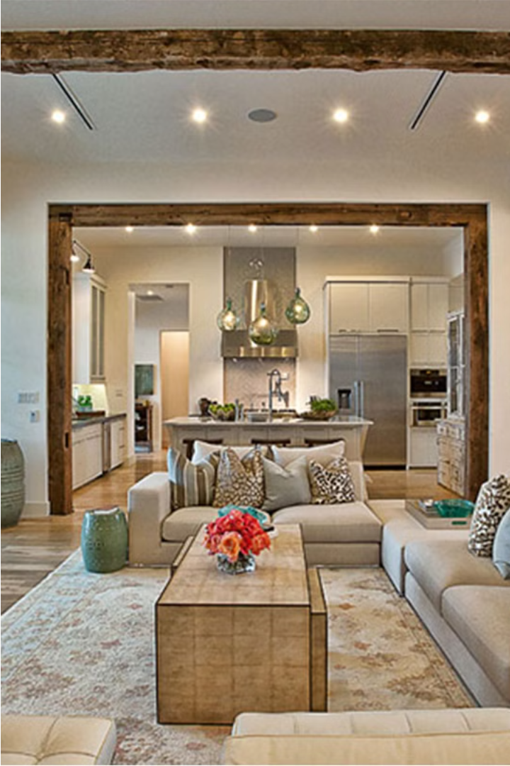
Mobile Controlled Home
By
Mohamed Harby
Eslam Alsaeed

Slide 2
Mobile Controlled Home
This mobile-controlled home system allows residents to manage their living space conveniently from their smartphones. Key features include secure door access, lighting control, and user management - all accessible through a user-friendly mobile app.
Link codes
https://github.com/EslamAlsaeed/Mobile-application-with-avr

Slide 3

Safety Door Subsystem
Secure Access
Access Logging
The safety door can be unlocked remotely using the mobile app, with user authentication via username and password.
The system tracks all door openings and closings.
Tamper Detection
The door lock has an alarm if someone attempts to Enter wrong password more than three times .

Slide 4
Light On/Off Subsystem
Remote Control Users can turn lights on and off remotely
using the mobile app,
providing convenience .

Slide 5

User Management
10 User Accounts
The system supports up to 10 unique user accounts
with customizable access privileges.

Slide 6




Password Security
Password Entry
Incorrect Attempts
Secure Storage
Users must enter their username and password to access the mobile app and control the home.
If the password is entered incorrectly three times, the system triggers an alarm to prevent unauthorized access.
All user passwords are securely stored and encrypted, ensuring the privacy and integrity of the system.

Slide 7

Alarm System
Intruder Alert
The alarm sounds if
the password is entered incorrectly multiple times.

Slide 8
System Capabilities
Bluetooth Connectivity
The home system connects to user smartphones via Bluetooth, enabling seamless remote control.
1
2
Mobile App Integration
A user-friendly mobile app.

Slide 9
Conclusion
This mobile-controlled home system offers a comprehensive solution for secure and convenient management of residential spaces. By seamlessly integrating door access, lighting, and security features, it empowers homeowners to effortlessly control their living environment from the palm of their hand.

