Slide 1
Performance testing
Performance Testing
Prepared by:
Ahmed Alaa Elden Ahmed
Eslam ElRamikh
Esraa Sayed Mabed

Slide 2

•What is performance testing? •Why we do performance testing? •Types of performance Testing •Performance testing process •Tools used in performance testing •Differences between Script recorder and Blazemeter •Common performance challenges
Agenda

Slide 3

What is Performance Testing
Is a software testing process used for testing the speed, response time, stability, reliability, scalability and resource usage of a software application under particular workload.

Slide 4
Why we do performance testing ?
Performance Testing is done to provide stakeholders with information about their application regarding speed, stability, and scalability. More importantly, Performance Testing uncovers what needs to be improved before the product goes to market.
Performance testing is critical to customer satisfaction; if your application’s performance doesn’t meet the expectations of your customers, they will move on to your competitor. Performance testing can be complicated and requires specialized test planning.

Slide 5
Load testing :checks the application’s ability to perform under anticipated user loads. Stress testing : involves testing an application under extreme workloads to see how it handles high traffic or data processing.
Endurance testing : is done to make sure the software can handle the expected load over a long period of time.
Spike testing :tests the software’s reaction to sudden large spikes in the load generated by users.
Volume testing : Under Volume Testing large no. of. Data is populated in a database and the overall software system’s behavior is monitored. Scalability testing : The objective of scalability testing is to determine the software application’s effectiveness in “scaling up” to support an increase in user load. It helps plan capacity addition to your software system.
Types of Performance Testing

Slide 6

Performance Testing process

Slide 7
Performance testing Process
Identify the testing environment.
Identifying the hardware, software, network configurations and tools available allows the testing team to design the test and identify performance testing challenges
Identify performance metrics.
In addition to identifying metrics such as response time, throughput and constraints, identify what are the success criteria for performance testing.
Plan and design performance tests.
Identify performance test scenarios that take into account user variability, test data, and target metrics.

Slide 8
Performance testing Process
Configure the test environment.
Prepare the elements of the test environment and instruments needed to monitor resources.
Implement your test design.
Develop the tests.
Execute tests.
In addition to running the performance tests, monitor and capture the data generated.
Analyze, report, retest.
Analyze the data and share the findings. Run the performance tests again using the same parameters and different parameters.

Slide 9



Performance Testing Tools
• Jmeter
• Loadrunner
• Web load

Slide 10
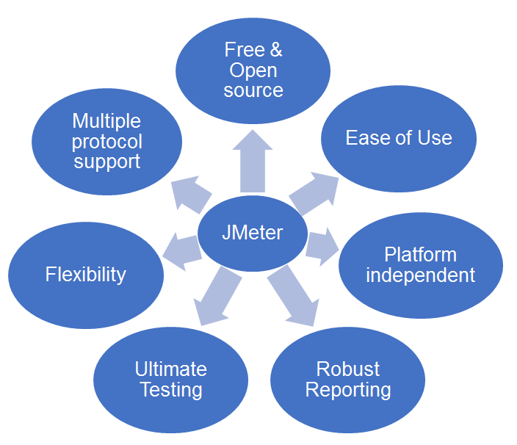
Advantages of Jmeter

Slide 11
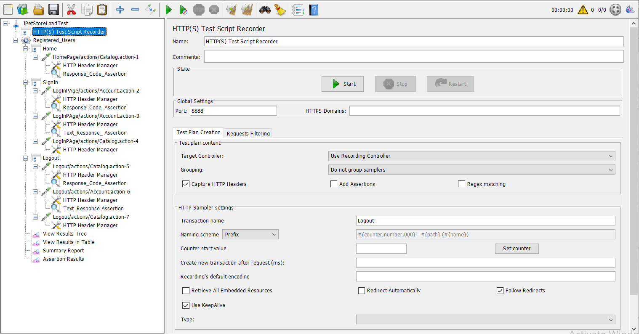
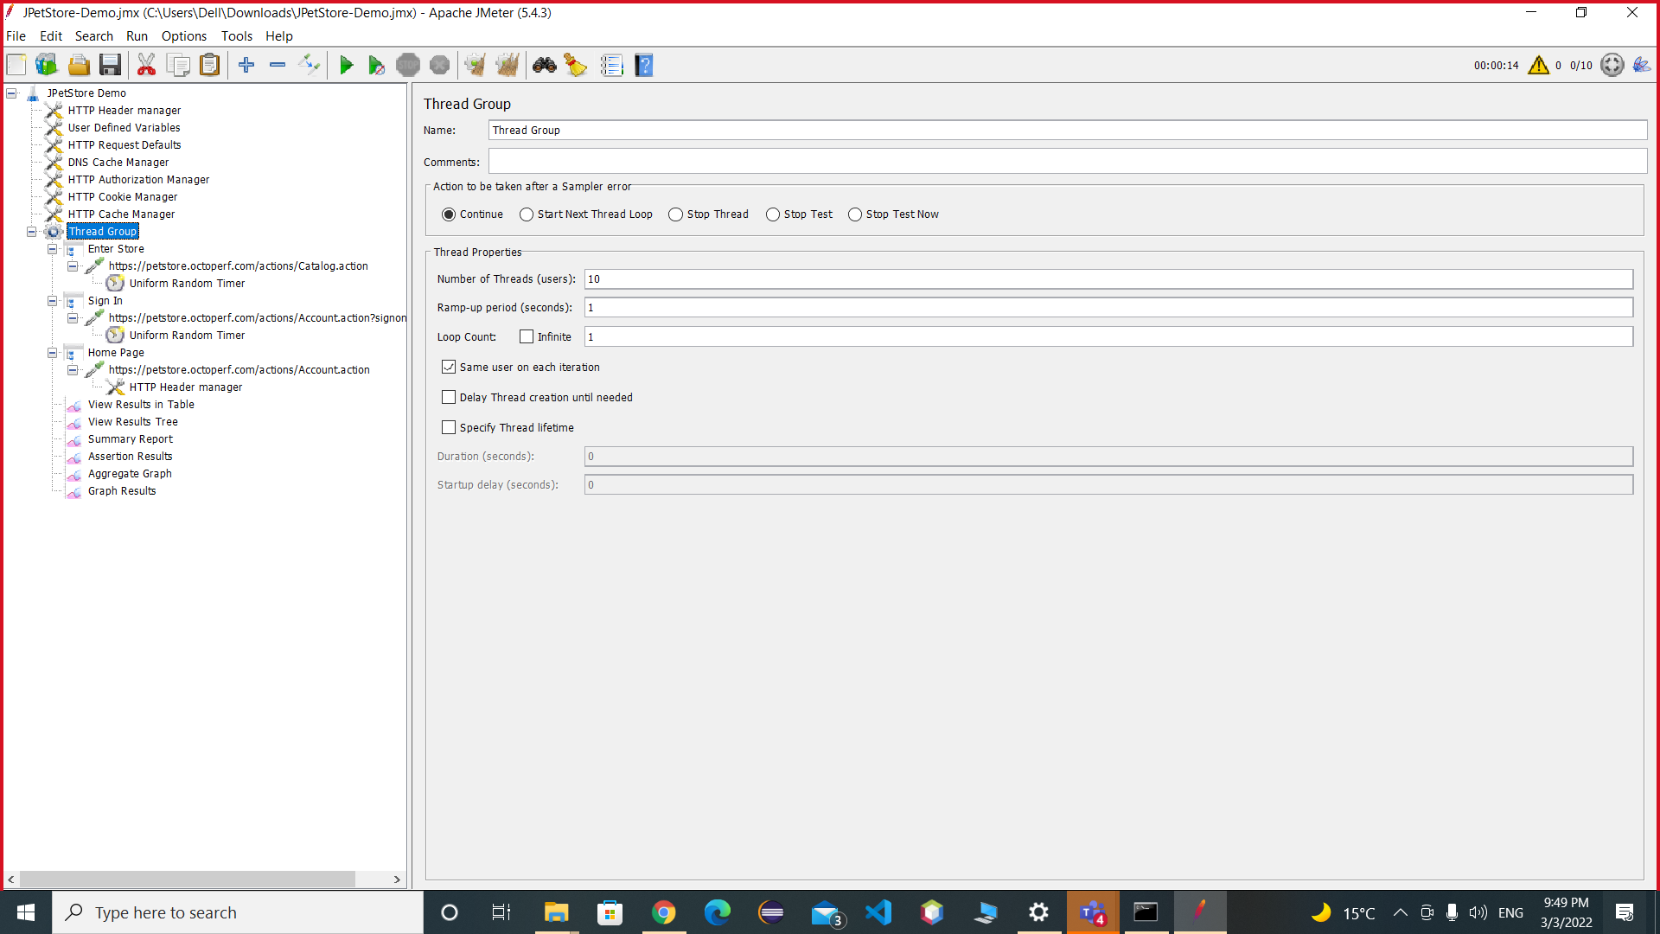
Http Script recorder VS Blazemeter recorder

Slide 12
Challenges of Performance Testing
Long Load time : Load time is normally the initial time it takes an application to start. This should generally be kept to a minimum. While some applications are impossible to make load in under a minute, Load time should be kept under a few seconds if possible.
Poor response time : Response time is the time it takes from when a user inputs data into the application until the application outputs a response to that input. Generally, this should be very quick. Again if a user has to wait too long, they lose interest.
Poor scalability : A software product suffers from poor scalability when it cannot handle the expected number of users or when it does not accommodate a wide enough range of users. Bottlenecking : Bottlenecks are obstructions in a system which degrade overall system performance. Bottlenecking is often caused by one faulty section of code. Bottlenecking is generally fixed by either fixing poor running processes or adding additional Hardware.

Slide 13
Thank you

