Slide 1


Clustering
Group 8

Slide 2
What we have done
1. Choose Books
2. Data preprocessing, Cleaning, and Labeling
3. Feature engineering
LDA , BOW , TF-IDF , word Embedding
4. Build the models
K-means , EM , hierarchical clustering
5. Choose the champion model
6. Error analysis

Slide 3
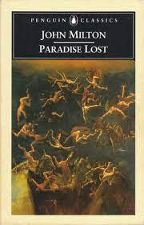




1. Choose Books
Poetry
Drama
Romance
Fiction
Mystery
Children
Fiction

Slide 4
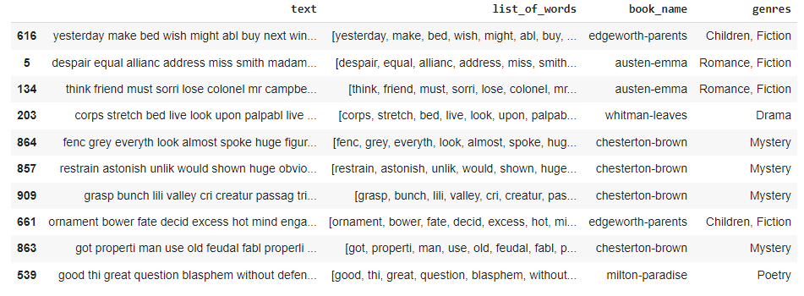
2. Data preprocessing, Cleaning, and Labeling
Remove Titles
Remove Headlines
Remove Special Characters
Remove Digits
Remove Stop Words
Apply
Stemming

Slide 5
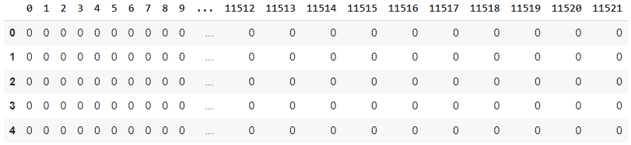
3. Feature engineering
BOW

Slide 6
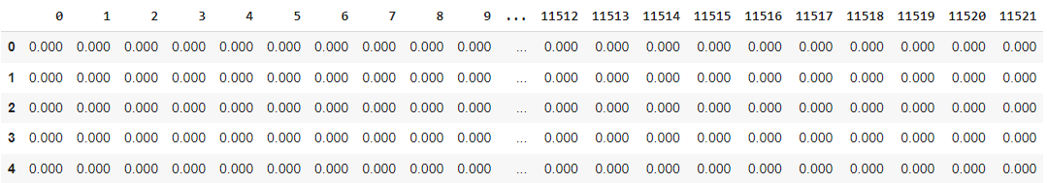
3. Feature engineering
TF-IDF

Slide 7
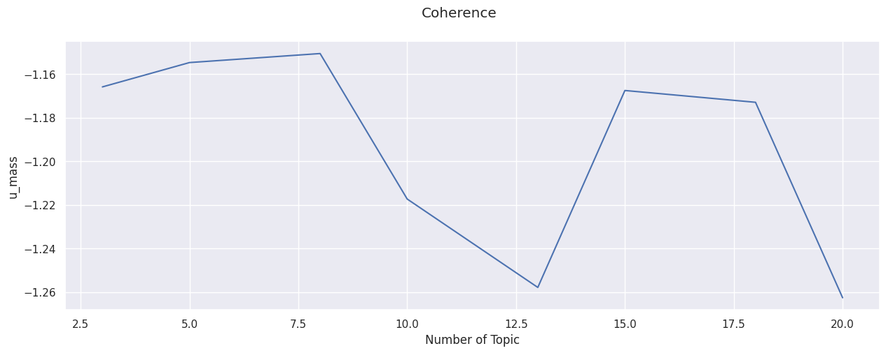
3. Feature engineering
LDA
Number of Topics = 20 topics

Slide 8
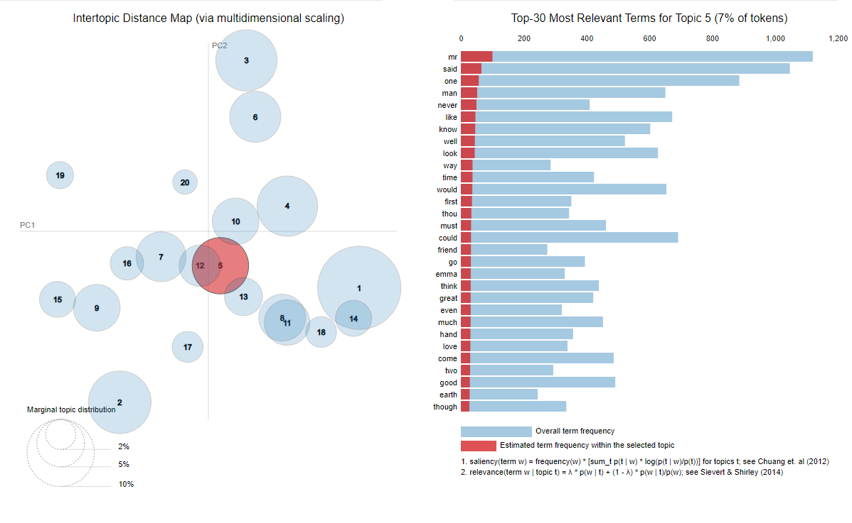
3. Feature engineering
LDA
Number of Topics = 20 topics

Slide 9
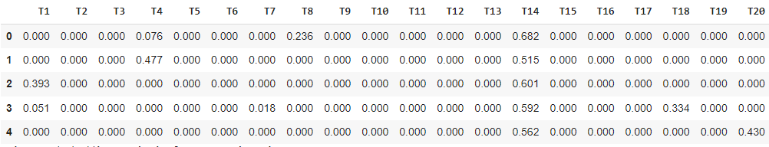
3. Feature engineering
LDA
Number of Topics = 20 topics

Slide 10
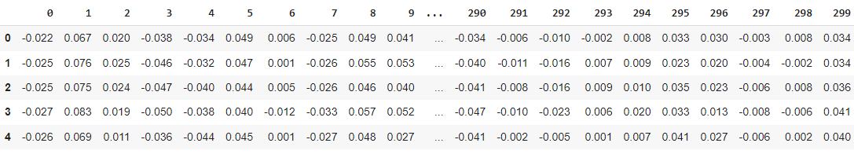
3. Feature engineering
word Embedding

Slide 11
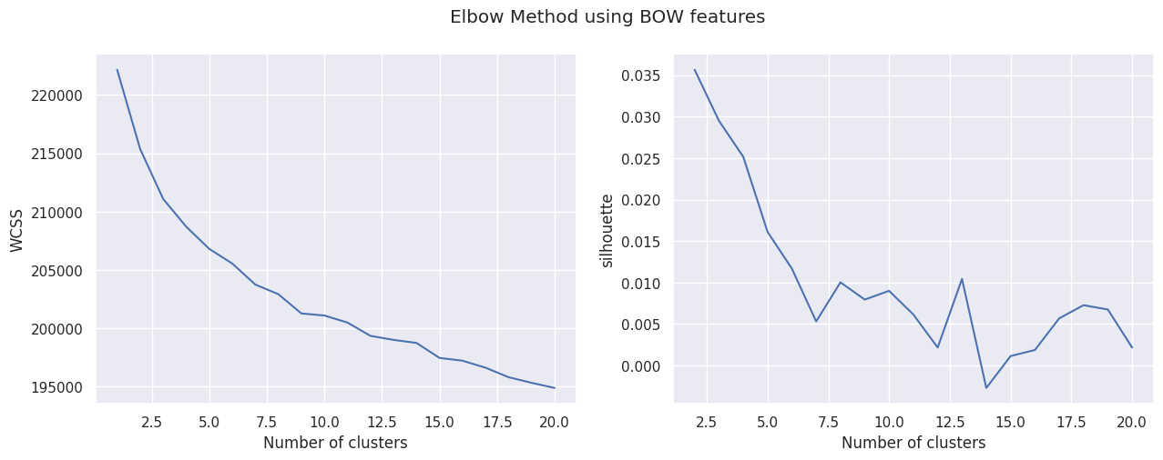
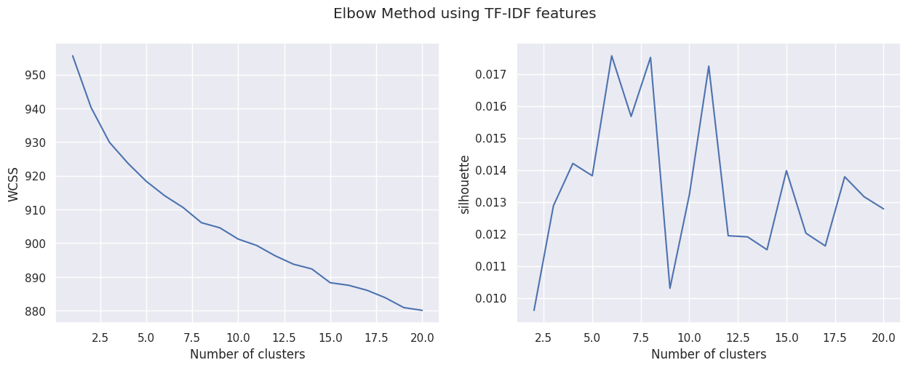
4. Build the models
K-means
K=13
K=6

Slide 12
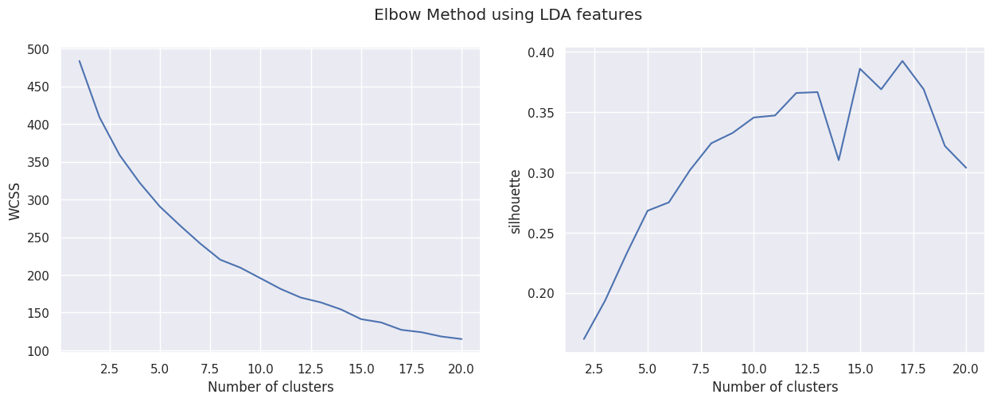
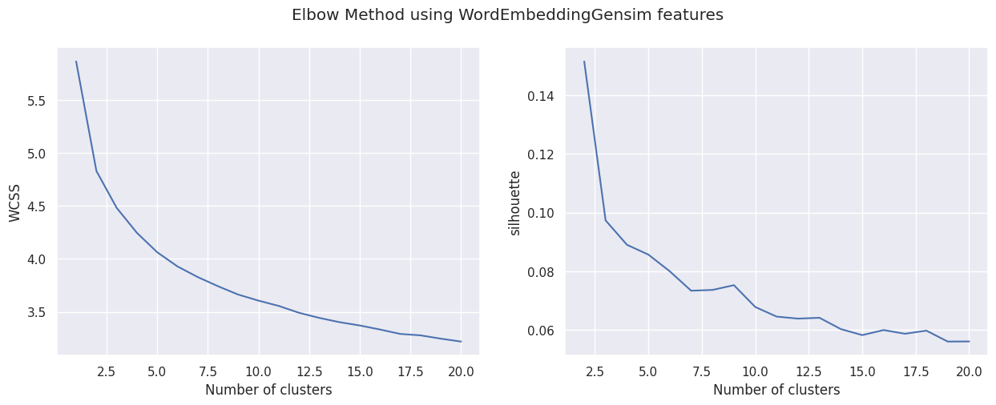
4. Build the models
K-means
K=15
K=5

Slide 13
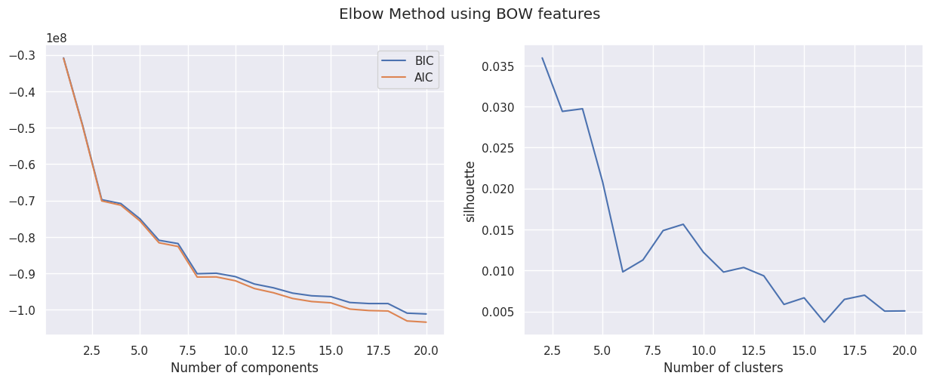
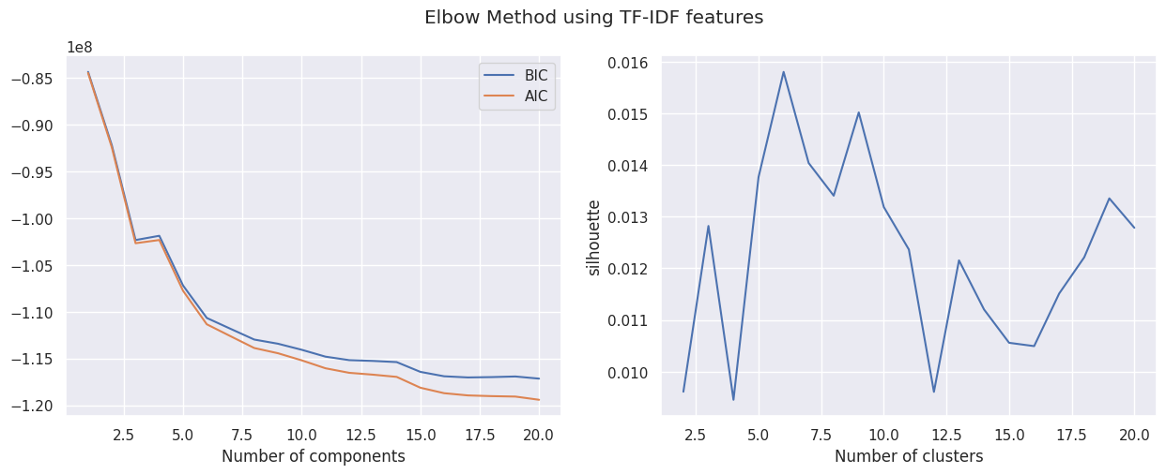
4. Build the models
EM
K=8
K=6

Slide 14
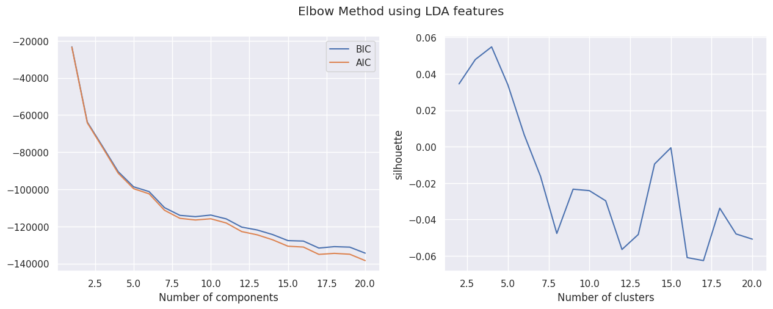
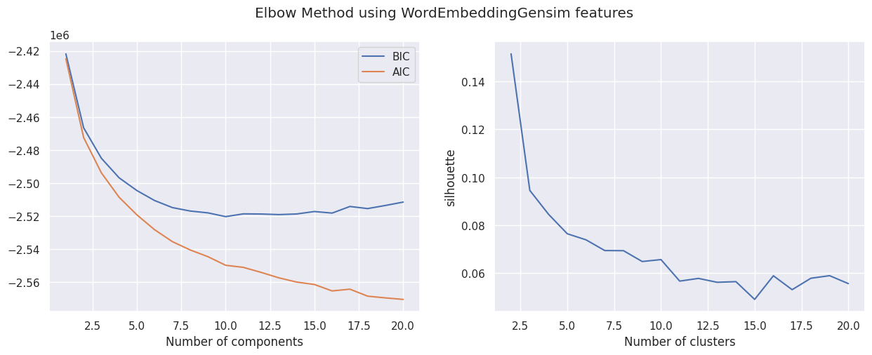
4. Build the models
EM
K=5
K=5

Slide 15
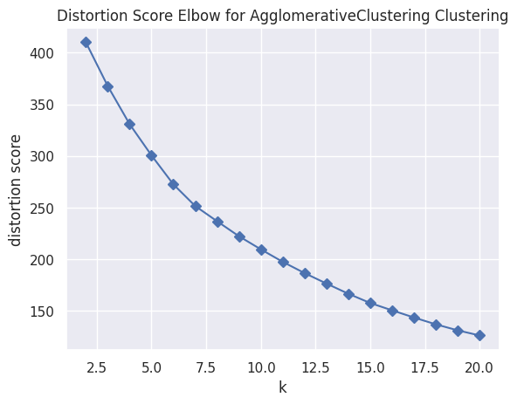
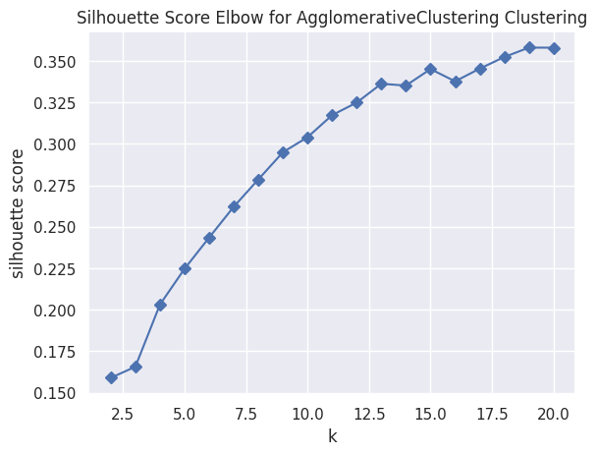
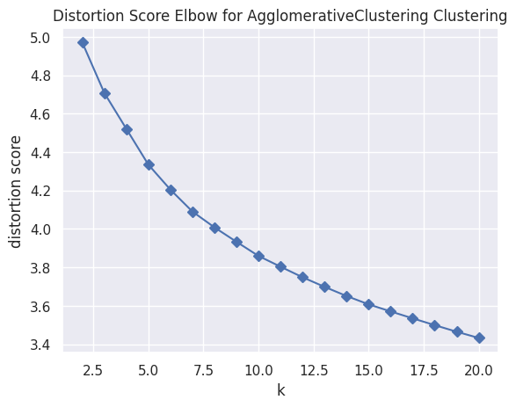
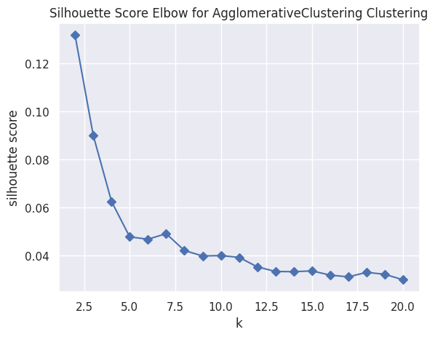
4. Build the models
hierarchical clustering
BOW
K=15
TF-IDF
K=7

Slide 16
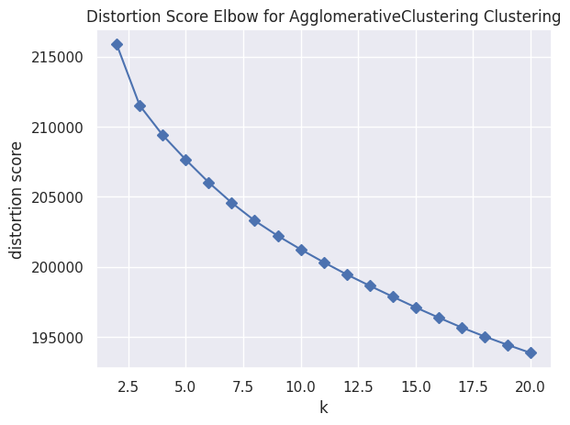
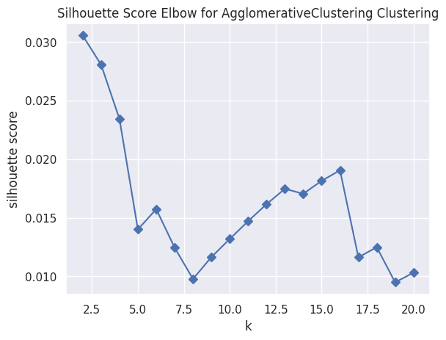
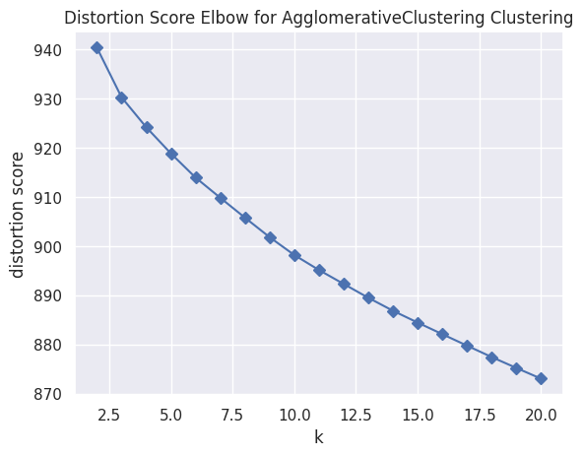
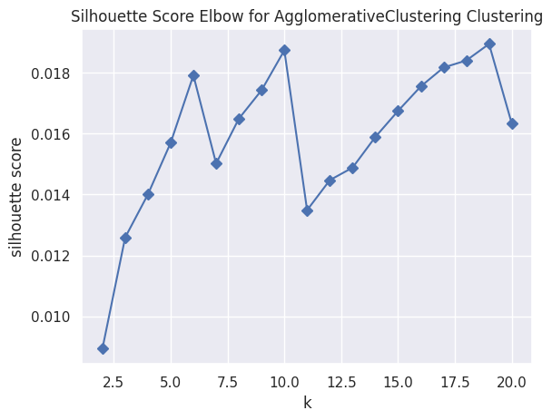
4. Build the models
hierarchical clustering
LDA
K=6
Word Embedding
K=10

Slide 17
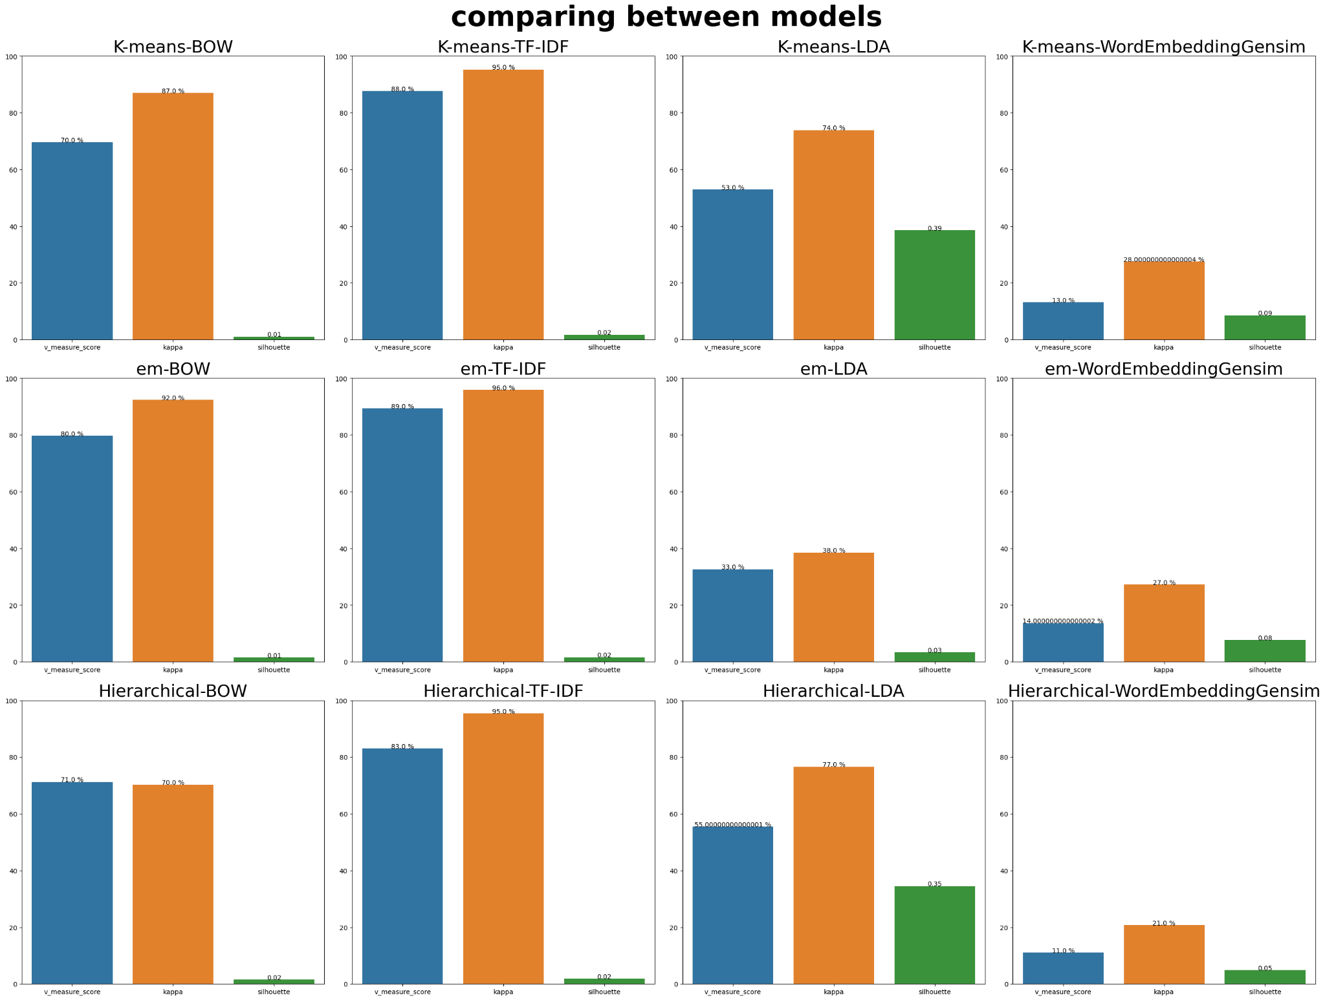
5. Choose the champion model
Our Champion Model is EM-TF-IDF Based on Cohen’s Kappa = 96%

Slide 18
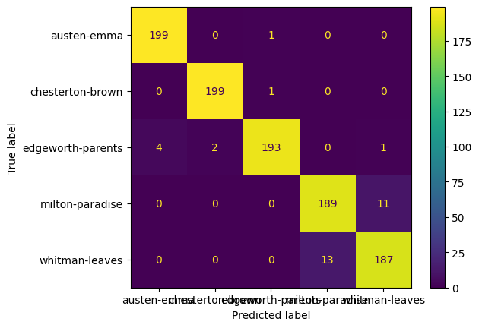
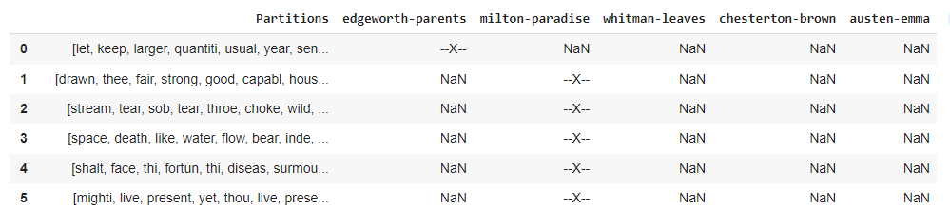
6. Error analysis

Slide 19

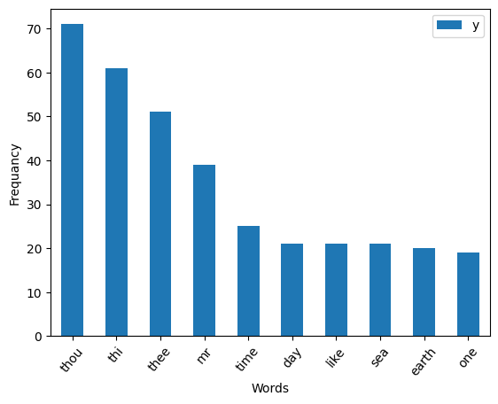
6. Error analysis

