Slide 1


Data Governance @ SneakerPark
Prepared by: Eslam Elassal
Submitted on: Jan 2024

Slide 2
Background
SneakerPark is an online shoe reseller that allows people to buy and sell used and new shoes. Buyers can bid for shoes or buy them outright, and sellers can set a price or sell to the highest bidder.
Each buyer and seller must have an active account in order to sell, bid, or purchase sneakers using SneakerPark’s website.
SneakerPark authenticates the shoes before shipping them to the buyer, so before listing an item, the seller must ship it to SneakerPark’s warehouse. Upon receipt, SneakerPark assigns an item number to each pair of sneakers and notifies the seller that they are now free to list their item. If the item is not listed within 45 days, SneakerPark returns it to the seller and sends an invoice to the seller for the shipping cost.
If the item is found to be inauthentic or in an unacceptable condition, it is also returned back to the seller in a similar fashion.
When the item sells, the buyer’s account is credited with the purchase price minus the SneakerPark service fee and shipping fees to deliver the item to the buyer.
Currently, SneakerPark only supports sales within the United States.

Slide 3
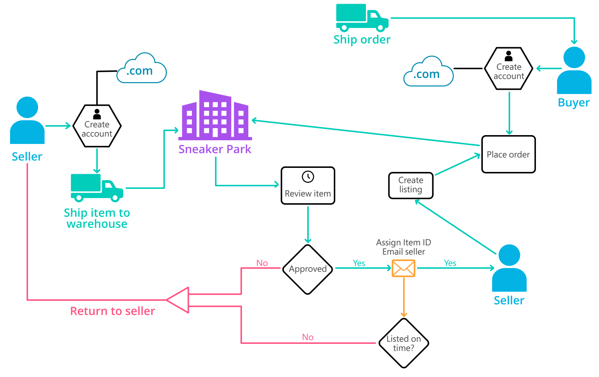
Background (cont’d)
Below you can see a diagram that will hopefully help you visualize some of SneakerPark's business processes. Keep in mind that it does not capture ALL processes and every nuance, but simply serves as another artifact to use in your project.

Slide 4
Step 1
Enterprise Data Catalog Part 1: Enterprise Data Model

Slide 5
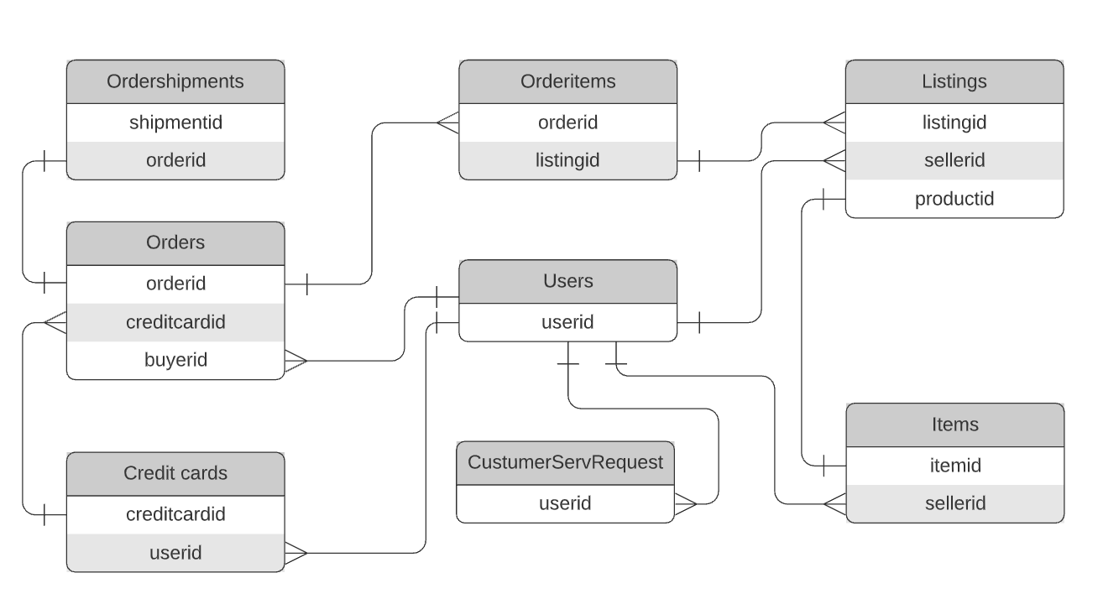
Replace the example below with your own solutions:

Slide 6
Step 2
Enterprise Data Catalog Part 2: Metadata
Results in the Excel File

Slide 7
Step 3
Data Quality
Part 1: Profiling and Cleansing
Results in the Excel File

Slide 8
Step 4
Data Quality
Part 2: Monitoring

Slide 9
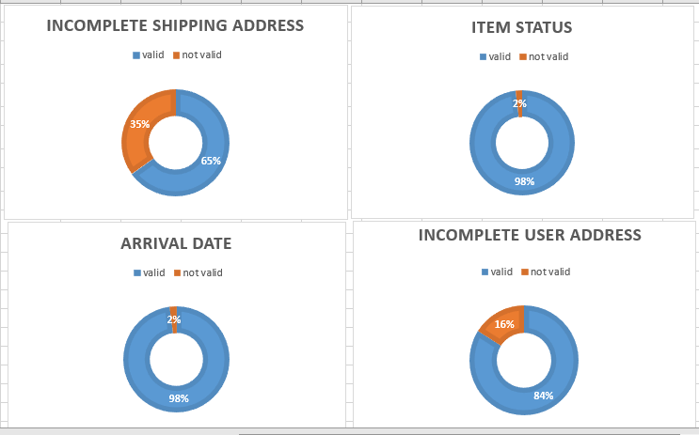
Using the metrics you've created in the last step, please create a mock-up of a data quality monitoring dashboard that will be used to monitor the data to ensure compliance with your data quality rules:
orders.shippingaddress 45%
items.itemstatus 2%
items.arrivaldate 2%
users.address 16%
65%
98%
98%
84%

Slide 10
Step 5
Master Data Management
Part 1: MDM Architecture

Slide 11
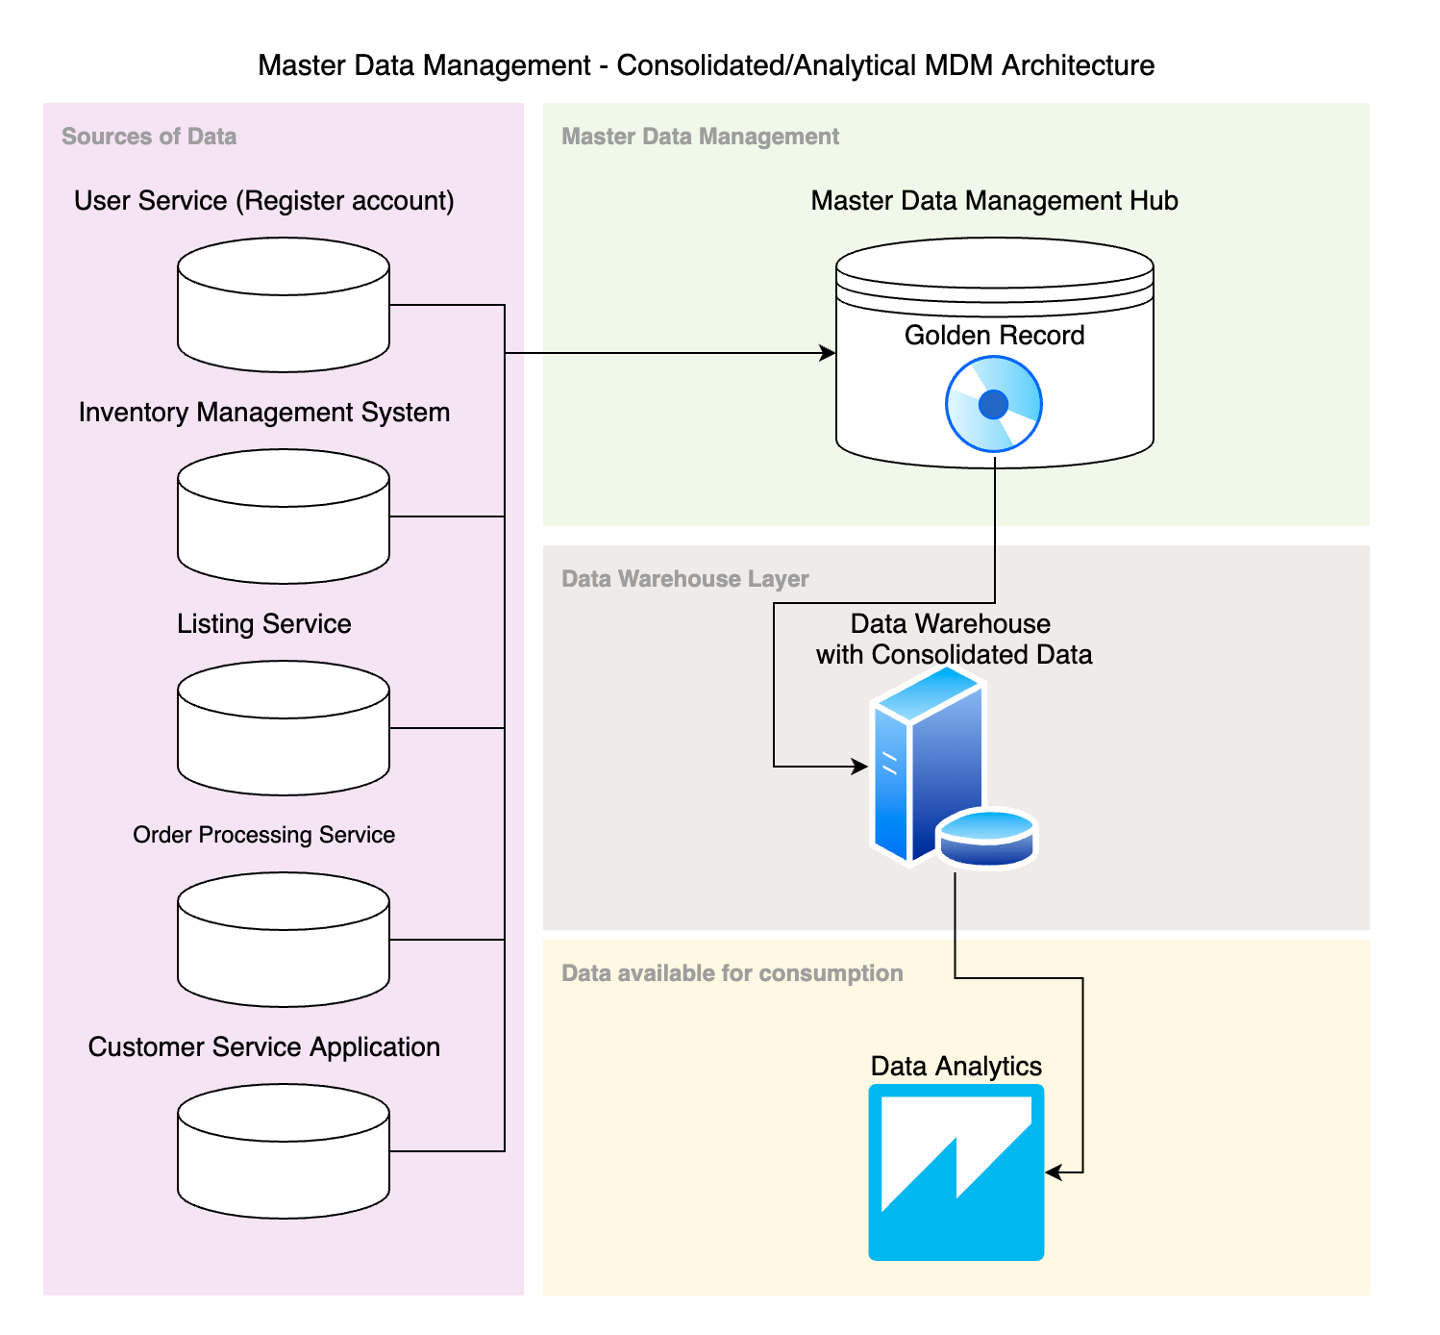
Master Data Management System and Short Explanation: How the current MDM Architecture affects the current systems? Answer: The impact of our MDM architecture on the current systems architecture is negligible because we offered the consolidated/analytical MDM Architecture, which does not interfere with our operating systems. We chose this implementation since it is a reliable and easy-to-use solution..

Slide 12
Explanation:
How the current MDM Architecture affects the current systems?
Answer:
The impact of our MDM design on the current systems architecture will be negligible because we suggested the "consolidated/analytical MDM Architecture," which does not interfere with our operating systems. We chose this implementation because it is a reliable solution that is easy to use and offers us a sufficient number of benefits.
We will be able to standardize and validate a few key variables for our data model—user information is one kind of data—by using the Golden Record. This will be fed into our data warehouse, which will further condense our data.

Slide 13
Step 6
Master Data Management
Part 2: Master Record

Slide 14
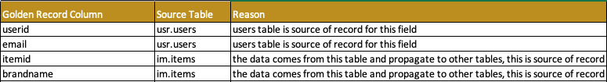
In this step, you will define a set of matching rules that will be used by the SneakerPark's MDM Hub to match item and customer entities between the company's different systems.
Please come up with 4 rules - 2 for Items and 2 for Customers and list them below.
Matching Rules:
Match users data on userid.
Match ítems data on itemid.
Additional Definitions of Golden Records:

Slide 15
Step 7
Data Governance:
Roles and Responsibilities

Slide 16
Write 1-2 paragraphs discussing what data governance roles and responsibilities will be necessary to oversee this new Data Management initiative.
Data Quality Management, Metadata Management, MDM, etc).
Data Governance Roles and Responsibilities –
As resources, Jake and Jessica can assist us in managing our data. In addition to her duties in data management and governance, Jessica is senior to Jake. The corporation plans to hire a junior resource to assist with the necessary efforts; the intern will report to Jessica..
Metadata Management: Even though Jessica is going to deliver this work to the new intern, it’s Jessica’s responsibility. All of the fields from our Database should be mapped with some basic description fields.
Data Quality Management & Monitoring Tools: Jake is responsible for this part, he’s responsible on assessing the quality of the data, and on making its quality increase be it with System changes or through talking with people and setting processes tp improve Data’s quality.
Data Lineage: Jake is responsible on designing Data Diagrams that explain Data Sources and Destinations so we can keep track of it.
Data Stewards: Establish a core team of stakeholders like Jessica who is working in our company for some time, and data stewards
to create a data governance framework. This begins with an
audit to identify issues with current data management
policies and areas needing improvement.

Slide 17
Data Quality Assurance: Define the problems we are trying to solve better regulatory compliance, increased data security, and improved data quality, And determine what we need to change, such as
fine-tuning access rights, protecting sensitive data, or
consolidating data silos. Assess tools and skills in your team
will need to execute the data governance program. This may
include people with skills in data modeling, data cataloging,
data quality, and reporting. Due to the lack of suitable
persons in the current team of the company. I recommend starting the recruitment process for the above-mentioned positions immediately.
Data Administrator: The primary task of this role will be to inventory our data to see what we have, how it’s classified, where it resides, who
can access it, and how it is used. Identify capabilities and gaps. Then figure out how to fill those gaps by hiring in-house specialists or by using a partner Data Analyst: Data Analysts often make recommendations about the methods and ways in which a company obtains and analyses data to improve quality and the efficiency of data systems. A Data Analyst job description should include, but not be limited to:
Collecting and interpreting data
Analysing results
Reporting the results back to the relevant members of the business
Identifying patterns and trends in data sets
Working alongside teams within the business or the management team to establish business needs
Defining new data collection and analysis processes

