Slide 1


Heap and stack
Heap and stack are two types of memory used in programming for different purposes
By Eslam Khder

Slide 2
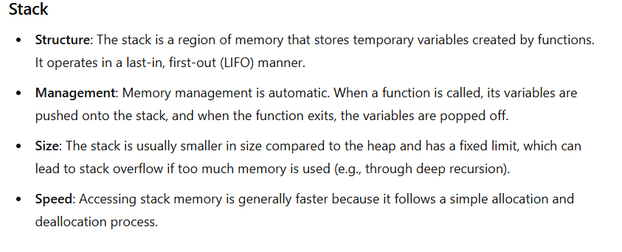
stack
By Eslam Khder

Slide 3
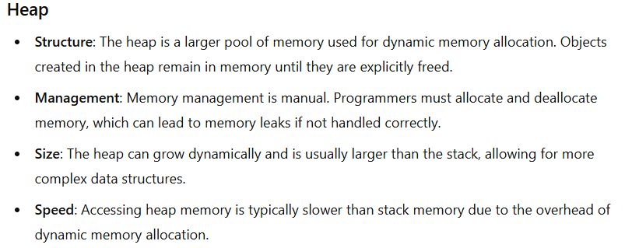
Heap
By Eslam Khder

Slide 4

Heap
By Eslam Khder

Slide 5
search
why Accessing heap memory is typically slower than stack memory.
By Eslam Khder

Slide 6
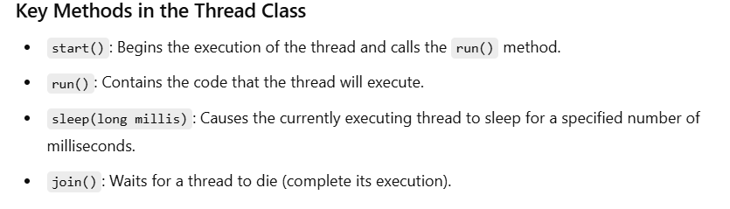
Thread
In Java, a thread is a lightweight process that allows concurrent execution of code. Threads are used to perform multiple tasks simultaneously
By Eslam Khder

Slide 7
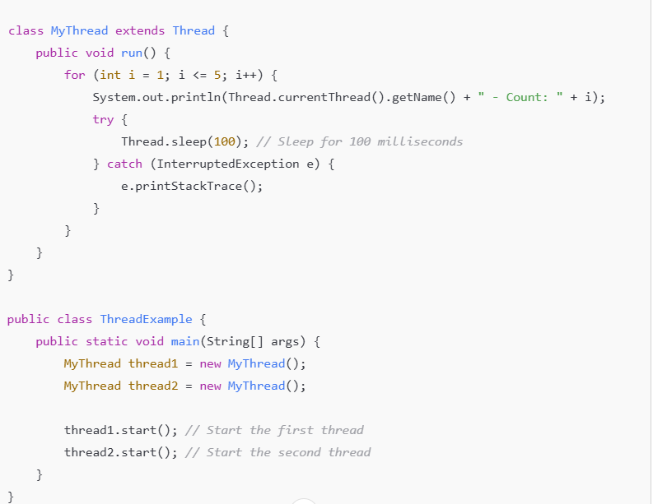
By Eslam Khder

Slide 8
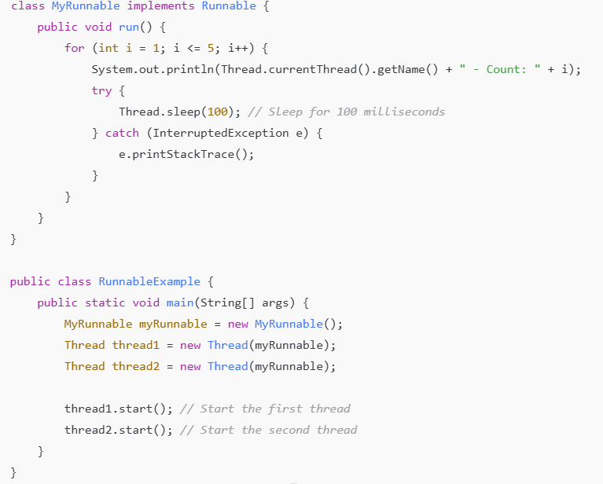
By Eslam Khder

Slide 9
synchronized
In Java, synchronized is a keyword used to control access to a block of code or an object by multiple threads. When a method or a block is marked as synchronized, it ensures that only one thread can execute it at a time,
By Eslam Khder

Slide 10
String, StringBuilder, and StringBuffer
By Eslam Khder

Slide 11
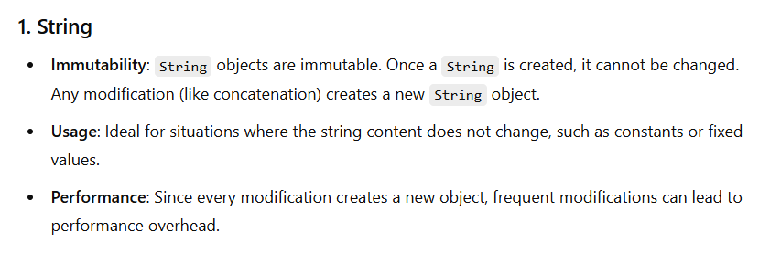
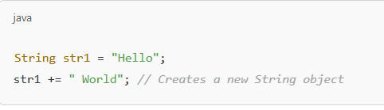
By Eslam Khder

Slide 12
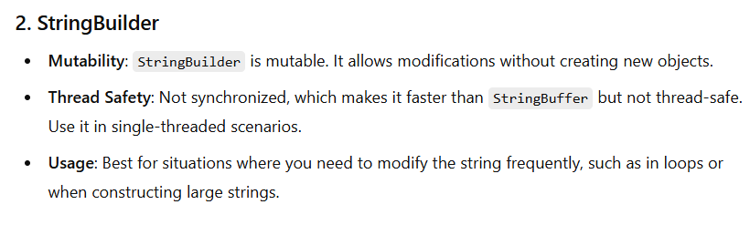
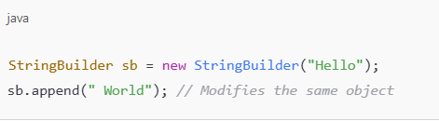
By Eslam Khder

Slide 13
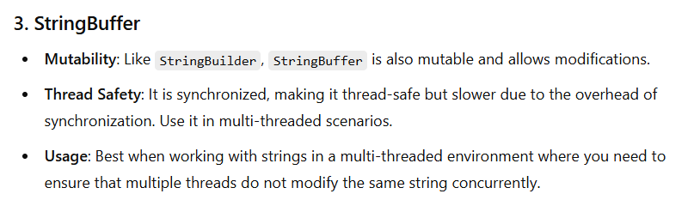
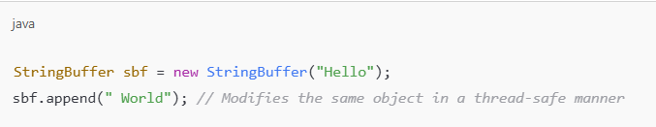
By Eslam Khder

Slide 14
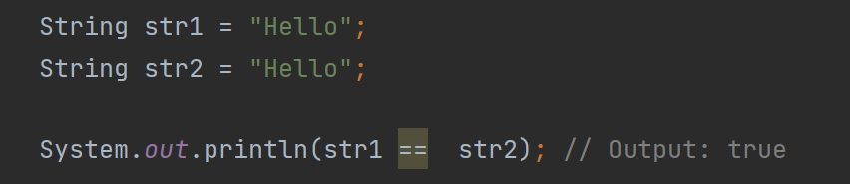
WHY
By Eslam Khder

Slide 15
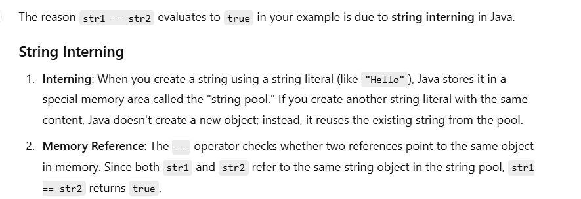
By Eslam Khder

Slide 16
1- برنامج شبه بتاع الحسابات
هقوله عدد الموظفين اللى عندى و بعدين ادخل الاسماء بتاعتهم
و بعد كده ادخل مثلا اسم الموظف و عدد الفلوس اللى خدهم و افضل اكرر العملية دى لحد ما ادوس 0 مثلا
تقوم تعرضلى كل موظف " اسمه و تفاصيل الفلوس اللى خدها و مجموعهم " 2 - هدخل استرنج شبه ده
((()()(()))) و يرجعلى true or false على حسب كل قوس ليه القفلة بتاعته ولا لأ
By Eslam Khder

Slide 17
Design Pattern
The Singleton design pattern ensures that a class has only one instance and provides a global point of access to it. This pattern is commonly used for managing shared resources, such as configuration settings or connection pools.
By Eslam Khder

Slide 18
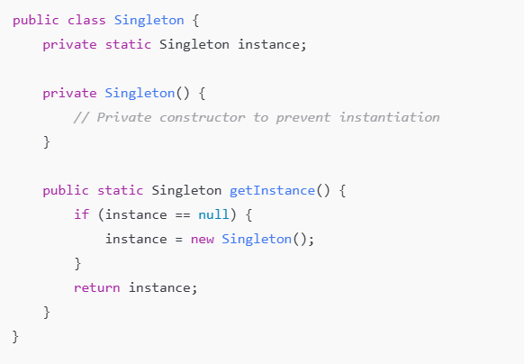
By Eslam Khder

Slide 19
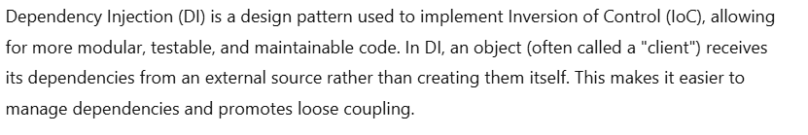
Dependency Injection (DI) - Inversion of Control (IoC)
By Eslam Khder

Slide 20
Write Code
By Eslam Khder

Slide 21
Factory Design Pattern
The Factory Design Pattern is a creational design pattern used to create objects without specifying the exact class of object that will be created. This pattern provides a way to delegate the instantiation logic to subclasses, promoting loose coupling and adherence to the Open/Closed Principle.
By Eslam Khder

Slide 22
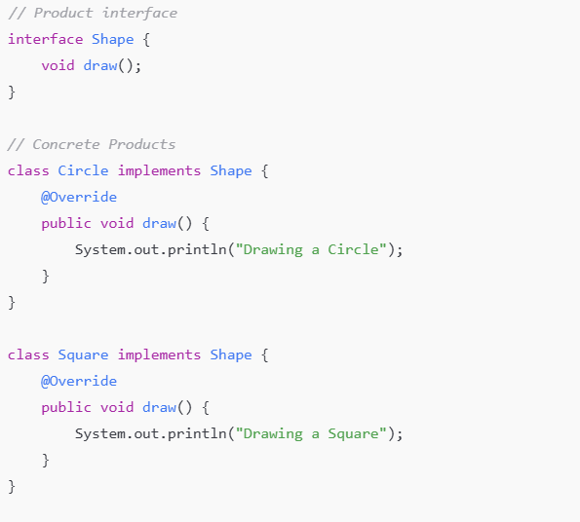
By Eslam Khder

Slide 23
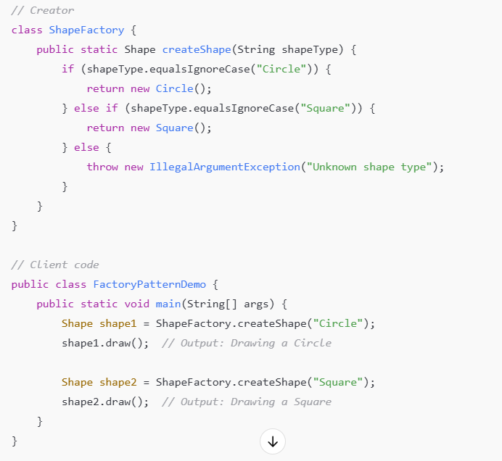
By Eslam Khder

Slide 24
By Eslam Khder

