Slide 1


CSRF
CSRF (Cross-Site Request Forgery) in Spring allows an attacker to make unauthorized requests on behalf of a user.
By Eslam Khder

Slide 2
CSRF
CSRF is an attack where an attacker tricks a user into making an unwanted request to a web application where the user is authenticated. Since the user is logged in, the server assumes that the request is legitimate, and processes it accordingly. This can lead to unauthorized actions being taken on behalf of the user, such as making financial transactions or changing account settings.
By Eslam Khder

Slide 3
CSRF
Spring provides built-in CSRF protection for web applications using Spring Security. CSRF protection in Spring works by ensuring that requests that modify data (such as POST, PUT, DELETE requests) include a special token. This token is tied to the user's session and must be included in the request. If the token is missing or invalid, the request will be rejected.
If you configure csrf().disable() in Spring Security, it completely disables CSRF protection for your application. This means that Spring Security will not check for or require CSRF tokens in requests, regardless of the HTTP method (GET, POST, PUT, DELETE, etc.).
By Eslam Khder

Slide 4
JWT (JSON Web Token)
JWT (JSON Web Token) It is a standard used for securely transmitting information between a client and a server, often in the context of authentication and authorization in web applications.
By Eslam Khder

Slide 5
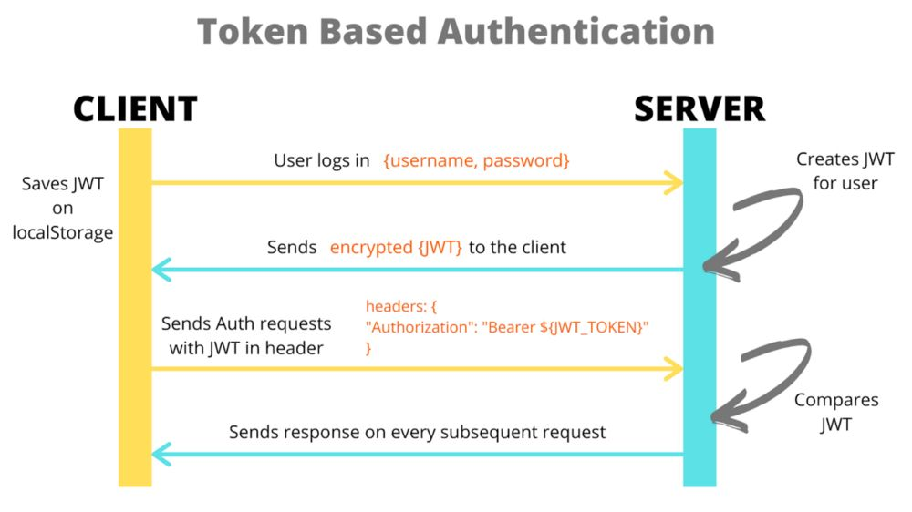
By Eslam Khder

Slide 6
Key Concepts
Claims: These are statements about an entity (typically, the user) and additional data.
JWT Structure: A JWT consists of three parts:
Header: Typically contains the type of token (JWT) and the signing algorithm (e.g., HS256 or RS256).
Payload: Contains the claims (the data), which is not encrypted, only base64 encoded. The
payload is where you put the user data or claims.
Signature: The signature is created using the header, payload, and a secret key (or a private key in asymmetric s
By Eslam Khder

Slide 7
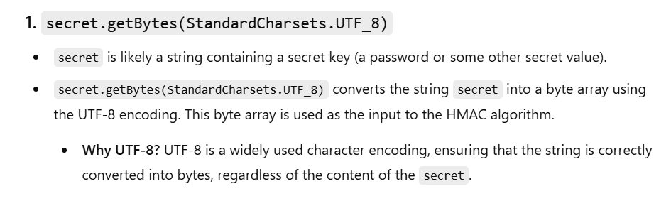
Using StandardCharsets.UTF_8 ensures that the String is always converted to bytes the same way, regardless of the system running the code — which is crucial for consistency and correctness in cryptographic operations like generating HMAC keys.
By Eslam Khder

Slide 8
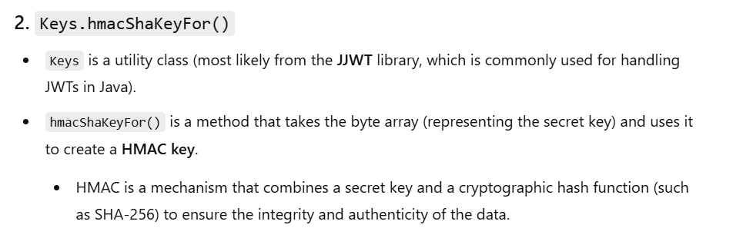
HMAC : Hash-based Message Authentication Code
SHA (Secure Hash Algorithm)
SHA-256?
SHA-256 (Secure Hash Algorithm 256-bit) is a cryptographic hash function
By Eslam Khder

