Slide 1
Introduction to AngularJS
Stacey Mulcahy | Technical Evangelist
Christopher Harrison | Content Developer

Slide 2

Meet Stacey Mulcahy | ‏@bitchwhocodes
Technical Evangelist, Microsoft NYC
Focuses on HTML/JS, IoT, Design & UX
Interviews designers & developers http://bit.ly/1CPUJNX
Talks Marketing & IoT on Channel 9 http://channel9.msdn.com/niners/bitchwhocodes
Blogs at http://thebitchwhocodes.com
Hosts and runs www.younggamemakers.com – teaching kids how to make games

Slide 3

Meet Christopher Harrison | ‏@geektrainer
Content Developer
Focused on ASP.NET and Office 365 development
Microsoft Certified Trainer
Regular presenter at TechEd
Long time geek
Still misses his Commodore 64
Periodic blogger (blog.geektrainer.com)
Marathoner, husband, father of one four legged child

Slide 4
Course Topics
Introduction to AngularJS
01 | Getting Started – Binding & Modules | 04 | Directives
02 | Controllers | 05 | View Management & Routing
03 | Filtering Data | 06 | Service, Provider & External data

Slide 5
Setting Expectations
Target Audience
Web Developers
Experience with JavaScript
Understanding of MVC, MVVM principles
Targeting AngularJS < 2.0
Suggested Prerequisites/Supporting Material
Collected tutorials & articles https://pinboard.in/u:bitchwhocodes/t:angular/
http://www.microsoftvirtualacademy.com/training-courses/single-page-applications-with-jquery-or-angularjs

Slide 6
Join the MVA Community!
Microsoft Virtual Academy
Free online learning tailored for IT Pros and Developers
Over 2.6 million registered users
Up-to-date, relevant training on variety of Microsoft products
“Earn while you learn!”
Get 50 MVA Points for this event!
Visit http://aka.ms/MVA-Voucher
Enter this code: IntroAngularJS (Expires 23Feb15)

Slide 7
Github Repository
Has all demo files along with slides from this session
http://aka.ms/angular

Slide 8
01 | Getting Started – About AngularJS, Binding & Modules
Stacey Mulcahy | Technical Evangelist
Christopher Harrison | Content Developer

Slide 9
Getting Started – About Angular JS, Binding & Modules
The Why and What of AngularJS
How AngularJS works
Hello World AngularJS application
What are AngularJS Modules
Creating an AngularJS Module
Module Architecture

Slide 10
01 | The Why and What of AngularJS
Stacey Mulcahy | Technical Evangelist
Christopher Harrison | Content Developer

Slide 11
What is AngularJS
Front-end JavaScript framework for creating web applications
Open source maintained by Google
MVC pattern
Handles common ( and often trying tasks ) such as DOM manipulation, updating UI based on data or input, registering callbacks.
Declarative programming

Slide 12
Why Use Angular
Good for dynamic web sites / web apps ( CRUD based )
Framework imposes a structure that is good for organization
Helps create responsive ( fast ) websites
Easy to test – to create software that is easily maintained

Slide 13
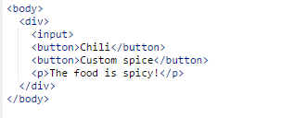
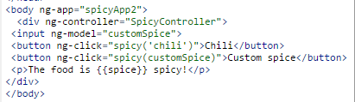
Declarative
AngularJS jQuery
The intention of the application is expressed or declared in the HTML for AngularJS

Slide 14
01 | How AngularJS Works
Stacey Mulcahy | Technical Evangelist
Christopher Harrison | Content Developer

Slide 15
Getting Started – How AngularJS Works
AngularJS will initialize when the DOM content is loaded
Looks for the ng-app directive – if its found, that is the root of the app
Directives can be declared a variety of ways: typically with the ng- prefix, but you can use data-ng
It will load the module associated with the directive if specified

Slide 16
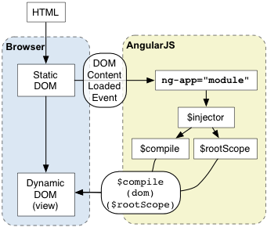
Getting Started – Bootstrap
http://docs.angularjs.org/guide/bootstrap

Slide 17
Getting Started – How AngularJS Works
Angular uses Constructor Injection – dependences are passed into the constructor
Constructor injection enforces order of initialization

Slide 18
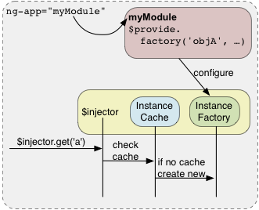
Getting Started – Dependency Injection
https://docs.angularjs.org/guide/di#using-strict-dependency-injection

Slide 19
Hello World AngularJS Application

Slide 20
01 | What are AngularJS Modules
Stacey Mulcahy | Technical Evangelist
Christopher Harrison | Content Developer

Slide 21
Getting Started – What are Modules?
Containers for the various parts of your application ( controllers, services etc )
Declarative – easy to understand
Maintainable, readable, testable
Define dependencies for our app
Module API https://docs.angularjs.org/api/ng/type/angular.Module

Slide 22
Getting Started – Modules Setup
A Module is comprised of configuration and run blocks
Configuration blocks – executed during configuration and registration. Only providers and constants can be passed.
Run blocks – happen after the injector is created. Only instances and constants can be passed in.
Some convenience methods for this
Run blocks is like a main method – it kickstarts the application
Modules can depend on other modules
They are only loaded once.

Slide 23
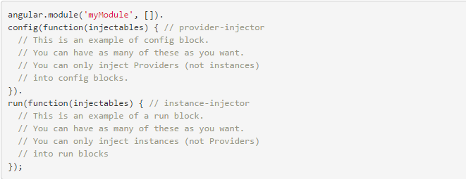
Getting Started – Modules Setup
https://docs.angularjs.org/guide/module

Slide 24
01 | Creating an AngularJS Module
Stacey Mulcahy | Technical Evangelist
Christopher Harrison | Content Developer

Slide 25
Creating a Module
Naming convention is lowerCamelCase
Organize by functionality or component type

Slide 26
Creating an AngularJS Module

Slide 27
Initializing An AngularJS Application Manually

Slide 28
01 | Module Architecture
Stacey Mulcahy | Technical Evangelist
Christopher Harrison | Content Developer

Slide 29
Getting Started – Module Architecture
Modules for each feature
Modules for each reusable component
Application level module with module dependencies injected and any setup

Slide 30
Multiple Modules in AngularJS

