Slide 1
02 | Angular Controllers
Stacey Mulcahy | Technical Evangelist
Christopher Harrison | Content Developer

Slide 2
Angular Controllers
What is a Controller
Creating a Controller
What is $scope
“Controller as” syntax
Multiple Controllers
Sharing Data across Controllers

Slide 3
02 | What is a Controller?
Stacey Mulcahy | Technical Evangelist
Christopher Harrison | Content Developer

Slide 4
What is a Controller?
A controller is a set of JavaScript functions bound to a scope
The ng-controller directive tells Angular to instantiate the new controller object, and inject the new scope as a dependency
Contain business logic for the view
Best for adding logic
Avoid using to manipulate the DOM

Slide 5
02 | Creating a Controller
Stacey Mulcahy | Technical Evangelist
Christopher Harrison | Content Developer

Slide 6
Creating a Controller
Requires ng-controller directive
Add controller code to a module
Name your controller based on functionality
Controllers are named using camel case ( FirstController)
Keep controllers lean

Slide 7
Creating a Controller

Slide 8
02 | Adding Behaviour
Stacey Mulcahy | Technical Evangelist
Christopher Harrison | Content Developer

Slide 9
02 | What is $scope
Stacey Mulcahy | Technical Evangelist
Christopher Harrison | Content Developer

Slide 10
What is $scope?
$scope is an object that refers to the app model
$scope provides the execution context for expressions
$scope is the glue between the controller and the view
Attach properties / functions to scope to make them available to the view
Any objects or primitives that is added to the $scope are considered model properties

Slide 11
Understanding Scope
Child scopes prototypically inherit
Isolate scopes do not
JavaScript Prototypical Inheritance : If it doesn’t exist in current, it will go up the chain ( parent ). Hiding and shadowing of properties.
Best practice of always have a “.” in models
https://github.com/angular/angular.js/wiki/Understanding-Scopes

Slide 12
Adding Behaviour
Business logic in the controller means exposing functions or reacting to events
Append properties or methods to the $scope
These methods need to be exposed to the view

Slide 13
Adding Behaviour

Slide 14
02 | Multiple Controllers
Stacey Mulcahy | Technical Evangelist
Christopher Harrison | Content Developer

Slide 15
Using Multiple Controllers

Slide 16
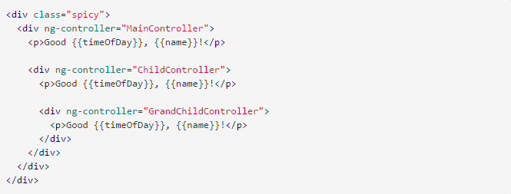
Controller and Scope
https://docs.angularjs.org/guide/controller

Slide 17
Scope and Controllers

Slide 18
02 | Sharing data across Controllers
Stacey Mulcahy | Technical Evangelist
Christopher Harrison | Content Developer

Slide 19
Sharing Data Across Controllers

Slide 20
02 | “Controller as “ syntax
Stacey Mulcahy | Technical Evangelist
Christopher Harrison | Content Developer

Slide 21
“Controller as” Syntax
Defines a named scope
Defines properties on the function ( Controller ) and not the $scope
$scope is still useful for things like $watch ( watching to see if a property changes )

Slide 22
Using “Controller as “ syntax

