Slide 1
TITLE: Credit Risk Analytics: Identifying Drivers of Loan Default
Summer Internship 2025
Role: Data Analyst Intern
Organization: Quant Lake Lending
Intern ID: IN-25-1005

Slide 2
Dataset Overview & Tools Used
Tools:
Python: Data preprocessing & modelling
Excel: EDA and data visualization
Tableau: Interactive dashboards
Workflow:
1. Data Cleaning
2. Exploratory Data Analysis
3. Visualization & Insights

Slide 3
1.Loan Default by Customer Group:
This matrix chart breaks down personal loan acceptance across Family size (1–4) and Education level (1–3).
Customers with higher education (level 2 and 3) and smaller family sizes tend to accept more loans.
It shows that education and family size both impact loan approval rates.

Slide 4
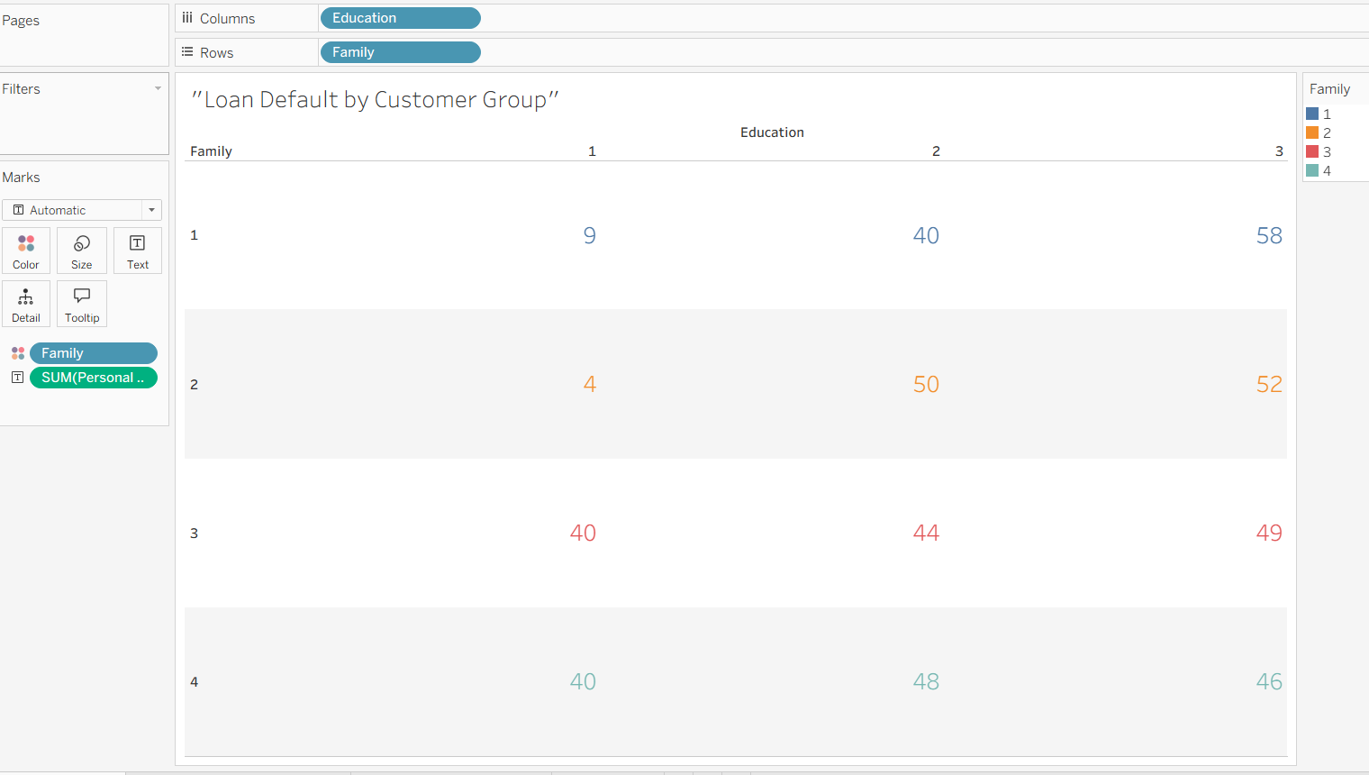

Slide 5
2.Loan Applications: Online vs Offline:
This bar chart compares the number of personal loan acceptances between offline (0) and online (1) users.
Online users (291) have accepted more loans than offline users (189).
This indicates a positive correlation between online banking usage and loan acceptance.
It also shows that customers engaged digitally are more open to banking products.

Slide 6
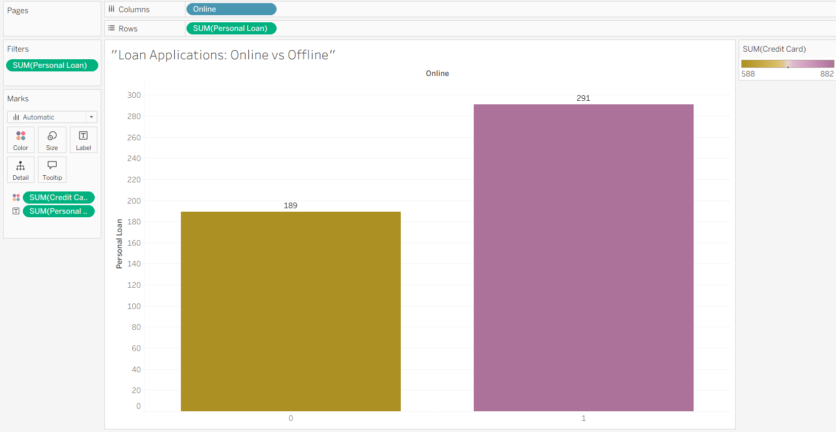

Slide 7
3. Income Distribution by Age:
This scatter plot shows how income varies across different age groups.
Most high-income earners are between ages 35 to 55, peaking around age 45.
Young customers (<30) and older customers (>60) tend to have lower income levels.
This insight is useful to target middle-aged groups for personal loan offers.

Slide 8
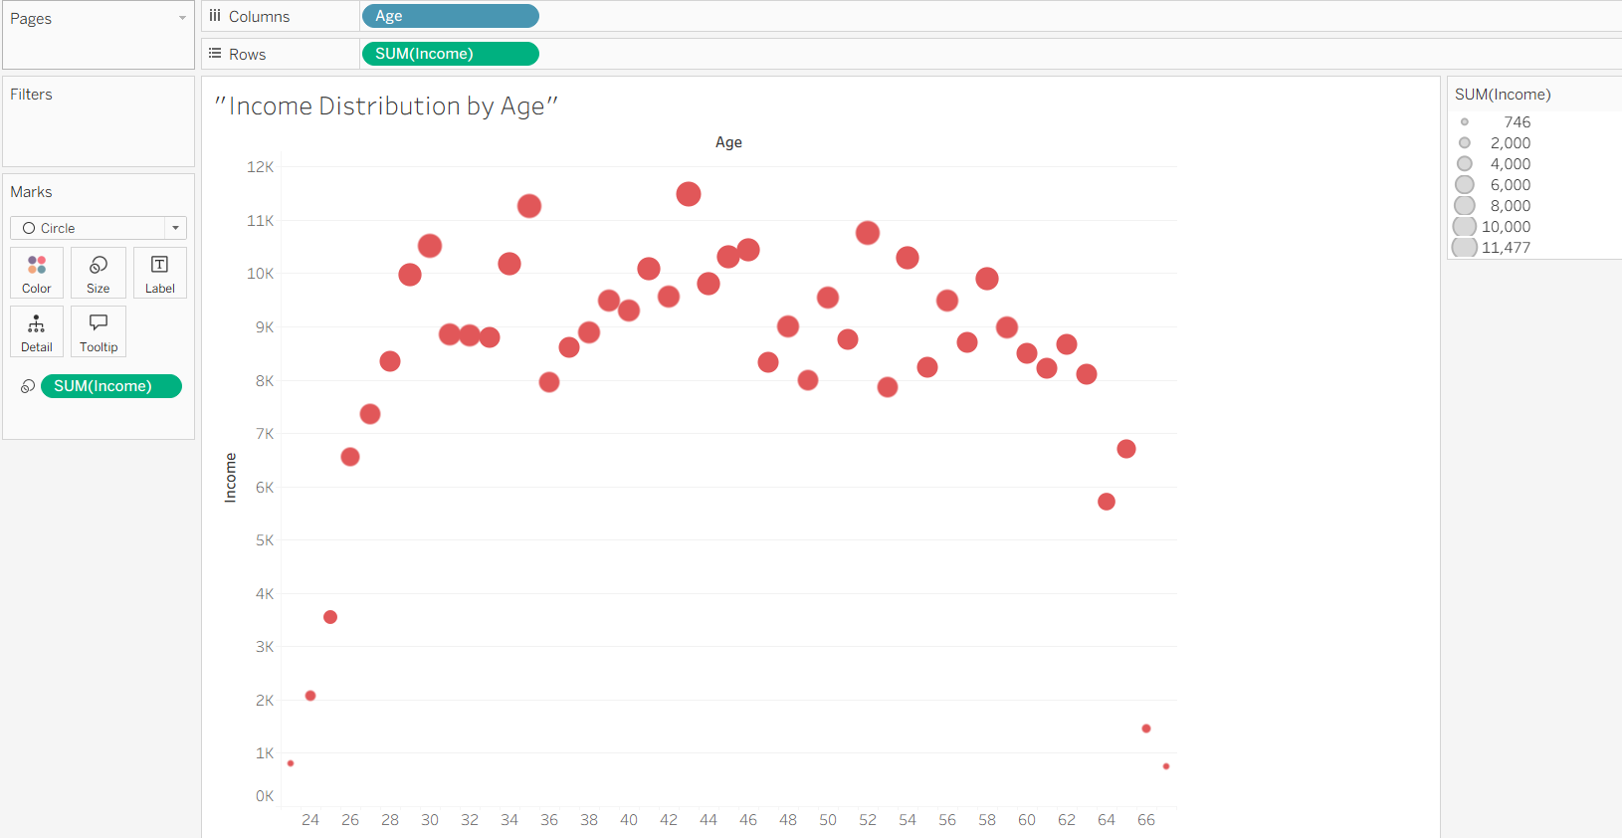

Slide 9
Recommendations & Conclusion
- Focus on customers aged 35–50 with higher education/income
- Encourage online loan applications
- Apply stricter filters for low-income, large-family applicants
- Use education and income-based scorecards in risk models

Slide 10
Key Insights:
1.Higher income & education → More likely to accept loans
2.Online banking users show higher conversion
3.Mortgage amount & family size have weaker correlation

Slide 11
“Thank You”

