Slide 1
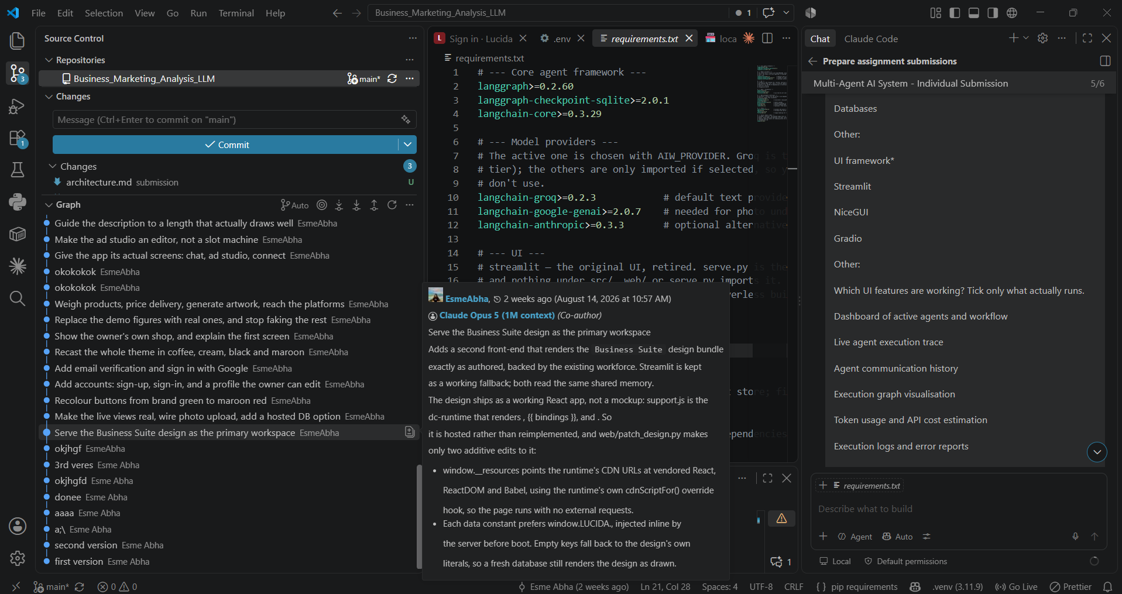
Lucida
Interactive Multi-Agent AI Workforce for a Small Business
• Supervisor-driven business workflow
• 8 specialist agents
• Shared memory + tool integration
• Human approval for risky actions
• Live dashboard + execution trace
AI Workforce | Business Intelligence | LangGraph

Slide 2
Problem and Motivation
Small businesses need support for research, pricing, stock, marketing, customer communication, and delivery.
Single-chatbot tools cannot coordinate end-to-end decisions across multiple tasks.
A real business system must reason, act, and wait for approval before spending money or publishing content.
The system must be explainable, traceable, and grounded in shared memory.
Business workflow automation
Research → pricing → stock → marketing → delivery
One supervisor, many specialists

Slide 3
System Architecture
Owner Request
Supervisor Agent
Market Research | Product Vision | Pricing | Inventory
Ad Creative | Customer Engagement | Delivery | Reporting
Shared Memory + Vector Store + SQLite + Logging
Final Business Recommendation

Slide 4
Specialized Agents
Market Research
Demand, competition, pricing gaps
Product Vision
Image analysis and product fit
Pricing
Cost, margin, break-even
Inventory
Stock tracking and reorder alerts
Ad Creative
Campaign copy and ad generation
Customer Engagement
Message analysis and sentiment
Delivery
Courier quotes and bookings
Reporting
Summaries and recommendations

Slide 5
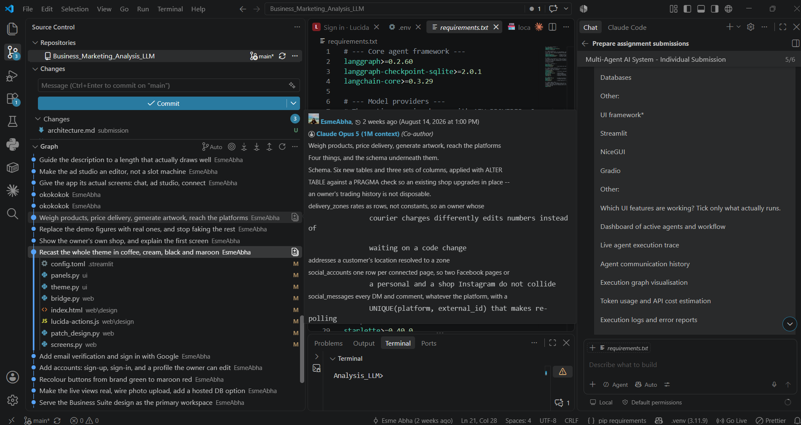
Workflow and Decision Flow
1. User sends a request or uploads a product image
2. Supervisor interprets intent and chooses the next agent
3. Specialist performs the task and writes the result to shared memory
4. Supervisor revisits routing until the goal is complete
5. Risky operations pause for human approval
6. Final answer is generated with evidence and numbers

Slide 6
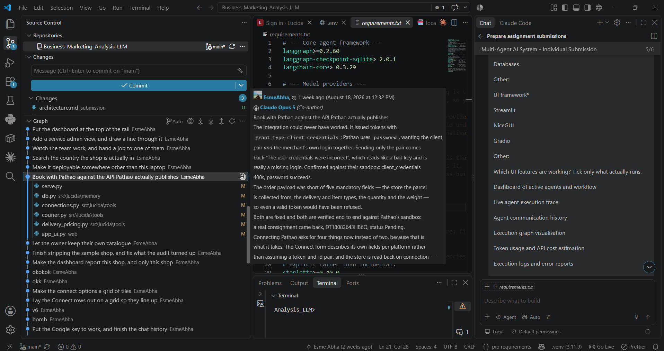
Interactive Dashboard and UI
• Dashboard of active agents and workflow
• Live execution trace and event feed
• Agent communication history
• Execution graph visualisation
• Token usage and API cost estimation
• Logs, errors, and memory viewer
• Human-in-the-loop controls: pause, resume, approve, retry
• Final report and output viewer

Slide 7
Tools, Memory, and Reliability
• Web search and local fallback search
• External business APIs
• Python code execution sandbox
• RAG and vector memory retrieval
• SQLite persistence and graph state
• Logging and error containment
• Owner approval gates before irreversible actions
Shared Memory
Structured data + semantic retrieval
Reliable coordination across agents

Slide 8
Conclusion
Lucida demonstrates a real multi-agent AI system, not a simple chatbot.
A Supervisor agent coordinates specialists, shares memory, and routes work based on the actual business task.
The system is interactive, explainable, and designed for business decision-making with human oversight.
Result: a practical AI workforce for small-business operations and workflow automation.

