Slide 1
Real Time Operating System “FreeRTOS” QUEUE; Task to Task Communication
Sherif Hammad
Using the FreeRTOS Real Time Kernel - a Practical Guide - Cortex M3 Edition (FreeRTOS Tutorial Books)
by Richard Barry

Slide 2
Agenda
What is a queue?
How to create a queue.
How a queue manages the data it contains.
How to send data to a queue.
How to receive data from a queue.
What it means to block on a queue.
The effect of task priorities when writing to and reading from a queue.

Slide 3
What is Queue?
A queue can hold a finite number of fixed size data items.
The maximum number of items a queue can hold is called its ‘length’.
Both the length and the size of each data item are set when the queue is created.
Normally, queues are used as First In First Out (FIFO) buffers where data is written to the end (tail) of the queue and removed from the front (head) of the queue.
It is also possible to write to the front of a queue.
Writing to a queue is a “physical append” to end of the queue.
Reading from a queue is a “logical remove” from the top of the queue.

Slide 4
What is Queue?

Slide 5
Blocking on Queue Reads
When a task attempts to read from a queue it can optionally specify a ‘block’ time.
‘block’ time is the time the task should be kept in the Blocked state to wait for data to be available from the queue should the queue already be empty.
A task that is in the Blocked state, waiting for data to become available from a queue, is automatically moved to the Ready state when another task or interrupt places data into the queue.
The task will also be moved automatically from the Blocked state to the Ready state if the specified block time expires before data becomes available.
Queues can have multiple readers so it is possible for a single queue to have more than one task blocked on it waiting for data.
Only one task will be unblocked when data becomes available. The task that is unblocked will always be the highest priority task that is waiting for data.
If the blocked tasks have equal priority, then the task that has been waiting for data the longest will be unblocked.

Slide 6
Blocking on Queue Writes
A task can optionally specify a block time when writing to a queue.
The block time is the maximum time the task should be held in the Blocked state to wait for space to become available on the queue, should the queue already be full.
Queues can have multiple writers, so it is possible for a full queue to have more than one task blocked on it waiting to complete a send operation.
Only one task will be unblocked when space on the queue becomes available.
The task that is unblocked will always be the highest priority task that is waiting for space.
If the blocked tasks have equal priority, then the task that has been waiting for space the longest will be unblocked.

Slide 7
Example 10. Blocking when receiving from a queue

Slide 8
Example 10. Blocking when receiving from a queue

Slide 9
Example 10. Blocking when receiving from a queue

Slide 10
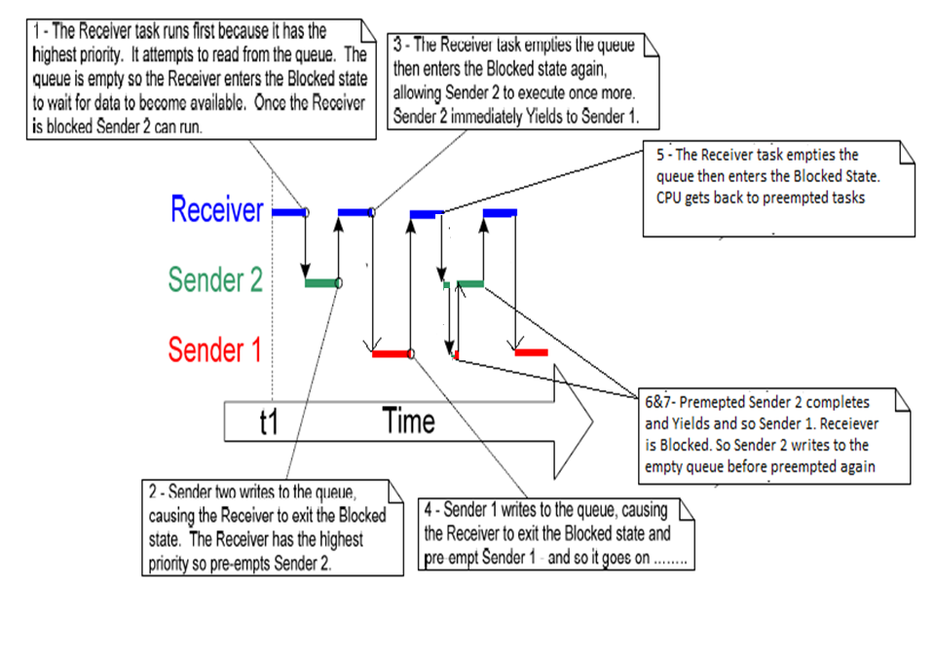
Example 10. Blocking when receiving from a queue

Slide 11
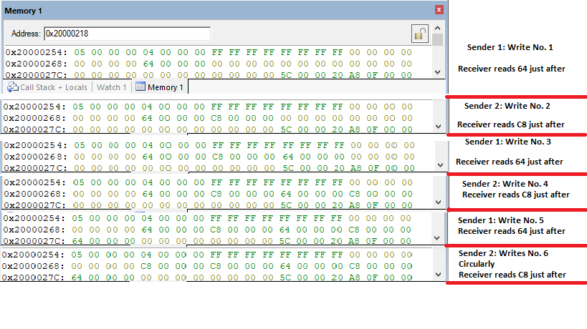
Example 10. Blocking when receiving from a queue

