Slide 1

CSE 3521: Introduction to Artificial Intelligence
[Many slides are adapted from the UC Berkeley. CS188 Intro to AI at UC Berkeley and previous CSE 3521 course at OSU.]

Slide 2

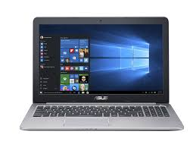
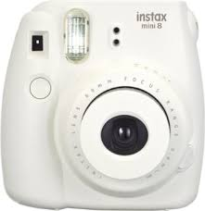
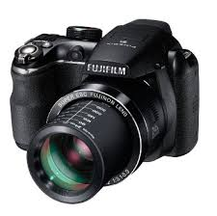
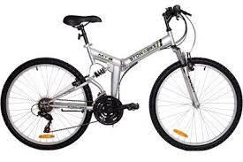
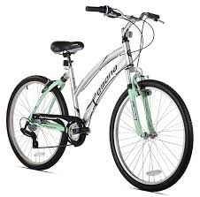
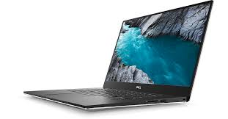
Supervised learning
Data type: $\left\{\left(x_{1},y_{1}\right),…,(x_{N},y_{N})\right\}$
Goal: Build a model so that given a future data instance $x$, it can tell the label $y$
Example: Nearest neighbors
The “label” in $\left\{\left(x_{1},y_{1}\right),…,(x_{N},y_{N})\right\}$provides supervision of how to give each data instance a label
The label can be “numerical” (regression) or “categorical” (classification)
laptop
laptop
camera
camera
bike
bike

Slide 3
The general representation of data instances
Definition:
A categorical value takes one category from a set of categories.
There is no intrinsic ordering of the categories
A numerical value is a real number.
There is a clear ordering and space between values.
Examples:
Coin instance: weight = 2.5 (g), size = 16.5 (mm)
Car instance: brand = Mazda, year = 2015, color = blue

Slide 4
The general representation of data instances
Mathematical representations:
Numerical values: vectors
Categorical values: a one-hot vector for each feature variable (each has exactly one 1)
weight
size
2.5
16.5
or
$$\left[\begin{matrix}2.5 \\ 16.5\end{matrix}\right]$$
Mazda
Toyota
Honda
1
0
0
Mazda
Toyota
Honda
1
0
0
Properties
A vector element: index & value
Every two one-hot vectors of different categories are of the same distance
blue
red
gray
1
0
0
blue
red
gray
1
0
0
concatenation
year
2015

Slide 5
Popular data instances in applications
Computer vision: image & video
Natural language processing: sentence & document
Speech: utterance
Robotics: LiDAR point cloud
Health care: electronic health record (EHR)

Slide 6
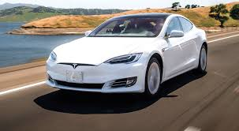
Computer vision
Image (s)
Video (s) = sequence of images
RGB image (s): Three matrices
Gray images (s): One matrix

Slide 7

Natural language processing
Character → Word → Sentence → Document → Doc. collections → …
Artificial intelligence (AI), sometimes called machine intelligence, is intelligence demonstrated by machines, unlike the natural intelligence displayed by humans and animals. Leading AI textbooks define the field as the study of "intelligent agents": any device that perceives its environment and takes actions that maximize its chance of successfully achieving its goals. Colloquially, the term "artificial intelligence" is often used to describe machines (or computers) that mimic "cognitive" functions that humans associate with the human mind, such as "learning" and "problem solving"
Machine learning (ML) is the study of computer algorithms that improve automatically through experience.
It is seen as a subset of artificial intelligence. Machine learning algorithms build a mathematical model based on sample data, known as "training data", in order to make predictions or decisions without being explicitly programmed to do so. Machine learning algorithms are used in a wide variety of applications, such as email filtering and computer vision, where it is difficult or infeasible to develop conventional algorithms to perform the needed tasks.

Slide 8
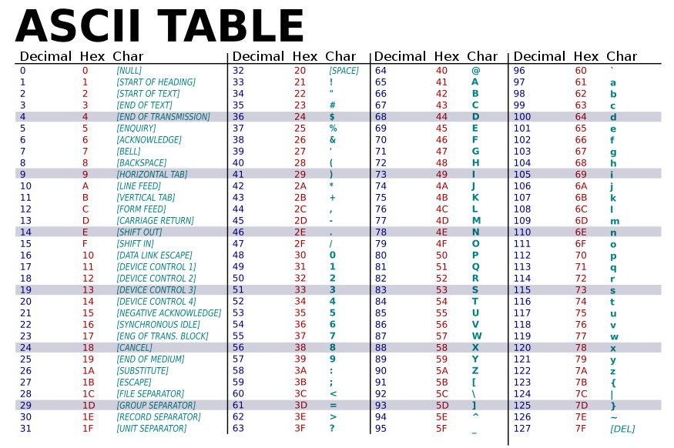
Natural language processing
Character → Word → Sentence → Document → Doc. collections → …
h | a | p | p | y
ASCII Code (symbol):
{0, 1, ……, 255}
104 | 97 | 112 | 112 | 121
Are these numbers “numerical values” or “categorical values” (indices)?
Is “a” (97) semantically closer to “b” (98) than “p” (112)?
If we change the order in the codebook, does it matter?

Slide 9
Natural language processing
Character → Word → Sentence → Document → Doc. collections → …
h | a | p | p | y
104 | 97 | 112 | 112 | 121
One-hot representation:
256-dimensional {0, 1} vector
Each column has exactly one 1
1
0 | 0 | 0 | 0 | 0
… | … | … | … | …
0 | 1 | 0 | 0 | 0
... | … | … | … | …
0 | 0 | 1 | 1 | 0
... | … | … | … | …
0 | 0 | 0 | 0 | 0
97
Properties
A vector element: index & value
Every two one-hot vectors (columns) are of the same distance if they are not the same
256
112
256

Slide 10
Natural language processing
Character → Word → Sentence → Document → Doc. collections → …
A word can be represented as a sequence of character indices (a sequence of one-hot vectors)
A word can be also represented just by a one-hot vector
More: “happy”: 0001235, “pleased”: 0128736, “sad”: 0059875, …… (from a dictionary)
What is the vector dimension?

Slide 11
Natural language processing
Character → Word → Sentence → Document → Doc. collections → …
A sequence of words OR a unique index of each sentence?
If there are 10K unique words, and each sentence is of length 10, how many indices?
tokenization
Machine learning (ML) is the study of computer algorithms that improve automatically through experience.
It is seen as a subset of artificial intelligence. …
“<Start>” “machine” “learning” “(” “<UNK>” “)” “is” “the” “study” “of” “computer” “algorithms” “that” “improve” “automatically” “through experience” “.” “<End>” “<Start>”
“it” “is” “seen” “as” “a” “subset” “of” “artificial” “intelligence” “.” “<End>” …
Sequences of indices/one-hot vectors of words
<UNK>: out-of-vocabulary (OOV) words

Slide 12
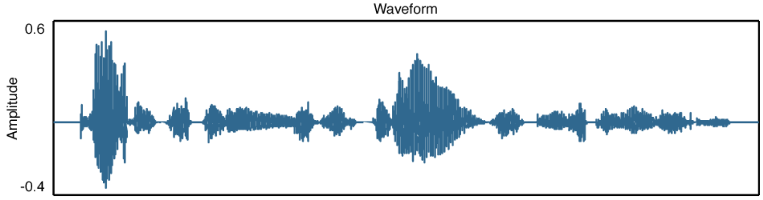
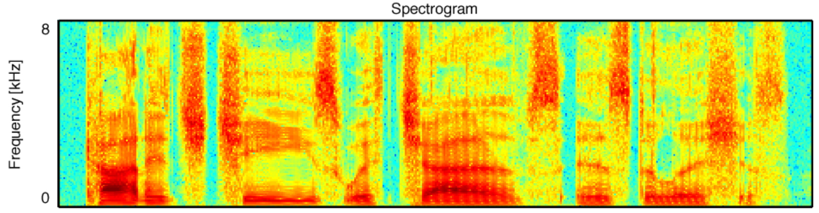
Speech
Utterance: a spoken word, statement, or vocal sound
Time-frequency representation:
Time index
0
+
magnitude
0.03 | -0.03 | 0.06 | -0.07 | 0.12 | -0.13 | 0.17 | -0.16
Frequency index
Time index
Time index

Slide 13
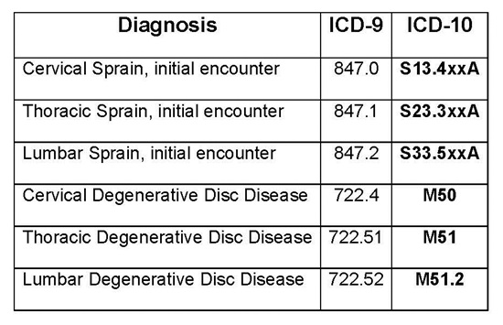
Health care
Electronic health/medical record (HER/EMR)
ICD-9/ ICD-10 codes
Every time you see a doctor, some diagnoses are made (with codes)
Properties
Multi-hot
One-hot
All-zero
code index
Time index

Slide 14
In summary
Data instances from many different applications can be represented by vectors or matrices!
Linear algebra is a very efficient and effective way to perform computation (e.g., discovering patterns) on them!
There are many other ways to represent data instances!

Slide 15


Data representations (aka features)
?
or
or

Slide 16
Machine learning (ML): detect patterns in data
From the perspective of first-order logic:
A coin with weight = 5.65 g and diameter = 23.6 mm ⇒ 10 cent
A coin with weight * 0.2 + diameter * 0.04 < 2 ⇒ 10 cent
Patterns:
to be detected by ML
Built upon features
Feature variables:
Values (facts) are to be extracted from the data
What feature variables should we use/define?

Slide 17

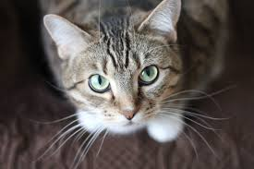

Data vs. features
raw data
features
raw data
features
Artificial intelligence (AI), sometimes called machine intelligence, is intelligence demonstrated by machines, unlike the natural intelligence displayed by humans and animals. Leading AI textbooks define the field as the study of "intelligent agents": any device that perceives its environment and takes actions that maximize its chance of successfully achieving its goals. Colloquially, the term "artificial intelligence" is often used to describe machines (or computers) that mimic "cognitive" functions that humans associate with the human mind, such as "learning" and "problem solving"
Machine learning (ML) is the study of computer algorithms that improve automatically through experience.
It is seen as a subset of artificial intelligence. Machine learning algorithms build a mathematical model based on sample data, known as "training data", in order to make predictions or decisions without being explicitly programmed to do so. Machine learning algorithms are used in a wide variety of applications, such as email filtering and computer vision, where it is difficult or infeasible to develop conventional algorithms to perform the needed tasks.
Can we use raw data representation as features?
If so, why bother further extracting features from the raw data?
simplify the data, remove unrelated information, domain knowledge, ……

Slide 18
Feature extraction
Feature extraction starts from an initial set of measured data and builds derived values (features) intended to be:
Informative
non-redundant
facilitating the subsequent learning and generalization steps
leading to better human interpretations

Slide 19
Feature extraction
Bag-of-words (BOW) representation
BOW for natural language processing and computer vision
Feature normalization: L1 and L2 normalized
Dataset representation
Histogram and Parzen window
Feature correlation
Feature normalization: z-score, whitening
Dimensionality reduction
Principal component analysis (PCA)

Slide 20
Bag of Words (BOW)

Slide 21

Bag of Words (BOW)
A simplified representation of sentences (documents) for classification or retrieval by counting the occurrences of each unique word (or phrase)
ignore the grammar
ignore the word order
keep the word counts (frequencies)
lead to a “fixed”-size vector representation
two
baseball
turn
“Baseball” “is” “a” “bat-and-ball” “game” “played” “between” “two” “opposing” “teams” “who” “take” “turns” “batting” “and” “fielding” “.”
who
game
is
bat-and-ball
play
between
opposing
teams
batting
and
A sequence of tokens (and their indices)
fielding

Slide 22
Bag of Words (BOW)
Given:
A dictionary, vocabulary, or codebook: f(token) → index $∈ \left\{1, ⋯, D\right\}$or N/A
An all-0 vector: $x$ = $\left[\begin{matrix}x[1] \\ ⋮ \\ x[D]\end{matrix}\right]=\left[\begin{matrix}0 \\ ⋮ \\ 0\end{matrix}\right]$
Input: A sequence of word tokens w[1], w[2], ….. w[M]
for m = 1 : M
if f(w[m]) ~= N/A
$x[f(\text{w}\text{[}\text{m}\text{]}\text{)}]$+= 1
end
end
Return: $x$
Out-of-vocabulary
“Stop” words: too frequent in all sentences/documents and less informative in differentiating them (e.g., “is”, “are”, “and”, ……)
Word token counts

Slide 23
Example: BOW for classification
Consider a document classification:
{sports, economics}
Nearest neighbor classification (NNC)
Compute distance to all training documents, each of them is represented by BOW
Output the “label” of the nearest document
Training documents
Sports
$$\left[⋮\right]$$
$$\left[⋮\right]$$
$$\left[⋮\right]$$
$$\left[⋮\right]$$
$$\left[⋮\right]$$
$$\left[⋮\right]$$
$$\left[⋮\right]$$
Baseball is a bat-and-ball game played between two opposing teams who take turns batting and fielding.
$$\left[⋮\right]$$
$$\left[⋮\right]$$
$$\left[⋮\right]$$
compute distance
$$\left[⋮\right]$$
$$\left[⋮\right]$$
Economics

Slide 24
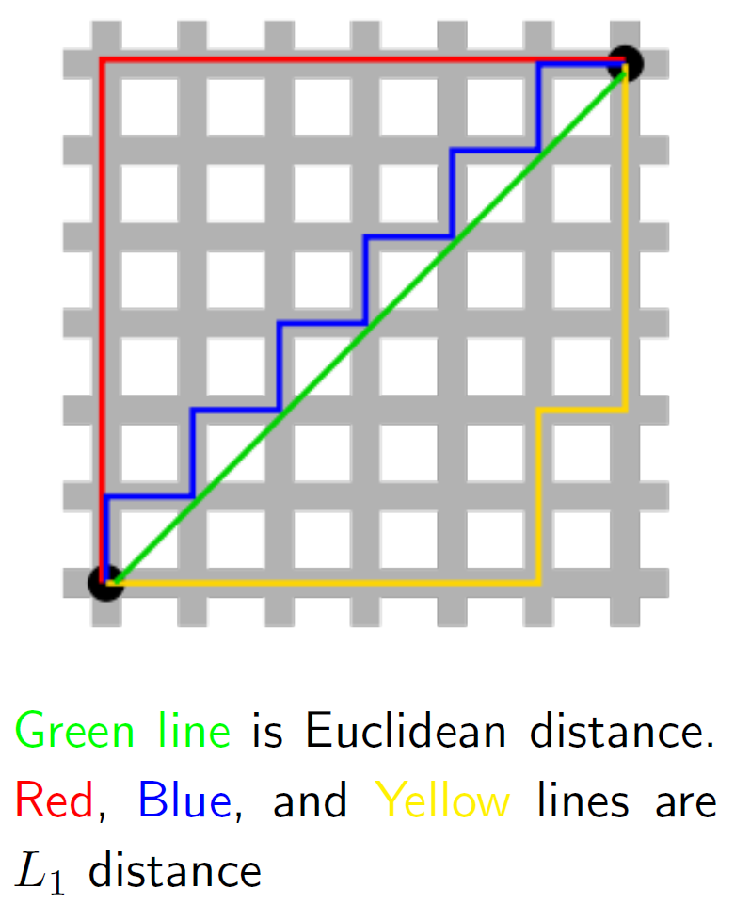
Example: BOW for classification
Distance
Euclidean (L₂) distance:
L₁ distance:
L_{p} norm:
$x$: 2-dimensional vectors
$${\left\|x−x_{n}\right\|}_{2}={\left(\sum_{d=1}^{D}{{\left(x\left[d\right]−x_{n}[d]\right)}^{2}}\right)}^{1/2}$$
$${\left\|x−x_{n}\right\|}_{1}=\sum_{d=1}^{D}{\left|x\left[d\right]−x_{n}[d]\right|}$$
$${\left\|x−x_{n}\right\|}_{p}={\left(\sum_{d=1}^{D}{{\left|x\left[d\right]−x_{n}[d]\right|}^{p}}\right)}^{1/p}$$

Slide 25
Example: BOW for classification
Given: a distance metric dis, a training set = $\left\{\left(x_{1},y_{1}\right),…,(x_{N},y_{N})\right\}$, $t=∞$ (min distance), $y$(predicted label)
Input: a test data instance $x$
for n = 1 : N
if dis($x$, $x_{n}$)$<t$
$y$= $y_{n}$
$t$ = dis($x$, $x_{n}$)
end
end
Return: $y$
Label:
$y$ $∈$ {sports, economics}
$y∈$ {-1, 1} or {0, 1}
$y∈$ {1, …, C}

Slide 26
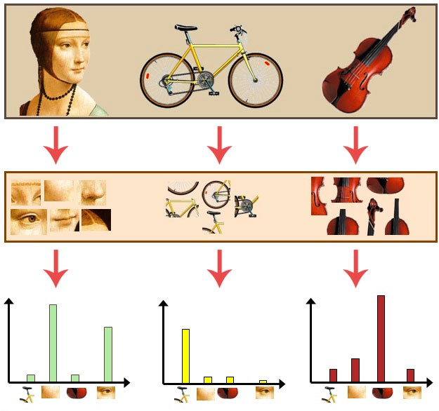
Bag of Words (BOW) for images
BOW can be applied to vision
Vocabulary: D image patches
Each image: a bag of patches
BOW representation: D-dim
For each image patch I[m], find the “nearest” patch in the vocabulary and use its index $∈$ {1, …, D} to represent I[m]
Count the time that each index shows up in the image
Image
Image patches
(Bag of patches)
BOW representation
Vocabulary

Slide 27
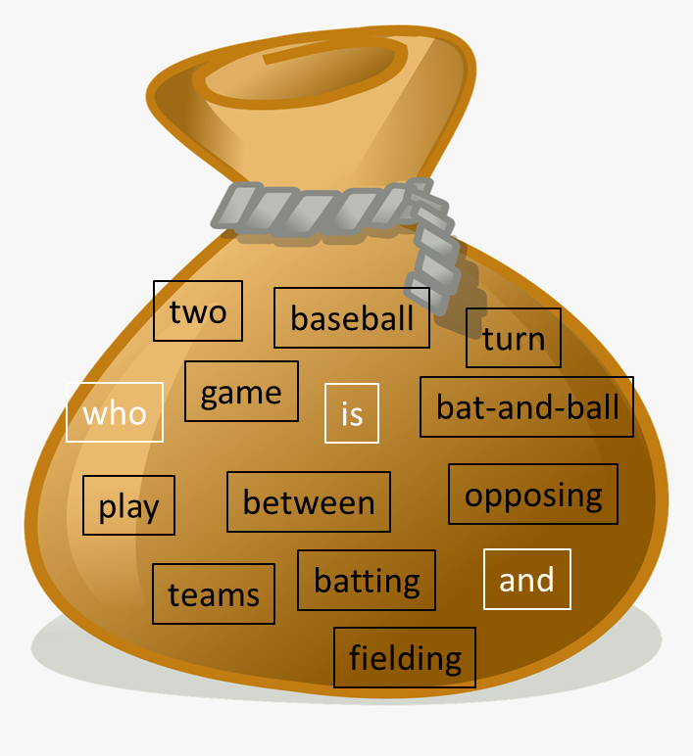
Bag of Words (BOW)
What do we lose?
What the original sequence was
Pros:
Simplified, easily-understandable, fixed-size
Baseball is a bat-and-ball game played between two opposing teams who take turns batting and fielding.
$$x$$

Slide 28
Bag of Words (BOW)
Cons:
missing the sequential information (e.g., “sheep follow wolfs” vs. “wolfs follow sheep”)
not normalized (e.g., comparing long vs. short documents)
words treated as independent (e.g., no synonyms and antonyms)
highly sparse, high dimensional

Slide 29
N-gram vocabulary
…
1
…
1
…
1
…
1
…
1
…
…
1
…
Cons 1: Missing the sequential information
One solution: N-gram vocabulary
1-gram (unigram): “sheep”, “follow”, “wolfs”
2-gram (bigram): “sheep-follow”, “follow-wolfs”
3-gram: “sheep-follow-wolfs”
…
Size of the vocabulary: D + D² + D³
“Sheep follow wolfs” becomes:
“sheep”
“follow”
“wolfs”
“sheep-follow”
“follow-wolfs”
“sheep-follow-wolfs”
1-gram
2-gram
3-gram

Slide 30
Dataset-independent normalization
Cons 2: not normalized
Sheep follow wolfs.
Sheep follow wolfs. Sheep follow wolfs.
…
1
…
1
…
1
…
…
2
…
2
…
2
…
“sheep”
“follow”
“wolfs”
“sheep”
“follow”
“wolfs”
compute distance

Slide 31
Dataset-independent normalization
Cons 2: not normalized
One solution: feature normalization
Vector norm (i.e., length or magnitude):
L_{p} normalization:
Properties
After L_{p} normalization, ${\left\|z\right\|}_{p}=1$
Proof:
$${\left\|\frac{x}{{\left\|x\right\|}_{p}}\right\|}_{p}={\left(\sum_{d=1}^{D}{{\left|\frac{x\left[d\right]}{{\left\|x\right\|}_{p}}\right|}^{p}}\right)}^{1/p}$$
$$={\left({\left(\frac{1}{{\left\|x\right\|}_{p}}\right)}^{p}\sum_{d=1}^{D}{{\left|x\left[d\right]\right|}^{p}}\right)}^{1/p}$$
$$={\frac{1}{{\left\|x\right\|}_{p}}\left(\sum_{d=1}^{D}{{\left|x\left[d\right]\right|}^{p}}\right)}^{1/p}$$
$=1$
$${\left\|x\right\|}_{p}={\left(\sum_{d=1}^{D}{{\left|x\left[d\right]\right|}^{p}}\right)}^{1/p}$$
$$z=\frac{x}{{\left\|x\right\|}_{p}}=\left[\begin{matrix}\frac{x[1]}{{\left\|x\right\|}_{p}} \\ ⋮ \\ \frac{x[D]}{{\left\|x\right\|}_{p}}\end{matrix}\right]$$

Slide 32
Dataset-independent normalization
Cons 2: not normalized
One solution: feature normalization
L₁ normalization: popular for counts (frequency, probability)
L₂ normalization: widely used if the vector angle plays an important role
…
1
…
1
…
1
…
…
1/3
…
1/3
…
1/3
…
…
1/3
…
1/3
…
1/3
…
…
2
…
2
…
2
…
“sheep”
“follow”
“wolfs”
“sheep”
“follow”
“wolfs”
$$x\left[2\right]$$
(1, 3)
(4, 1.5)
$$x\left[1\right]$$

Slide 33
Bag of Words (BOW)
Cons:
missing the sequential information (e.g., “sheep follow wolfs” vs. “wolfs follow sheep”)
not normalized (e.g., comparing long vs. short documents)
words treated as independent (e.g., no synonyms and antonyms)
highly sparse, high dimensional

Slide 34
Summary
Data and data representation (features)
Numerical vs. categorical variables
Feature extraction: from raw data to simplified, informative, non-redundant, or more interpretable representations
Bag-of-words (BoW) representation
Fixed-sized representations for sentences and documents (and images)
Nearest neighbor classification based on distance metrics

