Slide 1

CSE 3521: Introduction to Artificial Intelligence
[Many slides are adapted from the UC Berkeley. CS188 Intro to AI at UC Berkeley and previous CSE 3521 course at OSU.]

Slide 2

Bag of Words (BOW)
A simplified representation of sentences (documents) for classification or retrieval by counting the occurrences of each unique word (or phrase)
ignore the grammar
ignore the word order
keep the word counts (frequencies)
lead to a “fixed”-size vector representation
two
baseball
turn
“Baseball” “is” “a” “bat-and-ball” “game” “played” “between” “two” “opposing” “teams” “who” “take” “turns” “batting” “and” “fielding” “.”
who
game
is
bat-and-ball
play
between
opposing
teams
batting
and
A sequence of tokens (and their indices)
fielding

Slide 3

Bag of Words (BOW)
Given:
A dictionary, vocabulary, or codebook: f(token) → index $∈ \left\{1, ⋯, D\right\}$or N/A
An all-0 vector: $x$ = $\left[\begin{matrix}x[1] \\ ⋮ \\ x[D]\end{matrix}\right]=\left[\begin{matrix}0 \\ ⋮ \\ 0\end{matrix}\right]$
Input: A sequence of word tokens w[1], w[2], ….. w[M]
for m = 1 : M
if f(w[m]) != N/A
$x[f(\text{w}\text{[}\text{m}\text{]}\text{)}]$+= 1
end
end
Return: $x$

Slide 4
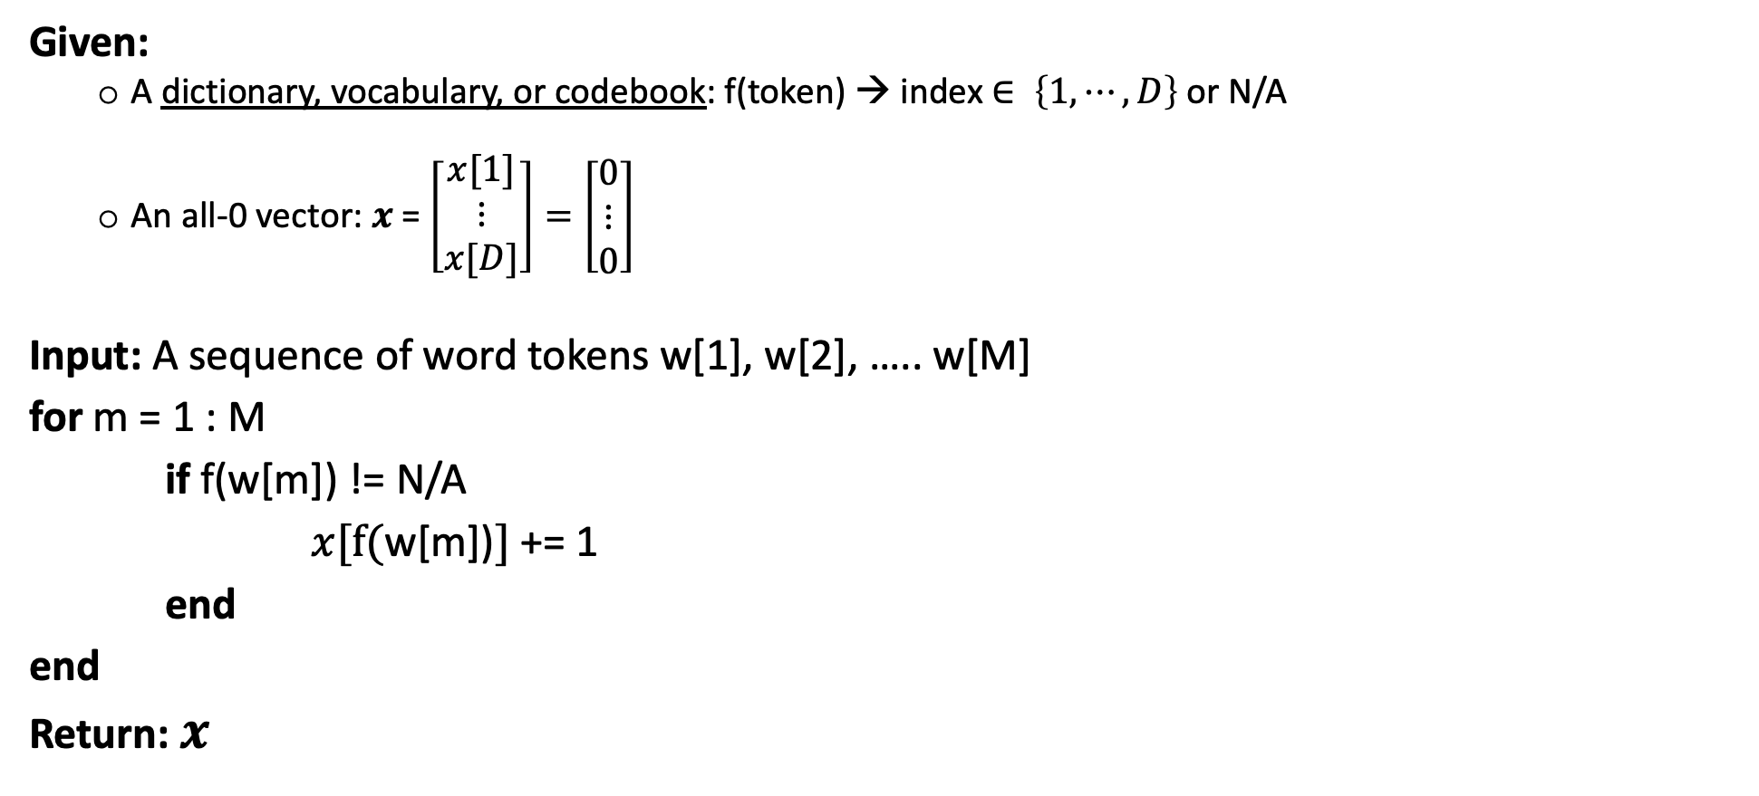
Bag of Words (BOW)
Given:
A dictionary, vocabulary, or codebook: f(token) → index $∈ \left\{1, ⋯, D\right\}$or N/A
An all-0 vector: $x$ = $\left[\begin{matrix}x[1] \\ ⋮ \\ x[D]\end{matrix}\right]=\left[\begin{matrix}0 \\ ⋮ \\ 0\end{matrix}\right]$
Input: A sequence of word tokens w[1], w[2], ….. w[M]
for m = 1 : M
if f(w[m]) != N/A
$x[f(\text{w}\text{[}\text{m}\text{]}\text{)}]$+= 1
end
end
Return: $x$

Slide 5
Bag of Words (BOW)
Given:
A dictionary, vocabulary, or codebook: f(token) → index $∈ \left\{1, ⋯, D\right\}$or N/A
An all-0 vector: $x$ = $\left[\begin{matrix}x[1] \\ ⋮ \\ x[D]\end{matrix}\right]=\left[\begin{matrix}0 \\ ⋮ \\ 0\end{matrix}\right]$
Input: A sequence of word tokens w[1], w[2], ….. w[M]
for m = 1 : M
if f(w[m]) != N/A
$x[f(\text{w}\text{[}\text{m}\text{]}\text{)}]$+= 1
end
end
Return: $x$
Out-of-vocabulary
“Stop” words: too frequent in all sentences/documents and less informative in differentiating them (e.g., “is”, “are”, “and”, ……)
Word token counts

Slide 6
Example: BOW for classification
Consider a document classification:
{sports, economics}
Nearest neighbor classification (NNC)
Compute distance to all training documents, each of them is represented by BOW
Output the “label” of the nearest document
Training documents
Sports
$$\left[⋮\right]$$
$$\left[⋮\right]$$
$$\left[⋮\right]$$
$$\left[⋮\right]$$
$$\left[⋮\right]$$
$$\left[⋮\right]$$
$$\left[⋮\right]$$
Baseball is a bat-and-ball game played between two opposing teams who take turns batting and fielding.
$$\left[⋮\right]$$
$$\left[⋮\right]$$
$$\left[⋮\right]$$
compute distance
$$\left[⋮\right]$$
$$\left[⋮\right]$$
Economics

Slide 7
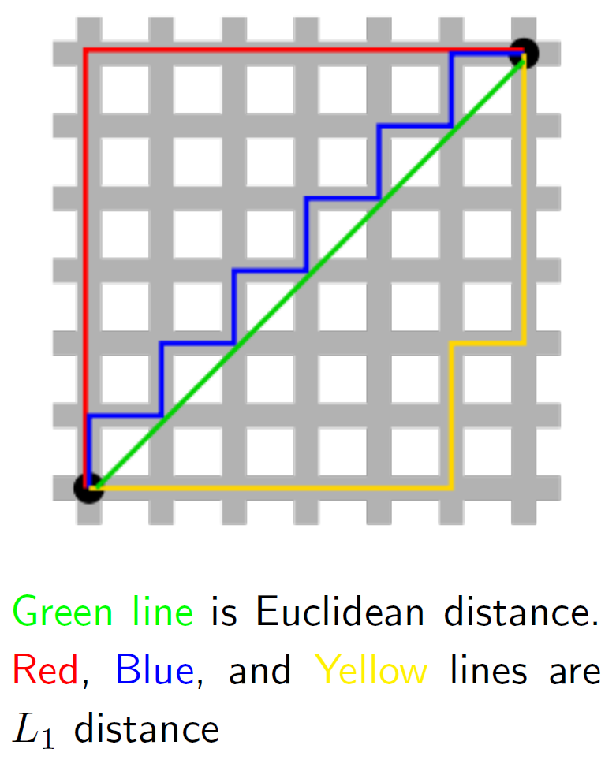
Example: BOW for classification
Distance
Euclidean (L₂) distance:
L₁ distance:
L_{p} norm:
$x$: 2-dimensional vectors
$${\left\|x−x_{n}\right\|}_{2}={\left(\sum_{d=1}^{D}{{\left(x\left[d\right]−x_{n}[d]\right)}^{2}}\right)}^{1/2}$$
$${\left\|x−x_{n}\right\|}_{1}=\sum_{d=1}^{D}{\left|x\left[d\right]−x_{n}[d]\right|}$$
$${\left\|x−x_{n}\right\|}_{p}={\left(\sum_{d=1}^{D}{{\left|x\left[d\right]−x_{n}[d]\right|}^{p}}\right)}^{1/p}$$

Slide 8
Example: BOW for classification
Given: a distance metric dis, a training set = $\left\{\left(x_{1},y_{1}\right),…,(x_{N},y_{N})\right\}$, $t=∞$ (min distance), $y$(predicted label)
Input: a test data instance $x$
for n = 1 : N
if dis($x$, $x_{n}$)$<t$
$y$= $y_{n}$
$t$ = dis($x$, $x_{n}$)
end
end
Return: $y$
Label:
$y$ $∈$ {sports, economics}
$y∈$ {-1, 1} or {0, 1}
$y∈$ {1, …, C}

Slide 9
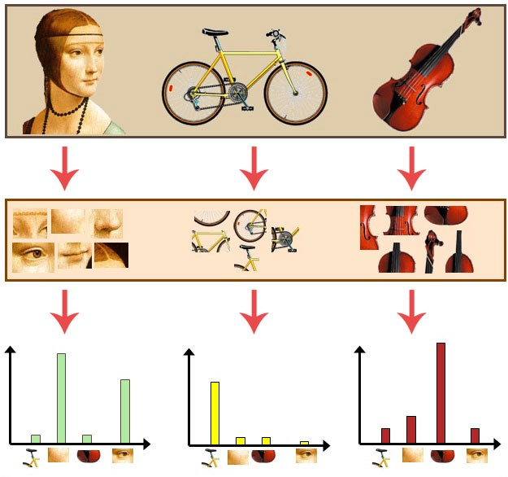
Bag of Words (BOW) for images
BOW can be applied to vision
Vocabulary: D image patches
Each image: a bag of patches
BOW representation: D-dim
For each image patch I[m], find the “nearest” patch in the vocabulary and use its index $∈$ {1, …, D} to represent I[m]
Count the time that each index shows up in the image
Image
Image patches
(Bag of patches)
BOW representation
Vocabulary

Slide 10
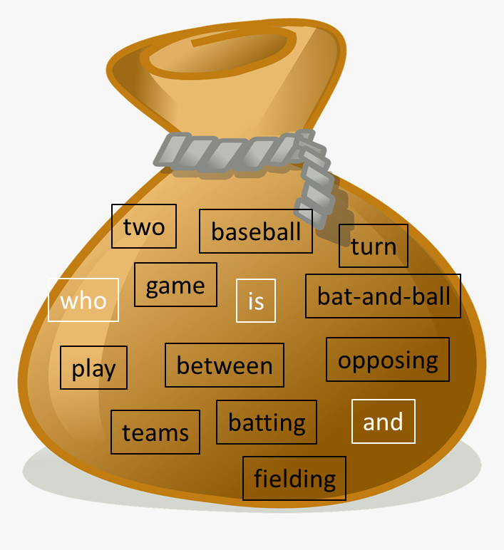

Bag of Words (BOW)
Pros:
Simplified, easily-understandable, fixed-size
What do we lose?
What the original sequence was
$$x$$
Baseball is a bat-and-ball game played between two opposing teams who take turns batting and fielding.

Slide 11
Bag of Words (BOW)
Cons:
missing the sequential information (e.g., “sheep follow wolfs” vs. “wolfs follow sheep”)
not normalized (e.g., comparing long vs. short documents)
words treated as independent (e.g., no synonyms and antonyms)
highly sparse, high dimensional

Slide 12
N-gram vocabulary
…
1
…
1
…
1
…
1
…
1
…
…
1
…
Cons 1: Missing the sequential information
One solution: N-gram vocabulary
1-gram (unigram): “sheep”, “follow”, “wolfs”
2-gram (bigram): “sheep-follow”, “follow-wolfs”
3-gram: “sheep-follow-wolfs”
…
Size of the vocabulary: D + D² + D³
“Sheep follow wolfs” becomes:
“sheep”
“follow”
“wolfs”
“sheep-follow”
“follow-wolfs”
“sheep-follow-wolfs”
1-gram
2-gram
3-gram

Slide 13
Dataset-independent normalization
Cons 2: not normalized
Sheep follow wolfs.
Sheep follow wolfs. Sheep follow wolfs.
…
1
…
1
…
1
…
…
2
…
2
…
2
…
“sheep”
“follow”
“wolfs”
“sheep”
“follow”
“wolfs”
compute distance

Slide 14
Dataset-independent normalization
Cons 2: not normalized
One solution: feature normalization
Vector norm (i.e., length or magnitude):
L_{p} normalization:
$${\left\|x\right\|}_{p}={\left(\sum_{d=1}^{D}{{\left|x\left[d\right]\right|}^{p}}\right)}^{1/p}$$
$$z=\frac{x}{{\left\|x\right\|}_{p}}=\left[\begin{matrix}\frac{x[1]}{{\left\|x\right\|}_{p}} \\ ⋮ \\ \frac{x[D]}{{\left\|x\right\|}_{p}}\end{matrix}\right]$$

Slide 15
Dataset-independent normalization
Cons 2: not normalized
One solution: feature normalization
L₁ normalization: popular for counts (frequency, probability)
L₂ normalization: widely used if the vector angle plays an important role
…
1
…
1
…
1
…
…
1/3
…
1/3
…
1/3
…
…
1/3
…
1/3
…
1/3
…
…
2
…
2
…
2
…
“sheep”
“follow”
“wolfs”
“sheep”
“follow”
“wolfs”
$$x\left[2\right]$$
(1, 3)
(4, 1.5)
$$x\left[1\right]$$

Slide 16
Bag of Words (BOW)
Cons:
missing the sequential information (e.g., “sheep follow wolfs” vs. “wolfs follow sheep”)
not normalized (e.g., comparing long vs. short documents)
words treated as independent (e.g., no synonyms and antonyms)
highly sparse, high dimensional

Slide 17
Summary
Data and data representation (features)
Numerical vs. categorical variables
Feature extraction: from raw data to simplified, informative, non-redundant, or more interpretable representations
Bag-of-words (BoW) representation
Fixed-sized representations for sentences and documents (and images)
Nearest neighbor classification based on distance metrics

