Slide 1
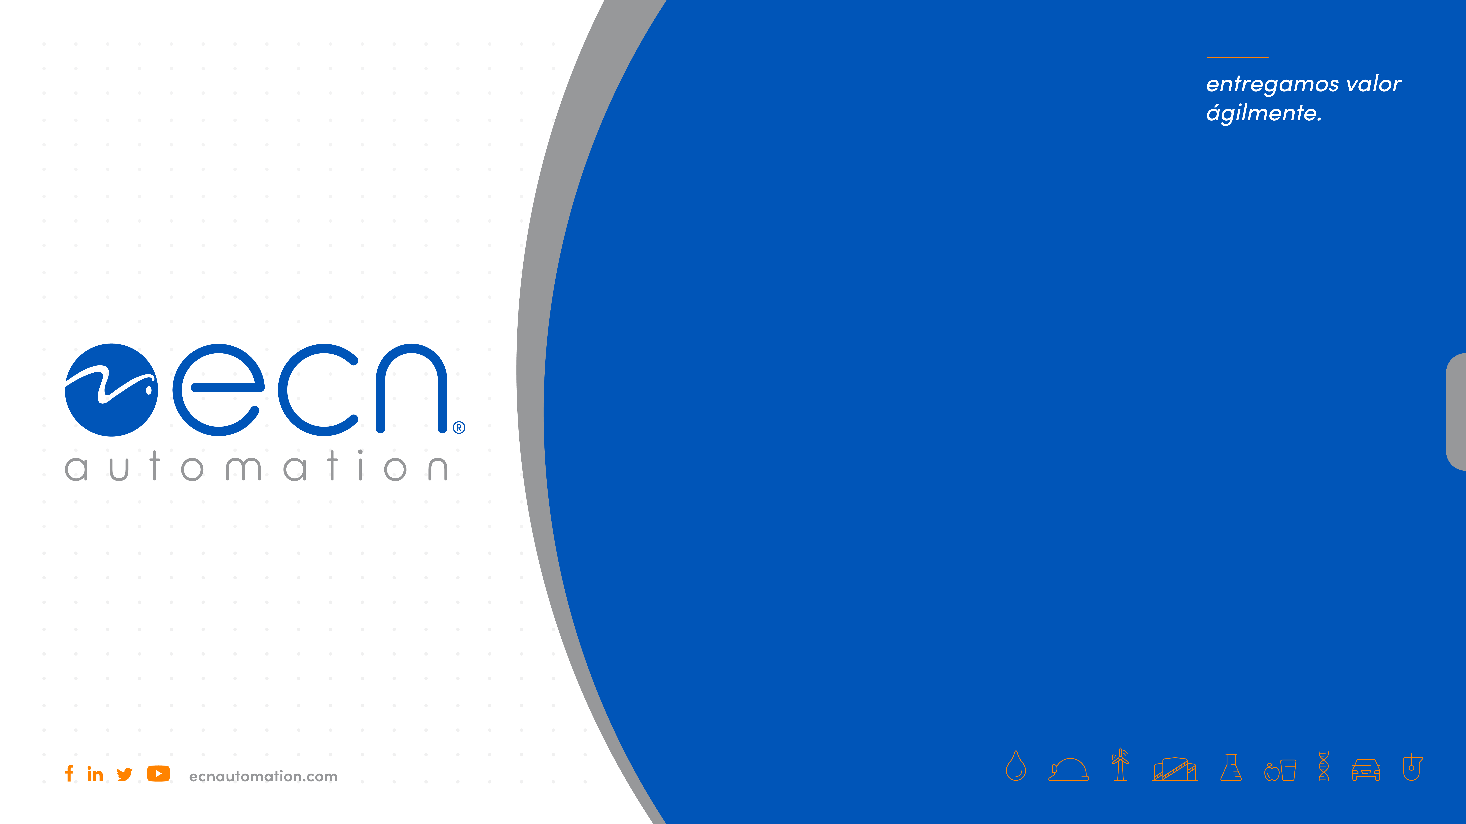
Transforming Traditional Industrial Networks.

Slide 2

Transforming Traditional Industrial Networks.
Leading digital transformation for The Connected Enterprise with industrial ready, world- class control, power and information systems and IT networking and security technologies.

Slide 3
Transforming Traditional Industrial Networks.
Leading digital transformation for The Connected Enterprise with industrial ready, world- class control, power and information systems and IT networking and security technologies.

Slide 4
Transforming Traditional Industrial Networks.
Leading digital transformation for The Connected Enterprise with industrial ready, world- class control, power and information systems and IT networking and security technologies.

Slide 5
Transforming Traditional Industrial Networks.
Leading digital transformation for The Connected Enterprise with industrial ready, world- class control, power and information systems and IT networking and security technologies.

Slide 6
Transforming Traditional Industrial Networks.
Leading digital transformation for The Connected Enterprise with industrial ready, world- class control, power and information systems and IT networking and security technologies.

Slide 7
Transforming Traditional Industrial Networks.
Leading digital transformation for The Connected Enterprise with industrial ready, world- class control, power and information systems and IT networking and security technologies.

Slide 8
Transforming Traditional Industrial Networks.
Leading digital transformation for The Connected Enterprise with industrial ready, world- class control, power and information systems and IT networking and security technologies.

Slide 9
Transforming Traditional Industrial Networks.
Leading digital transformation for The Connected Enterprise with industrial ready, world- class control, power and information systems and IT networking and security technologies.

Slide 10
Transforming Traditional Industrial Networks.
Leading digital transformation for The Connected Enterprise with industrial ready, world- class control, power and information systems and IT networking and security technologies.

