Slide 1
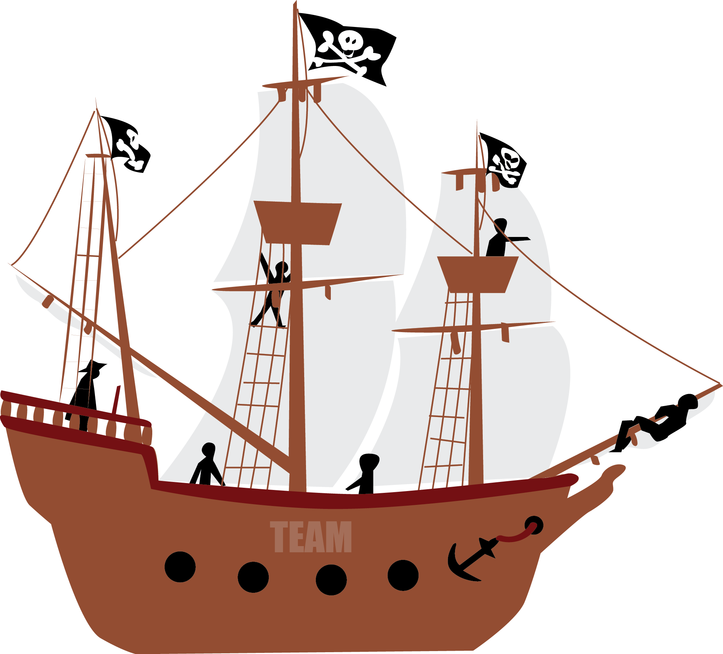
THE RETRO SPACE
“SPEEDBOAT”
mia.kolmodin@dandypeople.com
www.dandypeople.com/blog

Slide 2
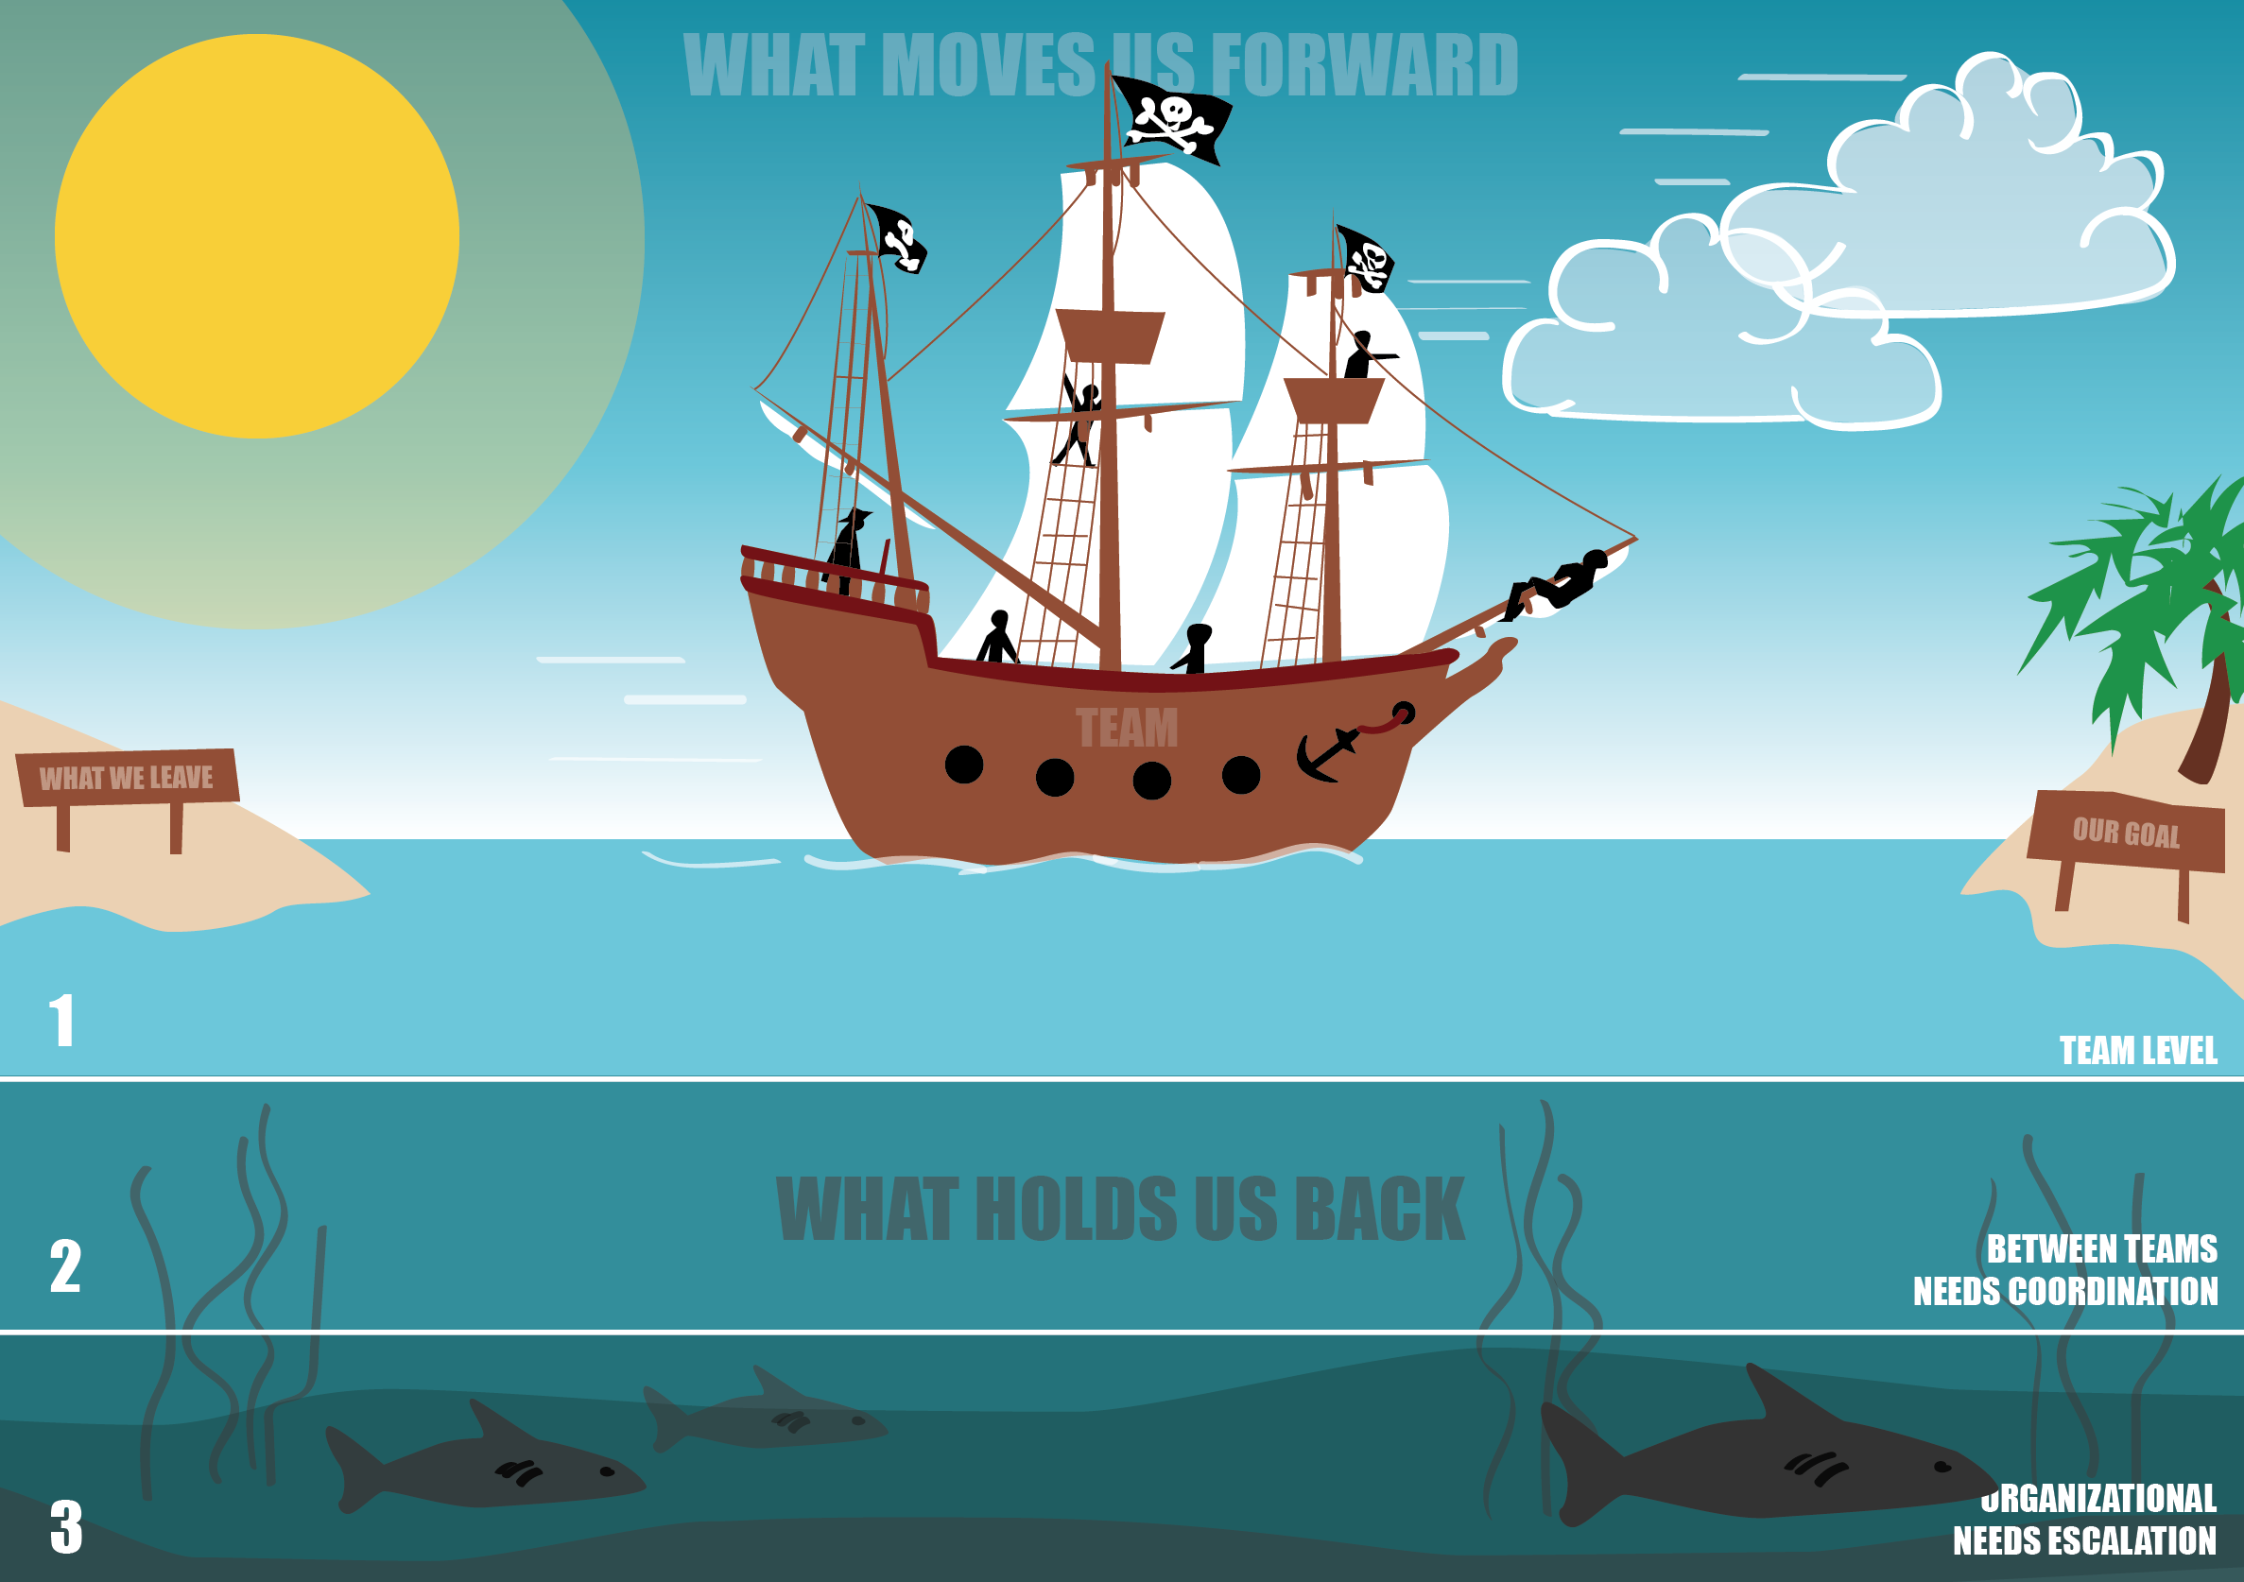

Having fun together
Supportive team members
We deliver great stuff that moves us forward as a company
More important to start new stuff then finish early
Working in silos within the team
Late feedback from customers
Deployment is high risk. It takes too long and we don´t dare to deploy on Fridays
How to know that our work is in line with our business strategy?
Without having a budget it is difficult to solve problems in the team. Why cant we have budget for ways of working?
mia.kolmodin@dandypeople.com
www.dandypeople.com/blog

Slide 3
For co-located teams that sit together:
Included in the blogpost is a high resolution speedboat poster that you can use and print out, either as a template for your facilitation, as a template for the teams so that they know the format for how they should visualize their speedboat, or you can print it out in a big format to use directly (but I rather have the teams visualize them selves).
For distributed teams that don’t sit together:
The idea with the power point is that it can be used for co-located teams to add notes on simultaneously. Upload it to Google Drive and save it as a Google Slide and invite every one in the team, then they can work together simultaneously.

Slide 4
The Speedboat Retrospective
The speedboat format of retrospective is something I like a lot and have used with teams or even whole organizations (divided into teams). I find it to be a good way for the team to think individually, and then collaborate and define solutions for their problems through visualization. Visualization helps the team to more easily figure out what problems they should solve them selves, and what problems needs to be solved between the teams, and what they need to ask management to help with. Some Agile coaches or Scrum Masters only highlight the negative on retrospectives, I believe it is a great thing to focus on the positive and also help the team take action more easily on real issues. It´s the teams responsibility to handle issues within the team, the Agile Coach/Scrum Masters job is to give them the capabilities to do that (not to do it for them).
The time box for the whole retro should be not less than one hour, and not more than 1,5 hour if you do a big group and have presentations as well.
You can this exercise in 5 steps:
Introduction: Present the exercise, show them the poster, ask them to assign someone responsible for facilitation (if I do more than one team) and tell them the agenda (or even hand it out).
First, ask the team to collect all the anchors. Ask every one in the team to do it quietly, one by one, and write them down on stickies. This is usually quite easy for the team if there is a good level of trust.
Ask the team to put out the anchors, one and one. When doing this they should agree and talk about what level the problem is on. This brings a lot of value to the team, and could be what helps the team to move forward. Doubles can be thrown away.
Focus on the anchors on the first level and ask the team to turn each anchor on the into goals (team level). If you have little time and a lot of goals, ask the team to pick 3 or 5. Write down the goals separately on new stickies, perhaps a new color, and put them on the left side by the island with the palms. This is where you are going.
Ask the team what positive actions they could take as a team to reach these goals. Also write this down on stickies and put it by the sun.
Ask the team to present their problems as well as their goals for the problems, and what actions they are going to take.
If you do this exercise with more than one team at a time a good wrap up is to ask all teams to present their speedboat to the other teams. Let them put up their poster on the wall side by side. Afterwards you can easily have a scrum of scrum to pick up what needs to be fixed between the teams, or you can bring the managers there (perhaps they where already joining) to take on the issues that they can help solving from all teams.

