Slide 1
Family ownership and Quality of Management
Chapter 21

Slide 2
The thought experiment
Research question: Are founder/family-owned companies better managed than other firms because of their ownership?
Intervention: a change in company ownership (the founder/family sells the firm)
Subjects: companies
Outcome variable: management score (1=worst practice … 5=best practice)
Causal variable: founder/family ownership (dummy: 1=founder/family ownership and 0 otherwise)

Slide 3
The data
A cross-sectional observational data from the World Management Survey.
Data is from 10282 medium-sized, manufacturing firms from 24 countries.
Data is collected between 2004 and 2015.
Management practice is measured in 18 dimensions.
  Our key variables is a simple average of these 18 scores.
  Range: 1 (worst practice) – 5 (best practice).

Slide 4
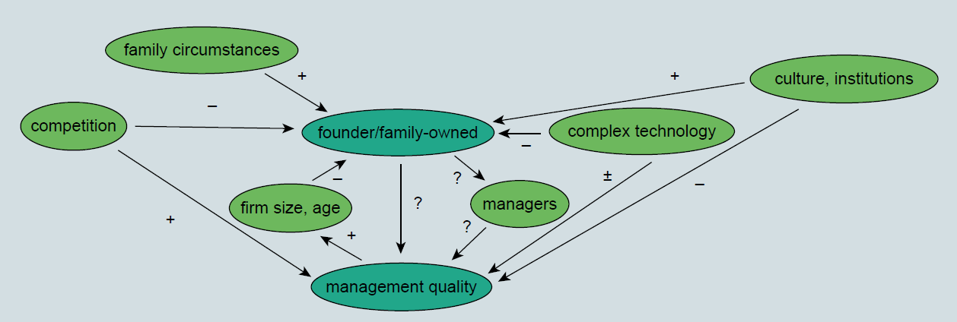
The causal map

Slide 5
The process
Step 1: Multiple regression
Step 2: Exact matching
Step 3: Propensity score matching

Slide 6
Exact matching
Proportion of non-management employees with college education
Age of the firm
Strength of competition in the market for its main product
Number of employees
Industry of the firm
Country

Slide 7
Coarsened exact matching
Proportion of non-management employees with college education
Age of the firm
Strength of competition in the market for its main product
Number of employees
Industry of the firm
Country
4 bins
4 bins (young, middle-aged, old, NA)
3 bins (weak, moderate, strong)
5 bins
20 categories
24 categories

Slide 8
laszlo.tokes@uni-corvinus.hu

