Slide 1
The synthetic control method
Chapter 24

Slide 2
Comparative case study
The impact of terrorism in the late 1960's on Basque Country’s GDP per capita (Abadie & Gardeazabal, 2003)
The impact of fuel price cap on market prices in Hungary
The effect of the tobacco control legislation (1988, California) on cigarette sales
Case study: only 1 treated subject
Comparative: compared to a counterfactual
  What should be the counterfactual?

Slide 3
The SCM
For the single treated subject create one artifical (synthetic) control observation
  Control, because it is used to estimate a counterfactual
  Synthetic, because it is not an existing subject, but we create it from potential controls

Slide 4
The control subject
Take all potential controls (donor pool)
  They are not affected by the intervention
  Maybe apply some pre-selection
Create one singe artifical subject as a weighted average of the subjects of the donor pool
  Weights are non-negative (there are subject with a 0 weight)
  Sum of the weights is 1
  Aim: the control is as similar to the treated as it is possible before the treatment

Slide 5
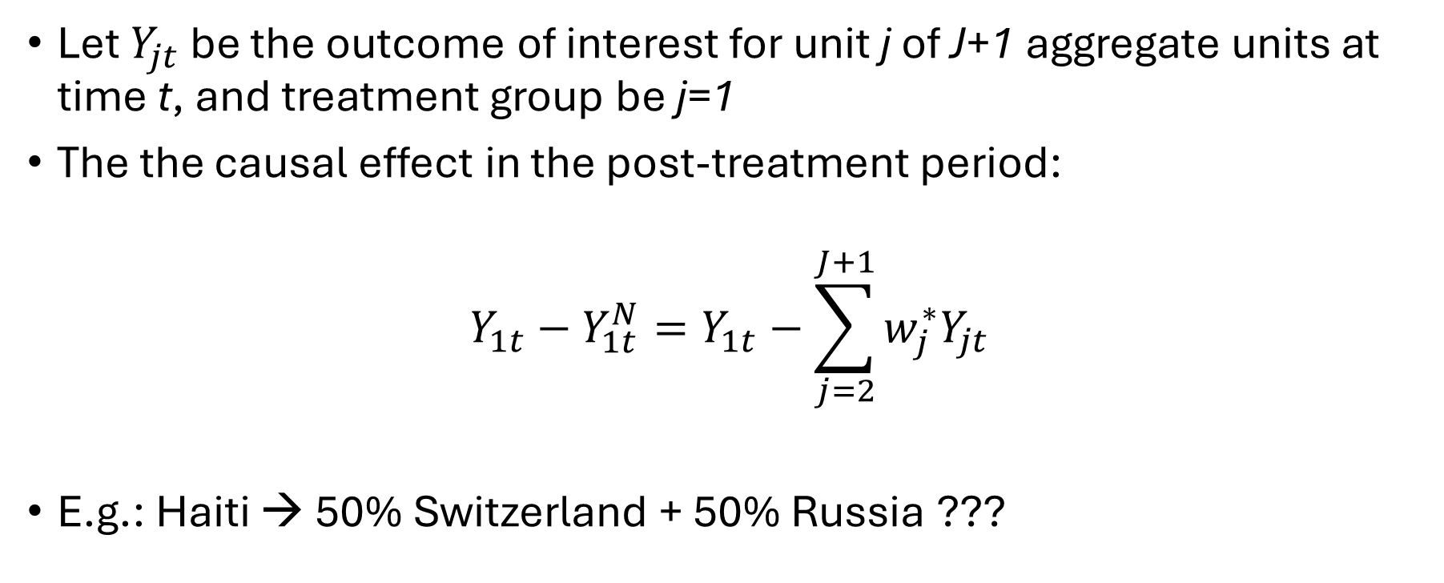
The causal effect
Let $Y_{jt}$ be the outcome of interest for unit j of J+1 aggregate units at time t, and treatment group be j=1
The the causal effect in the post-treatment period:
$${Y_{1t}−Y_{1t}^{N}=Y}_{1t}−\sum_{j=2}^{J+1}{w_{j}^{∗}Y_{jt}}$$
E.g.: Haiti → 50% Switzerland + 50% Russia ???

Slide 6
Predictors
Predictors (X) are used to
  capture structural similarities (the synthetic control resembles the treated subject not just in outcomes but also in factors that influence those outcomes)
  reduce bias (outcomes are often influenced by multiple factors beyond the treatment)
  prevent overfitting (to control for noise in the outcome variable during the pre-treatment period)
Weights (V) are assigned to predictors
  These represent the predictive power of the predictors

Slide 7
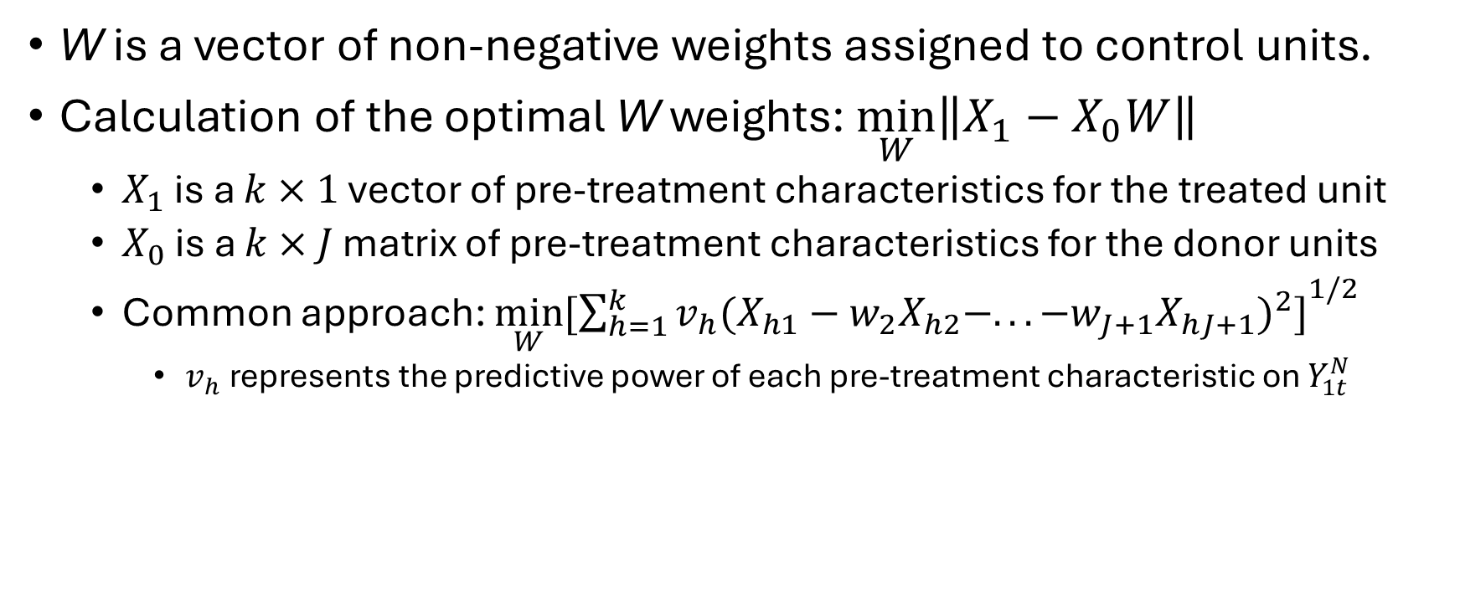
Weights are everywhere
W is a vector of non-negative weights assigned to control units.
Calculation of the optimal W weights: $\min_{W}\left\|X_{1}−X_{0}W\right\|$
  $X_{1}$ is a $k×1$ vector of pre-treatment characteristics for the treated unit
  $X_{0}$ is a $k×J$ matrix of pre-treatment characteristics for the donor units
  Common approach: $\min_{W}{[{\sum_{h=1}^{k}{v_{h}{(X_{h1}−w_{2}X_{h2}−.. .−w_{J+1}X_{hJ+1})}^{2}]}}^{1/2}}$
    $v_{h}$represents the predictive power of each pre-treatment characteristic on $Y_{1t}^{N}$

Slide 8
Estimating the effect of the 2010 Haiti Earthquake on GDP
Chapter 24

Slide 9
Setting
January 2010: a strong earthquake hit Haiti
Question: What was the effect of the earthquake on GDP?
  Death toll (100,000 people died)
  Many survivors emigrated
  Infrastructure was destroyed
  Deseases and malnutrion of survivors → decreased productivity
Outcome variable: GDP at constant (2010) prices
Post-intervention time: 2010-2015
Data: https://osf.io/sdj62/download

Slide 10
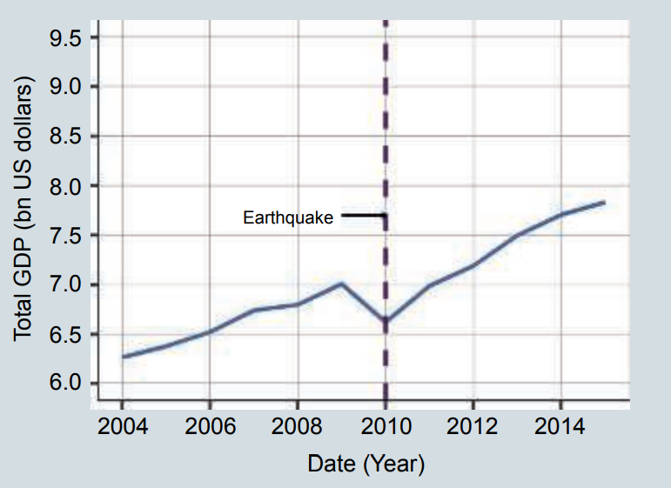
The shock

Slide 11
The donor pool
22 countries that
  have GDP per capita below USD (PPP) 4000 in 2009,
  and have all the necessary data for the period 2004-2015.
Confounder variables are key geographical and macroeconomic variables: land size, population, GDP per capita, exports, imports, consumption, gross capital formation, and inflation.

