Slide 1
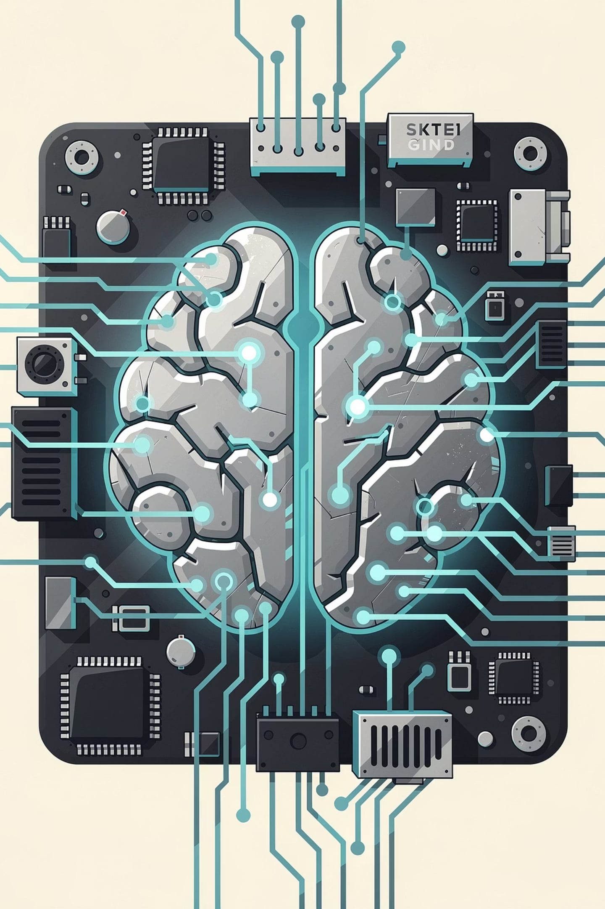
AI for Beginners
A Complete Learning Course — From AI Fundamentals & Machine Learning through Neural Networks, Large Language Models, Prompt Engineering & Response Behaviour Control.
7 Modules
Structured learning path from foundations to advanced control
Key Formulas
Every important equation explained in plain English
Concrete Examples
Real-world illustrations for every concept
Beginner-Friendly
No prior maths or programming degree required

Slide 2
Table of Contents
01
02
03
Module 1 — What is AI?
Module 2 — Machine Learning Fundamentals
Module 3 — The Math Layer
Foundations & History
Key Formulas Explained
Supervised, Unsupervised & Reinforcement Learning
04
05
06
Module 4 — Neural Networks & Deep Learning
Module 5 — How Large Language Models Work
Module 6 — Prompt Engineering
Talking to AI Effectively
Architectures, Activations & Backpropagation
Tokens, Embeddings & Transformers
07
Module 7 — What Controls AI Response Behaviour
Temperature, Top-P, RLHF & the Full Control Stack

Slide 3


MODULE 1
What is AI? — Foundations & History
Artificial Intelligence (AI) is the field of computer science concerned with building systems that can perform tasks that normally require human intelligence — things like recognising speech, understanding language, making decisions, and learning from experience. AI does not mean a robot with a human brain. It means software that can sense, reason, and act in some useful way.
Working Definition: AI is any program that makes a decision by learning from data rather than following hand-coded rules.

Slide 4
MODULE 1 — SECTION 1.2
A Brief History of AI
1950
1
Alan Turing proposes the 'Turing Test' — can a machine fool a human?
2
1956
John McCarthy coins the term 'Artificial Intelligence' at Dartmouth.
1980s
3
Expert systems boom — hand-coded rules, narrow domains.
4
1997
IBM Deep Blue defeats world chess champion Garry Kasparov.
2012
5
Deep learning breakthrough: AlexNet crushes image recognition benchmarks.
6
2017
Google publishes the Transformer paper: 'Attention Is All You Need.'
2022
2024+
ChatGPT (GPT-3.5) reaches 100 million users in just 2 months.
Multimodal models: AI reads text, images, audio, and code together.

Slide 5
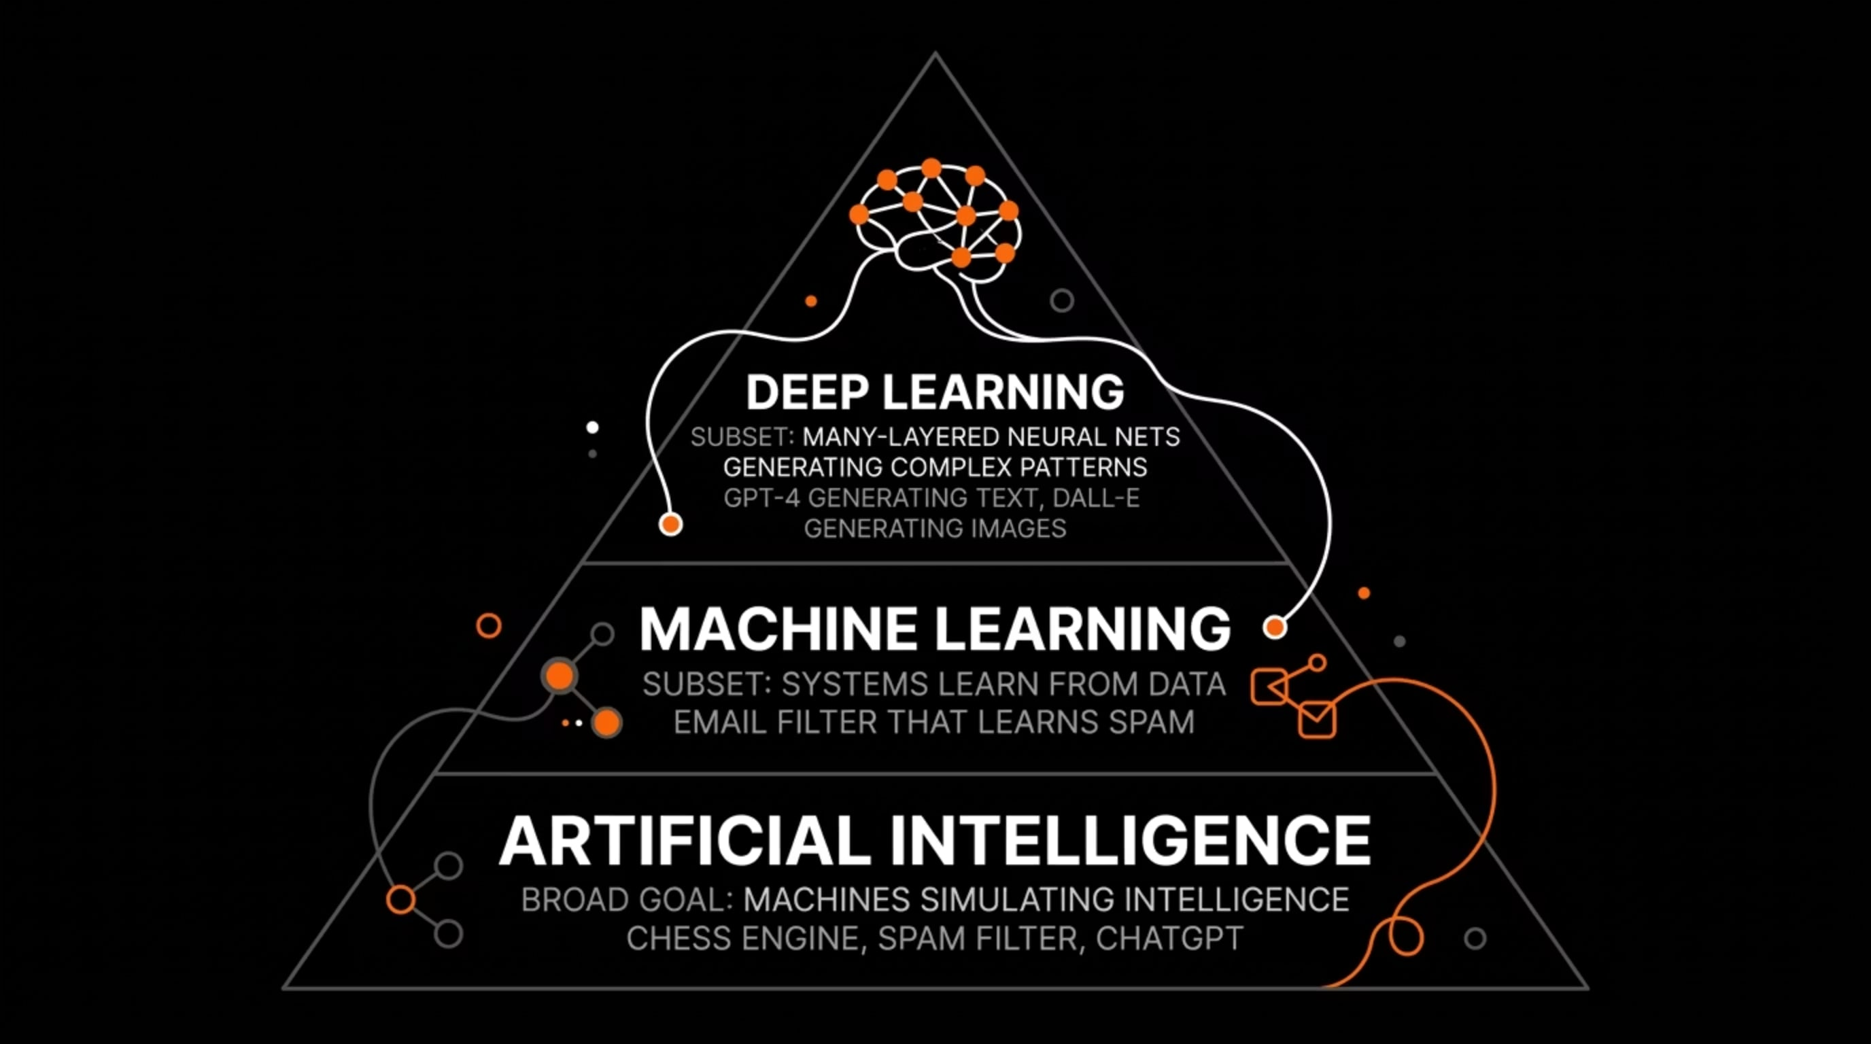
MODULE 1 — SECTION 1.3
The Three Tiers of AI
People often blur three related terms. Here is the precise distinction between them:
Each tier is a subset of the one above it. Deep Learning is the most specialised — it requires large datasets and significant compute, but delivers the most powerful results for complex tasks like language and image generation.

Slide 6



MODULE 1 — SECTION 1.4
Narrow AI vs. General AI vs. Super AI
Narrow AI (ANI) — Exists Today
Artificial General Intelligence (AGI) — Hypothetical
Artificial Super Intelligence (ASI) — Speculative
The only kind of AI that currently exists. It is very good at one specific task — translation, image recognition, game-playing — but is completely helpless outside its training domain. Every AI product you use today is Narrow AI.
A system that can reason and learn across any domain as flexibly as a human. Does not exist yet. The timeline for AGI is actively and hotly debated among researchers, with estimates ranging from decades to never.
A hypothetical system smarter than any human in every domain. Remains entirely speculative and is primarily a topic of philosophical and long-term safety research.

Slide 7






MODULE 1 — SECTION 1.5
Where AI Is Used Today
You interact with AI dozens of times every day — often without realising it. Here are the most common applications in modern life:
Search Engines
Social Media Feeds
Ranking billions of pages in milliseconds to surface the most relevant results for your query.
Deciding which posts, ads, and videos you see — and in what order — based on your behaviour.
Fraud Detection
Medical Imaging
Your bank flagging unusual card transactions in real time before you even notice.
Detecting tumours and anomalies from X-rays and MRI scans, often matching specialist accuracy.
Voice Assistants
Recommendation Engines
Siri, Alexa, and Google Assistant understanding and responding to natural spoken language.
Netflix, Spotify, and Amazon predicting what you want to watch, hear, or buy next.

Slide 8

MODULE 2
Machine Learning Fundamentals
The Core Idea
Traditional Programming
Machine Learning
A human writes explicit rules: IF spam keyword THEN mark as spam. Every rule must be hand-crafted by an engineer who anticipates every possible case.
You show the system 10,000 examples of spam and 10,000 examples of real email and let it figure out the rules itself. The system learns the pattern from data — no manual rule-writing required.

Slide 9
MODULE 2 — SECTION 2.2
Supervised Learning
The model is trained on labelled data — each input has a known correct output. The model learns to map inputs to outputs by minimising the error between its predictions and the true labels.
Task
Input (X)
Output (Y) — Label
Spam detection
Email text
Spam / Not Spam
House price prediction
Size, location, rooms
Price in $
Image classification
Pixel values
Cat / Dog / Car
Sentiment analysis
Movie review text
Positive / Negative
Supervised learning is the most widely used form of ML in production systems today. The quality and quantity of labelled data is often the single biggest factor in model performance.

Slide 10
MODULE 2 — SECTION 2.2
Unsupervised & Reinforcement Learning
Unsupervised Learning
Reinforcement Learning (RL)
No labels. The model finds hidden structure in the data by itself — grouping similar things together (clustering) or compressing data (dimensionality reduction).
An agent learns by trial and error: it takes actions in an environment, receives a reward (or penalty), and gradually learns which actions maximise the reward. Think of training a dog — good behaviour gets a treat.
Customer segmentation — grouping shoppers by behaviour without telling the model what groups to form.
Anomaly detection — finding unusual patterns in network traffic.
Topic modelling — discovering themes across thousands of articles.
AlphaGo / AlphaZero — mastered Go by playing millions of games against itself.
ChatGPT training — RLHF uses human feedback as a reward signal.
Robotics — a robot arm learns to pick up objects.

Slide 11
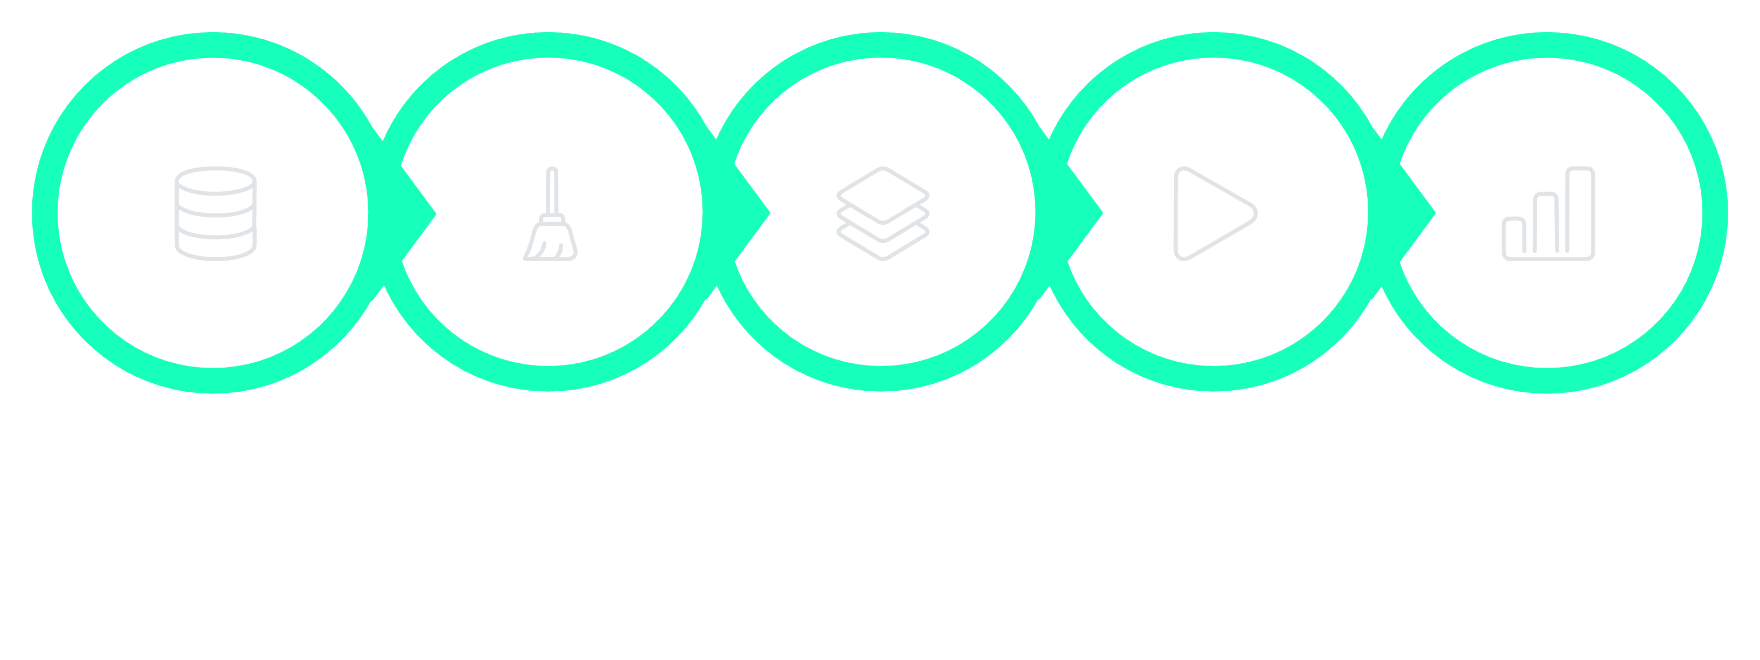
MODULE 2 — SECTION 2.3
The ML Workflow
Collect
Clean
Choose
Train
Evaluate
This seven-step cycle is iterative, not linear. In practice, teams loop between steps 3–6 many times before deploying. The quality of step 1 (data collection) often determines the ceiling of what any model can achieve — garbage in, garbage out.

Slide 12
MODULE 2 — SECTION 2.4
Overfitting vs. Underfitting
Overfitting
The Goal
Underfitting
The model memorises the training data perfectly but fails on new data — it has learned the noise, not the signal. Like a student who memorises exam answers but cannot solve new problems. Symptom: 99% training accuracy, 60% test accuracy.
The right balance — a model that generalises to new, unseen examples. It captures the true underlying pattern without memorising irrelevant details.
The model is too simple to capture the real pattern — it performs poorly on both training and new data. Usually caused by choosing a model that is not expressive enough for the task.
Practical Tip: If your model scores 99% on training data but 60% on test data, it is overfitting. Add more training data or use regularisation techniques.

Slide 13
MODULE 3
The Math Layer — Key Formulas Explained
You do not need a maths degree to understand AI, but knowing a handful of formulas gives you a much stronger mental model of how things work. Each formula in this module is shown with a plain-English explanation and a concrete numerical example. Think of these as the grammar rules of the language that AI speaks.
Vectors
Dot Product
Neuron Formula
Representing data as numbers
Similarity and weighting
The core computation unit
Loss Functions
Gradient Descent
Measuring how wrong the model is
How models learn

Slide 14

MODULE 3 — SECTION 3.1
Vectors — Representing Data as Numbers
Everything in ML starts with turning real-world things into numbers. A vector is just an ordered list of numbers. It is the fundamental data structure of machine learning.
Concrete Example — Representing a House:
x = [120, 3, 2, 5] where x_1 = 120 m² area, x_2 = 3 bedrooms, x_3 = 2 bathrooms, x_4 = 5 km from city centre.
Once you have a vector, you can do maths on it — compare it to other vectors, multiply it by weights, and pass it through functions. Every image, sentence, audio clip, and data record in ML is ultimately represented as a vector (or a collection of vectors).

Slide 15
MODULE 3 — SECTION 3.2
The Dot Product — Similarity and Weighting
The dot product combines two vectors into a single number. It measures how much two vectors 'agree' in direction — and it is the core operation inside every neuron in a neural network.
Concrete Example: Weights w = [0.5, 1.2, 0.3], input x = [2, 1, 4]
w \cdot x = (0.5)(2) + (1.2)(1) + (0.3)(4) = 1.0 + 1.2 + 1.2 = 3.4
This weighted sum — where each input is multiplied by its corresponding weight and the results are added together — is the fundamental computation that every artificial neuron performs. The weights determine how much each input feature matters to the final output. Learning, in neural networks, is largely the process of finding the right weights.

Slide 16
MODULE 3 — SECTION 3.3
The Neuron Formula
A single artificial neuron computes a weighted sum of its inputs, adds a bias, then passes the result through an activation function.
w (weights)
x (inputs)
How much each input matters. Learned during training.
The data coming in — the features of your example.
b (bias)
activation
A constant offset; lets the neuron fire even when all inputs are 0.
A non-linear function

