Slide 1

Swinburne University of Technology
K-medoid Method As An Integer Programming Problem
Presented by
Duy Khoa Pham

Slide 2

1. Abstract
2. Introduction
3. K-medoid method formulated as an integer programming problem
Overview
4. Future work
5. Conclusion
6. Reference

Slide 3
1. Abstract
1.1. Clustering
Clustering is a data analysis technique used to identify similar kinds of subgroups in a dataset
Data points (observations) from one subgroup (cluster) are likely similar and different from other subgroups
1.2. Purpose of the presentation
The presentation illustrate the K-Medoids algorithm, one of the most well-known clustering methods
The method explains based on mathematical analysis of integer programming problem
The future work using K-Medoids to examine the center location of coordinates (longitude and latitude) of road accidents occurred in urban areas in Great Britain

Slide 4
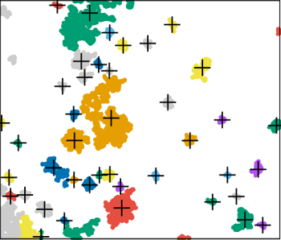
2. Introduction
2.1 Problem
Each accident being labelled according to the specific urban center where it occurred
To improve the effectiveness of ambulance services, it is vital to identify the center point for ambulance callers in these urban areas
The goal is to select k points that after assigning all the remaining points to the nearest selected point (cluster center), the total sum of distances between the points and centers is minimal
Figure 1. The data point where accident occurred in area of the Great Britain
2.2 K-Medoids clustering
K-Means algorithm: is a basic unsupervised learning algorithm to solve clustering problems
It partitions N observations into K clusters where each observation is assigned to the cluster with the closest mean serving as a prototype of the cluster

Slide 5
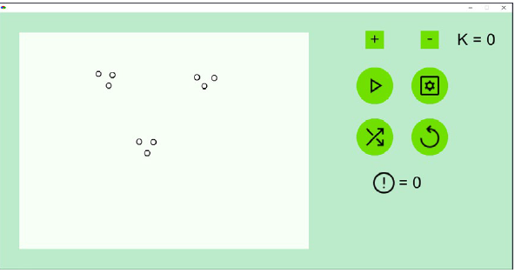
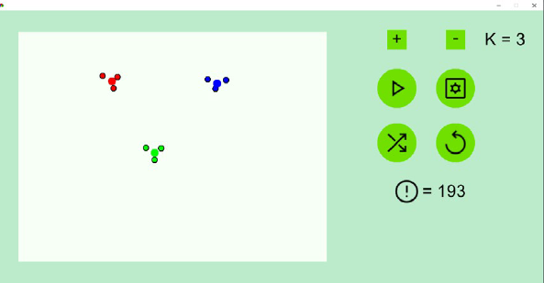
2. Introduction
Figure 2. Original data
Figure 3. Clustered data
The K-medoids algorithm is a clustering algorithm that is similar to K-means, but instead of calculating the centroid of a cluster, it chooses one of the actual data points as the center of the cluster (point to put ambulance callers)
2.3. Integer programming problem
A subset of linear programming where the decision variables are restricted to be integers
It is a mathematical optimization problem where the objective function and the constraints are linear, and the decision variables are restricted to take integer values

Slide 6

3. K-medoid method formulated as an integer programming problem
3.1. Mathematical problem
There are n demand points in total and the distance matrix
$$D=\left\{d_{ij}\right\}, i=1,…, n, j=1,…, n$$
This matrix is symmetric, and its main diagonal consists of zeros. The goal is to select k points as center points (clusters). The decision variables are binary:
$$x_{ij} ∈\left\{0, 1\right\}, i=1,…, n, j=1,…, n$$
$$y_{j}∈\left\{0,1\right\}, j=1,…, n$$
Variable $y_{j}$ is 1 if data point $j$ is treated as a cluster point. If not, the variable is 0
Variable $x_{ij}$is 1 if point $i$ is assigned to point j. If not, the variable is 0

Slide 7
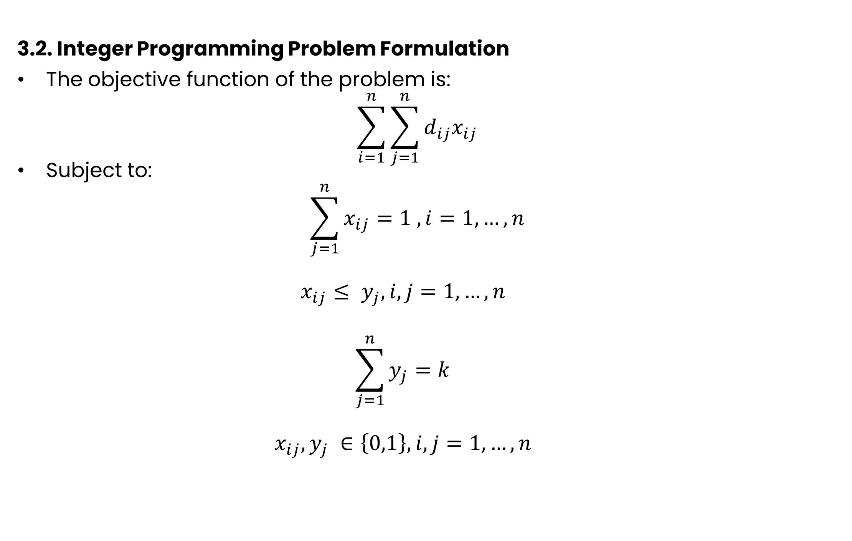
3. K-medoid method formulated as an integer programming problem
3.2. Integer Programming Problem Formulation
The objective function of the problem is:
$$\sum_{i=1}^{n}{\sum_{j=1}^{n}{d_{ij}x_{ij}}}$$
Subject to:
$$\sum_{j=1}^{n}{x_{ij}=1 , i=1,…,n}$$
$$x_{ij}≤ y_{j}, i, j=1,…,n$$
$$\sum_{j=1}^{n}{y_{j}=k}$$
$$x_{ij}, y_{j} ∈\left\{0,1\right\}, i, j=1,…,n$$
(1)
(2)
(3)
(4)
(5)

Slide 8
3. K-medoid method formulated as an integer programming problem
3.3. Formulation explanation
The objective function is aim to minimize the total distance between each cluster with the points assigned to it
Constraints (2) ensure that each point (point i) is assigned to one cluster
Constraints (3) ensure that the point i can only be assigned to the point j if this point (point j) is ensured to be a cluster
Constraint (4) ensures that exactly k points are selected as center point
(1)-(5) is an integer programming problem

Slide 9
4. Future work
In the project, the author will formulate the equation of integer programming problem to examine the problem of define center point as mentioned in Introduction
The experience will be hold in Python and MATLAB for training model and defining the center location
Find way to solve integer programming problem with best resources for computer
The training dataset example is shown in text file

Slide 10
5. conclusion
K-medoid method is a popular clustering algorithm that seeks to partition a dataset into K clusters, where each cluster is represented by its medoid
The K-medoid problem can be formulated as an integer programming
K-medoid method as an integer programming problem provides a useful framework for solving clustering problems and has numerous applications in areas such as machine learning, data mining, and pattern recognition
The application of K-medoid method will be demonstrated to examine the center locations of accident occurred in area of the Great Britain

Slide 11
6. Reference
Vinod, H. D. (1969). Integer Programming and the Theory of Grouping. Journal of the American Statistical Association, 64(326), 506–519. https://doi.org/10.2307/2283635
Bodaghi, B., & Sukhorukova, N. (2018). Solving multi-resource allocation and location problems in disaster management through Linear Programming. arXiv.org. https://doi.org/10.48550/arXiv.1812.01228
GeeksforGeeks (2022), Clustering in Machine Learning, https://www.geeksforgeeks.org/clustering-in-machine-learning/

Slide 12
Thank you for your attention!

