Slide 1
0 Apology

Slide 2
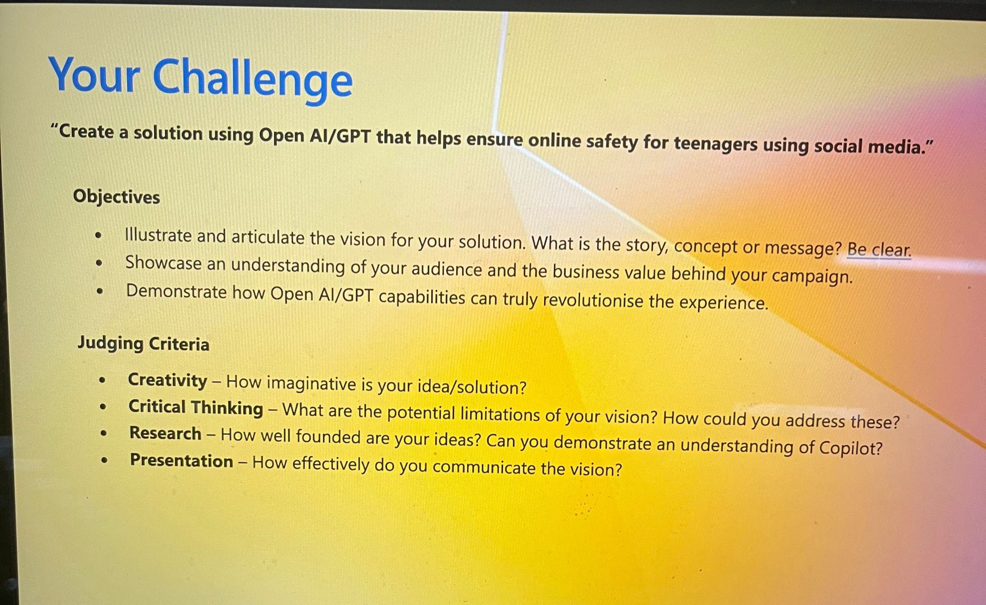
1 Topic Analysis

Slide 3
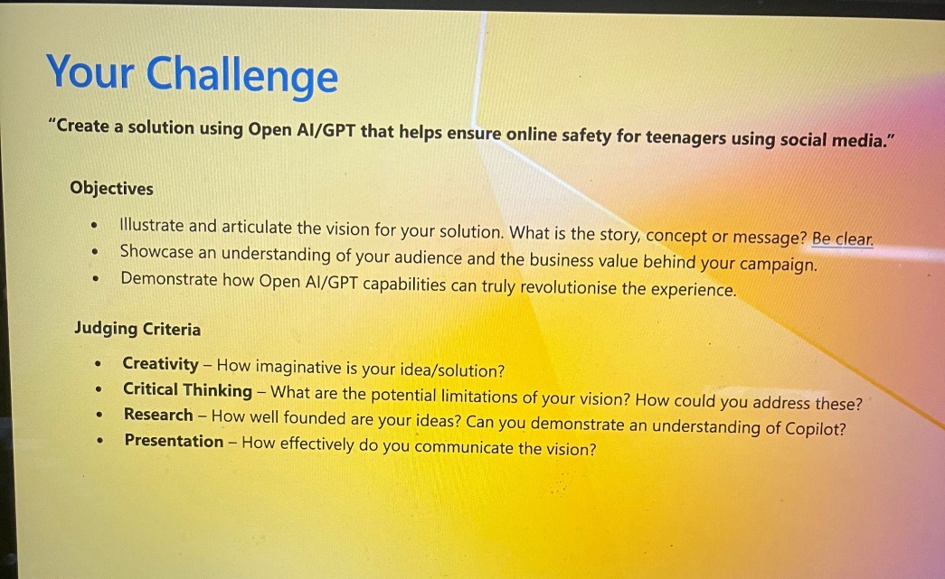
1 Topic Analysis
On the surface, this is a product solution aimed at protecting minors.
But in reality, those who support and pay for this solution are:
1. Parents and educators
2. Social media platforms using the plugin

Slide 4
2 Multilateral Feedback Mechanism
For parents and educators, the solution must:
- Be practical and feasible to implement
- Be effectively monitorable
- Offer sustainable feedback
On the surface, this is a product solution aimed at protecting minors.
But in reality, those who support and pay for this solution are:
1. Parents and educators
2. Social media platforms using the plugin
For social media platforms, the solution must:
1. Be implementable within legal and ethical boundaries
2. Be commercially compliant and sustainable

Slide 5
2 Multilateral Feedback Mechanism
Questions we need to answer:
How does the product work for minors, parents, platforms, and third-party regulatory agencies simultaneously?
Who will you charge for the service? Why will they be willing to pay? How will you ensure ongoing operations?
For parents and educators, the solution must:
- Be practical and feasible to implement
- Be effectively monitorable
- Offer sustainable feedback
For social media platforms, the solution must:
1. Be implementable within legal and ethical boundaries
2. Be commercially compliant and sustainable

Slide 6
2 Multilateral Feedback Mechanism
The real focus of the topic
Incorporating minors, parents, and third-party regulatory agencies into the product solution
Designing a business model that addresses who to charge and how to charge them
In other words, creating our own multilateral feedback mechanism.

Slide 7
3 Comparison Between New and Old Outlines
OLD
NEW
titles/ project name
problem statement
dangers of minors interacting with harmful content
Highlight the complexity of aligning the interests of these groups
solution - ColourGuard
the scoring system (Introduces ColourGuard as a multilateral product addressing minors’ needs, parents’ expectations, and platform compliance.)
its adaptability for monitoring, regulating, and reporting
visual of the scoring scale
The entire feedback loop involving users, parents, and platforms
dynamic interplay between monitoring and action steps.
ethical and legal considerations
Integrates the original ethical and legal aspects with additional focus on operational feasibility for parents and platforms.
cost estimate - can pair with slide 7
Combines the old cost estimate with a clearer explanation of monetization strategies targeting parents, educators, and platforms.
Justifies why these groups would be willing to pay.
revenue potential
Extends revenue potential with a focus on long-term sustainability through multilateral buy-in and continuous updates to the product.
conclusive statement
Wrap up with actionable steps and recommendations for refining the product and pitch.
titles/ project name
problem statement
dangers of minors interacting with harmful content
solution - ColourGuard
the scoring system
visual of the scoring scale
highlight how scoring updates dynamically
ethical and legal considerations
cost estimate - can pair with slide 7
revenue potential
conclusive statement

Slide 8
3 Comparison Between New and Old Outlines
titles/ project name
problem statement
dangers of minors interacting with harmful content
Highlight the complexity of aligning the interests of these groups
solution - ColourGuard
the scoring system (Introduces ColourGuard as a multilateral product addressing minors’ needs, parents’ expectations, and platform compliance.)
its adaptability for monitoring, regulating, and reporting
visual of the scoring scale
The entire feedback loop involving users, parents, and platforms
dynamic interplay between monitoring and action steps.
ethical and legal considerations
Integrates the original ethical and legal aspects with additional focus on operational feasibility for parents and platforms.
cost estimate - can pair with slide 7
Combines the old cost estimate with a clearer explanation of monetization strategies targeting parents, educators, and platforms.
Justifies why these groups would be willing to pay.
revenue potential
Extends revenue potential with a focus on long-term sustainability through multilateral buy-in and continuous updates to the product.
conclusive statement
Wrap up with actionable steps and recommendations for refining the product and pitch.
Critical Thinking

Slide 9
4 Additional Tips
For the content:
1. Narrativity: Develop a coherent storyline.
2. Examples: Use concrete, relatable examples.
3. Dramatic Effect: Add elements that make the narrative engaging.
For the slides:
1. Avoid overly simplistic designs.
2. Use visually rich, appealing slides that blend text and images seamlessly.
3. Ensure text is large enough to be readable—even in video presentations.

