Slide 1
GoGo Money Front End
Design ideas

Slide 2
Login Page (Page 1)
Landing.jsp
Welcome to GoGo Money! New here? Click create account!
UserName:
Password:
LOGIN
Create Account

Slide 3
If Create Account page (Page 2)
createAccount.jsp
*Introduction for how GoGo Money works*
Enter Name
Create User name:
Create Password:
*List of Categories here*

Slide 4
Populate Finances (page 3)
populateFinances.jsp
Please enter your current monetary bank amount:
$:
Please Enter bi-weekly or monthly income, and the day of month deposit:
*Optional*
Regular Income
$:
Day:
And
Day:
Please enter any other income name, amount, and the day of deposit:
Name:
$:
Day:
Please enter recurring bill name, amount,
category it falls under, and day of month occurrence:
Name:
$:
Day:
Category (scroll down):
Add another bill Button
How much money would you like to save every month?
$:
Save
Home

Slide 5
Home Screen page (page 4)
displaySummary.jsp
Welcome @Name
Your GoGo Money left for the month!
$$$
Enter a new transaction, the name and a category it falls under:
$:
Name:
Category (Scroll down):
Deposit or withdrawal (scroll down
Add another transaction
Submit
// If deposit { ignore category }

Slide 6
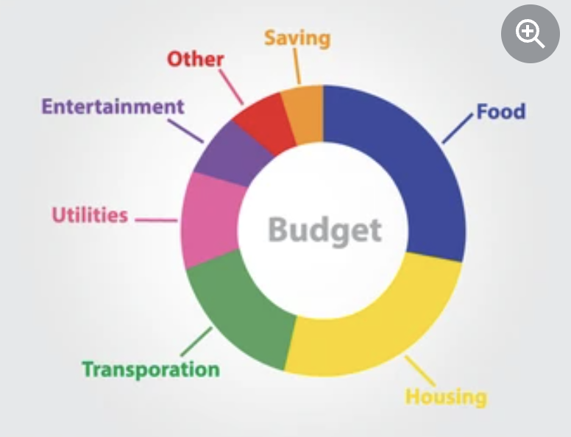
Continuation of Homepage (this is still page 4 just scrolled down)
displaySummary.jsp
An Average of your spending!
*Example pie chart for now*
Log Out
populateFinances
Transactions

Slide 7
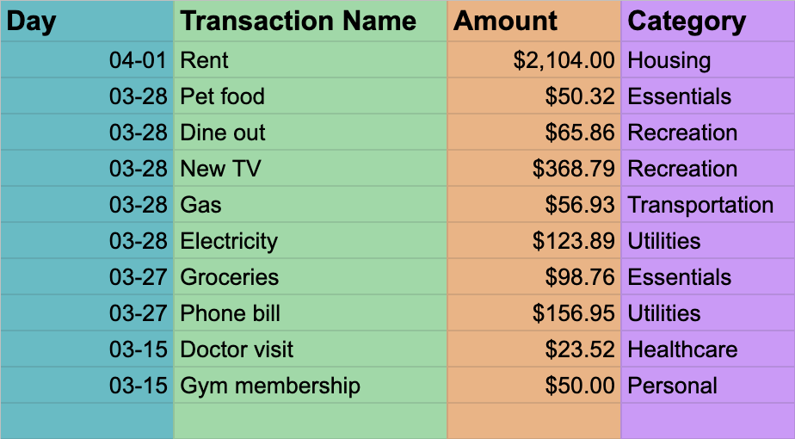
Transaction spreadsheet (page 5)
displayTransactions.jsp
Your Recent Transaction History
X
X
X
X
X
Back to Home/display Summary

Slide 8
Transaction spreadsheet page (scrolled down Page 4)
The list of categories and items that fall under
Housing: Rent, mortgage, etc
Insurance: Car, health, life, home/renters
Savings: amount user wants to save each month
Utilities: Gas, electricity, internet, phone
Essentials: groceries, pet food/care, poilet taper
Healthcare: family/pet care, vet visits, medication
Transportation: gas, vehicle repairs
Recreation/entertainment: Movies, converts, vacations, hobbies, steaming subscriptions, dine out
Personal: clothes, home furnishings, gym memberships
*Ideas to incorporate list on the Financial questionnaire page and Home page*

Slide 9
Additional suggestions and notes for website
Notifications on spending
Summary at the end of the month of money spent, received, and saved (home page)

Slide 10
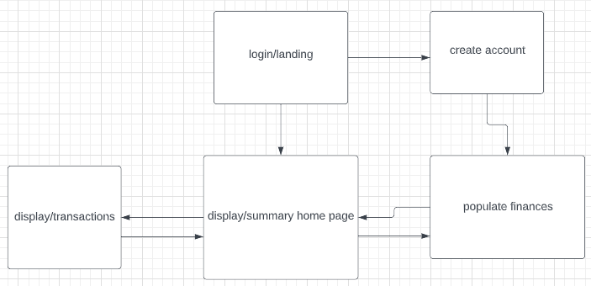

Slide 11
Populate Finances page 3 IGNORE PAGE FOR NOW STILL IN EDIT *****SKIP SLIDE*
Change, add, and delete your recurring deposits and transactions
Name
Amount
Category (scroll down)
Deposit/withdrawal (scroll down)
Income
Income
$: 5,000
Deposit
Delete
Rent
$:1,800
Housing
Withdrawal
Delete
Electricity
$:150
Utilities
Withdrawal
Delete
Groceries
$:500
Essentials
Withdrawal
Delete
Add
Submit Changes
How much would you like to save?
$:
*If deposit { ignore category } *

