Slide 1
Tanzanite
Streamline engagement in the “chaotic real world”

Slide 2
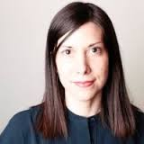
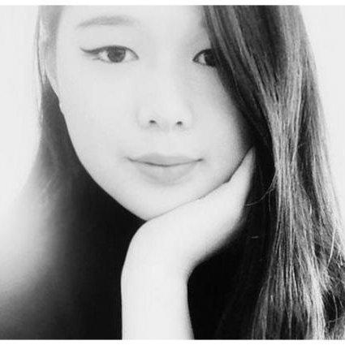
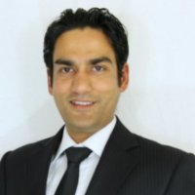

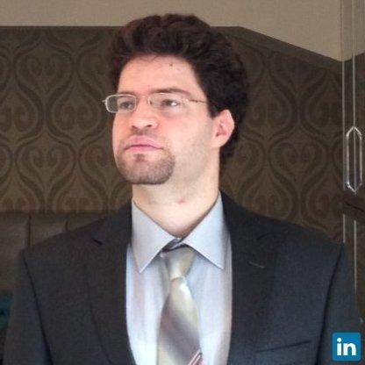

Who Are We?
Eliana
Senior Visual Merchandiser
Valentino, PRADA
Fashion Institute of Technology, Italy
Göktuğ
Software Engineer
Kreix, METeSports U Society
METU, Turkey
Kelly
Software Engineer
Microsoft, Facebook
Brown University, United States
Maryam
Production Director
Mano
Indonesia
Stephanie
Industrial & Accessories Designer
rag & bone, Nike
Brown University, United States
Gautam
Marketing Technology Innovator
ellipsis, PayPal, Cisco
Indian Institute of Technology, India

Slide 3
What Are We Hacking?
Streamline engagement in the “chaotic real world” such as
Trade Shows
Conferences
Retail Stores
Enable innovation between
Designers & Buyers
Vendors
Fashion Retailers

Slide 4
What’s Our Secret Sauce?
Collect and match targeted information about the physical world in real time

Slide 5

It’s Show Time!

Slide 6
Q & A
teamtanzanite@gmail.com

