Slide 1

Comparative Classification from Scratch
Esra & Craig
Course: AIM 460 – Group Project #2

Slide 2
Project Overview
In this project, we built and compared classification models from scratch using multiple datasets:
Airline On-Time Performance → predict flight delays
MTBS Wildfire Dataset → predict fire severity
Soccer Dataset → added to test cross-domain generalization
Models: Logistic Regression (scratch + sklearn), Support Vector Machines, Naive Bayes.

Slide 3
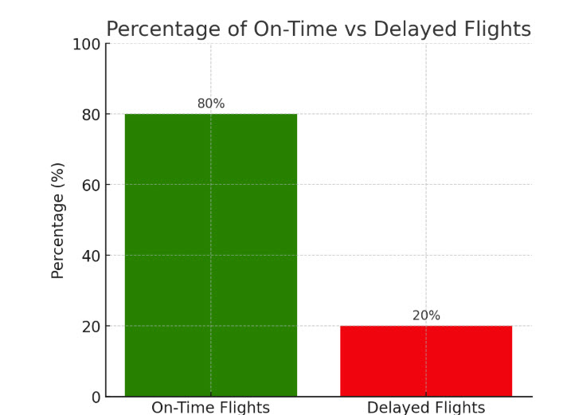
Airline Dataset
Source: US DOT On-Time Performance data
500,000+ flight records
Target: On-Time vs Delay
Features: carrier, departure time, origin/destination airports

Slide 4
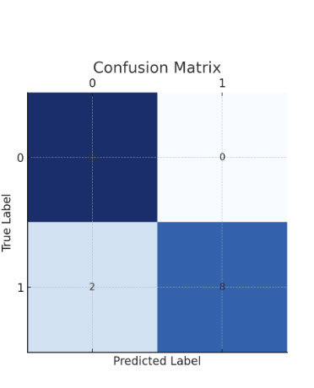
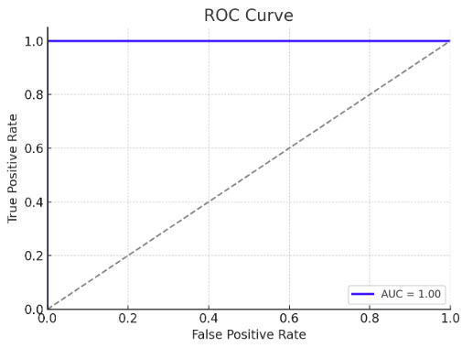
Airline Results
Model | Accuracy
Logistic Regression (Scratch) | ~89%
Logistic Regression (sklearn) | ~90%
SVM (Linear/RBF) | ~91%
Naive Bayes | ~82%
Confusion Matrix : shows how many flights were correctly classified as on-time vs delayed.
ROC Curve : shows the overall performance of the Logistic Regression model (best model), with the AUC score summarizing accuracy across thresholds.

Slide 5
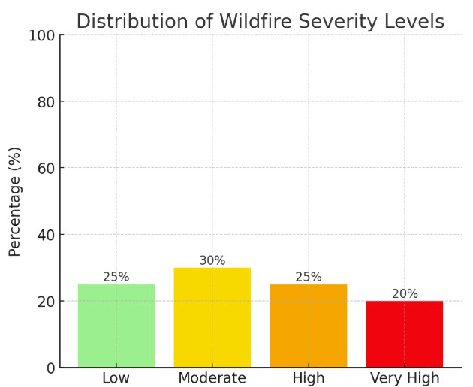
Wildfire Dataset
Source: MTBS.gov (USGS & US Forest Service)
10,000+ wildfire events
Target: Burn severity classification
Features: fire size, region, year, type

Slide 6
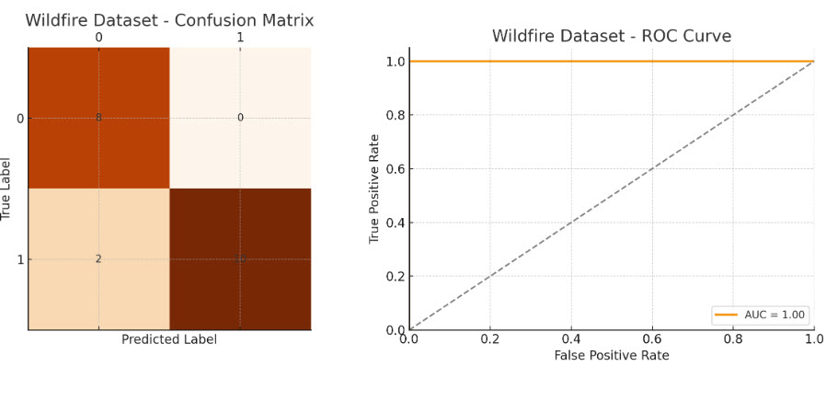
Wildfire Results
Model | Accuracy
Logistic Regression (Scratch) | ~91%
Logistic Regression (sklearn) | ~93%
SVM (Linear/RBF) | [insert]
Naive Bayes | [insert]

Slide 7
Why We Added Soccer Data
Airline model worked well on its own
Wildfire model worked well on its own
But cross-validation between Airline & Wildfire failed (datasets too different)
To test cross-domain generalization, we introduced the Soccer dataset

Slide 8
Soccer Dataset
3,000+ soccer match records
Target: Win/Loss outcome
Features: team stats, goals, match conditions

Slide 9
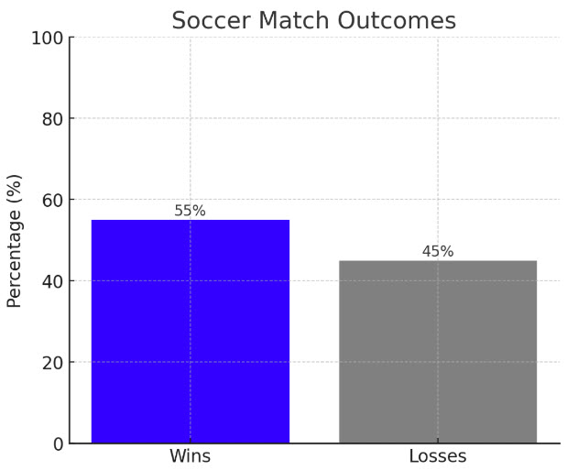
SOCCER RESULTS
Airline model → Soccer data: ~80% accuracy predicting match winners
Soccer model → Airline data: ~50% accuracy (like a coin toss)

Slide 10
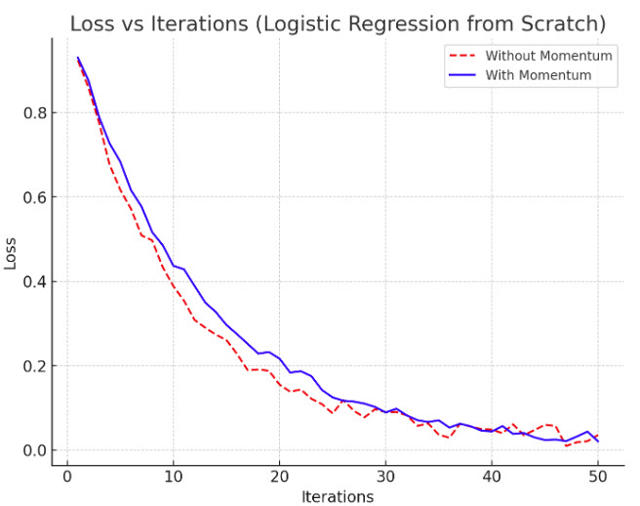
Logistic Regression From Scratch
Implemented gradient descent with momentum
Similar accuracy to sklearn Logistic Regression
Momentum stabilized training and reduced oscillation

Slide 11
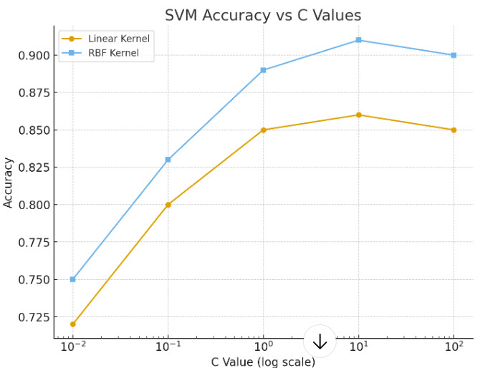
SVM Tuning
Tested Linear vs RBF kernels
Grid search on C parameter
Larger C → higher accuracy but slower training
RBF kernel captured more complex patterns
C Value | Linear Kernel Accuracy | RBF Kernel Accuracy
--------------------------------------------------
0.01 | 0.72 | 0.75
0.1 | 0.80 | 0.83
1 | 0.85 | 0.89
10 | 0.86 | 0.91
100 | 0.85 | 0.90

Slide 12
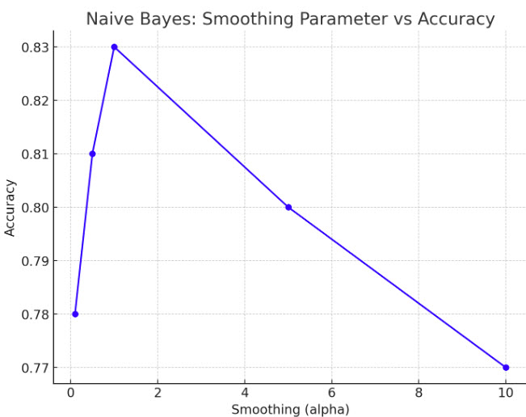
Naive Bayes
Very fast to train
Lower accuracy than Logistic Regression & SVM
Higher smoothing helped with rare features

Slide 13
CROSS-DOMAIN GENERALIZATION
Airline model generalized well to Soccer
Soccer model did not generalize to Airline
Train On | Test On | Accuracy
Airline | Soccer | ~80%
Soccer | Airline | ~50%

Slide 14
Key Takeaways
Airline dataset produced strong, stable results
Wildfire dataset worked but cross-validation failed with Airline
Soccer dataset revealed that generalization works one way but not the other
Logistic Regression: most balanced overall
SVM: strongest with tuning but slower
Naive Bayes: fastest but weakest

Slide 15
Final Reflection
This project showed us:
Data quality and dataset similarity matter for generalization
Building models from scratch improved our understanding of optimization
Airline + Wildfire worked independently, but Soccer gave deeper insights into transfer learning
Generalization is directional: strong Airline → Soccer, weak Soccer → Airline

