Slide 1
GLOBAL SUPERSTORE
Sales Analytics
Data Project Report
SQL Database Design · Star Schema Modelling · Power BI Dashboard
May 2026
51,290+
10
5
Records
SQL Queries
Dashboard Pages

Slide 2





Presentation Agenda
01
Dataset Overview
~2 min
Source data, fields, and engineered features
02
Database Design
~2 min
Star schema architecture and table relationships
03
SQL Query Analysis
~2 min
10 analytical queries and business logic
04
Power BI Dashboard
~2 min
Five dashboard pages and key visualisations
05
Key Findings & Insights
~2 min
Data-driven conclusions and recommendations

Slide 3
01 · DATASET
Dataset Overview
Source Dataset
51,290+
30
Global Superstore — a retail analytics dataset covering transactions across multiple international markets, spanning 2012–2015.
Orders
Source Fields
147
3
Countries
Segments
Key Field Groups
Field Group | Key Fields | Purpose
Order Identity | order_id, order_date, ship_date | Track each transaction
Customer | customer_id, segment, market | Identify customer & segment
Geography | country, state, city, region | 4-level spatial hierarchy
Product | category, sub_category, product_name | 3-level product taxonomy
Financials | sales, profit, discount, shipping_cost | Core KPIs
Engineered | profit_margin, is_weekend, discount_bin | Derived features

Slide 4
02 · DATABASE
dim_date
date_key (PK)
Star Schema Design
order_year/month/quarter
dim_customers
is_weekend
dim_location
customer_id (PK)
location_key (PK)
customer_name
country
segment
city
market
fact_sales
state
order_id
region
customer_id (FK)
product_key (FK)
dim_products
location_key (FK)
dim_shipping
product_key (PK)
ship_key (FK)
ship_key (PK)
product_id
sales / profit / discount
ship_mode
category
order_priority
sub_category

Slide 5
03 · SQL QUERIES
10 Analytical SQL Queries
Q1
Total Sales & Profit per Year
Q2
Top 5 Products by Sales
GROUP BY / SUM
TOP N / ORDER BY
Q3
High-Value Customers
Q4
Order Count per Region
HAVING > 5000
COUNT DISTINCT
Q5
Products Above Avg Sales
Q6
Profit Margin per Segment
Scalar Subquery
SUM/SUM ratio
Q7
Monthly Sales Trend
Q8
Highest Single Order
Multi-col GROUP
MAX Subquery
Q9
Top Shipping Modes by Profit
Q10
Sales Summary View
JOIN + ORDER
CREATE VIEW

Slide 6
03 · SQL DEEP DIVE
Query Highlights
Q1 — Total Sales & Profit per Year
SELECT d.order_year,
SUM(f.sales) AS total_sales,
SUM(f.profit) AS total_profit
FROM fact_sales f
JOIN dim_date d ON f.order_date = d.date_key
GROUP BY d.order_year
ORDER BY d.order_year;
Joins fact_sales with dim_date and aggregates annual revenue and profit to reveal growth trajectory.
Q3 — High-Value Customers (HAVING)
SELECT c.customer_name,
SUM(f.sales) AS total_sales
FROM fact_sales f
JOIN dim_customers c
ON f.customer_id = c.customer_id
GROUP BY c.customer_name
HAVING SUM(f.sales) > 5000;
HAVING clause filters post-aggregation — customers whose total revenue exceeds 5,000 USD.
Q5 — Products Above Average Sales
SELECT p.product_name,
SUM(f.sales) AS total_sales
FROM fact_sales f
JOIN dim_products p
ON f.product_key = p.product_key
GROUP BY p.product_name
HAVING SUM(f.sales) >
(SELECT AVG(sales) FROM fact_sales);
Scalar subquery computes global average; outer query filters products exceeding that threshold.

Slide 7
04 · DASHBOARD
Power BI Dashboard
Five analytical pages translating SQL findings into interactive business intelligence
01
02
03
04
05
Sales Overview
Product Performance
Customer Analysis
Shipping & Logistics
Time Intelligence

Slide 8
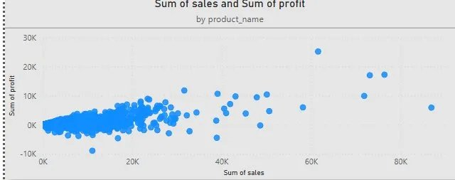
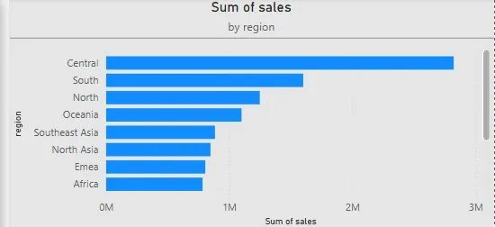
PAGE 1 · SALES OVERVIEW
Sales Overview
13M
1.47M
103M
242.08K
Total Sales
Total Profit
Total Orders
Profit Margin
Sales vs Profit by Product
Sales by Market

Slide 9
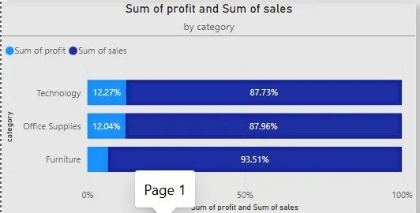
PAGE 2 · PRODUCT PERFORMANCE
Product Performance
Sales by Category & Sub-Category
Technology dominates
Phones & Copiers drive the highest revenue in the dataset.
Furniture margins
Tables show high revenue but carry lower profit margins.
Top 5 confirm Q2
SQL Query 2 correctly identifies Phones, Chairs & Storage as top SKUs.

Slide 10
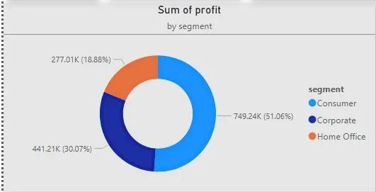
PAGE 3 · CUSTOMER ANALYSIS
Customer Analysis
Revenue by Segment
51.06%
Largest segment by revenue — primary marketing target.
Consumer
30.07%
High average order value — key account programme candidate.
Corporate
18.88%
Smallest segment but consistent growth trend 2012–2015.
Home Office

Slide 11
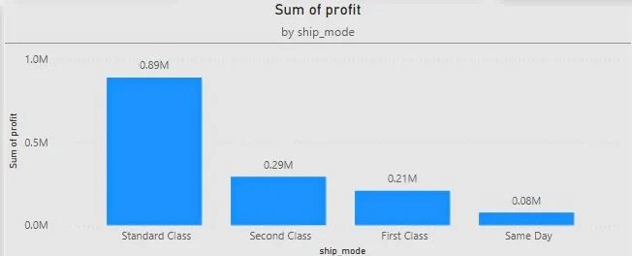
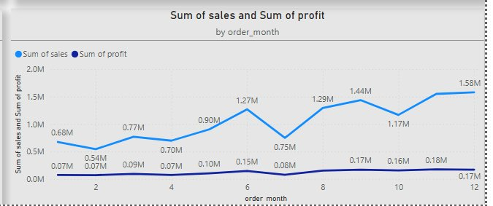
PAGES 4 & 5 · SHIPPING + TIME
Shipping & Time Intelligence
Profit by Shipping Mode
Monthly Sales Trend (2015)
Standard Class Best
Same Day Erosion
Q4 Spike
Weekday Revenue
Carries 53% of orders AND highest absolute profit.
Same Day shipping shows the lowest profit margin — cost vs. revenue imbalance.
October–December accounts for ~38% of annual revenue — strong seasonality signal.
87% of total sales occur on weekdays — B2B-driven demand pattern.

Slide 12






05 · KEY FINDINGS
Key Findings & Insights
Consistent Revenue Growth
Technology Dominates
~20% year-on-year revenue growth from 2012 to 2015 across all markets and segments.
Technology category leads in both revenue and profit margin — Phones & Copiers are top SKUs.
Consumer Segment Leads
Shipping Cost Pressure
Consumer segment represents 51% of revenue; Corporate shows the highest revenue-per-order.
Same Day shipping delivers the lowest profit. Standard Class optimises cost vs. service level.
Q4 Seasonality
Discount Risk
October–December accounts for 38% of annual sales — requiring proactive inventory planning.
Orders with >40% discount consistently report negative or near-zero profit margins.

Slide 13
05 · RECOMMENDATIONS
Actionable Recommendations
Cap Discounts at 20%
Invest in Technology
01
Enforce a maximum 20% discount policy in CRM. Orders above this threshold consistently erode profit margins to near zero.
02
Reallocate marketing budget toward Technology. It drives the highest revenue with above-average margins across all markets.
Optimise Shipping Mix
Develop LATAM Market
03
Negotiate Standard Class carrier rates. Incentivise customers to choose Standard over First Class or Same Day for non-critical orders.
04
LATAM has reasonable order volume but lower revenue-per-order than other markets. A targeted campaign could unlock significant growth.
Q4 Inventory Planning
Automate ETL Pipeline
05
October–December generates 38% of annual revenue. Pre-position stock to prevent stockouts and protect customer satisfaction scores.
06
Migrate manual SQL ETL to a scheduled pipeline (SQL Server Agent or dbt) to enable daily data refresh and reduce analyst overhead.

Slide 14
Conclusion
This project demonstrates a complete end-to-end analytics pipeline — from raw retail data through a normalised star-schema SQL warehouse to an interactive Power BI dashboard.
Data Engineering
Star schema with 5 dim tables + 1 fact table, ensuring query performance and referential integrity.
SQL Analysis
10 queries covering aggregations, HAVING, subqueries, and a reusable view (vw_sales_summary).
Dashboard
5 Power BI pages delivering sales, product, customer, shipping and time intelligence insights.
Business Value
6 actionable recommendations to improve profit margins, reduce shipping costs and grow LATAM.
May 2026 · Global Superstore Dataset · Data Analysis Project

Slide 15
Q & A
Questions & Discussion
Global Superstore Sales Analytics · May 2026

