Slide 1





E-COMMERCE
PROJECT
Graduation Project in E-commerce Data Analytics

Slide 2
01
02
03
Our Team
project objective
Why OList
OVERVIEW
04
05
06
Olist Business Perspective
OList Ecosystem
Data Details
07
08
09
Data cleaning
What we found
Data Modeling

Slide 3






01
OUR TEAM
ABDELHADI MOHAMED
HAMZA WALID
ZIAD ASHRAF
AYA ABDELAZIZ
ESRAA BAHAA
Business Understanding & EDA
Data Cleanig
Data Modeling
SQL Data Analysis
Data Visuation

Slide 4
02
PROJECT OBJECTIVE
The objective of this project is to analyze a real-world e-commerce business using data, in order to understand its business ecosystem, operational performance, customer behavior, and the relationships between different business factors, then transform these findings into an interactive dashboard that supports data-driven decision-making.

Slide 5

03
WHY OLIST
We chose Olist because it provides a complete and interconnected e-commerce dataset that allows us to analyze a real business from multiple perspectives, rather than focusing on a single function such as sales.
HTTPS://WWW.KAGGLE.COM/DATASETS/OLISTBR/BRAZILIAN-ECOMMERCE

Slide 6
REVENUE STREAMS
  Subscription and software fees
  Transaction and service fees
  Logistics and shipping-related services
  Payment and financial service revenues
04
OLIST BUSINESS PERSPECTIVE
CUSTOMER SEGMENTS
  Small and Medium-Sized Businesses (SMBs)
  Online Sellers and Merchants
  Businesses looking to expand their digital sales channels
VALUE PROPOSITION
  An integrated ecosystem for managing digital commerce
  Simplified access to multiple sales channels and marketplaces
  Centralized management of orders, inventory, logistics, and payments
  Reduced operational complexity for merchants
HOW DOES OLIST COMPANY WORK?

Slide 7
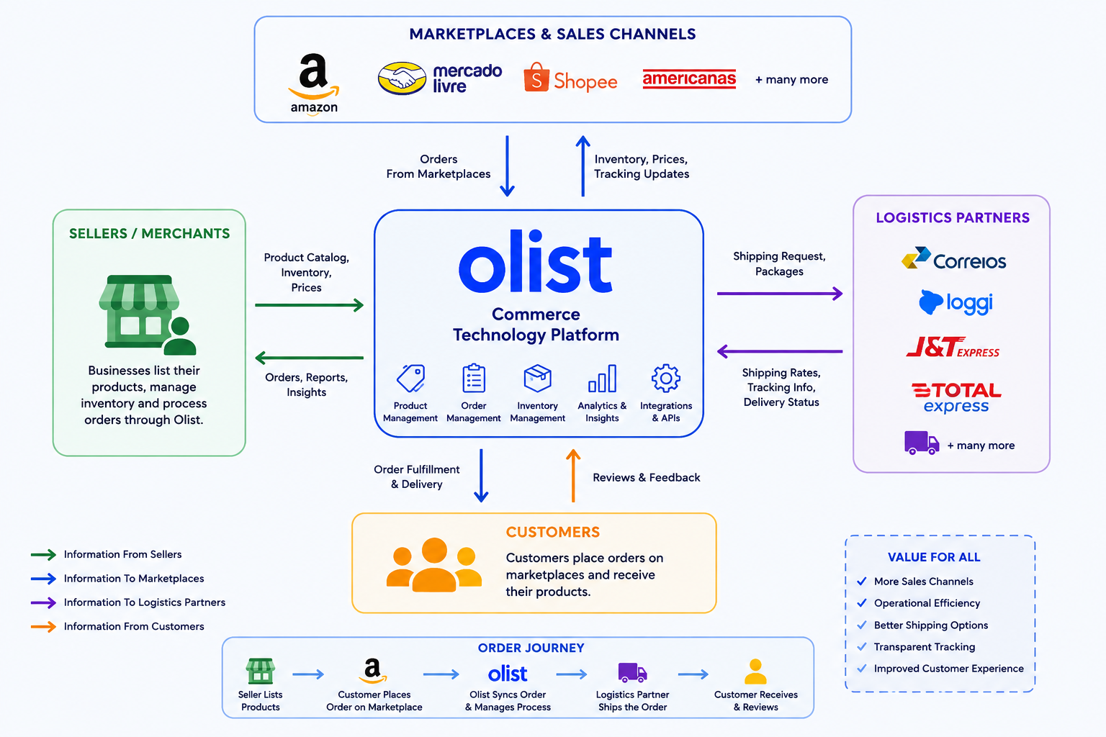
OLIST ECOSYSTEM
05
LOGISTECS PARTENER

Slide 8


06
Data Dictionary
Data Details

Slide 9

HOW IS OLIST PERFORMING OVERALL?
BUSINESS QUESTION CATEGORY
HOW DOES DELIVERY PERFORMANCE AFFECT CUSTOMER SATISFACTION?
HOW DOES THE MARKETPLACE BEHAVE

Slide 10
07
DATA CLEANING

Slide 11


WHAT WE FOUND
08
The cleaning process was a simple one as not many issues were found across the files. the greatest hurdle was in one file that had many duplicates that reached a million rows.
ALREADY CLEAN
CLEANED
4 files out of 9 had no duplicates, and correct data type for each column
5 files out of 9 needed cleaning or adding columns for better quality

Slide 12
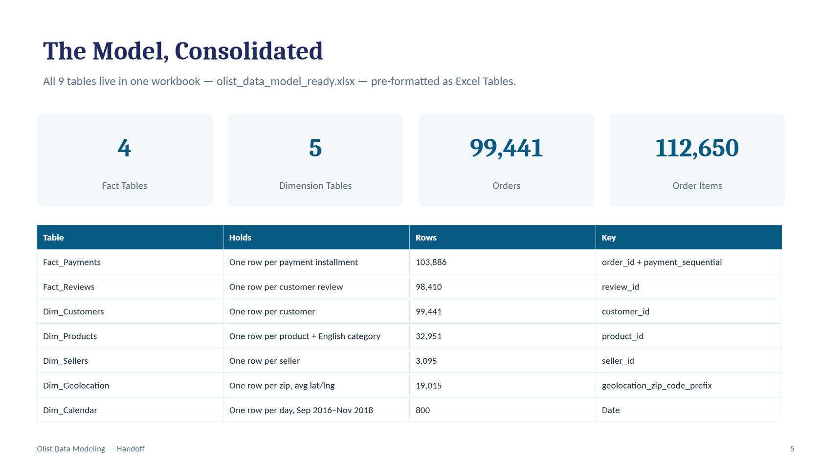
DATA MODELING
09

Slide 13
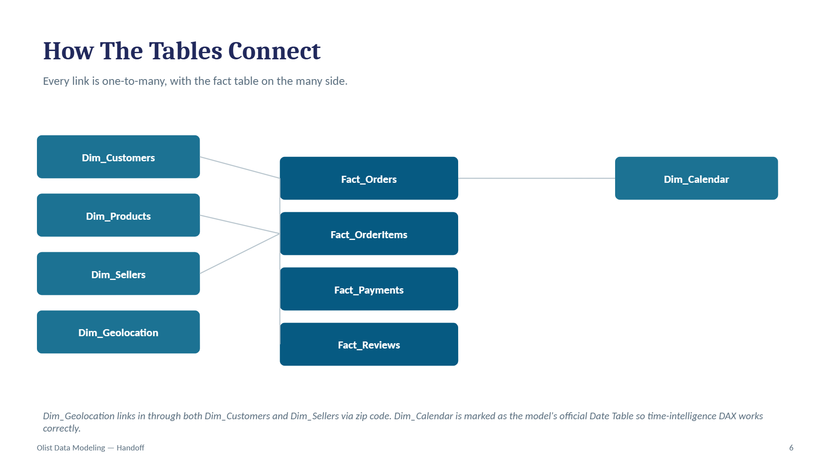
DATA MODELING
10

Slide 14
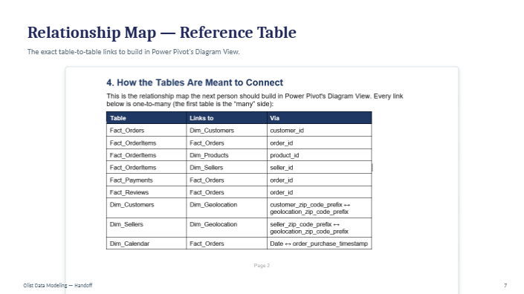
DATA MODELING
11

Slide 15
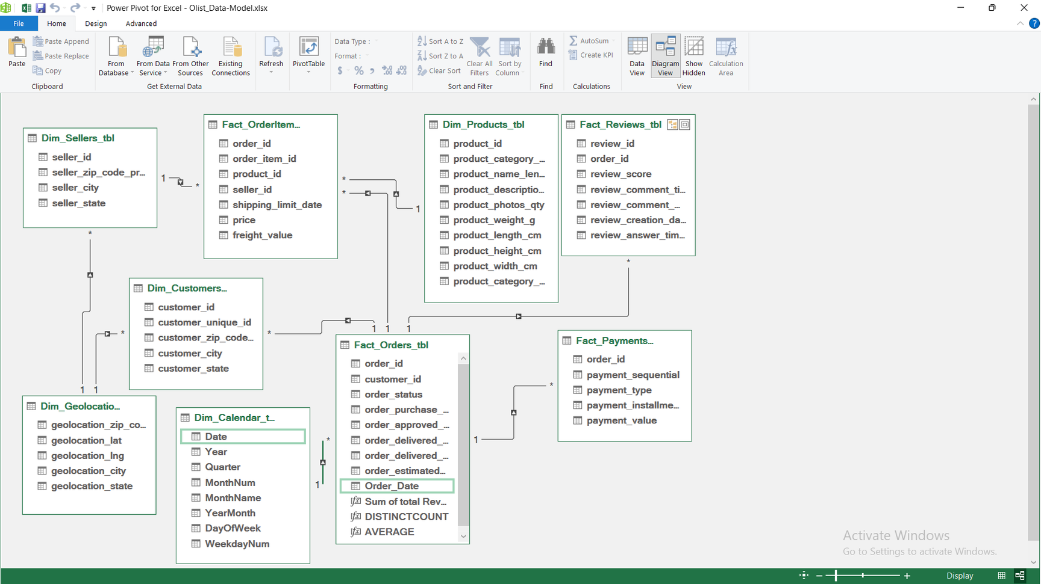
DATA MODELING
12

Slide 16
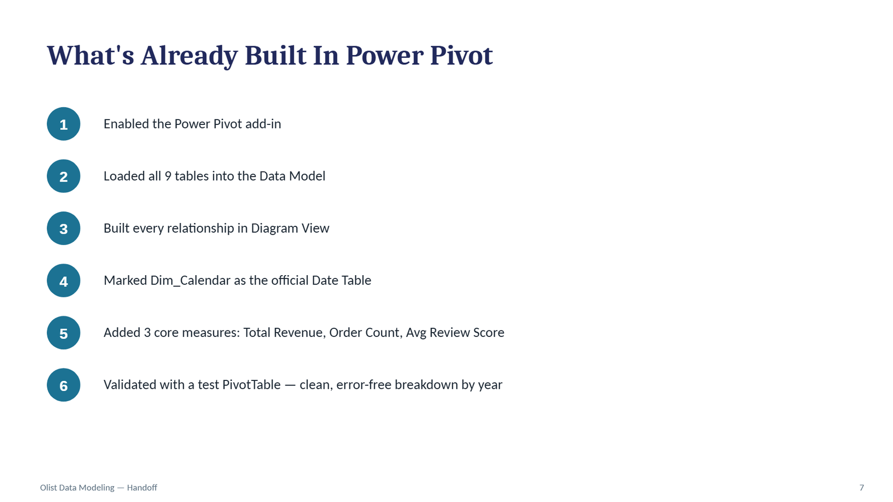
DATA MODELING
13

Slide 17
SQL ANALYSIS
Turning Olist data into business evidence
26
MySQL
8
Objective
completed analyses
analytical engine
business areas
Use SQL to answer practical business questions and extract decision-relevant findings — not simply demonstrate syntax.
Focus: revenue • customers • products • sellers • payments • delivery • customer experience
A reproducible, business-first SQL workstream built on the cleaned and modeled Olist dataset.
Olist E-commerce Data Analysis • SQL Workstream
MySQL

Slide 18
How the SQL Analysis Was Structured
02
A business-first approach with lightweight, reproducible MySQL queries
1 Business Question
2 SQL Approach
3 Evidence
Start from a decision-relevant question rather than from a SQL technique.
Use joins, aggregation, CASE, date functions and subqueries only where they add analytical value.
Validate the result, then translate the output into an actionable business insight.
Core SQL patterns
Implementation Choice
• GROUP BY + aggregates
Revenue, orders, seller and category performance
When heavy joins caused MySQL performance issues, queries were simplified by aggregating at the correct grain first.
• JOINs
Connect facts with customer, seller and product dimensions
• CASE WHEN
Delivery status and business classifications
• Subqueries
Order-level metrics before overall averages
• Date functions
Monthly, weekday and hourly demand
Olist E-commerce Data Analysis • SQL Workstream
MySQL

Slide 19
Revenue & Marketplace Performance
03
The strongest commercial signals from the SQL work
≈ R$15.4M
96K+
3.1%
SQL revenue baseline
delivered orders
repeat-customer rate
Revenue by Category
SQL
What It Means
SELECT p.category,
SUM(oi.price + oi.freight_value) AS revenue
FROM Fact_OrderItems oi
JOIN Dim_Products p ON oi.product_id = p.product_id
GROUP BY p.category
ORDER BY revenue DESC;
SQL groups delivered order-item revenue by product category. Health & Beauty is among the leading categories, at ≈ R$1.41M in the documented analysis.
Revenue is concentrated across a smaller group of categories, while the very low repeat-customer rate signals a major retention opportunity.
Olist E-commerce Data Analysis • SQL Workstream
MySQL

Slide 20
Customer & Demand Behavior
04
SQL reveals geographic concentration and a major retention opportunity
CUSTOMER MIX
Geographic Concentration
Demand Timing
96.9%
One-time
São Paulo is the leading customer market by customer count and revenue.
≈77% of orders occur on weekdays, indicating a clear weekly demand pattern.
3.1%
Repeat
Basket Size
SQL
Business Implication
SELECT customer_unique_id,
COUNT(DISTINCT order_id) AS orders
FROM customer_orders
GROUP BY customer_unique_id;
Average order size is ≈1.13 items, indicating predominantly small baskets.
Prioritize retention and align operational capacity with the strongest customer markets and weekday demand.
Olist E-commerce Data Analysis • SQL Workstream
MySQL

Slide 21
Seller & Payment Signals
05
Operational concentration and customer payment behavior
Seller Concentration
Payment Behavior
The seller marketplace is highly long-tailed.
Median seller: ≈ 7 orders / ≈ R$846 revenue
Top seller: ≈ 1,819 orders / ≈ R$226,988 revenue
Credit card is the dominant payment method, with installment usage forming an important part of customer behavior.
SQL
SQL
SELECT seller_id,
SUM(price + freight_value) AS revenue,
COUNT(DISTINCT order_id) AS orders
FROM Fact_OrderItems
GROUP BY seller_id
ORDER BY revenue DESC;
SELECT payment_type,
COUNT(*) AS records
FROM Fact_Payments
GROUP BY payment_type
ORDER BY records DESC;
Implication: protect high-value sellers while maintaining a reliable checkout experience around dominant payment methods.
Olist E-commerce Data Analysis • SQL Workstream
MySQL

Slide 22
Delivery & Customer Experience
06
The clearest operational signal: delivery performance matters to satisfaction
ON-TIME
LATE
Customer Satisfaction
Delivery vs Reviews
≈92%
≈7.8%
Average review score: 4.09 / 5
Positive reviews: ≈85%
On-time orders: ≈4.29 / 5
Late orders: ≈2.27 / 5
AVG DELIVERY
≈12.5 days
Strongest Finding
Delivery reliability is not merely a logistics KPI. Late orders receive substantially lower review scores, making delivery performance a direct customer-experience lever.
Business implication
Reducing late deliveries is one of the clearest operational opportunities identified by the SQL analysis.
Olist E-commerce Data Analysis • SQL Workstream
MySQL

Slide 23
Key Business Takeaways
07
What the SQL analysis adds to the Olist business story
01
Revenue is concentrated
A smaller set of categories and sellers drives a substantial share of marketplace value.
02
Retention is the biggest opportunity
Only ≈3.1% of unique customers are repeat buyers.
03
Demand is concentrated
São Paulo leads customer activity and ≈77% of orders occur on weekdays.
04
Seller performance is uneven
A small group of sellers contributes disproportionately to marketplace activity.
05
Delivery affects experience
Late orders receive substantially lower review scores than on-time orders.
Final message
SQL transformed the modeled Olist data into reproducible evidence for commercial, customer, seller, payment and operational decisions.
Olist E-commerce Data Analysis • SQL Workstream
MySQL

Slide 24
14
DASHBOARD

Slide 25
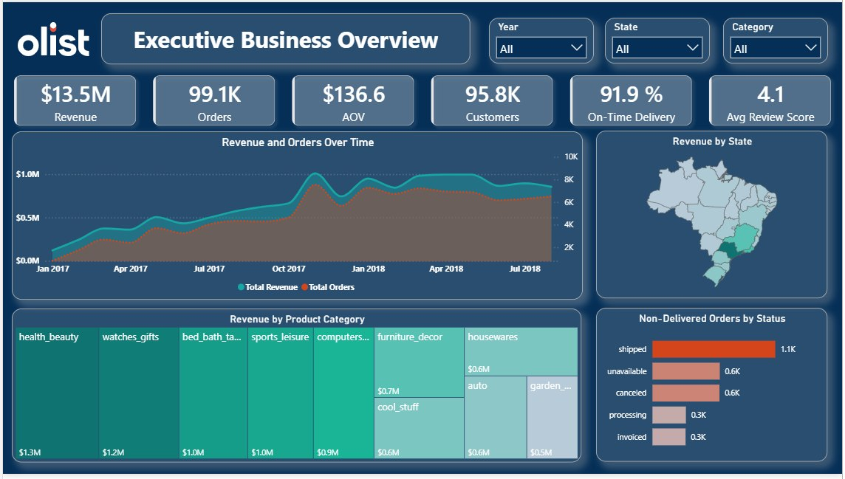

Slide 26
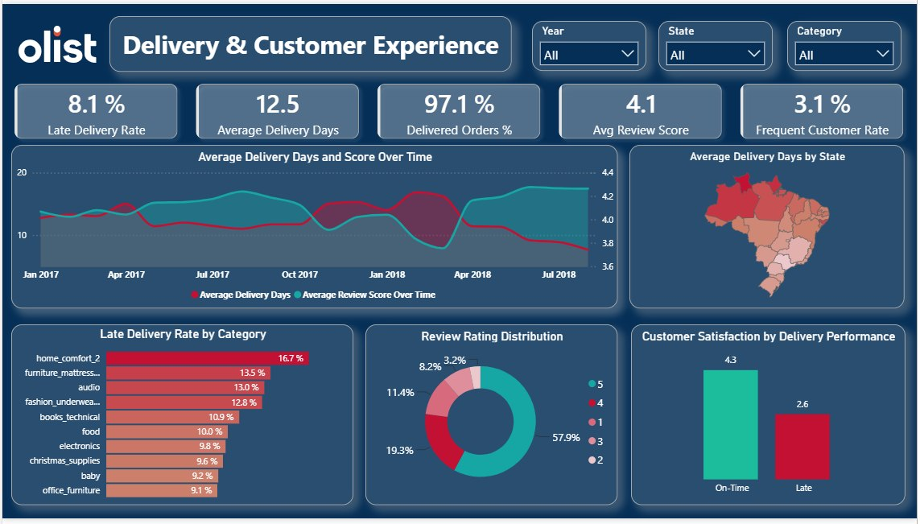

Slide 27
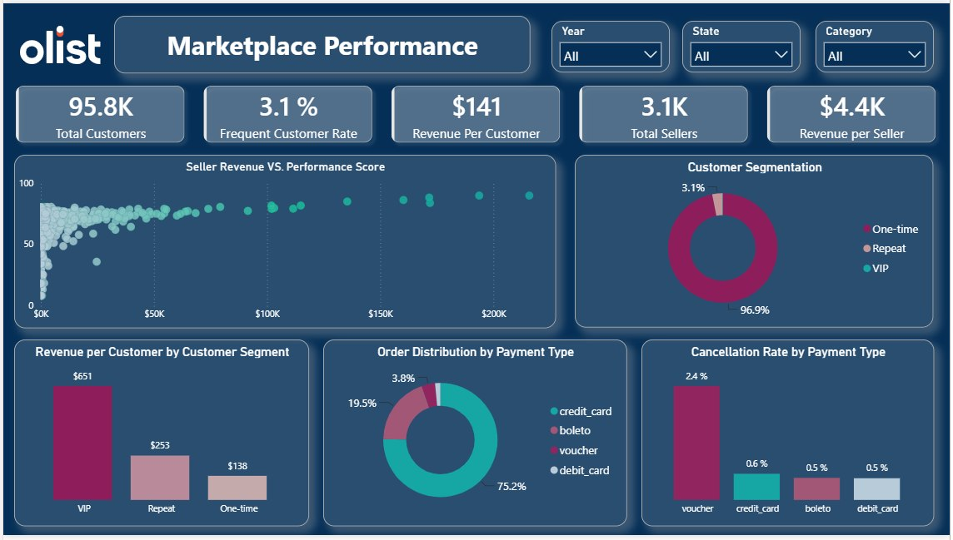

Slide 28

THANK YOU

