Slide 1
Gloves for Deaf
Done By: Esraa Hosam

Slide 2
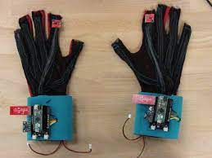
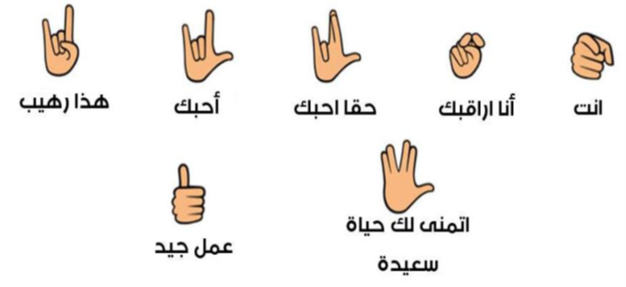
ABOUT
Sign language is the only way to communicate for listening and talking with disabled people. Approximately 10% of deaf people use sign language as their first language.
This project aims to bridge the gap between deaf community and normal masses.
This project converts sign language to text.

Slide 3
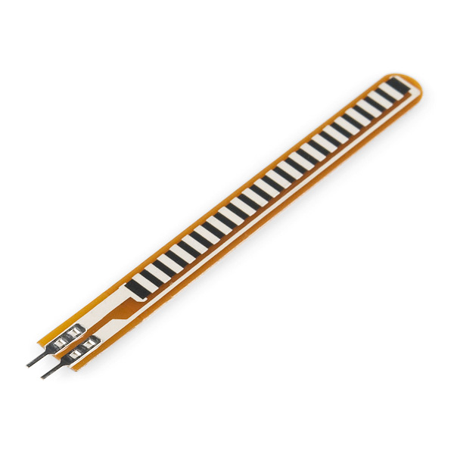
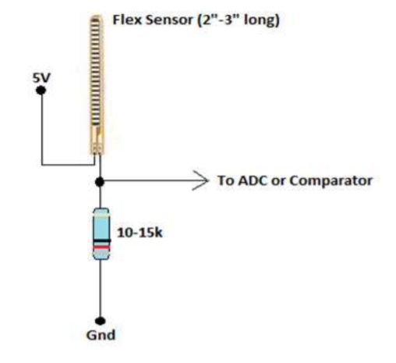
COMPONENTS
Flexible Sensors : Transducer which changes its resistance when its shape is changed.
ATMEGA32
LCD: 16×2

Slide 4
DRIVERS USED
ADC
LCD 8bit communication (D0-D7)

Slide 5
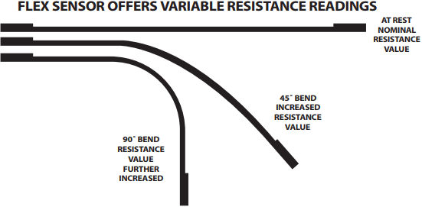
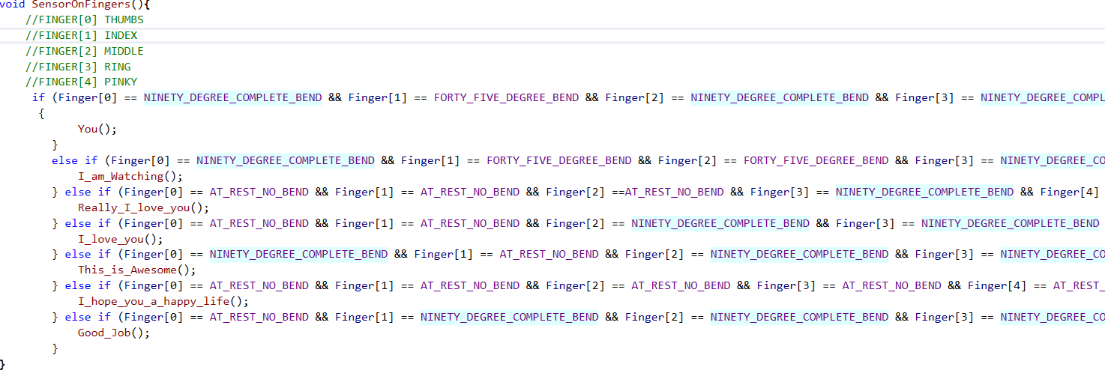
HOW IT WORKS

Slide 6
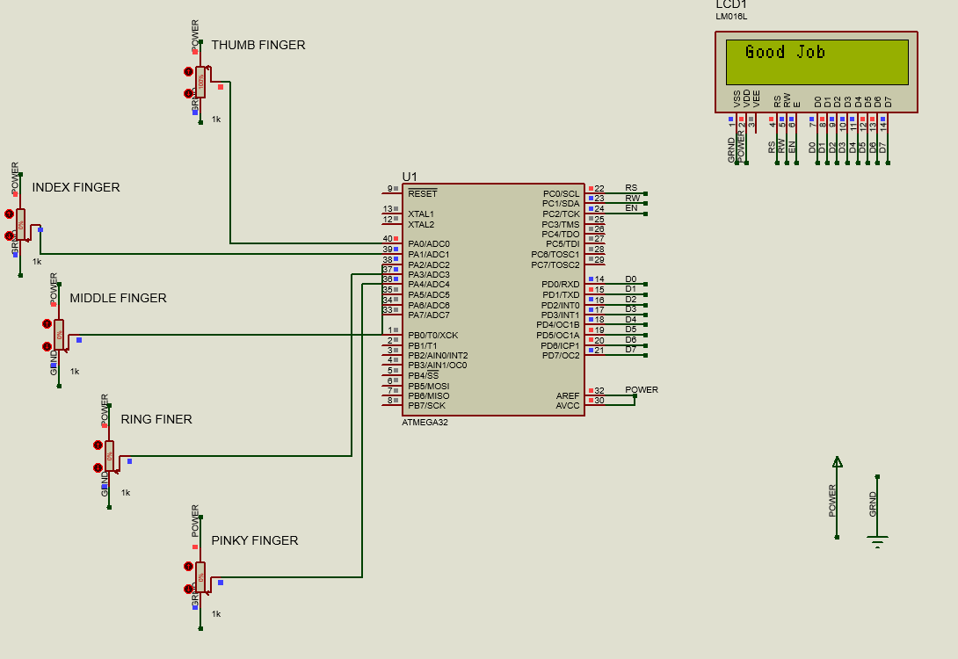
HOW IT WORKS

Slide 7
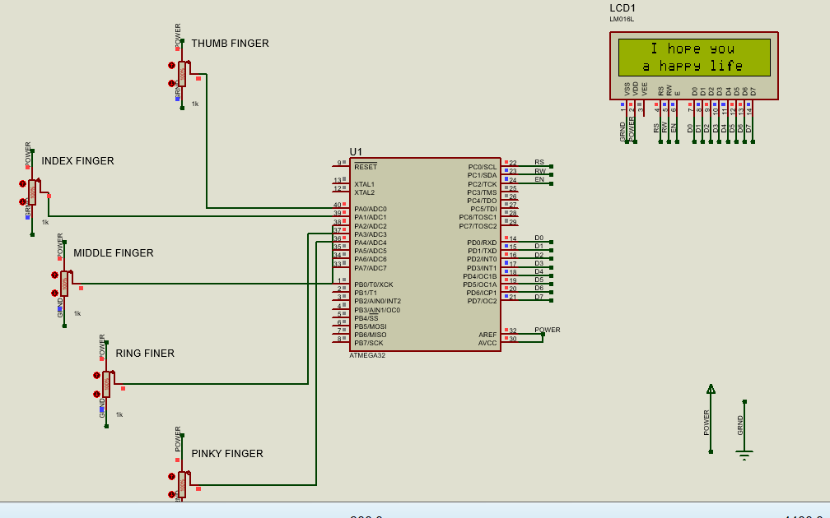
HOW IT WORKS

Slide 8
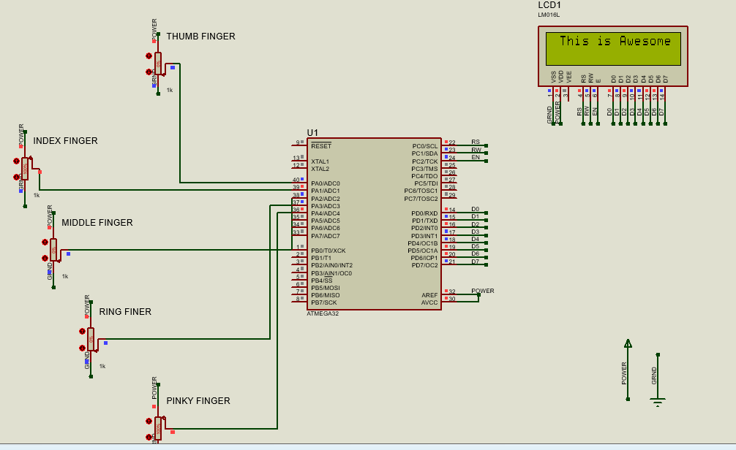
HOW IT WORKS

Slide 9
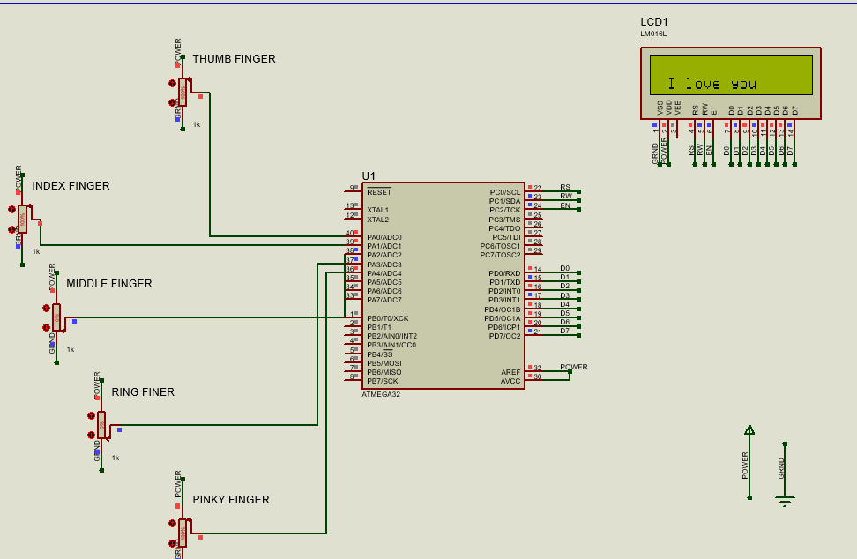
HOW IT WORKS

Slide 10
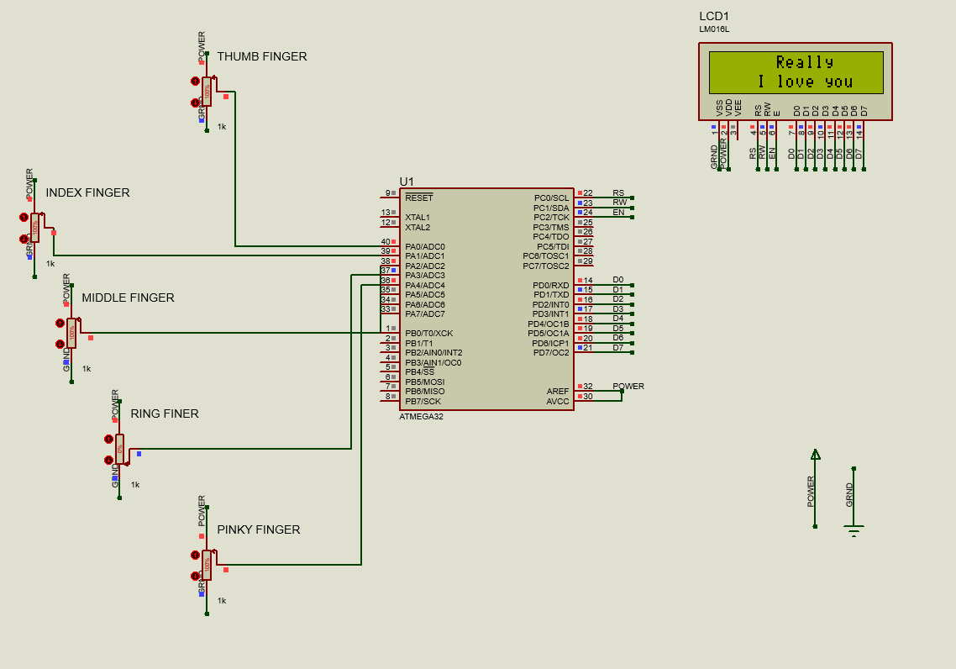
HOW IT WORKS

Slide 11
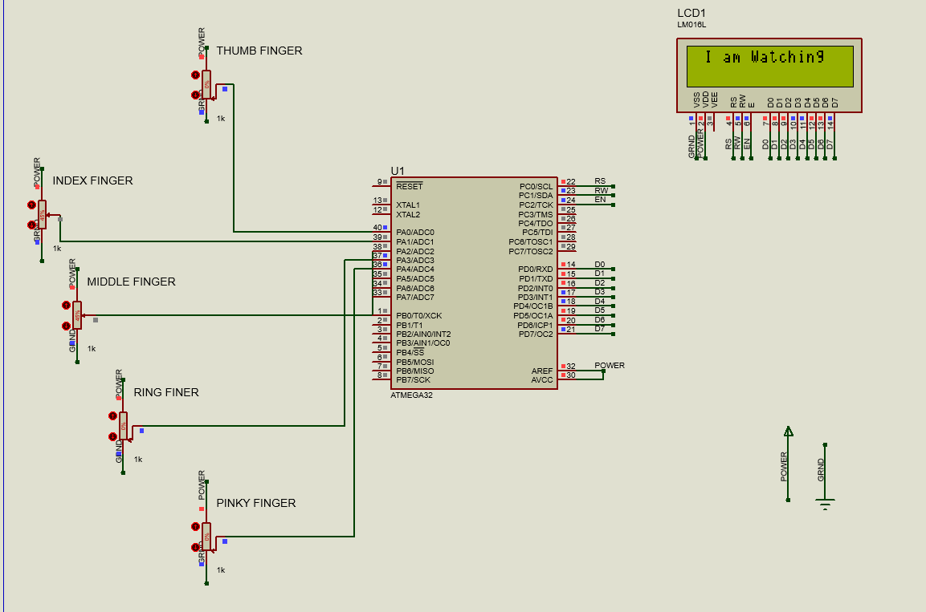
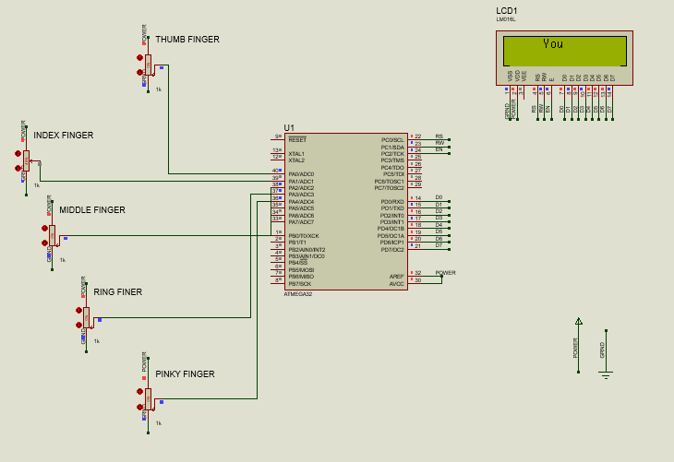
HOW IT WORKS

