Slide 1
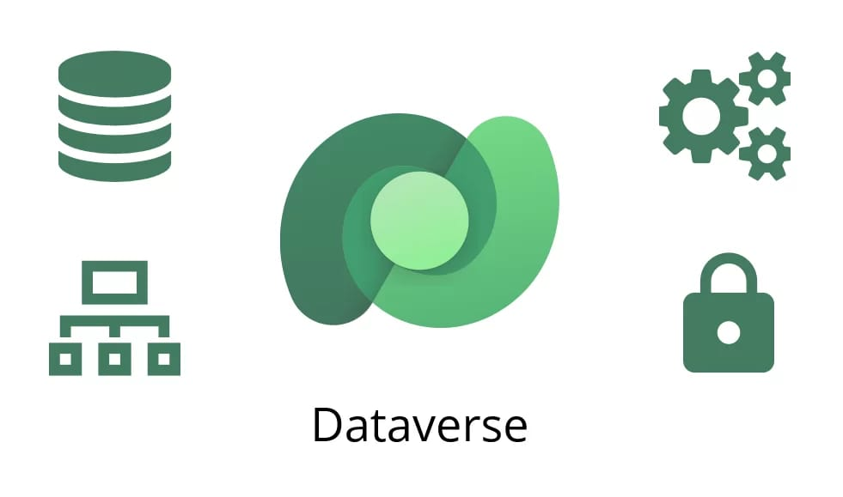







Instructor : ENG/ Menna Tarek

Slide 2
What is Dataverse
DataVerse : Is A Cloud-based Platform That Allows To Store , Organize , and Share data across different applications and Services while maintaining security, quality, and consistency.
In Microsoft Context :
Microsoft Dataverse is a secure and scalable data service that stores information in a structured format of tables and relationships, enabling seamless integration across the Power Platform and Dynamics 365.

Slide 3
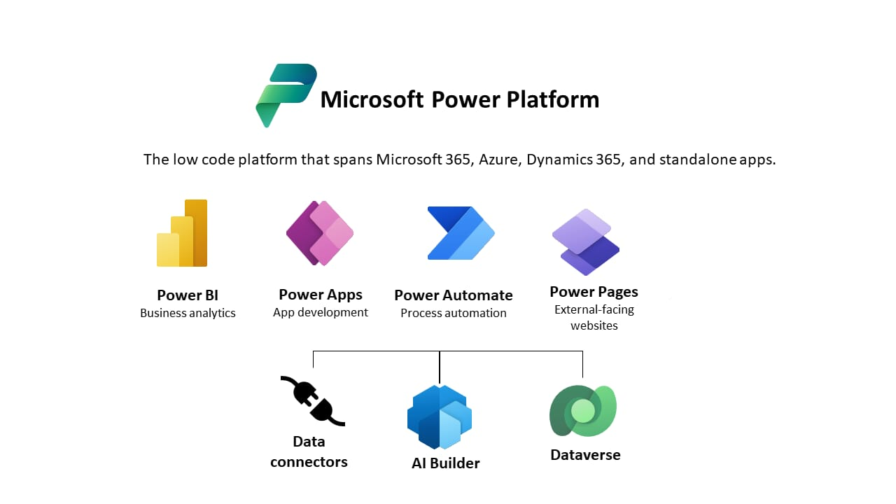
Where Does it Fit in Power Platform ?
Power Apps → Build apps using stored data.
Power Automate → Automate workflows with
Dataverse data.
Power BI → Create dashboards & analytics
from Dataverse.
Dynamics 365 → Business applications with
shared Dataverse backend.

Slide 4
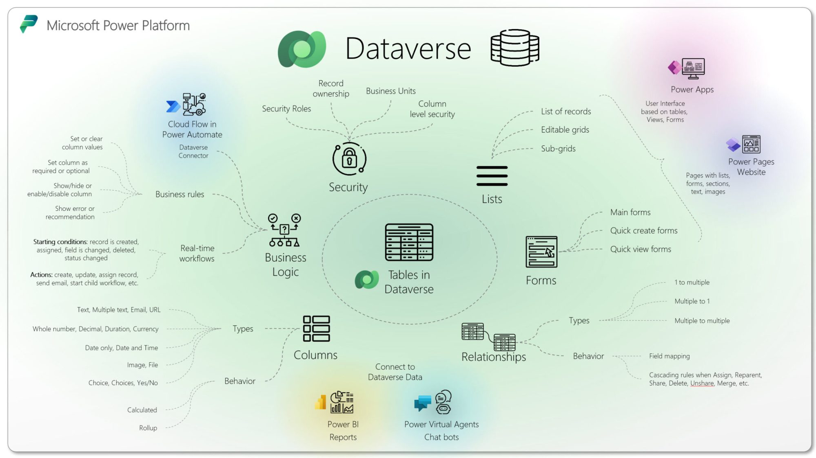
Core Components
Tables – Store data like database tables.
Columns – Fields with specific data types
(Text, Number, Date, Choice, Lookup, File, Image).
Rows – Records in the table.
Relationships – Link tables
(One-to-Many, Many-to-One, Many-to-Many).
Business Rules – Set conditions without coding.
Security Roles – Control access & permissions

Slide 5
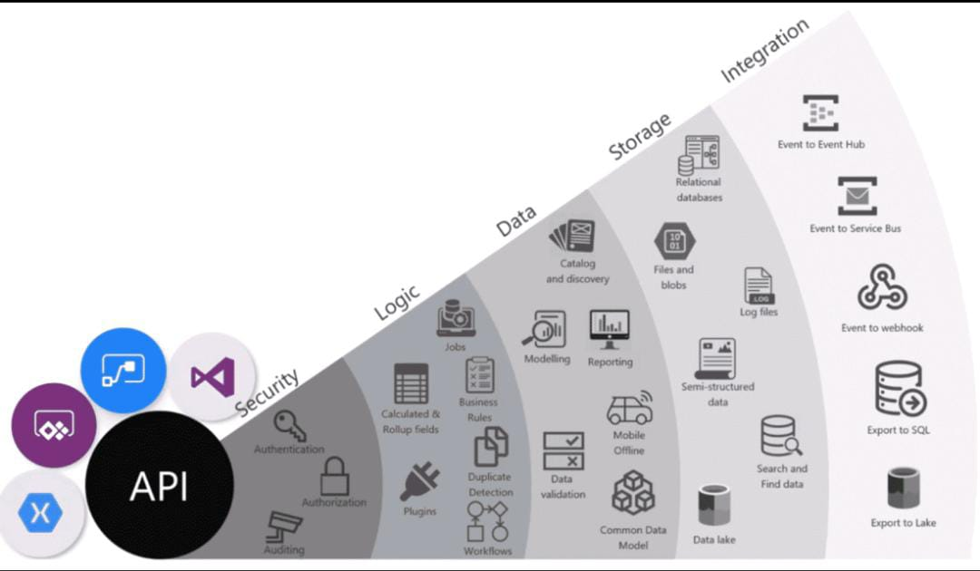
Key Features
High-level security (role-based & row-level).
Cloud storage – accessible from anywhere.
Easy integration with Microsoft ecosystem.
Supports business logic without coding.
Relational data management.
AI & analytics-ready.

Slide 6
Key Security Features
Row-Level Security (RLS): Dataverse supports row-level security through security roles and access control policies, ensuring that users can only view or edit the rows of data they are authorized to access.
Role-Based Access Control (RBAC): Permissions are assigned to users based on roles, controlling what data and actions they can access.
Data Encryption: Data is encrypted both at rest and in transit to maintain confidentiality.
Business Units: Organizational units help define data access boundaries for different teams or departments.
Audit Logs: Track data changes and user activities for compliance and monitoring.

Slide 7
Dataverse vs. Traditional Databases
Feature | Dataverse | SQL Server / MySQL
Ease of use | Simple UI | Needs SQL knowledge
Security | Built-in | Manual setup
Integration | Native with Microsoft | Requires configuration
Hosting | Cloud only | Cloud / On-premises

Slide 8
Limitations & Considerations
Licensing costs (not free for all users).
Capacity limits (storage quotas based on licenses).
Requires Microsoft account & environment setup.
Not as customizable at the raw database level as pure SQL.

Slide 9
Real-World Example
Want to create tables
Build App: create a simple app for employees to browse upcoming training sessions and sign up.
Automate Reminders: Use Power Automate to send reminders for upcoming trainings.
Report Stats : use Power BI to report attendance stats.
No custom database code, fully integrated security, and everything works across desktop, mobile, and Teams.

Slide 10
Summary
Dataverse is a secure, cloud-based data platform for storing, organizing, and sharing data.
Provides structured data storage with tables, relationships, and integration capabilities.
Works seamlessly with Power Apps, Power BI, and Dynamics 365.
Supports Row-Level Security and Role-Based Access Control to protect sensitive data.
Ensures data consistency, scalability, and high availability for business needs

Slide 11
Thank You
Team Members :
Esraa Ahmed
Sama Mohamed
Waad osamaa
Bassant Fekry Soliman
Yomna Abd Elhalim Elhadad
Noura Tarek Elsherbiny

