Slide 1




Quantum-Enhanced Weather Forecasting
A Hybrid ML and QNN Approach

Slide 2
Introduction
•Cairo weather forecasting is crucial for agriculture and planning.
•Goal: Predict rainfall and temperature using ML and QNN.
•Challenge: Imbalanced data, time dependencies, limited QML resources.

Slide 3


Project Pipeline
3.Model 1: Rain Classification
5. Quantum Neural Network (QNN) Classification
1. Load & Clean Data
2. Feature Engineering & EDA
4.Model 2: Temperature Regression

Slide 4

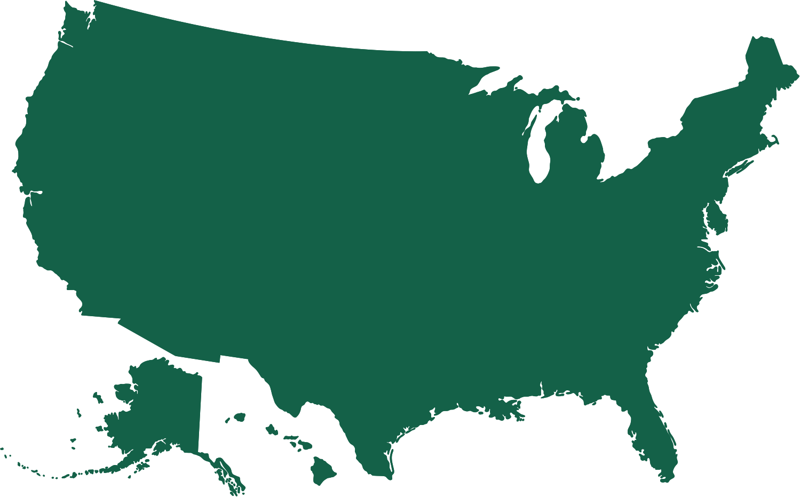









Dataset & Cleaning
•Data from 2009–2025 (daily records)
•Dropped columns with all nulls: visibility_mean/max/min
•No duplicates found
•Created rain_flag for classification target

Slide 5
Feature Engineering
•Extracted time-based features: month, year, day, season, dayofyear
•Created: avg_temp_past_7d, rain_prev_1d
•Converted wind direction to sin & cos
•Used correlation heatmap to remove redundant features
•Applied SMOTE to balance rain_flag

Slide 6
Exploratory Data Analysis
•Plotted temperature trends over time
•Compared real vs apparent temperature
•Analyzed rainy vs non-rainy temperature
•Checked outliers: all within expected Cairo range
Rain Classification (XGBoost)
•Model: XGBoostClassifier
•Handled imbalance using SMOTE
•Removed 'weather_code' due to leakage
•Selected top 10 features using F-score

Slide 7



Rain Classification Results
•Model performed well post-SMOTE
1
2
3
•Accuracy: 89.13%
•Rain class (1) recall: 0.72
•Macro F1-score: 0.71

Slide 8


Temperature Regression (XGBoost)
•Model: XGBoostRegressor
•Used predicted rain_flag as feature
•R² = 0.9788, RMSE = 0.9176°C, MAE = 0.6844°C
•Residuals are centered and well-behaved
QNN Classification
•Used 2-qubit QNN with 1 repetition
•Top 3 features selected due to limit
•Final loss: 0.7029 after 15 epochs
•Accuracy: 45%, Rain class recall: 0.43
•Low performance due to shallow QNN and limited encoding

Slide 9



Insights
•Classical ML outperformed QNN
•SMOTE improved minority class prediction
•Rain classification improved temperature prediction
•Feature leakage identified and handled

Slide 10
Challenges
•Class imbalance for rain_flag
•QNN underfitting due to low circuit complexity
•Feature leakage from time series (e.g., weather_code)
Future Work
•Use variational quantum circuits (VQC)
•Deeper QNN with expressive encodings
•Include satellite & humidity maps
•Deploy as a real-time web-based tool

Slide 11
QNN Classification
Initial Configuration
QNN with 3 features, 2 qubits, 1 repetition
Final Loss: 0.7029
Accuracy: 45%
Rain class recall: 43%, precision: 5%
Underfitting due to limited circuit depth and low feature representation

Slide 12
QNN Classification
Improved Configuration
QNN with 5 features, 5 qubits, 2 repetitions, weighted loss
Loss reduced from 2.35 to 2.02 over 15 epochs
Accuracy: 78%
Rain class recall: 56%, precision: 17%
Class weighting and deeper architecture improved minority class learning

Slide 13
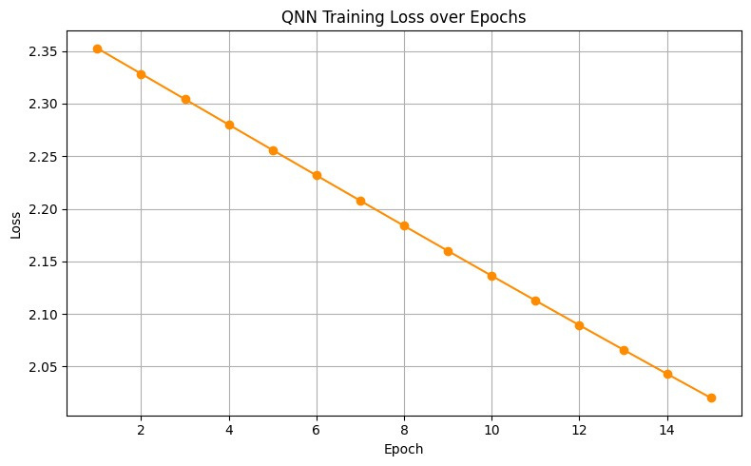




Key Insight
Increasing features, qubits, and repetitions led to notable performance gains. Training remains sensitive to encoding and duration; further tuning may enhance results.

Slide 14
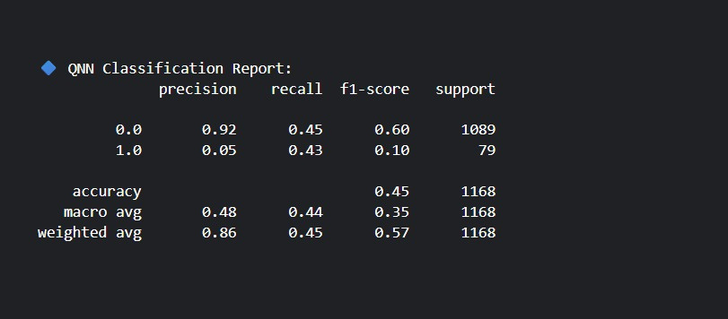
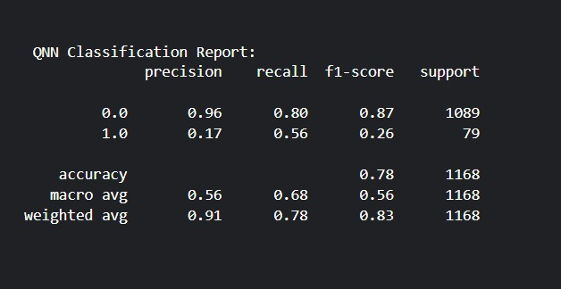

Slide 15
Conclusion
•Built full EDA → ML → QNN pipeline
•Strong performance from classical models
•QNN useful for experimentation under resource constraints

Slide 16


Thank You

