Slide 1
HTML
Hyper Text Markup Language

Slide 2
Course Contents
Topic1: Introduction to HTML &
Dealing With Text
Topic2 : Images & Hyper Links
Topic3 : Tables
Topic4 : Forms
Topic5 : Frames

Slide 3

What Is Internet?
Millions of computer networks connected to each other via the ‘Internet Backbone’

Slide 4
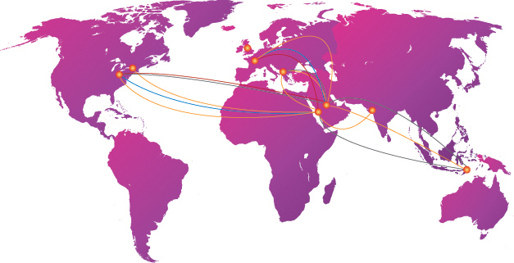
What Is Internet Backbone?
The Internet Backbone is an infrastructure of fiber optics cable owned by private companies.

Slide 5

What Is the World Wide Web?
The World Wide Web—the Web, for short—is a network of computers able to exchange text, graphics, and multimedia information via the Internet.
The Web relies on three mechanisms to make these resources readily available : Http Protocol ,URL , HypetText.
Notes:
The World Wide Web—the Web, for short—is a network of
computers able to exchange text, graphics, and multimedia
information via the Internet. By sitting at a computer that is
attached to the Web, using either a dialup phone line or a
much faster broadband (Ethernet, cable, or DSL connection),
you can visit Web-connected computers next door, at a nearby
university, or halfway around the world. And you can take full
advantage of the resources these computers make available,
including text, graphics, videos, sounds, and animation. Think
of the Web as the multimedia version of the Internet, and you’ll
be right on the mark.
The World Wide Web (Web) is a network of information resources. The Web relies on three mechanisms to make these resources readily available to the widest possible audience:
A uniform naming scheme for locating resources on the Web (e.g., URIs).
Protocols, for access to named resources over the Web (e.g., HTTP).
Hypertext, for easy navigation among resources (e.g., HTML).

Slide 6

What Is WebSite?
A website is a collection of related web pages, images, videos or other digital assets that are addressed relative to a common Uniform Resource Locator (URL), often consisting of only the domain name, or the IP address, and the root path ('/') in an Internet Protocol-based network.
Notes:
A web site is hosted on at least one web server, accessible via a network such as the Internet or a private local area network.
A web page is a document, typically written in plain text interspersed with formatting instructions of Hypertext Markup Language (HTML, XHTML). A web page may incorporate elements from other websites with suitable markup anchors.

Slide 7
How Does the Web Work?
You type a website address or “URL” into your browser.
http://www.google.com
html
URL: Uniform Resource Locater

Slide 8
How Does the Web Work? Cont.
URL Have two parts:
Domain Name
HTTP = Hyper Text Transfer Protocol
http://www.Google.com
Protocol Type
Notes:
A “Protocol’ is a structured set of communication rules that allows machines to share data.

Slide 9
How Does the Web Work?
When you click the hyperlink, your computer sends a message called an HTTP request. This message says, in effect, “Please send me the Web page that I want.”
The web server recieves the request and when it finds the Web page, it sends it to your computer, and your Web browser displays it.
http://www.google.com
html

Slide 10
Where Does HTML Fit In?
Hypertext is a type of text that contains hyperlinks (or just links), which enable the reader to jump from one hypertext page to another.
Hypertext Markup Language (HTML) enables you to mark up text so that it can function as hypertext on the Web. The term markup comes from printing; editors mark up manuscript pages with funny-looking symbols that tell the printer how to print the page. HTML consists of its own set of funny-looking symbols that tell Web browsers how to display the page. These symbols, called elements, include the ones needed to create hyperlinks.

Slide 11
What is HTML?
HTML is a language for describing web pages.
HTML stands for Hyper Text Markup Language.
HTML is not a programming language, it is a markup language .
A markup language is a set of markup tags .
HTML uses markup tags to describe web pages .

Slide 12
HTML Versions
HTML 1.0
HTML 2.0
HTML 3.2
HTML 4.0
HTML 4.1
Report

Slide 13
HTML Tags
HTML tags are keywords surrounded by angle brackets like <html>.
HTML tags normally come in pairs like <b> and </b>.
The first tag in a pair is the start tag, the second tag is the end tag.
Start and end tags are also called opening tags and closing tags.

Slide 14
HTML Document Structure
A single piece of HTML code is called a tag.
HTML tags are surrounded by pointed brackets (“<” and “>”).
Tags usually come in pairs. The tags will format the text between the beginning tag and the end tag of the pair.
For Example:
the pair of HTML tags to create bold text looks like this:
<B>This text will be bold.</B>

Slide 15
HTML Document Structure
Basic Tags
HTML
HEAD
BODY
Indicates the start and end of an HTML Document
Describe web page .The material in the head is invisible.
Defines the part of the document that contains the visible information

Slide 16
HTML Document Structure Cont.
<html>
<head>
<title>Example page!</title>
</head>
<body>
Hi.This is My First HTML page
</body>
</html>
Demo

Slide 17
HTML Editors
Text Editors
Notepad
Textpad
WYSIWYG editors
Dreamwaver
PageBreeze
Altova Stylevision
Notes:
What you see is what is you get

Slide 18
Working with Text

Slide 19
Working With Text
Headings
Paragraphs
Fonts
Physical styles
Preformatted Text Element
Ordered List
Unordered list

Slide 20
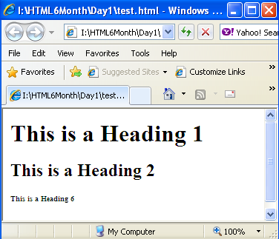
Headings
There are six levels of headings, ranging from a heading 1 (the largest) to a heading 6 (the smallest).
<h1>This is a Heading 1<h1>
<h2>This is a Heading 2<h2>
<h6>This is a Heading 6<h6>
Notes:
Note: Browsers automatically add an empty line before and after headings.
Use HTML headings for headings only. Don't use headings to make text BIG or bold.
Search engines use your headings to index the structure and content of your web pages.
Since users may skim your pages by its headings, it is important to use headings to show the document structure.
H1 headings should be used as main headings, followed by H2 headings, then less important H3 headings, and so on.
The elements inside the head element should not be displayed by a browser.
According to the HTML standard, only a few tags are legal inside the head section. These are: <base>, <link>, <meta>, <title>, <style>, and <script>.
Look at the following illegal construct:
<head> <p>This is some text</p> </head> In this case the browser has two options:
Display the text because it is inside a paragraph element
Hide the text because it is inside a head element
If you put an HTML element like <h1> or <p> inside a head element like this, most browsers will display it, even if it is illegal.

Slide 21
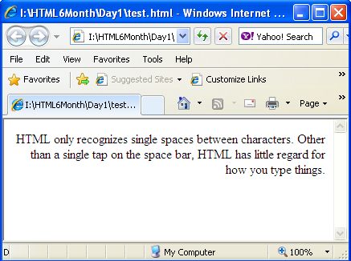
Paragraph
HTML only recognizes single spaces between characters. Other than a single tap on the Spacebar, HTML has little regard for how you physically type your paragraphs. What HTML does recognize is tags to format paragraphs.
<p align=“right”>
HTML only recognizes single spaces between characters. Other than a single tap on the space bar, HTML has little regard for how you type things.
</p>

Slide 22
Font
The <font> tag determines which font is applied to your text.
Font Tag Has Many Attributes:
<font>
Applying specific font name to my text
</font>
Face
Size
Color

Slide 23
Font Cont.
Face : Font tag by itself, this tag has no effect on text. You specify the fonts as a value of the face attribute. So we must use face attribute to apply specific font name
<font face=“Arial”>
Applying specific font name to my text
</font>

Slide 24
Font Cont.
Size : The size attribute accepts a numeric value .
Absolute Value
<font face=“Arial” size=“4”>
Applying specific font name to my text
</font>

Slide 25
Font Cont.
Color: colors can be defined using hexadecimal notation (a six-character code for expressing the combined red, green, and blue values of affected pixels) or a number of predefined English equivalents.
<font size=”2” color=”#0000FF”>
This text has been turned blue using hexadecimal notation, which uses six characters preceded by
a pound sign (#). </font>
<font size=”2” color=”purple”>
This text is making use of the word “Purple” one of the 16 recognized colors in the HTML standard. </font>

Slide 26
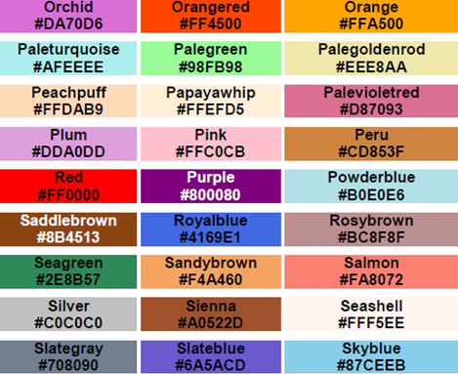
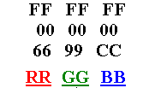
Font Cont.

Slide 27
Styles
To apply physical styles on text in HTML ,we will use a
Collection of tags, those tags could change the
appearance of HTML text.
To create bold text : <b> Bold Text </b>
To Create italic text :<i> Italic Text </i>
To underline text: <u> Underline </u>
To strike through text: <s>Strikethrough </s>
To superscript text: a<sup>2</sup>
To subscript text : H<sub>2</sub>

Slide 28
Preformatted Text
The <pre> tag tells the browser that text is preformatted, which means it should leave all white space as entered.
<pre>
| Mon | Tues | Wed | Thurs | Fri |
------------------------------------------------------
Calculus | X | | X | | X |
--------------------------------------------------------------------
English | | X | | X | |
---------------------------------------------------------------------
Latin | X | | X | | |
</pre>

Slide 29
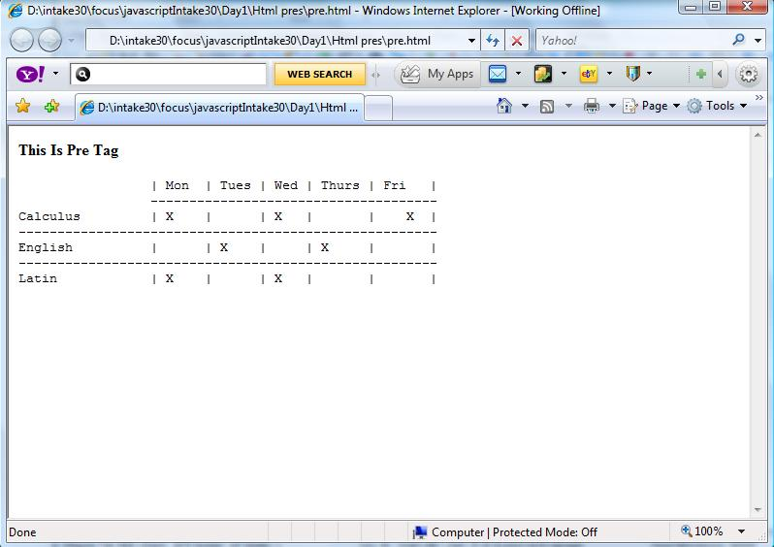
Preformatted Text Cont.

Slide 30
Ordered list
Orderded list is used to make a numbered list of items. Use the <ol> (ordered list) and <li> (list item) tag
<font face=”Verdana” size=”2”>
<ol>
<li> Apply to wet hair </li>
<li> Massage gently into hair and scalp </li>
<li> Rinse thoroughly </li>
<li> Repeat steps 1 - 3 to ensure you burn through
a bottle of this stuff a week. </li>
</ol>
</font>

Slide 31
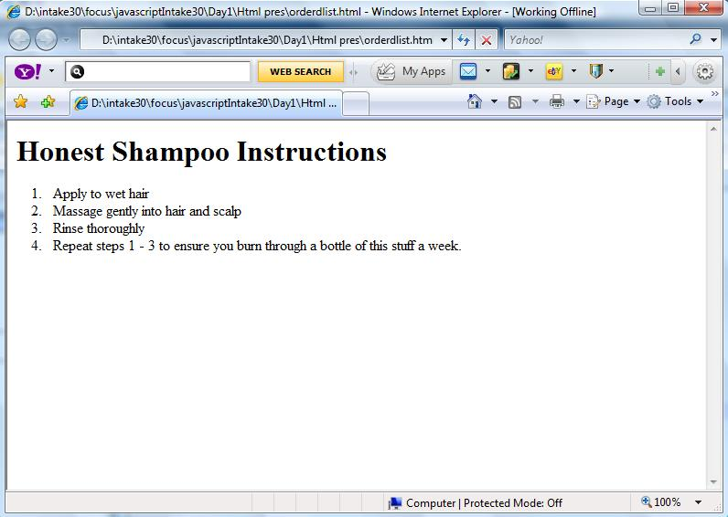
Ordered list Cont.

Slide 32
Ordered list Cont.
To Modify ordered list :
Use Type Attribute
Type=“1” default
Type=“A”
Type=“a”
Type=“I”
Type=“i”
<font face=”Verdana” size=”2” >
<ol type=“a”>
<li> Apply to wet hair </li>
<li> Massage gently in hair</li>
<li> Rinse thoroughly </li>
<li> Repeat steps 1 - 3</li>
</ol>
</font>

Slide 33
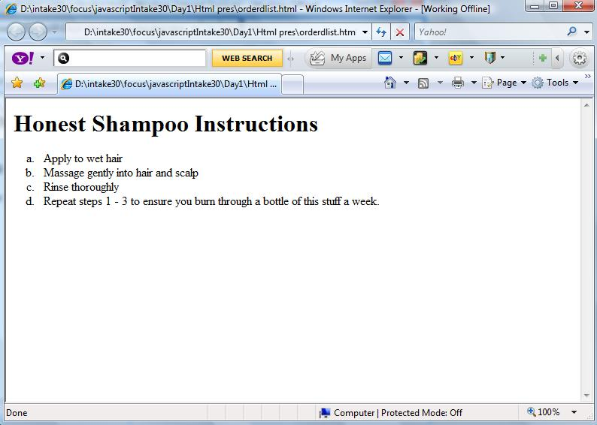
Ordered list Cont.

Slide 34
UnOrdered list
UnOrderded list is used to make a non numbered list of items. Use the <ul> (unordered list) and <li> (list item) tag
<font face=”Verdana” size=”2”>
<ul>
<li> Apply to wet hair </li>
<li> Massage gently into hair and scalp </li>
<li> Rinse thoroughly </li>
<li> Repeat steps 1 - 3 to ensure you burn through
a bottle of this stuff a week. </li>
</ul>
</font>

Slide 35
Unordered list Cont.
To Modify unordered list :
Use Type Attribute
Type=“disc” default
Type=“square”
Type=“circle”
<font face=”Verdana” size=”2” >
<ul type=“circle”>
<li> Apply to wet hair </li>
<li> Massage gently in hair</li>
<li> Rinse thoroughly </li>
<li> Repeat steps 1 - 3</li>
</ul>
</font>

Slide 36
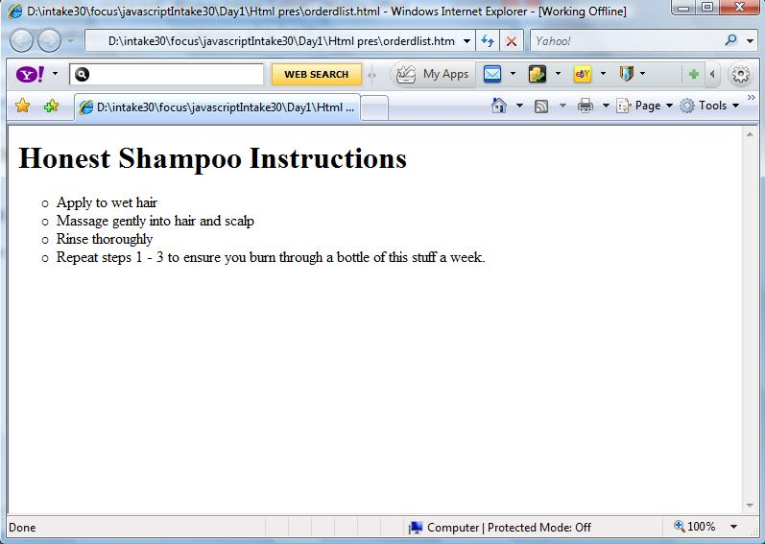
UnOrdered list Cont.

