Slide 1
HTML
Hyper Text Markup Language

Slide 2
Working with Hyperlinks

Slide 3
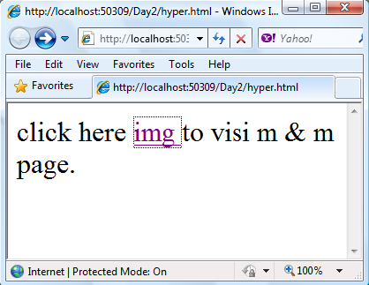
Hyperlinks
Hyperlinks are essential for the Web. You create them
with the anchor tag<a>.
Place an opening anchor tag in front of that text or image tag and define an href attribute, setting it equal to the pathname of the file you want to open when the link is clicked.
<font size="6">
click here
<a href="img.html" > img </a>
to visi m & m page.
</font>

Slide 4
Hyperlinks Cont.
To format a link so that the document it points to
opens in a new browser window, define a target
attribute and set it equal to “_blank”
<a href=”bingo.html” target=“_blank”> text-link </a>

Slide 5
Hyperlinks Cont.
To control the color of text links, define the three following attributes for the <body> tag, setting them equal to hexadecimal or predefined color name values:
link specifies the color of links that haven’t been visited.
vlink specifies the color of links that have been visited.
alink specifies the color of links that are currently active.
<body link=”#0000FF” vlink=”#990099” alink=”#FF0000”>
<a href=”bingo.html” target=“_blank”>text-link</a>
</a>

Slide 6
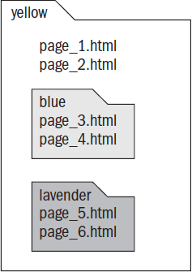
Hyperlinks Cont.
Defining Pathnames
A pathname is simply a way to describe the file structure of your site — how files and folders (also called directories) are laid out on your computer, and ultimately the Web server.
In the follwing picture :
The Yellow directory containing two files (page_1.html and page_2.html) plus two additional subdirectories (Blue and Lavender), each of which contain two files

Slide 7
Hyperlinks Cont.
To reference a document in the same directory as the current file:
<a href=”page_2.html”> Link </a>
To reference a document inside a directory that’s next to the current file :
<a href=”blue/page_3.html”> Link </a>
Notes:
To reference a document in the same directory as the current file, set the href attribute equal to the document’s filename. For example, to create a link in page_1.html that opens page_2.html, write the anchor tag as follows:
<a href=”page_2.html”> </a>
To reference a document inside a directory that’s next to the current file, set the href attribute equal to the directory’s name, add a forward slash, and follow it with the filename. For example, to create a link in page_1.html that opens page_3.html, write the anchor tag as follows:
<a href=”blue/page_3.html”> text or image </a>

Slide 8
Hyperlinks Cont.
To move up one directory in the file structure, referencing a document outside the directory of the current file:
<a href=”../page_1.html”> Link </a>
To reference a document inside a directory that is outside the current file’s directory :
<a href=” ../blue/page_3.html”> Link </a>
Notes:
To move up one directory in the file structure, referencing a document outside the directory of the current file, precede the filename with two periods and a forward slash. For example, to create a link in page_3.html that opens page_1.html, write the anchor tag as follows:
<a href=”../page_1.html”> text or image </a>
To reference a document inside a directory that is outside the current file’s directory, precede the filename with two periods and a forward slash, and follow it with the directory name and filename. For example, to create a link in page_5.html that opens page_3.html, write the anchor tag as follows:
<a href=”../blue/page_3.html”> text or image </a>

Slide 9
Hyperlinks Cont.
Linking to Named Anchors
You can do more than just link to documents and images. If you name an anchor tag at a specific place within a document you can specify that exact location in a hyperlink.
<a name=”answer_2”>
<p>A: Push the green Power button on the remote. If that fails, check the surge strip.</p></a>
<a href=” #answer_2”>
Q: How do I turn on the TV?
</a>

Slide 10
Working with Images

Slide 11
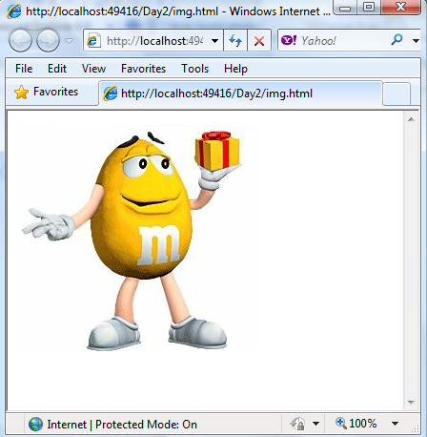
Images
<img> tag is responsible of Inserting image to web
page . When you place the <img> tag in your
document’s code, the browser embeds the image file
you reference in the document.
For Example:
<img src=“m.jpg” />

Slide 12
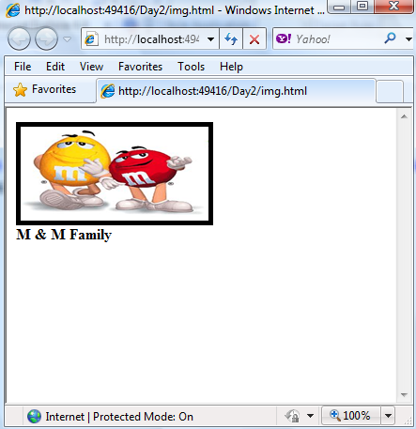
Images Cont.
Set some image’s properties
<img src=”m&m.jpg” width=”200” height=”100”
alt=”Our cats, Daisy and Calvin.” border=”5” />
<font face=”Arial” size=”2”>
<b> M& M Family.</b></font>

Slide 13
Images Cont.
Controlling Image Alignment and Spacing:
To vertically align the top of the image with the top, middle, or bottom of the preceding line of text, set the align attribute equal to top, middle, or bottom.
align attribute: top , middle , bottom .

Slide 14
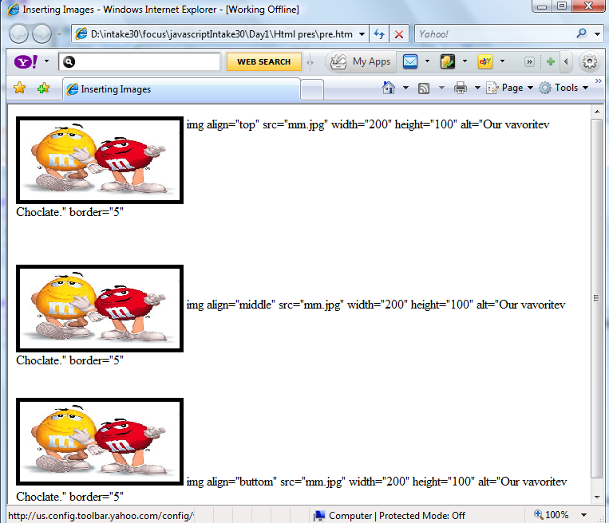
Align=“top”
Align=“middle”
Align=“bottom”

Slide 15
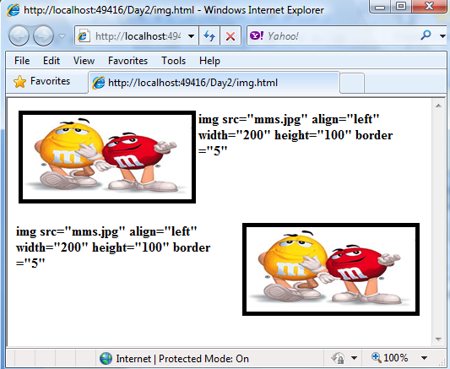
Images Cont.
To float an image element to the left or right margin, set the align attribute equal to either left or right.
Align=“left”
Align=“right”

Slide 16
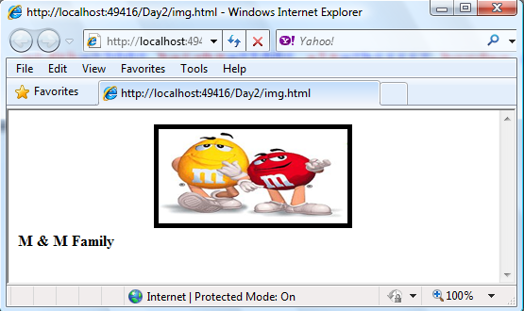
Images Cont.
To center an image, wrap the <img> tag inside opening and closing <center> tags.
<center>
<img src=”m&m.jpg” width=”200” height=”100”
alt=”Our cats, Daisy and Calvin.” border=”5” />
</center>

Slide 17
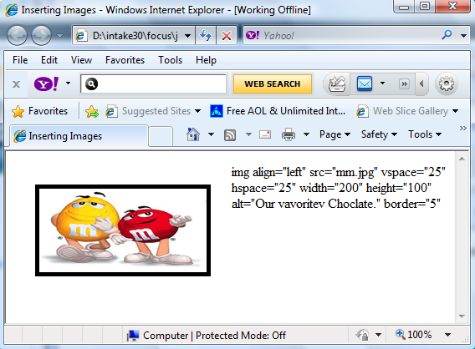
Images Cont.
To increase the amount of white space around an image, add the hspace and vspace attributes
<img src=”m&m.jpg” width=”200” height=”100” border=”5” hspace=“25”
Vspace=“25”/>

