Slide 1
HTML
Hyper Text Markup Language

Slide 2
Working with Tables

Slide 3
Tables
A table is a structured element that consists of rows and columns of cells. You can place any kind of content you like in these cells: text, images, and even other tables.
There are three sets of container tags required to build any table. The <table> and </table> tags define where the table begins and ends, the <tr> and </tr> tags define where each row begins and ends, and the <td> and </td> tags define the individual cells within each row.
There are no tags specifically defining columns; they result when multiple rows of cells are stacked on top of each other.

Slide 4
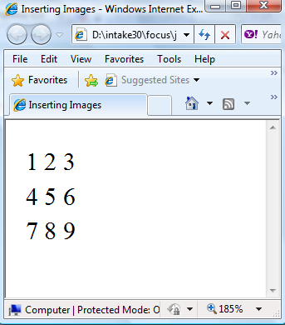
Tables Cont.
Simple Table Structure
<table>
<tr>
<td> 1 </td> <td> 2 </td> <td> 3 </td> </tr>
<tr>
<td> 4 </td> <td> 5 </td> <td> 6 </td> </tr>
<tr>
<td> 7 </td> <td> 8 </td> <td> 9 </td> </tr>
</table>

Slide 5
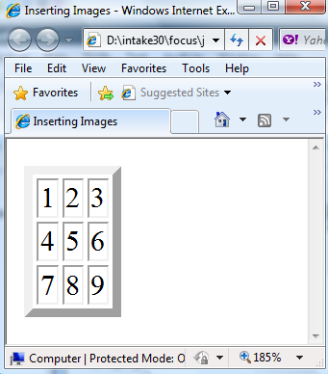
Tables Cont.
Table Borders
<table border=“5”>
<tr>
<td> 1 </td> <td> 2 </td> <td> 3 </td> </tr>
<tr>
<td> 4 </td> <td> 5 </td> <td> 6 </td> </tr>
<tr>
<td> 7 </td> <td> 8 </td> <td> 9 </td> </tr>
</table>

Slide 6
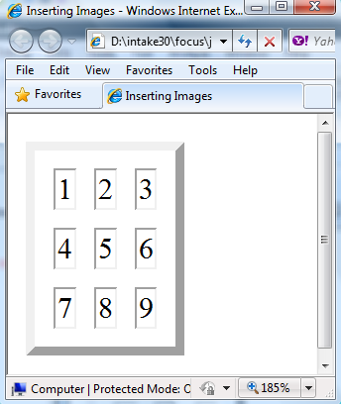
Tables Cont.
To control the thickness of internal borders between cells, define cellspacing attribute.
<table border=“5” cellspacing=“10”>
<tr>
<td> 1 </td> <td> 2 </td> <td> 3 </td> </tr>
<tr>
<td> 4 </td> <td> 5 </td> <td> 6 </td> </tr>
<tr>
<td> 7 </td> <td> 8 </td> <td> 9 </td> </tr>
</table>

Slide 7
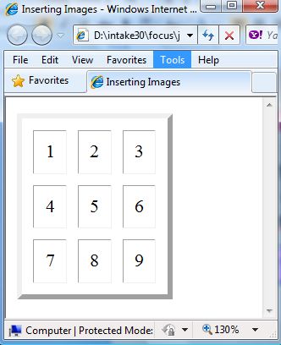
Tables Cont.
To control the amount of empty space between the border of a cell and the content inside it,define cellpadding attribute.
<table border=“5” cellpadding=“10”>
<tr>
<td> 1 </td> <td> 2 </td> <td> 3 </td> </tr>
<tr>
<td> 4 </td> <td> 5 </td> <td> 6 </td> </tr>
<tr>
<td> 7 </td> <td> 8 </td> <td> 9 </td> </tr>
</table>

Slide 8
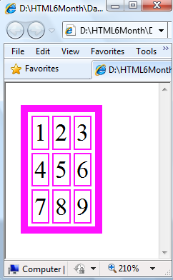
Tables Cont.
To specify a border color, define a bordercolor attribute.
<table border=“5” bordercolor=“#FF11FF”>
<tr>
<td> 1 </td> <td> 2 </td> <td> 3 </td> </tr>
<tr>
<td> 4 </td> <td> 5 </td> <td> 6 </td> </tr>
<tr>
<td> 7 </td> <td> 8 </td> <td> 9 </td> </tr>
</table>

Slide 9
Tables Cont.
Spanning Cells
Asingle cell can span multiple columns or rows. The number of columns or rows a cell spans is defined using the colspan and rowspan attributes.
To span a cell across a number of columns, add the colspan attribute to the <td> tag and set it equal to the number of columns you want to span.

Slide 10
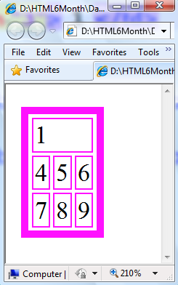
Tables Cont.
To span a cell across a number of columns.
<table border=“5” cellspacing=“10”>
<tr>
<td colspan=“3”> 1 </td>
</tr>
<tr>
<td> 4 </td> <td> 5 </td> <td> 6 </td> </tr>
<tr>
<td> 7 </td> <td> 8 </td> <td> 9 </td> </tr>
</table>

Slide 11
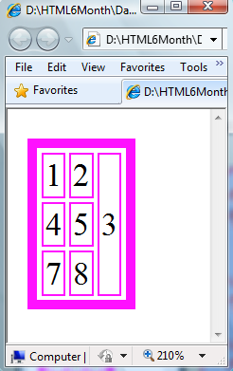
Tables Cont.
To span a cell across a number of rows .
<table border=“5” cellspacing=“10”>
<tr>
<td> 1 </td> <td> 2 </td>
<td rowspan=“3”> 3 </td>
</tr>
<tr>
<td> 4 </td> <td> 5 </td>
</tr>
<tr>
<td> 7 </td> <td> 8 </td>
</tr>
</table>

Slide 12
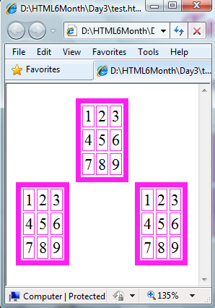
Tables Cont.
Table alignment.
To specify a table’s alignment, define an align attribute of the <table> tag and set it equal to left, right, or center.
Align=“center”
Align=“right”
Align=“left”

Slide 13
Tables Cont.
Aligning Table Elements
To align the content within a cell horizontally, define an align attribute for the <td> tag and set it equal to left, right, or center.
To align the content
within a cell vertically,
define a valign attribute
for the <td> tag and
set it equal to
top, middle, bottom.
To set the horizontal or vertical alignment for an entire row, define the align or valign attributes of the <tr> tag.

Slide 14
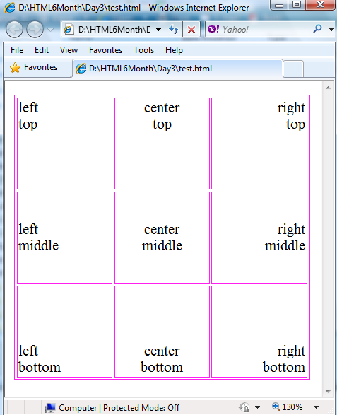
Tables Cont.
Align=“left”
Valign=“top”

Slide 15
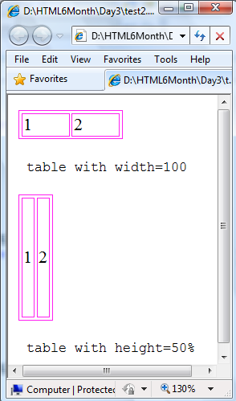
Tables Cont.
Defining Dimensions for Table Elements
the dimensional attributes width and height can be applied to the <table>, <tr>, and <td> or <th> tags with more or less similar results.
we can set this value equal to pixel value or percentage value according to the page width and height.

Slide 16
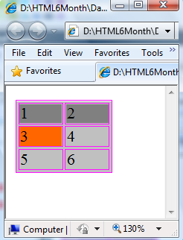
Tables Cont.
Table bgcolor properties .
<table bgcolor=“silver”>
<tr bgcolor=“gray”>
<td> 1 </td> <td> 2 </td>
</tr>
<tr>
<td bgcolor=“#ff6600”> 3 </td> <td> 4 </td>
</tr>
<tr>
<td> 5 </td> <td> 6 </td>
</tr>
</table>

