Slide 1
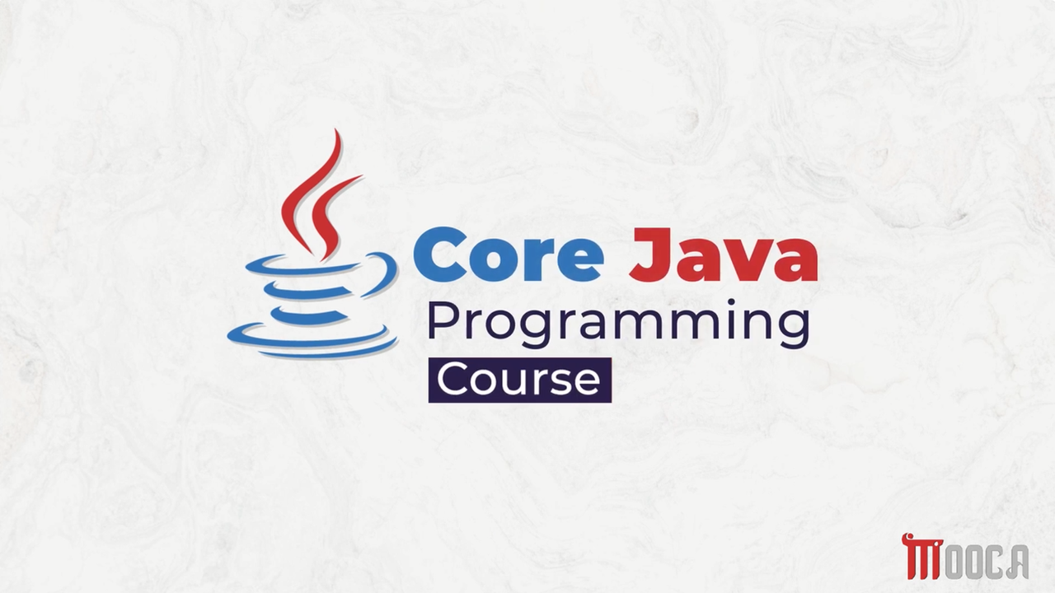

Slide 2
✍Lecture 3:
Primitive Data types .
Literals in java .
Variables .
Type Casting .
Arrays .
Lab 3.

Slide 3
✍Lecture 4 :
The Arithmetic and Bitwise Operators
The Relational and Boolean Logical Operators
The Ternary and instanceof Operators
Tha Arrow Operator and Lambda Expression
Selection Statements
Iteration Statements
Jump Statements
Java String
String Methods
StringBuffer, StringBuilder and StringTokenizer
Lab 4 .

Slide 4
✍Lecture 5 :
Java Packages
Import Packages
Interfaces
Implementing Interfaces
General Considerations
Functional Interfaces
Predefined Functional Interfaces
Lab 5 .

Slide 5
✍Lecture 6 :
Wrapper Classes
Annotations
Annotations Basics
Lab 6 .

Slide 6
✍Lecture 7 :
Exception
Exception Handlling
Lab 7 .

Slide 7
✍What is an Exception
An Exception is an event that occurs during program execution and interrupts the normal flow of the program.
Happens while the program is running.
Represents an unexpected problem.
If not handled, the program may terminate.

Slide 8
✍Why Do Exceptions Occur
Common reasons:
Division by zero
Accessing an invalid array index
Opening a file that doesn't exist
Using a null object reference
Invalid user input

Slide 9
✍Benefits of Exception Handling
Prevents program crashes.
Makes programs more reliable.
Separates error-handling code from normal code.
Helps identify the exact problem.

Slide 10
✍Common Exceptions in Java :
Exception | Cause
ArithmeticException | Division by zero
NullPointerException | Using a null object
ArrayIndexOutOfBoundsException | Invalid array index
NumberFormatException | Invalid number conversion
IOException | File input/output problems

Slide 11
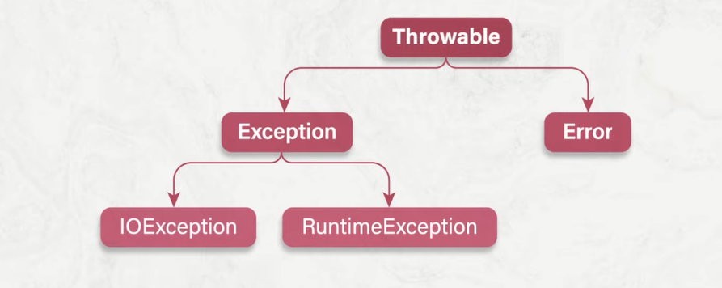
✍Exception Hierarchy

Slide 12
✍What is Exception Handling
Exception Handling is a mechanism that allows a program to continue running even after an error occurs.
Java provides:
try
catch
finally
throw
throws

Slide 13
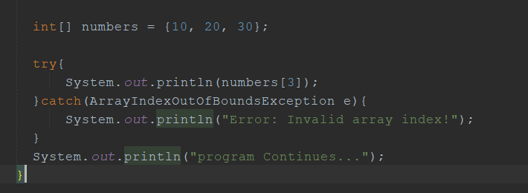
✍try Block

Slide 14
✍Two Types of Exceptions
Checked Exceptions
The compiler forces you to deal with it.
IOException
SQLException
Unchecked Exceptions
It appears during operation.
ArithmeticException
NullPointerException
ArrayIndexOutOfBoundsException

Slide 15
✍Types of Exceptions
Checked Exception | Unchecked Exception
Compile Time | Runtime
Must be handled | Optional to handle
Example: IOException | Example: ArithmeticException
Example: FileNotFoundException | Example: NullPointerException

Slide 16
✍What is a Custom Exception
Sometimes Java's built-in exceptions are not enough, so we create our own exception class to represent a specific business rule.
Why create a custom exception?
Improve code readability.
Provide meaningful error messages.
Handle application-specific errors.
Student age cannot be negative.
Product quantity cannot be less than zero.

Slide 17
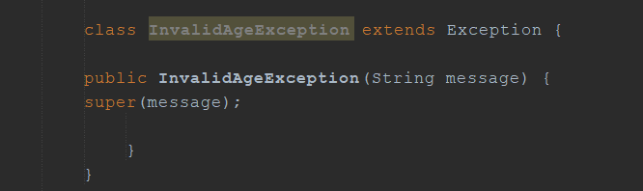
✍Creating a Custom Exception
extends Exception → Makes it a Checked Exception.
super(message) → Sends the message to the parent Exception class.

Slide 18
✍Throwing Custom Exception
Check the condition.
If invalid → throw the exception.
Otherwise continue normally.

Slide 19
✍Exception Methods
Method | Description
getMessage() | Returns error message
toString() | Returns exception name + message
printStackTrace() | Prints detailed error information

Slide 20
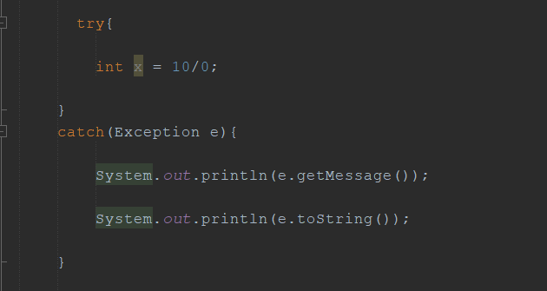
✍Exception Methods

Slide 21
✍finally Block
The finally block always executes whether an exception occurs or not.
Used for
Closing files
Closing database connections
Releasing resources

Slide 22
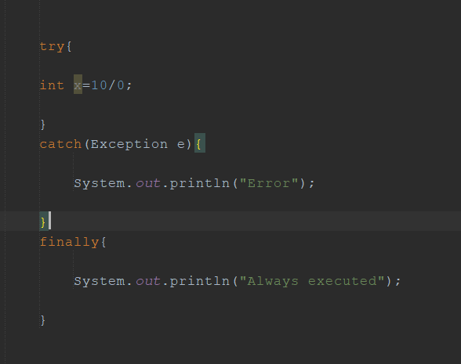
✍finally Block
Example :

Slide 23
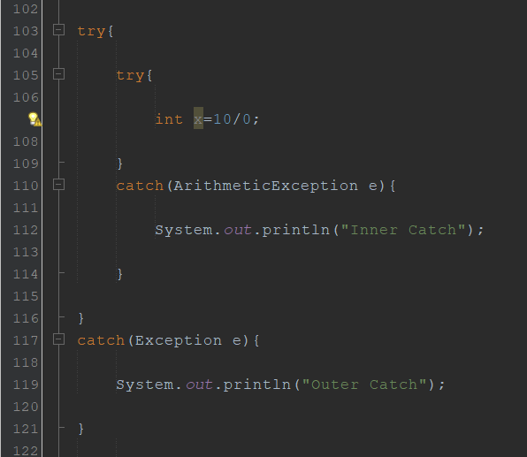




✍Nested try
A try-catch block can be placed inside another try-catch block to handle errors at different levels.

Slide 24
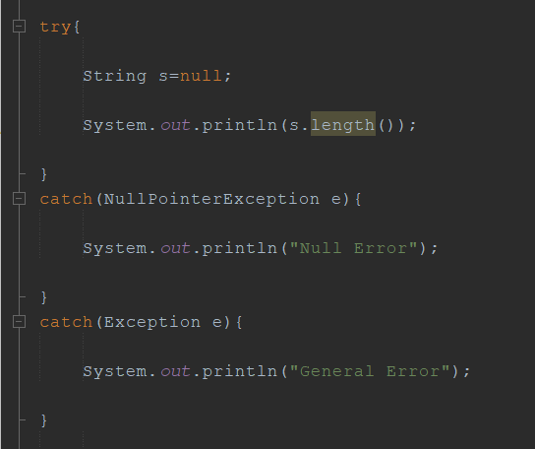
✍Multiple Exceptions
Always start with the most specific exception, followed by the more general ones.

Slide 25
✍Best Practices
Catch specific exceptions.
Never leave catch empty.
Use meaningful messages.
Close resources.
Don't use Exception for every case.

Slide 26
✍Rethrowing and Chaining Exceptions
Rethrowing Exceptions
Sometimes we catch an exception but cannot fully handle it, so we throw another exception to the caller.
Chaining Exceptions
The original exception can be attached as the cause of the new exception.

Slide 27
✍Why finally
When an exception occurs,
Program execution stops.
Remaining code inside the method is skipped.
Resources may remain open.
Examples of resources:
Files
Database connections
Network sockets

Slide 28
