Slide 1
Capstone Project
Launching Mexican Restaurant in New York City

Slide 2
My client, Company A is a successful restaurant chain in Mexico that is looking to expand business into USA through New York City.
So it is evident that to survive in such competitive market it is very important to strategically plan. Various factors need to be studied in order to decide on the Location.
Thus, Company A need to choose the correct location to start its first venture. First move is very important, thereby choice of location is very important.
Background
The City of New York, is the most populated city in the United States. New York City is very diverse and highly multicultural. It provides lots of business opportunities. It has attracted many different players into the market. It is a global hub of business and commerce.
This also means that the market is highly competitive. Therefore, any new business venture or expansion needs to be analyzed carefully. The insights derived from analysis will give good understanding of the business environment and give a new establish an opportunity to position itself strategically good in the market.

Slide 3
Introduction
With it's diverse culture , comes diverse food items. There are many restaurants in New York City, each belonging to different cuisines like Chinese, Indian, French etc. So as part of this project , we will list and visualize all major parts of New York City that has Mexican restaurants.
Queries that can be answered using this project?
Which areas have potential Mexican Restaurant Market ?
Which all areas lack Mexican Restaurants ?
What is best location in New York City for Mexican Cuisine ?

Slide 4
Data
1. Data source : https://cocl.us/new_york_dataset
Description - New York City data that contains list of Boroughs, Neighborhoods along with their latitude and longitude. This data is used to set to explore various neighborhoods of new york city.
2. Data source : Foursquare API
Description : By using this API we will get all the venues in each neighborhood. We can filter these venues to get only Mexican Restaurants.
3. Data source : https://data.cityofnewyork.us/City-Government/Borough-Boundaries/tqmj-j8zm
Description : By using this geo space data we will get the New York Borough boundaries that will help us to visualize choropleth map.

Slide 5
Methodology
Collect the New York city data from https://cocl.us/new_york_dataset
Using FourSquare API we will find all venues for each neighborhood.
Filter out all venues that are Mexican Restaurants.
Find rating , tips and like count for each Mexican Restaurants using FourSquare API.
Using rating for each restaurant in order to analyse the neighborhood and borough.

Slide 6
Libraries
pandas and numpy for handling data.
request module for using FourSquare API.
geopy to get co-ordinates of City of New York.

Slide 7
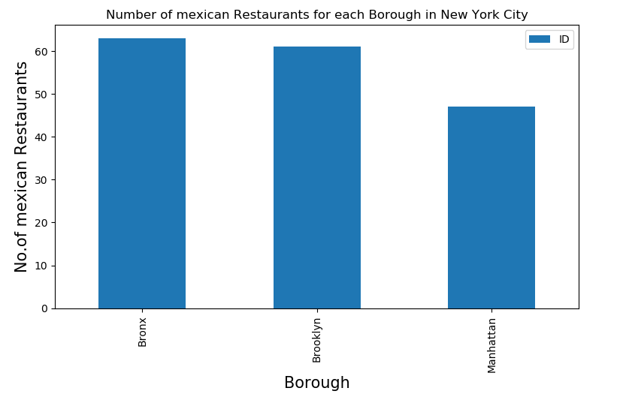
Result
Bronx has maximum number of Mexican Restaurants

Slide 8
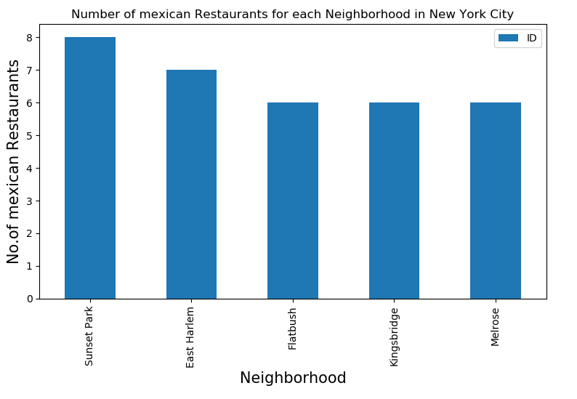
Result
Sunset Park has maximum number of Mexican Restaurants

Slide 9
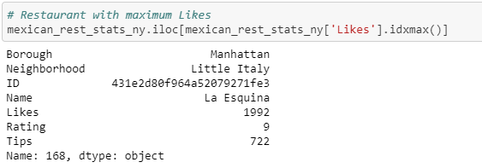
Result
Restaurant with maximum like

Slide 10
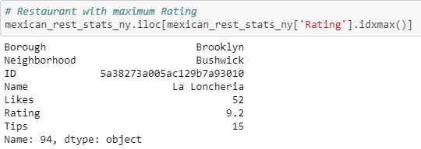
Result
Restaurant having maximum Rating

Slide 11
Discussion
Manhattan is found to be the most competitive market for launching new Mexican restaurant
Bronx is found to be the best oppurtunity based on Foursquare ratings
Do not launch in the Greenpoint, Windsor Terrace, East Williamsburg and Buschwick neighborhoods of Brooklyn
Good Mexican Restaurants;
La Esquina;
La Loncheria;

Slide 12
This analysis suggests an opportunity analysis based on Foursquare ratings and Likes; but lacks risk analysis, like the cost of the location and competition in that area.
Conclusion
A restaurant with a high rating could still be unprofitable, which is unsuccessful from a business perspective. So the suggestion is relatively narrow. To suggest more practical and profitable ideas, the relationship between customer reactions and financial performance should be evaluated.

Slide 13

Thank you
Any queries ?

