Slide 1

Collision resistance
Online Cryptography Course
Dan Boneh
HMAC:
a MAC from SHA-256

Slide 2
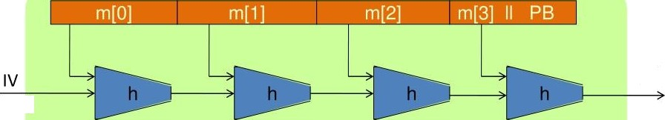
The Merkle-Damgard iterated construction
H(m)
(fixed)
Thm:
h collision resistant
H collision resistant
Can we use H(.) to directly build a MAC?
Dan doneh

Slide 3

Standardized method:
HMAC (Hash-MAC)
Most widely used MAC on the Internet.
H: hash function.
example: SHA-256 ; output is 256 bits
Building a MAC out of a hash function:
HMAC:
S( k, m ) = H( kÖopad , H( k@ipad II m ) )
Dan doneh

Slide 4
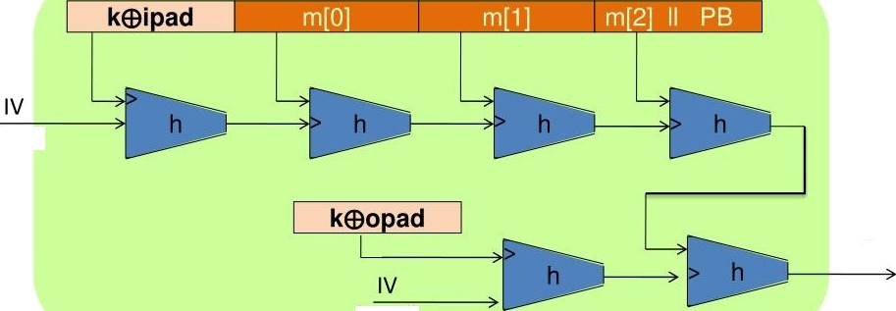
HMAC in pictures
(fixed)
tag
(fixed)
Similar to the NMAC PRF.
main difference: the two keys k₁, k₂ are dependent
Dan doneh

Slide 5
Presented By Ali Zenhom Ali Abdelkhaleq Under the supervision of Dr. Omar

