Slide 1
CSE 1062 Fundamentals of Programming Lecture #10
Spring 2016
Computer Science & Engineering Program
The School of EE & Computing
Adama Science & Technology University

Slide 2
Arrays and Pointers Practice
Case Study: [Data Processing] Students’ Grading
Searching and Sorting
Dynamic Array Allocation
Pointer: Output Exercises

Slide 3

Case Study: [Data Processing] Students’ Grading
Your professor has asked you to write a C++ program that determines grades at the end of the semester.
For each student, identified by an integer number between 1 and 60, four exam grades must be kept, and two final grade averages must be computed.
The first grade average is simply the average of all four grades.
The second grade average is computed by weighting the four grades as follows:
The first grade gets a weight of 0.2, the second grade gets a weight of 0.3, the third grade gets a weight of 0.3, and the fourth grade gets a weight of 0.2. That is, the final grade is computed as follows:

Slide 4
Using this information, construct a 60-by-7 two-dimensional array,
the first column is used for the student number, the next four columns for the grades, and the last two columns for the computed final grades.
The program’s output should be a display of the data in the completed array.

Slide 5
For testing purposes, the professor has provided the following data:
Student | Grade 1 | Grade 2 | Grade 3 | Grade 4
1 | 100 | 100 | 100 | 100
2 | 100 | 0 | 100 | 0
3 | 82 | 94 | 73 | 86
4 | 64 | 74 | 84 | 94
5 | 94 | 84 | 74 | 64

Slide 6
Searching and Sorting
Sorting: Arranging data in ascending or descending order for some purpose
Searching: Scanning through a list of data to find a particular item

Slide 7
Search Algorithms
Searches can be faster if the data is in sorted order
Two common methods for searching:
Linear search
Binary search
Linear search is a sequential search
Each item is examined in the order it occurs in the list
Average number of comparisons required to find the desired item is n/2 for a list of n items

Slide 8

Linear Search
Each item in the list is examined in the order in which it occurs
Not a very efficient method for searching
Advantage is that the list does not have to be in sorted order
On average, the number of required comparisons is n/2, where n is the number of elements in the list

Slide 9
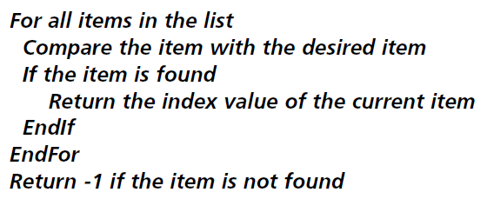
Linear Search
Pseudocode for a linear search

Slide 10
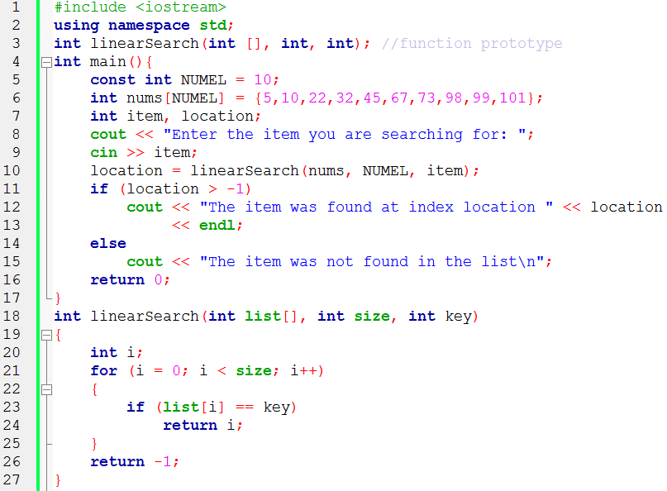
Linear Search

Slide 11
Binary Search
Binary search requires that the list is stored in sorted order
Desired item is compared to the middle element, with three possible outcomes:
Desired element was found: finished
Desired element is greater than the middle element, so discard all elements below
Desired element is less than the middle element, so discard all elements above

Slide 12
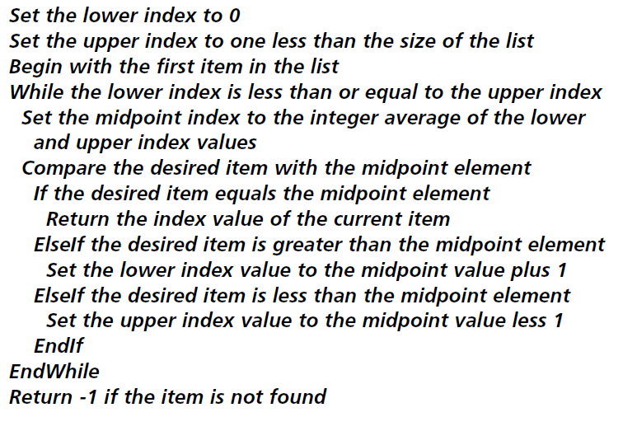
Binary Search
Pseudocode for a binary search

Slide 13
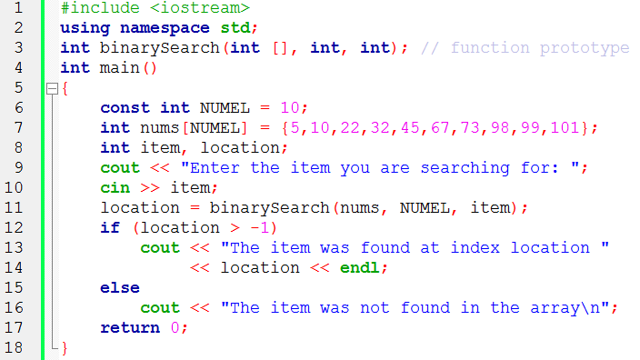
Binary Search

Slide 14
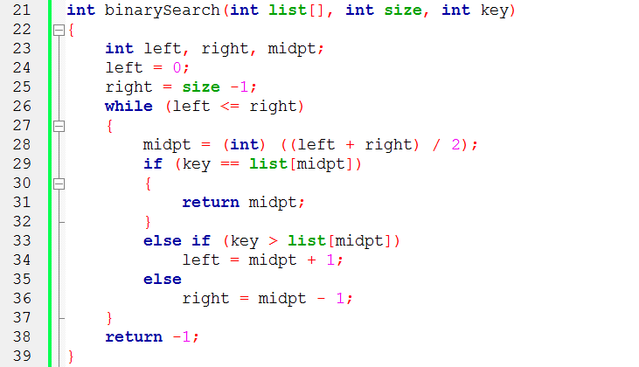
Binary Search

Slide 15
Binary Search
On each pass of binary search, the number of items to be searched is cut in half
After p passes through the loop, there are n/(2^{p}) elements left to search

Slide 16
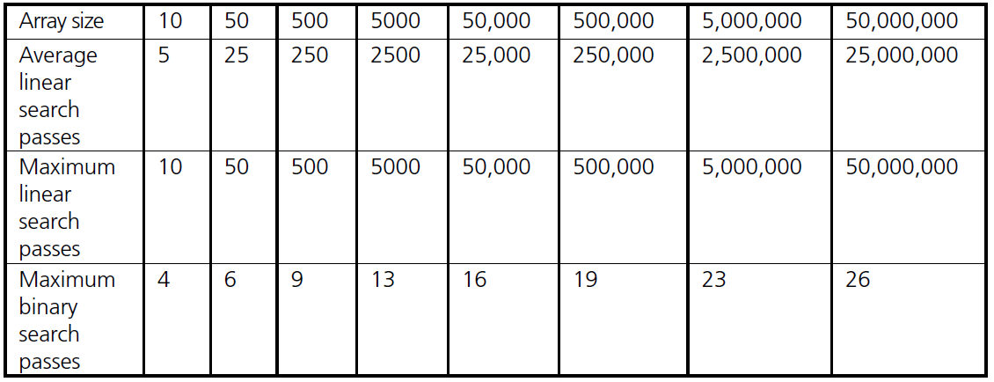
Linear and Binary Search

Slide 17
Sort Algorithms
Two major categories of sorting techniques exist
Internal sort: Use when data list is small enough to be stored in the computer’s memory
External sort: Use for larger data sets stored on external disk
Internal sort algorithms
Selection sort
Exchange sort

Slide 18
Selection Sort
Smallest element is found and exchanged with the first element
Next smallest element is found and exchanged with the second element
Process continues n-1 times, with each pass requiring one less comparison

Slide 19
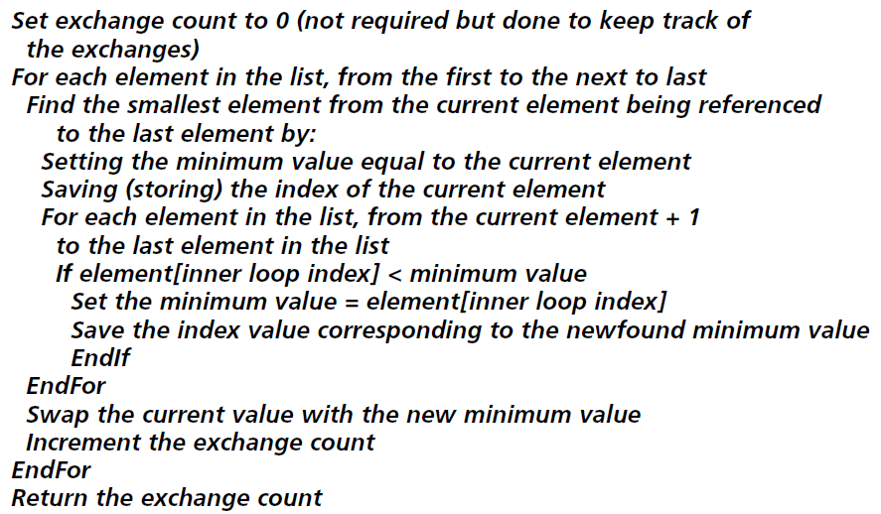
Selection Sort
Pseudocode for a selection sort

Slide 20
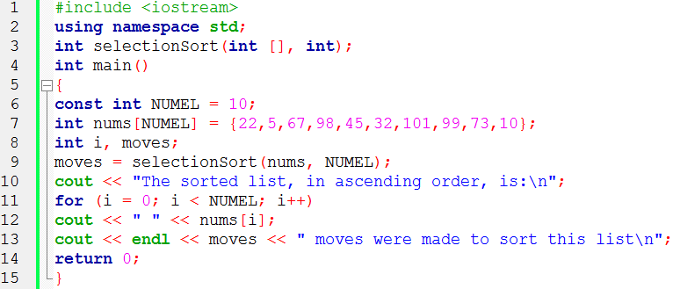
Selection Sort

Slide 21
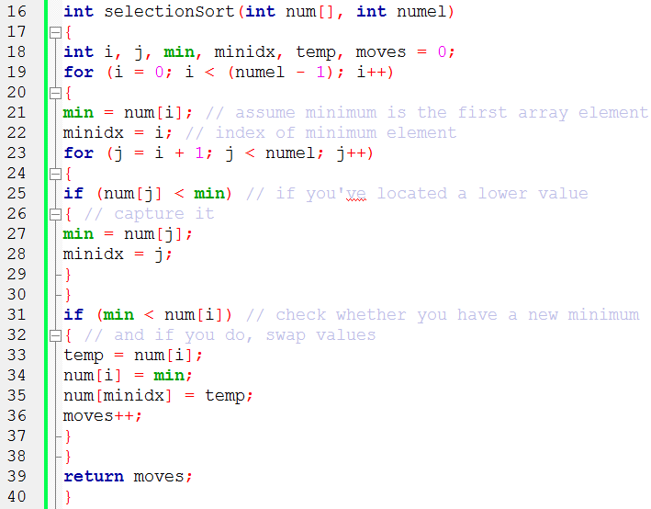
Selection Sort

Slide 22
Selection Sort
Selection sort advantages :
Maximum number of required moves is n-1
Each move is a final move
Selection sort disadvantages:
n(n-1)/2 comparisons are always required
Order of magnitude of selection sort: O(n²)

Slide 23
Exchange (Bubble) Sort
Successive values in the list are compared
Each pair is interchanged if needed to place them in sorted order
If sorting in ascending order, the largest value will “bubble up” to the last position in the list
Second pass through the list stops comparing at second-to-last element
Process continues until an entire pass through the list results in no exchanges

Slide 24
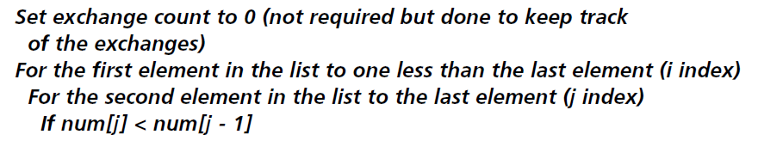
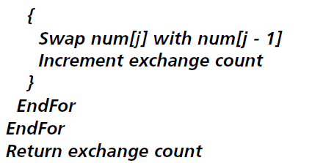
Exchange (Bubble) Sort
Pseudo code for an exchange sort
Convert to a c++ program

Slide 25
Exchange (Bubble) Sort
Number of comparisons
O(n²)
Maximum number of comparisons
n(n-1)/2
Maximum number of moves
n(n-1)/2
Many moves are not final moves

Slide 26
Dynamic Array Allocation
As each variable is defined in a program, sufficient storage for it is assigned from a pool of computer memory locations made available to the compiler
After memory locations have been reserved for a variable, these locations are fixed for the life of that variable, whether or not they are used
An alternative to fixed or static allocation is dynamic allocation of memory
Using dynamic allocation, the amount of storage to be allocated is determined or adjusted at run time
Useful for lists because allows expanding or contracting the memory used

Slide 27
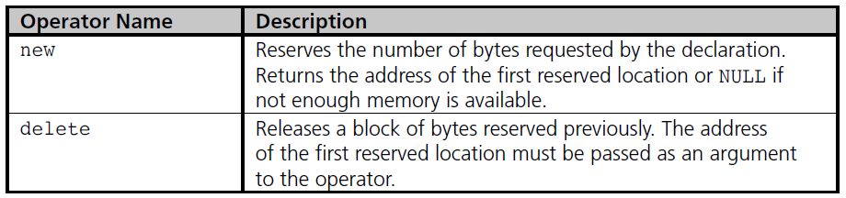
Dynamic Array Allocation
new and delete operators provide the dynamic allocation mechanisms in C++

Slide 28
Dynamic Array Allocation
Dynamic storage requests for scalar variables or arrays are made as part of a declaration or an assignment statement
Example:
int *num = new int; // scalar
Example:
int *grades = new int[200];// array
Reserves memory area for 200 integers
Address of first integer in array is value of pointer variable grades

Slide 29
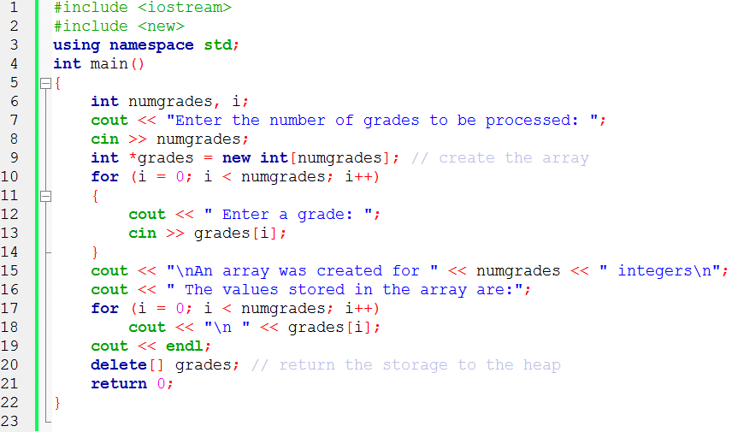
Dynamic Array Allocation Example

Slide 30
Pointer: Output Exercises
Determine the Output of the following code fragments in the table cells
int *p; int *q; p=new int; q=p; *p=46; *q=39; cout<<*p<<""<<*q <<endl; | int *secret; int j ; secret=new int[10]; secret[0]=10; for(j=1;j<10;j++) secret[j]=secret[j-1]+5; for(j=0;j<10;j++) cout<<secret[j]<<""; cout<<endl; | int a=3,b=5; int *p1,*p2; p1=&b; p2=&a; cout<<*(&b) <<" "<<*p2<<endl; p1=p2; cout<<*p1<<" "<<*p2<<endl; cout<<a<<" "<<b<<endl; *p2=4; *p1=*p2 cout<<a<<" "<<b;

Slide 31
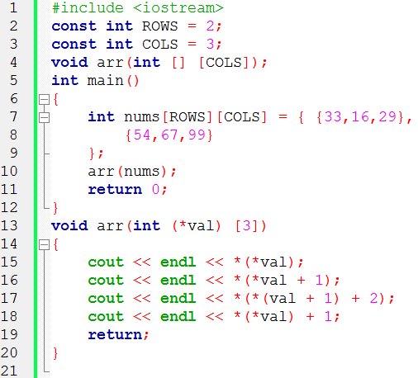
Pointer: Output Exercises

