Slide 1
Computer Organization and Architecture
Chapter 1 Introduction

Slide 2
Architecture & Organization 1
Architecture is those attributes visible to the programmer
Instruction set, number of bits used for data representation, I/O mechanisms, addressing techniques.
e.g. Is there a multiply instruction?
Organization is how features are implemented
Control signals, interfaces, memory technology.
e.g. Is there a hardware multiply unit or is it done by repeated addition?

Slide 3
Architecture & Organization 2
All Intel x86 family share the same basic architecture
The IBM System/370 family share the same basic architecture
This gives code compatibility
At least backwards
Organization differs between different versions

Slide 4
Structure & Function
Structure is the way in which components relate to each other
Function is the operation of individual components as part of the structure

Slide 5
Function
All computer functions are:
Data processing
Data storage
Data movement
Control

Slide 6
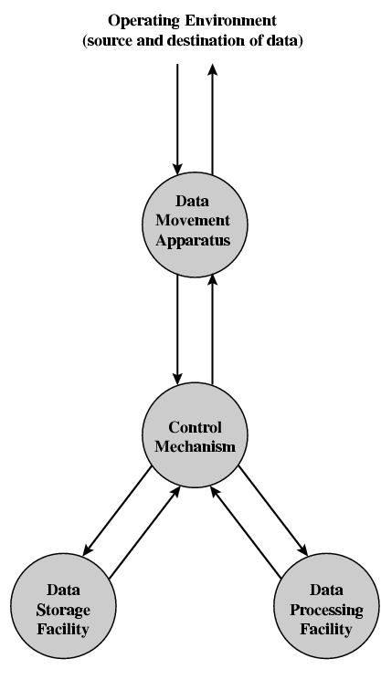
Functional View

Slide 7
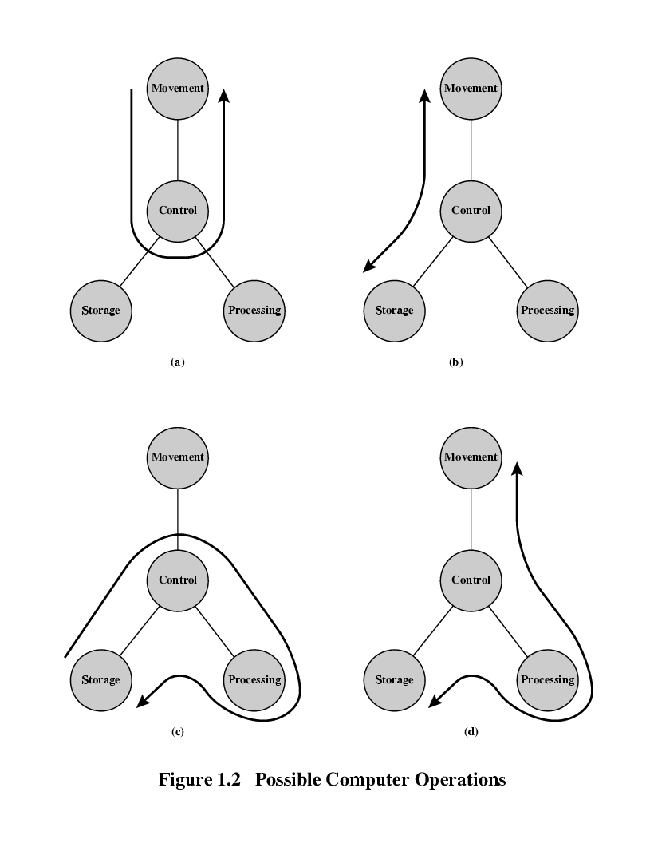
Operations (a) Data movement

Slide 8
Operations (b) Storage

Slide 9
Operation (c) Processing from/to storage

Slide 10
Operation (d) Processing from storage to I/O

Slide 11
Structure - Top Level
Peripherals
Computer
Central
Processing
Unit
Main
Memory
Computer
Systems
Interconnection
Input
Output
Communication
lines

Slide 12
Structure - The CPU
CPU
Computer
Arithmetic
and
Login Unit
I/O
Registers
System
Bus
CPU
Internal CPU
Interconnection
Memory
Control
Unit

Slide 13
Structure - The Control Unit
Control Unit
CPU
ALU
Sequencing
Login
Internal
Bus
Control
Unit
Control Unit
Registers and
Decoders
Registers
Control
Memory

