Slide 1
English → Amharic
Neural Machine Translation with Seq2Seq-LSTM and Attention
ወደ ዩኒቨርሲቲ እሄዳለሁ።
Deep Learning Course Project · Instructor: Fantahun Bogale Gereme
Bethel Negusu GSR/8221/18
Esrom Adugna GSR/4064/18
Selamawit Siferh GSR/6879/18
Aklilu Solomon GSE/0756/18
Live demo: esraprojects.github.io/deep_learning-amharic_translation-using-seq2seq
Notes:
Introduce the team and the goal: build, compare and deploy two LSTM translation models for English to Amharic.

Slide 2
Objective and workflow
Develop, evaluate, compare and deploy an English→Amharic translator
1
Data
2
Tokenize
3
Train
OPUS MT560 + habtew, cleaning, normalization, split
SentencePiece subwords, 8k per language
Seq2Seq-LSTM and Attention-LSTM, same budget
4
Evaluate
5
Analyze
6
Deploy
BLEU, chrF, loss, time, parameters
error categories and attention maps
FastAPI + Gradio, live browser demo
Notes:
The whole pipeline is reproducible with one script: scripts/run_pipeline.sh.

Slide 3
Dataset: MT560 + habtew
HF: michsethowusu/english-amharic_sentence-pairs_mt560 (CC-BY-4.0) · habtew/english-amharic-translation (no license stated)
906,388
MT560: religious (Bible, Qur'an, Watchtower); habtew adds news and everyday sentences
Amharic has 3× more word types than English (rich morphology)
SOV word order in Amharic vs SVO in English
Removed misaligned, duplicate and wrong-script pairs; homophone normalization (ሐ/ኀ/ሃ→ሀ, ሠ→ሰ, ዐ→አ, ፀ→ጸ)
raw sentence pairs
517,095
training pairs after cleaning
3k / 5k
validation / test pairs
Notes:
MT560 is the main corpus (documented license); habtew was added to cover everyday language. 88k habtew pairs remain after de-duplication.

Slide 4
Two models, same encoder
The only difference is the attention mechanism, so the comparison is fair
Basic Seq2Seq + LSTM
Attention Seq2Seq + LSTM
7,995,200 parameters
8,191,808 parameters
2-layer BiLSTM encoder (2×128)
Final encoder state initializes a 2-layer LSTM decoder (256)
Whole sentence squeezed into one fixed vector
Sutskever et al., 2014
Same encoder and decoder
Luong global attention: score = hₜᵀ Wₐ h̄ₛ
Context cₜ = Σ aₜₛ h̄ₛ; h̃ₜ = tanh(W꜀[hₜ; cₜ])
Looks back at every source word at each step
Notes:
Attention adds only 196k parameters (+2.5%).

Slide 5
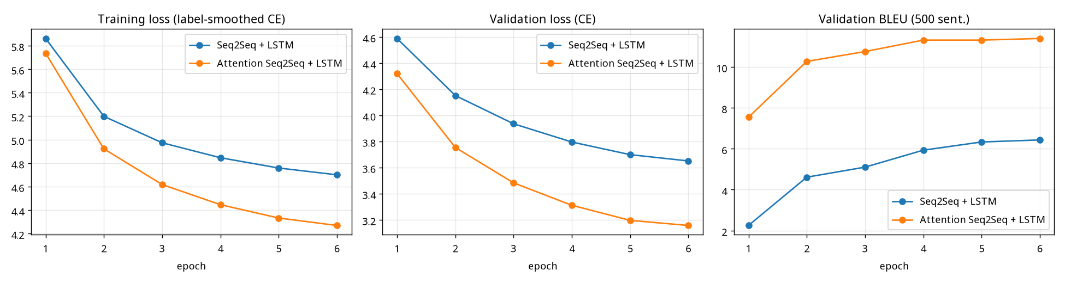
Training configuration
Identical for both models; 4-core CPU, no GPU
Hyper-parameter | Value
Embedding size | 256
Hidden units | 256 (encoder 2×128 bidirectional)
Layers | 2 encoder + 2 decoder
Batch size | 128 (length-bucketed)
Learning rate | 1e-3, halved on validation plateau
Optimizer | Adam, gradient clip 1.0
Epochs | 6 (7-hour budget per model)
Loss | Cross-entropy, label smoothing 0.1
Dropout | 0.3
Vocabulary | SentencePiece unigram, 8k EN + 8k AM
The gap between the models opens in epoch 1 and keeps growing; both were still slowly improving.
Notes:
Training was resumable, with checkpoints every 250 steps.

Slide 6
Results: attention wins clearly
Test set, 5,000 sentences, beam search (k=5)
11.35
 | Seq2Seq | Attention
Parameters | 7,995,200 | 8,191,808
Training time | 420.2 min | 420.2 min
Test perplexity | 40.07 | 24.2
Beam / greedy BLEU | 5.26 / 4.91 | 11.35 / 10.36
Inference / sentence | 33 ms | 35.6 ms
Test set, beam | 174.8 s | 185.5 s
BLEU with attention (baseline 5.26)
23.13
chrF with attention (baseline 13.68)
3.19
test loss with attention (baseline 3.69)
+6.1 BLEU for +2.5% parameters. Beam search adds +1.0 BLEU over greedy decoding.

Slide 7
Translation examples
Source → Seq2Seq → Attention-LSTM (beam search); full table with references in results/examples.md
Source (EN) | Seq2Seq + LSTM | Attention-LSTM
The children are playing in the garden. | ልጆቹ ቤት ውስጥ እየተጫወቱ ነው። | ልጆቹ በአትክልት ቦታው ውስጥ እየተጫወቱ ነው።
My mother is cooking dinner for the family. | እናቴ ቤት ውስጥ እየገባች ነው። | እናቴ ለቤተሰቧ እራት እያበሰለች ነው።
I am going to the university. | እኔ ወደ ቤት ሄድኩ። | እኔ ወደ ዩኒቨርሲቲ ሄድኩ።
Jesus taught his disciples to love one another. | ኢየሱስ ደቀ መዛሙርቱን ለሌሎች ፍቅር አሳይቷል። | ኢየሱስ ደቀ መዛሙርቱ እርስ በርስ እንዲወደዱ አስተምሯቸዋል።
We must read the Bible every day. | መጽሀፍ ቅዱስ በየእለቱ መጽሀፍ ቅዱስን ማጥናት ይኖርብናል። | በየእለቱ መጽሀፍ ቅዱስን ማንበብ ይኖርብናል።
Added habtew data and fine-tuning on 761 curated pairs fixed everyday sentences like these; uncovered vocabulary (e.g. “weather”) is still hard.

Slide 8
Error analysis
Automatic indicators on the test set
Error type | Seq2Seq | Attention
Missing words (output too short) | 35.34% | 22.56%
Additional words (output too long) | 7.42% | 7.7%
Repeated words | 7.74% | 8.14%
Word-order agreement | 0.948 | 0.95
Morphology (right stem, wrong affix) | 3.81% | 5.56%
Named entities correct | 82.54% | 90.81%
Numbers copied correctly | 70.94% | 97.95%
BLEU, sentences with rare words | 1.9 | 3.88
Attention fixes under-translation, long sentences, names and numbers. Its main weakness is repetition (no coverage mechanism).

Slide 9
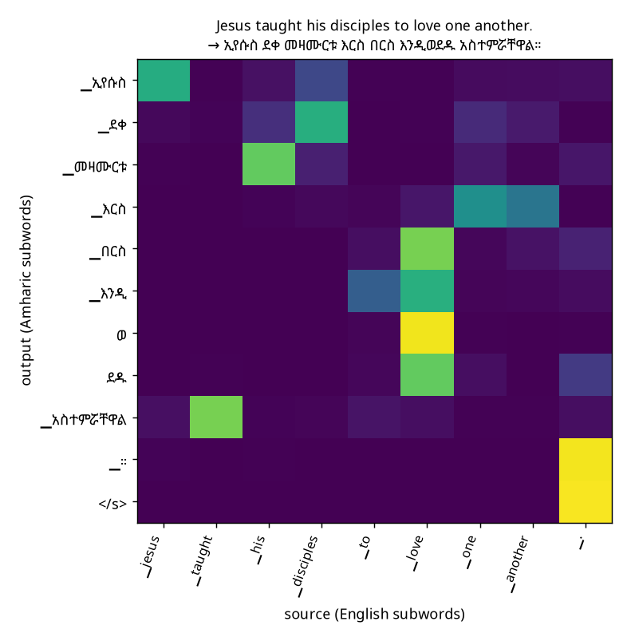
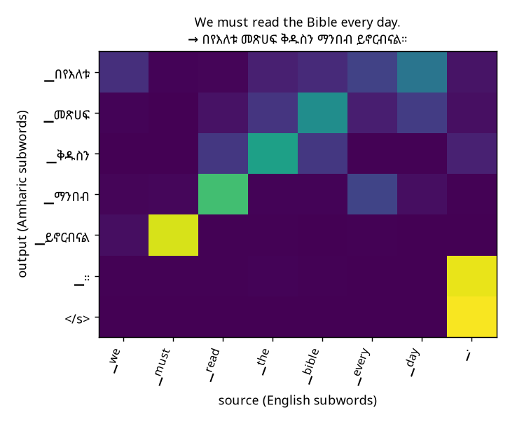
What the attention model looks at
Rows = generated Amharic subwords, columns = English source subwords
Learns the SOV reordering: the final verb አስተምሯቸዋል attends back to “taught”
“We must read the Bible every day” → Amharic order: every day, Bible, read, must
The subject “we” becomes the verb suffix -ናል, so it has no attention row of its own
“I am going to the university” → እኔ ወደ ዩኒቨርሲቲ ሄድኩ: ዩኒቨርሲቲ attends to “university”, the suffix -ኩ to “I”

Slide 10
Deployment
Input → preprocess → encoder → attention decoder → Amharic output
REST API (FastAPI)
Web UI (Gradio)
POST /translate
{"text": "I am going to the university."}
→ {"translation": "…"}
Both models side by side, example sentences, live attention heatmap
Docker
Live browser demo
Trained models, tokenizers, dependencies and inference pipeline in one image
ONNX Runtime Web on GitHub Pages; the model runs on the visitor's device, free and always online
esraprojects.github.io/deep_learning-amharic_translation-using-seq2seq

Slide 11
Conclusion
2.2×
+2.5%
97.95%
BLEU of the attention model vs the baseline
extra parameters for attention
numbers copied correctly (baseline 70.94%)
Future work: GPU training for more epochs · coverage / input feeding against repetition · more general-domain data · Transformer baseline
Live demo · esraprojects.github.io/deep_learning-amharic_translation-using-seq2seq

